Slide 1
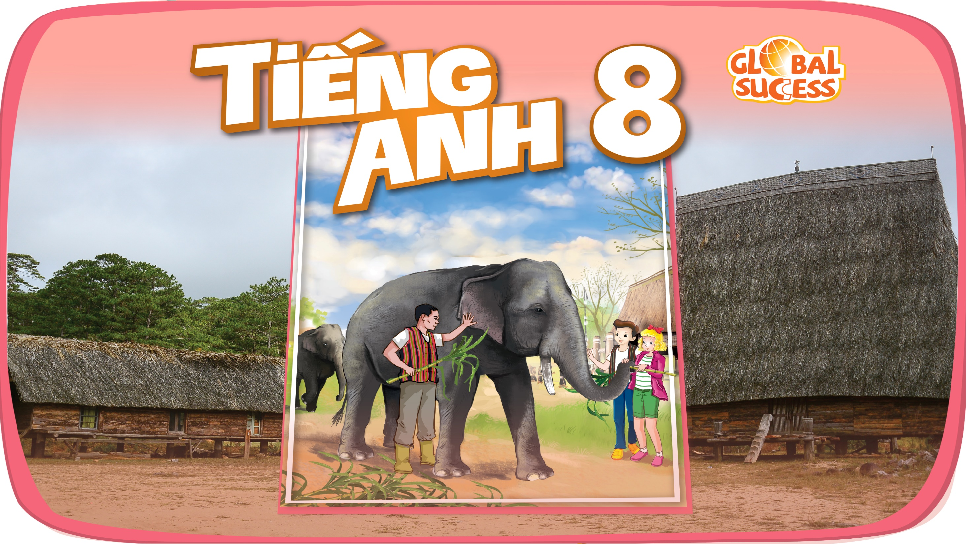

Slide 2

Unit
12
LIFE ON OTHER PLANETS
LESSON 7: LOOKING BACK & PROJECT
VOCABULARY REVIEW
1
GRAMMAR REVIEW
Unit
PROJECT

Slide 3
LESSON 7: LOOKING BACK & PROJECT
WARM-UP
Brainstorming
Task 1: Write a word under each picture.
Task 2: Circle the correct words.
Task 3: Rewrite the sentences.
Task 4: Correct the mistakes.
LOOKING BACK
PROJECT
Our favorite planet
CONSOLIDATION
Wrap-up
Homework

Slide 4
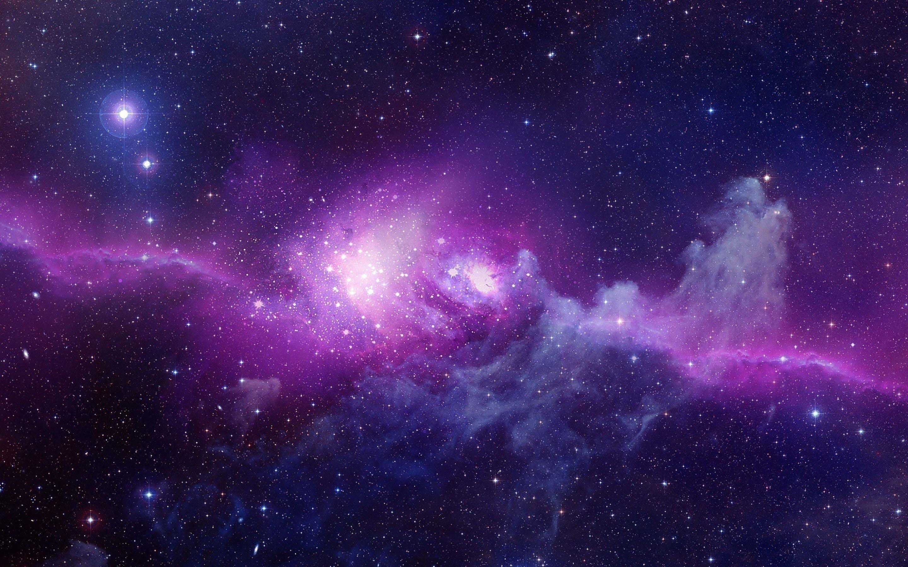
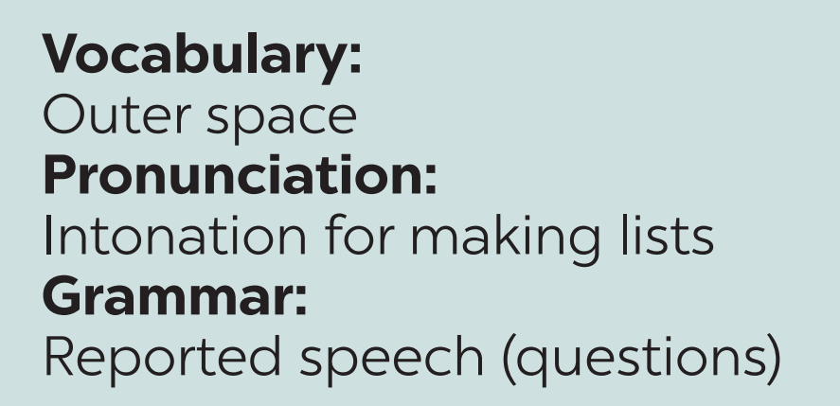
WARM-UP
What have you learned from this Unit?

Slide 5
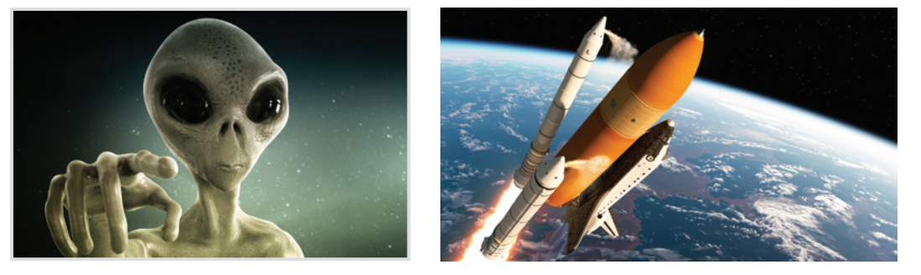
LOOKING BACK - VOCABULARY
1
Write a word under each picture.
1. a____
rocket
alien
2. r_____

Slide 6
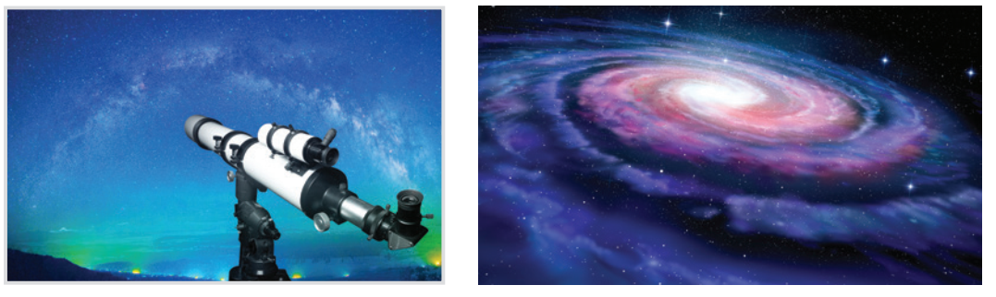
LOOKING BACK - VOCABULARY
1
Write a word under each picture.
telescope
galaxy
3. t________
4. g_____

Slide 7
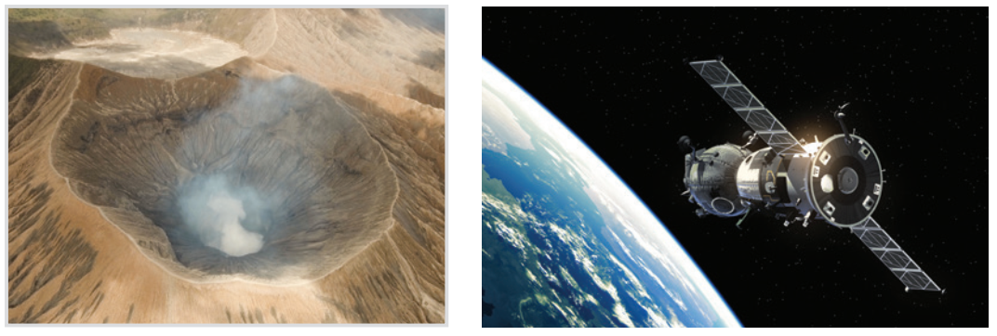
LOOKING BACK - VOCABULARY
1
Write a word under each picture.
5. c____
satellite
crater
6. s______

Slide 8
LOOKING BACK - VOCABULARY
2
Circle the correct words to complete the sentences.
1. UFOs / Rockets are spaceships from another planet.
2. We have no possibility / condition of making our own spaceship.
3. We can’t find any living craters / creatures in the solar system except for us.
4. Scientists are working to find a habitat / habitable planet.
5. The gravity / atmosphere of the Earth makes things fall to the ground when we drop them.

Slide 9
LOOKING BACK - GRAMMAR
3
Rewrite each sentence so that it is closest in meaning to the original one.
1. “What is this novel about?” said Mary.
 Mary wanted to know ______________________.
2. “Who’s your favourite actor, Nick?” I said.
 I asked Nick _______________________.
3. “What time does the next train leave?” Mai said to me.
 Mai asked me ________________________.
what that novel was about
who his favourite actor was
what time the next train left

Slide 10
LOOKING BACK - GRAMMAR
3
Rewrite each sentence so that it is closest in meaning to the original one.
4. How do the scientists observe the other planets?” the students asked.
 The students wondered _______________________
_______________.
5. Mai wondered, “Why can’t humans live on Mars?”
 Mai wondered _____________________________.
how the scientists observed
the other planets
why humans couldn’t live on Mars

Slide 11
LOOKING BACK - GRAMMAR
4
Which of the underlined parts in each question is incorrect? Find and correct it.
1. The teacher asked the pupils what they are doing then.
2. My father wondered me what I was going to do the following weekend.
3. My brother wanted to know who the scientists were exploring other planets.
A
B
C
 were
A
 asked
B
C
A
B
 how/ why
C

Slide 12
LOOKING BACK - GRAMMAR
4
Which of the underlined parts in each question is incorrect? Find and correct it.
4. I asked my teacher what food spacemen eat when they were
travelling in a spacecraft.
5. Scientists are still wondering how many planets are there in our galaxy.
A
B
 ate
C
A
B
C
 there are

Slide 13
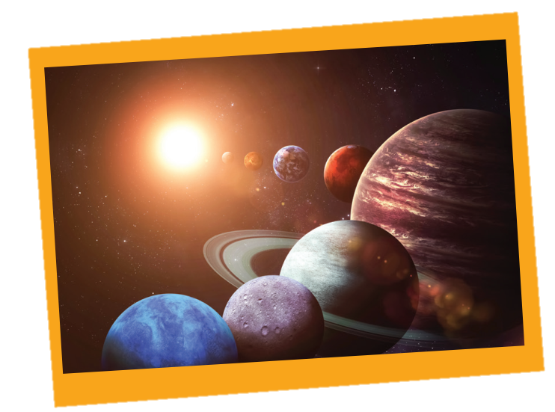
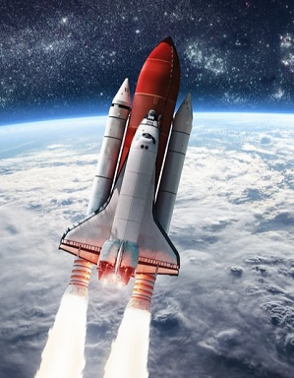
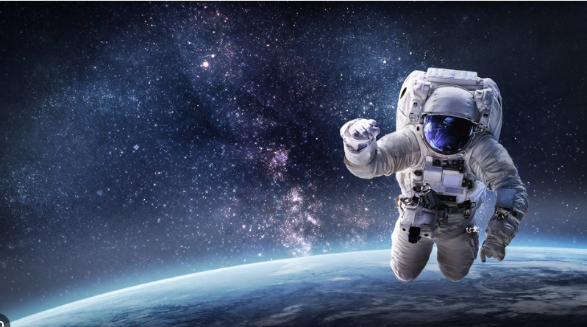
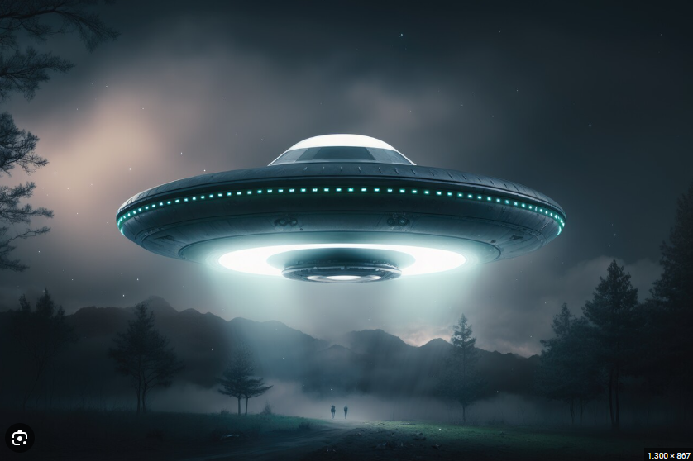
PROJECT

Slide 14

CONSOLIDATION
1
Wrap-up
What have we learnt in this lesson?
Review the vocabulary and grammar of Unit 12.
Make a poster about our favourite planet.

Slide 15

CONSOLIDATION
2
Homework
- Learn new words by heart.
- Review the knowledge & skills of Unit 12.

Slide 16

Website: hoclieu.vn
Fanpage: facebook.com/tienganhglobalsuccess.vn/

