Slide 1

Unit 3: All about food
Lesson 3e: Grammar
Page 60

Slide 2
Lesson Outline
Warm-up
Presentation
Practise
Production
Consolidation
Wrap-up

Slide 3
Objectives
By the end of this lesson, students will be able to…
- use comparatives correctly.

Slide 4

WARM-UP

Slide 5
Choose the word whose main stress is placed differently from that of the others.
1. A. healthy B. famous C. polite D. crowded
/ˈhelθi/ /ˈfeɪməs/ /pəˈlaɪt/ /ˈkraʊdɪd/
2. A. clever B. spicy C. British D. correct
/ˈklevər/ /ˈspaɪsi/ /ˈbrɪtɪʃ/ /kəˈrekt/
3. A. favourite B. expensive C. difficult D. excellent
/ˈfeɪvərɪt/ /ɪkˈspensɪv/ /ˈdɪfɪkəlt/ /ˈeksələnt/

Slide 6

It’s time to learn …

Slide 7

Presentation

Slide 8
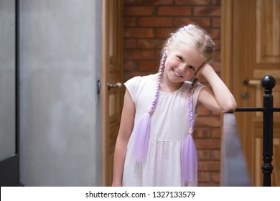

COMPARATIVE
Sarah is 8 years old.
Danny is 10 years old.
Who’s younger?
Sarah is younger.

Slide 9
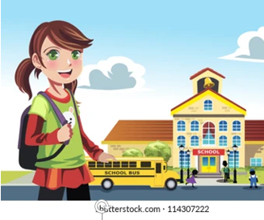

Lan goes to school at 7:00.
Linh goes to school at 7:30.
Who’s earlier?
Lan is earlier.

Slide 10
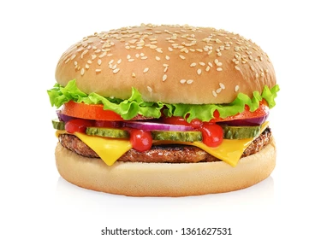
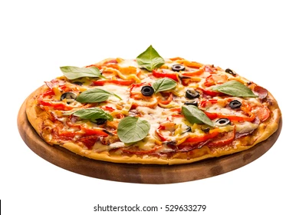
A hamburger is 30,000 dong.
A pizza is 200,000 dong.
Which is more expensive?
A pizza is more expensive.

Slide 11
Complete the rules.
 | Comparative | Example
short adjectives
long adjectives
Adj + ER
younger
MORE + adj
more expensive

Slide 12
Spelling rules
• adjectives + -er
long – longer
• -e + r
nice – nicer
• one-syllable adjectives ending in vowel + consonant ➝ double consonant + -er
thin – thinner
• -y ➝ -y + -ier
happy – happier

Slide 13
Note:
clever, common, friendly, narrow form their comparative with -er or more
Ex: friendly – friendlier/ more friendly
Irregular adjectives:
Special case: a lot of ➝
good ➝
little ➝
worse (than)
bad ➝
many/ much ➝
better (than)
more (than)
less (than)
more (than)

Slide 14
Practice

Slide 15
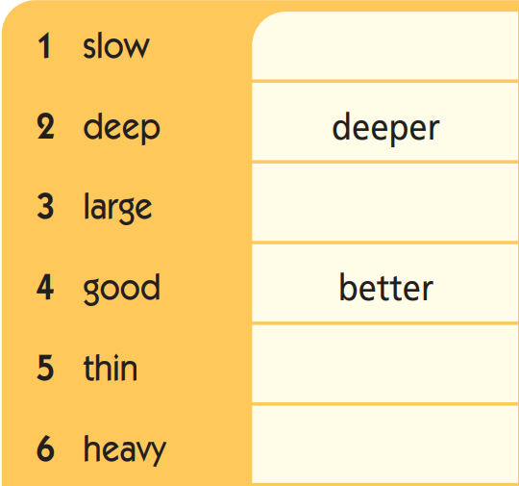
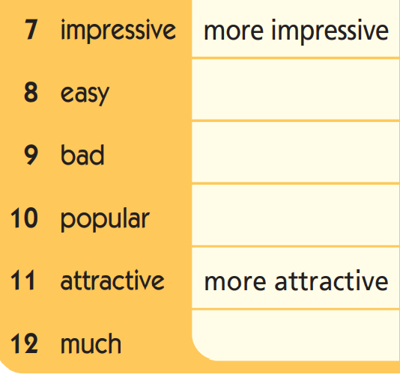
Write the comparative forms.
slower
easier
larger
worse
more popular
thinner
heavier
more

Slide 16
2 Put the adjectives in brackets into the comparative form.
1 Paul’s restaurant is ______________ (busy) than Rico’s.
2 Rico’s is ______________________ (expensive) than Paul’s.
3 The waiters at Rico’s are _____________________ (polite) than
the ones at Paul’s.
4 The service at Rico’s is ________________ (quick) than at Paul’s.
5 Paul’s is ___________________ (crowded) than Rico’s.
6 Rico is ___________________ (friendly) than Paul.
busier
more expensive
more polite
quicker
more crowded
friendlier/more friendly

Slide 17
Complete the sentences, using the comparative form of the following adjectives: healthy, popular, difficult, good, tasty, clever.
Math is …………………………… than English.
Orange juice is …………………………….. than coffee.
She is ………………………………… than her sister. She can do many things.
I prefer chicken because it is ……………………………. than fish.
Motorbikes are ……………………………… than cars in Vietnam.
Milk is …………………………. for your health than coke.
more difficult
healthier
cleverer/ more clever
tastier
more popular
better

Slide 18
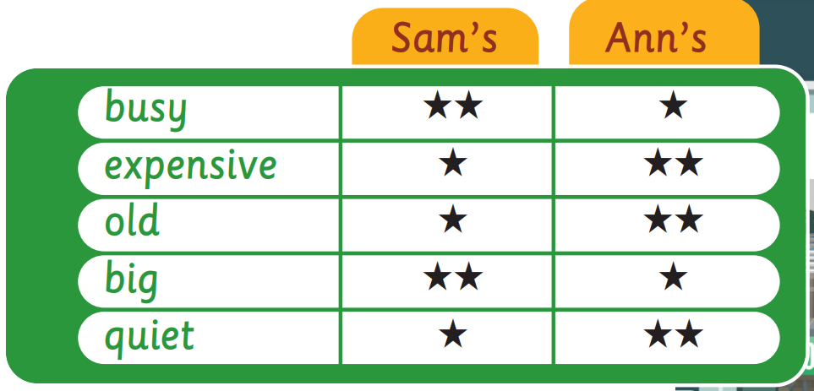
3 Look at the table. Compare the cafés.
Sam’s is busier than Ann’s.

Slide 19
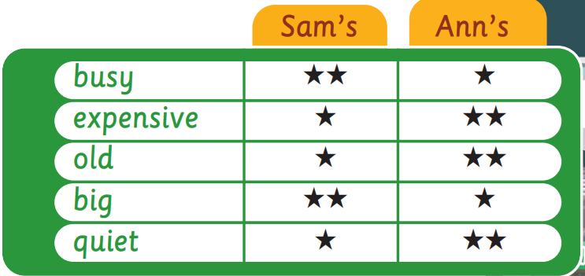
Ann’s is more expensive than Sam’s.
Ann’s is older than Sam’s.
Sam’s is bigger than Ann’s.
Ann’s is quieter than Sam’s.

Slide 20

Production

Slide 21
Pair work
Student A says an adjective. Student B gives the comparative form and then use it in a sentence. Change the role.
tasty
tasty – tastier
Fish is tastier than chicken.

Slide 22

CONSOLIDATION

Slide 23
Write five sentences, using comparative forms of different adjective (short adjectives, long adjectives, adjectives + y, special adjectives such as good, bad, many, much, a lot).

Slide 24

WRAP-UP

Slide 25
Today’s lesson
Grammar
Comparatives of:
- short adjectives
- long adjectives
- adjectives + -y
- good/bad/many/much/a lot

Slide 26
Homework
Practise making sentences using comparatives.
Complete the grammar notes in TA 6 Right on Notebook
(p. 32)
Prepare the next lesson (p. 61 SB)
Do the exercise in TA 6 Right on Workbook (p. 32)

Slide 27

Enjoy your day!

