Slide 1

Unit 4: Festivals and Free Time
Lesson 2.3: Pronunciation & Speaking
Page 35

Slide 2
Lesson Outline
Warm-up
Pronunciation
Practice
Speaking
Consolidation
Wrap-up

Slide 3
Objectives
By the end of this lesson, students will be able to…
- Know how to pronounce sound changes "What time…?“/wʌtaɪm/.
- Ask and answer about time of festival activities.

Slide 4

WARM-UP

Slide 5

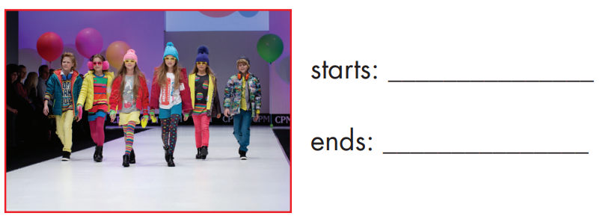
Work in pairs
Ask and answer
6 p.m
8 p.m

Slide 6

Pronunciation

Slide 7
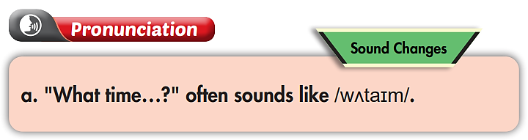
What time does the fashion show start?
What time does the fashion show end?

Slide 8
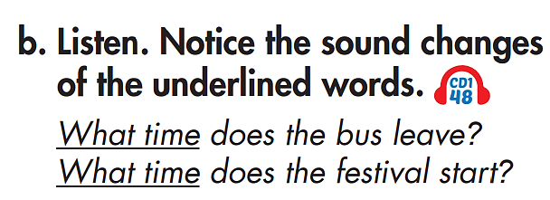


Slide 9
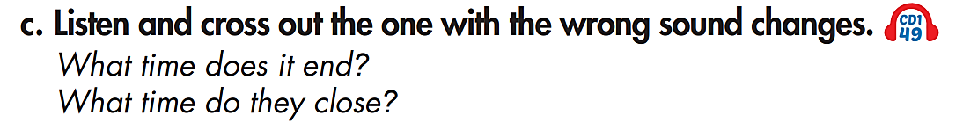

Slide 10
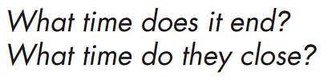

Slide 11

Practice

Slide 12
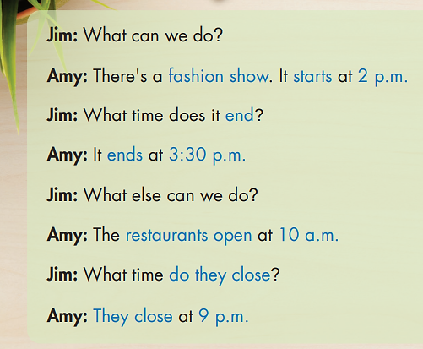

Slide 13

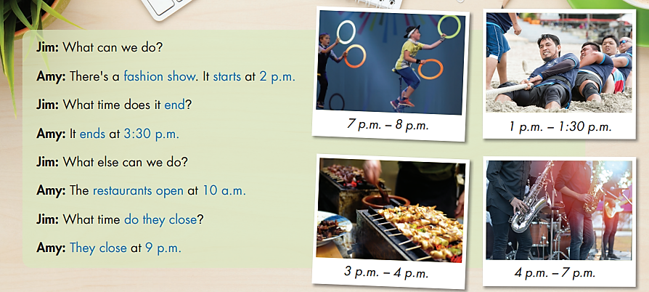
circus performance
tug of war
food stand
music performance

Slide 14

Speaking

Slide 15

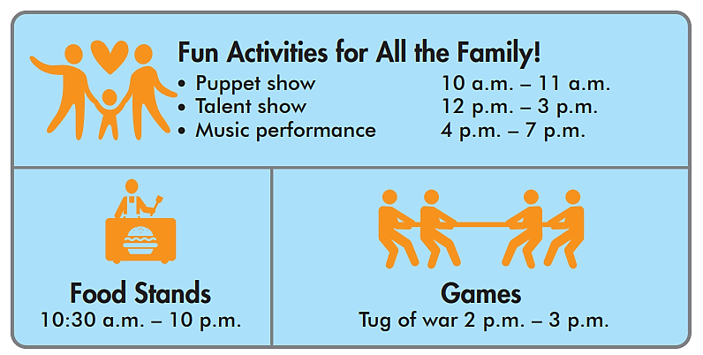
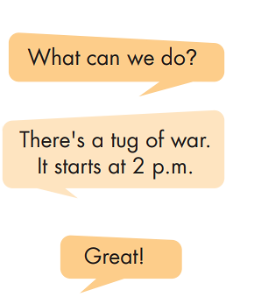
Pre-Speaking

Slide 16

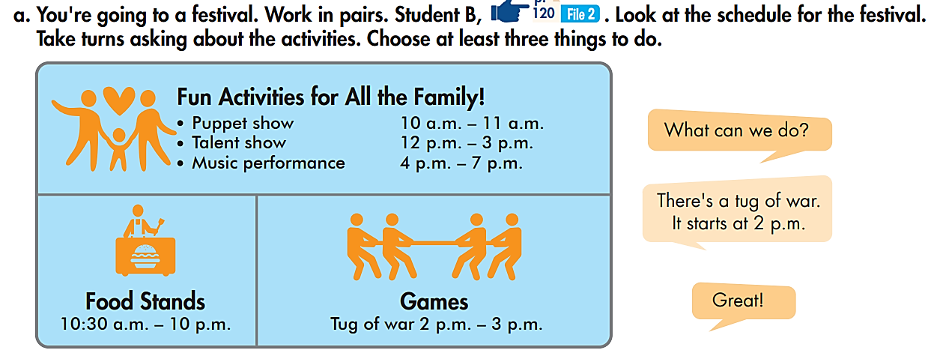
While-Speaking
Work in pairs

Slide 17
Post-Speaking

Slide 18

CONSOLIDATION

Slide 19

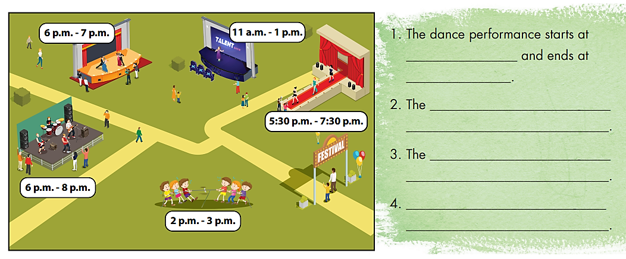
Extra Practice
WB page 23
6 p.m.
7 p.m.
talent show starts at 11 a.m.
and ends at 1 p.m.
music performance starts
at 6 p.m. and ends at 8 p.m.
The tug of war starts at 2 p.m.
and ends at 3 p.m.

Slide 20

WRAP-UP

Slide 21
Today’s lesson
Pronunciation:
Practice pronouncing sound changes like "What time…?“/wʌtaɪm/.
Talk about time of festival activities.

Slide 22
Homework
Practice pronouncing sound changes.
Practice talking about time of activities in a festival.
Prepare the next lesson (page 36 - SB).
Play the consolidation games in Tiếng Anh 6 i-Learn Smart World DHA App on www.eduhome.com.vn

Slide 23
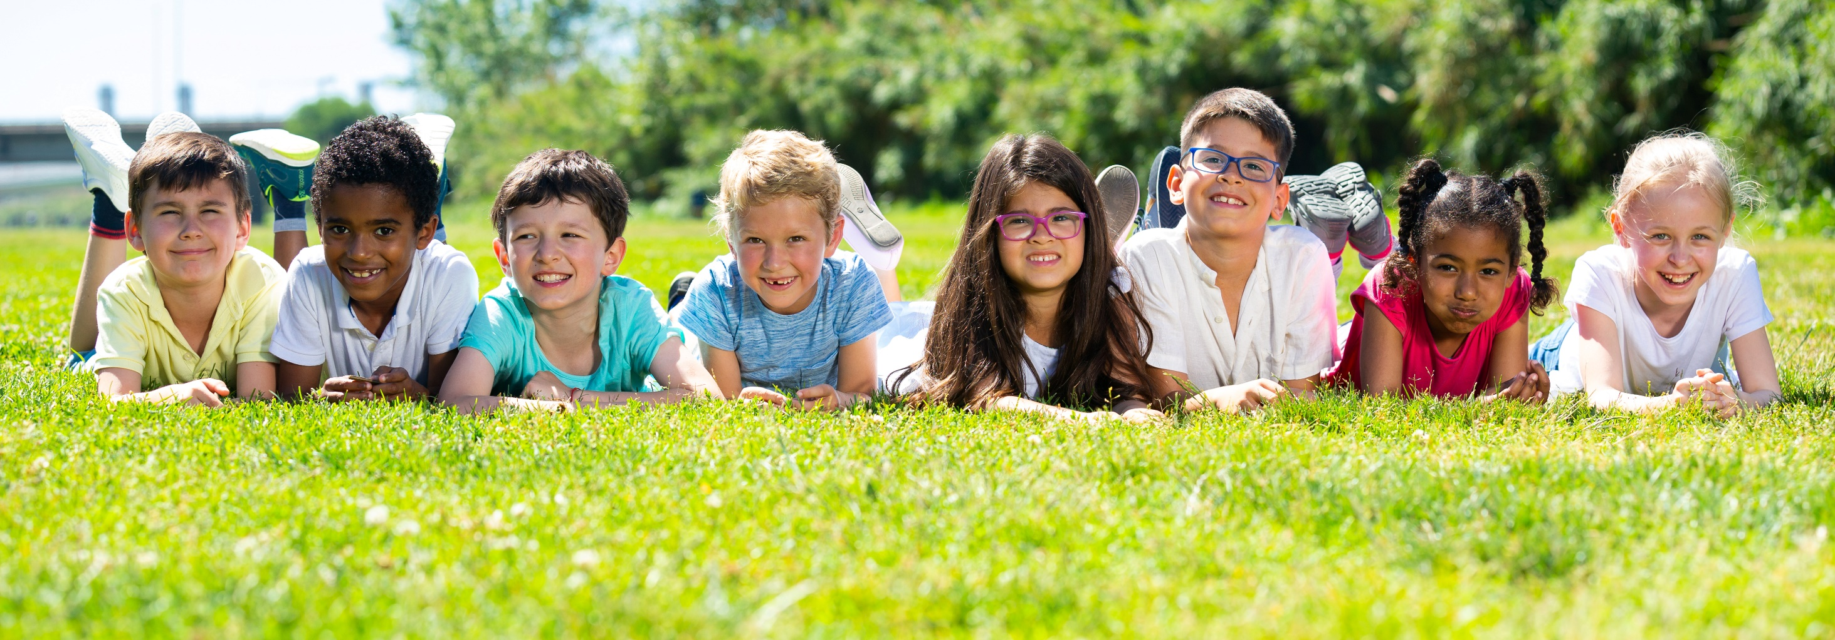
Have a nice day!

