Slide 1
www.guorkhan.blogspot.com
bathroom
bedroom

Slide 2
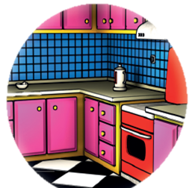
www.guorkhan.blogspot.com
kitchen
balcony

Slide 3
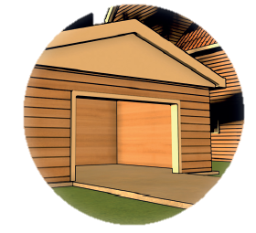
www.guorkhan.blogspot.com
car
garage

Slide 4
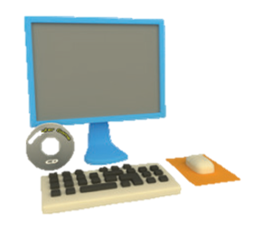
www.guorkhan.blogspot.com
shampoo
computer

Slide 5
www.guorkhan.blogspot.com
kettle
home

Slide 6
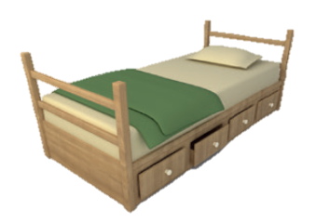
www.guorkhan.blogspot.com
bath
bed

Slide 7
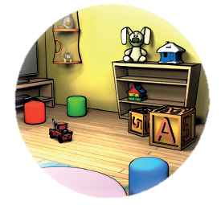
www.guorkhan.blogspot.com
cup
playroom

Slide 8
www.guorkhan.blogspot.com
car
cup

Slide 9
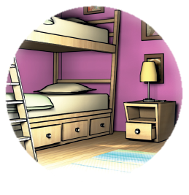
www.guorkhan.blogspot.com
sofa
bedroom

Slide 10
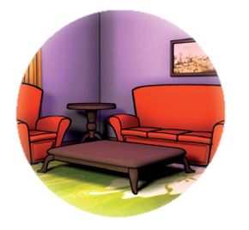
www.guorkhan.blogspot.com
livingroom
bathroom
Notes:
doğru cevap

Slide 11
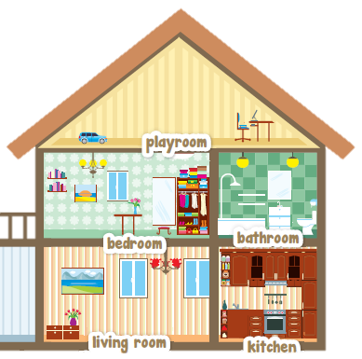
www.guorkhan.blogspot.com
home
school
Notes:
doğru cevap

Slide 12
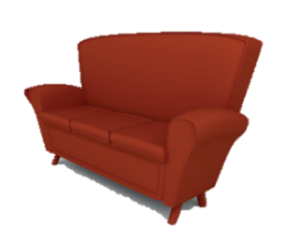
www.guorkhan.blogspot.com
sofa
garage
Notes:
doğru cevap

Slide 13
I have twelve fish.
WELL DONE!
www.guorkhan.blogspot.com

Slide 14
TRY AGAIN

Slide 15
SƯU TẦM: ĐOÀN VĂN DOANH, NAM TRỰC, NAM ĐỊNH
LINK NHÓM DÀNH CHO GV BỘ MÔN VẬT LÝ TRAO ĐỔI TÀI LIỆU VÀ CHUYÊN MÔN CT 2018
https://www.facebook.com/groups/299257004355186

