Slide 1

Unit 3: All about food
Lesson 3c: Vocabulary
Page 58

Slide 2
Lesson Outline
Warm-up
Presentation
Practise
Production
Consolidation
Wrap-up

Slide 3
Objectives
By the end of this lesson, students will be able to…
learn cooking tools and food preparation verbs.

Slide 4

WARM-UP

Slide 5
Discussion
Ask and answer about cooking.
Do you like cooking?
What can you cook?
What do you need to cook it?

Slide 6

It’s time to learn …

Slide 7

Presentation

Slide 8
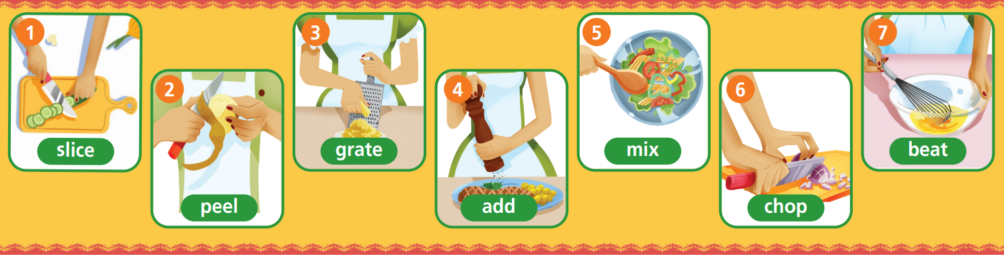
Label the pictures with the following verbs:
add, mix, peel, slice, chop, beat, grate
slice
grate
mix
beat
peel
add
chop

Slide 9

Listen and repeat.
slice (v) /slaɪs/: xắt / thái lát
peel (v) /piːl/: gọt vỏ
grate (v) /ɡreɪt/: mài, nạo
add (v) /æd/: thêm vào
mix (v) /mɪks/: trộn
chop (v) /tʃɒp/: chặt nhỏ
beat (v) /biːt/: đánh (trứng)

Slide 10
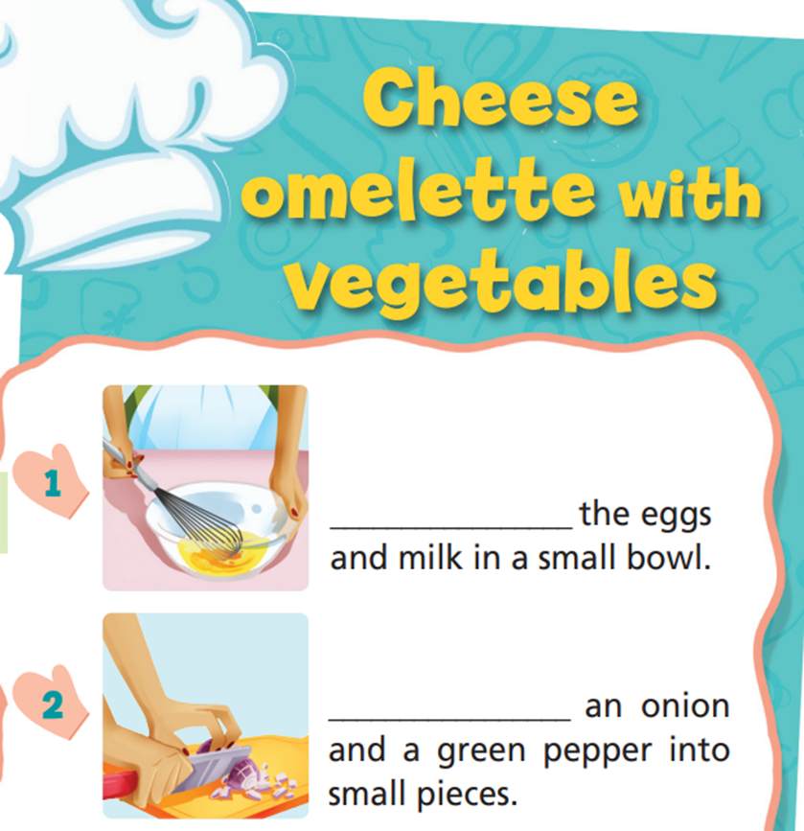
Look at the pictures and complete the sentences with the correct food preparation verbs.
add
mix
peel
slice
chop
beat
grate
Beat
Chop

Slide 11
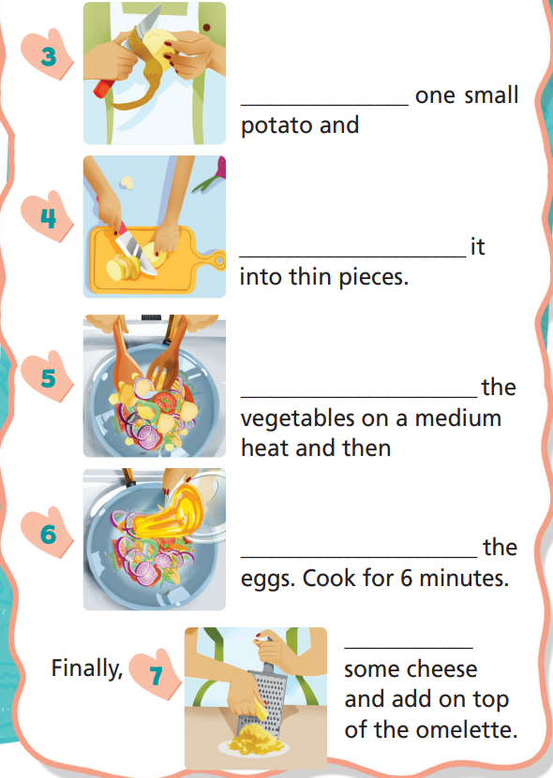
Peel
add
mix
peel
slice
chop
beat
grate
Slice
Mix
Add
Grate

Slide 12

Practise

Slide 13
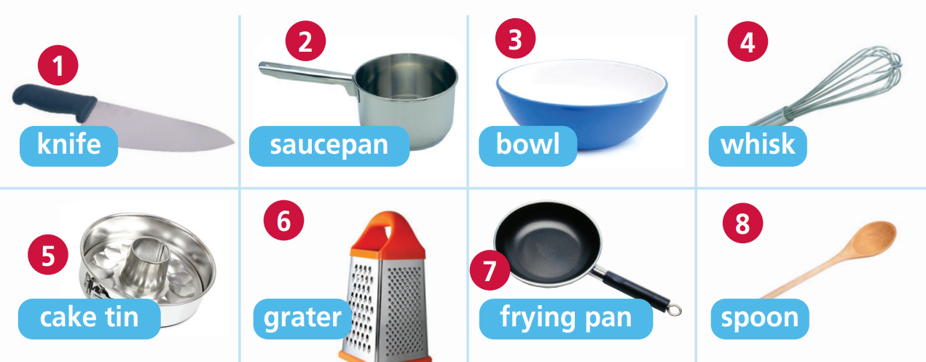
Label the pictures with the following nouns:
spoon, bowl, knife, grater, saucepan, cake tin, frying pan, whisk
knife
saucepan
bowl
whisk
cake tin
grater
frying pan
spoon

Slide 14
Listen and repeat.
Knife (n) /naɪf/: dao
Saucepan (n) /ˈsɔːspən/: cái chảo
Bowl (n) /bəʊl/: tô, chén
Whisk (n) /wɪsk/: cái đánh trứng, kem
Cake tin (n) /keɪk tɪn/: khuôn làm bánh
Grater (n) /ˈɡreɪtə/: bàn xát, bàn nạo
Frying pan (n) /ˈfraɪɪŋ pæn/: chảo chiên
Spoon (n) /spuːn/: muỗng, thìa

Slide 15
Listen and repeat.
Knife (n) /naɪf/: dao
Saucepan (n) /ˈsɔːspən/: cái chảo
Bowl (n) /bəʊl/: tô, chén
Whisk (n) /wɪsk/: cái đánh trứng, kem
Cake tin (n) /keɪk tɪn/: khuôn làm bánh
Grater (n) /ˈɡreɪtə/: bàn xát, bàn nạo
Frying pan (n) /ˈfraɪɪŋ pæn/: chảo chiên
Spoon (n) /spuːn/: muỗng, thìa

Slide 16
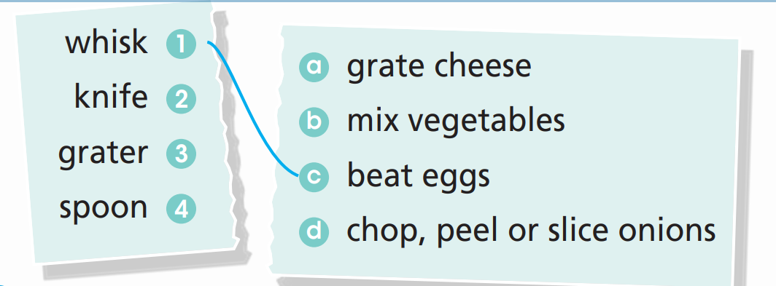
3 a) Match the cooking tools (1-4) to the correct phrases (a-d).

Slide 17
b) Make sentences using your answers in Exercise 3a. Tell your partner.
You need a whisk to beat eggs.
You need a knife to chop, peel, slice onions.
You need a grater to grate cheese.
You need a spoon to mix vegetables.

Slide 18
Complete the sentences with one of the cooking tools:
1 We need a ______________ to bake a cake.
2 Andy needs a ____________ to fry an egg.
3 Brian needs a ____________ to slice some onions.
4 Harry needs a _____________ to boil some rice.
5 Kelly needs a ______________ to beat the eggs.
cake tin
frying pan
knife
saucepan
whisk

Slide 19
Production

Slide 20
Tell your partner your favorite dish and what tools you need to cook it.
My favourite dish is cupcake. I need a whisk to beat the eggs.

Slide 21

CONSOLIDATION

Slide 22
Write six sentences about your favourite dishes, how to make it and the tools you need to make it, using the vocabulary you have learned today.

Slide 23

WRAP-UP

Slide 24
Today’s lesson
Vocabulary
Cooking tools and food preparation verbs.

Slide 25
Homework
Learn the vocabulary about free time activities.
Do exercises 1 in TA 6 Right on WB (p. 30)
Do the exercises in TA 6 Right on Notebook (p. 31)
Prepare the next lesson (p. 59 SB)

Slide 26

Enjoy your day!

