Slide 1

Getting Started
Lesson 3
Page 7

Slide 2
Lesson Outline
Warm-up
Vocabulary
Structure
Consolidation
Wrap-up

Slide 3
Objectives
By the end of this lesson, students will be able to ask the other people’s names and introduce themselves.
Vocabulary:
Hello, goodbye, Tom, Lucy
Structures:
Hello, what’s your name?/ My name’s Tom./ Goodbye.

Slide 4

WARM UP

Slide 5
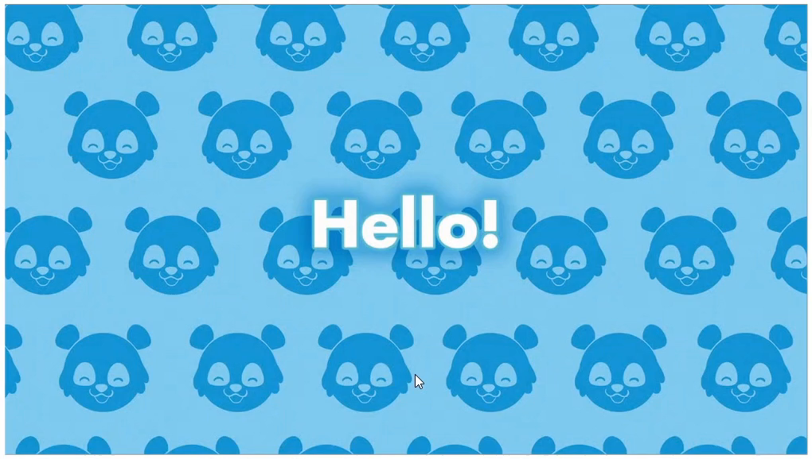
Hello

Slide 6

It’s time to learn …

Slide 7
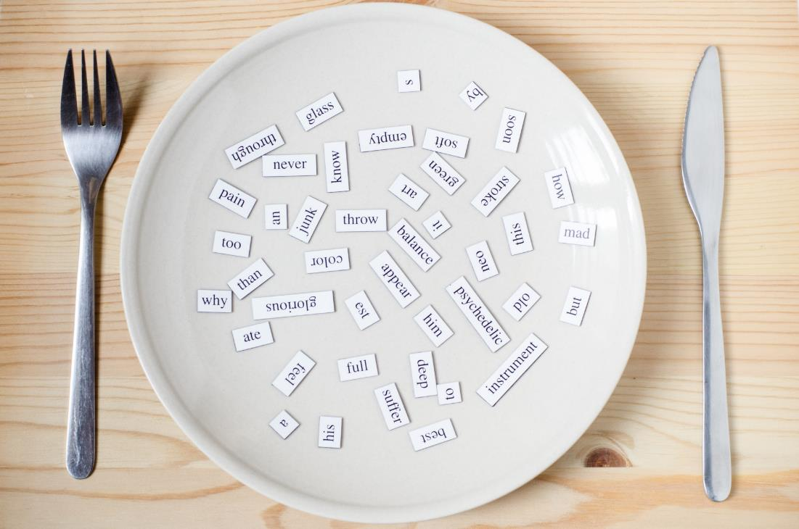
New words
Hello
Goodbye
Tom
Lucy

Slide 8

Presentation

Slide 9





A
Listen and point. Repeat. (CD1 Track 06)
1
2
3
4
hello
goodbye
Tom
Lucy
/həˈləʊ/
xin chào
/ˌɡʊdˈbaɪ/
tạm biệt
/Tɑːm/
Tom
/ˈLuːsi/
Lucy
Click on each English word to hear the sound.

Slide 10
Decode
1
2
3
4
Well done!
1
4
1
2
1
2
3
1
2
2
3
2
2
3
4
1
2
4
3
2
1
3
4
4
1
4
1
Notes:
Decode
Have the class look at the pictures and numbers.
Demonstrate the activity in front of the class.
Call out a number and have the class say the word.
- Eg.
Teacher: Number 2
Student: “Goodbye”
- Help students with their pronunciation if needed.

Slide 11
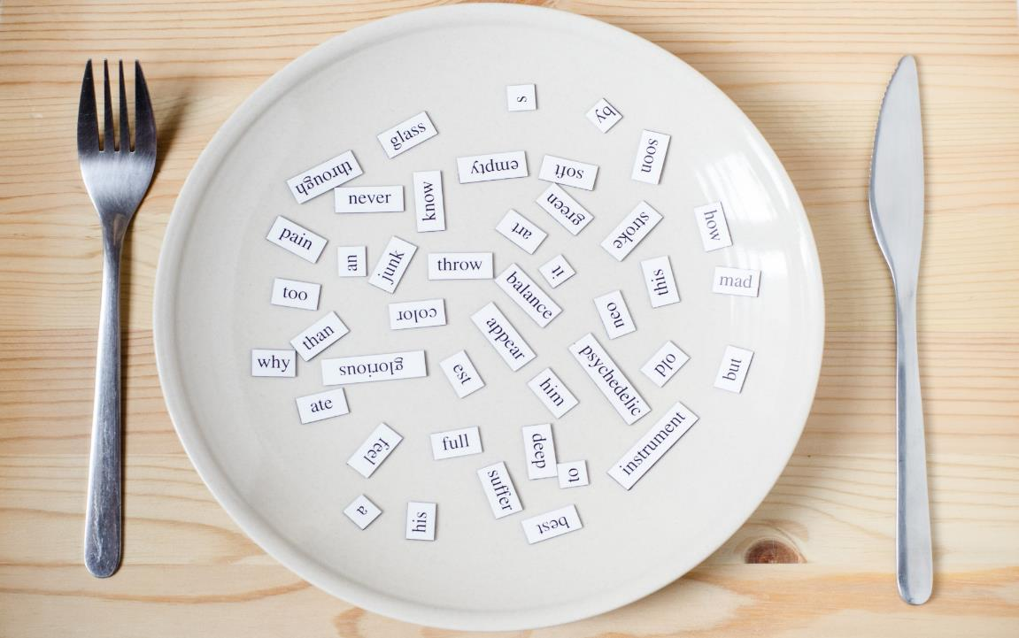
Structures
Hello, what’s your name?
My name’s Tom. Goodbye.

Slide 12
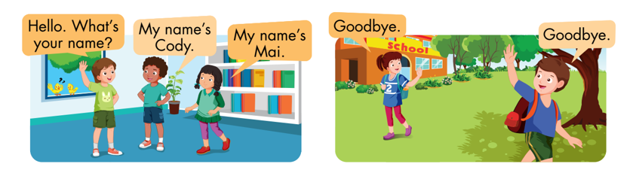
B
Listen and point. Repeat. Role-play. (CD1 Track 07)
Notes:
B. Listen and point. Repeat. Role-play. (CD1 Track 07)
Have students call out the things they can see in each picture.
Play the audio and have them point to the characters.
Play the audio again and have them repeat the new words.
Divide the class into pairs to role-play the dialogue.
Swap roles and repeat.
Invite some pairs to demonstrate the activity in front of the whole class.
Go around the class and support them if necessary.

Slide 13

Practice

Slide 14
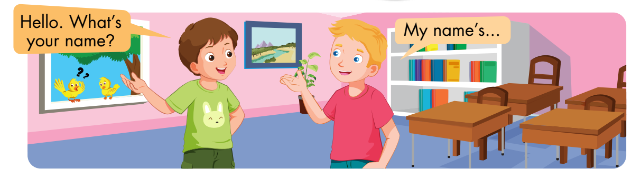
C
Practice with your friends.
Notes:
C. Practice with your friends.
Divide the class into two teams.
Show a flashcard to the class.
Have Team A call out the command and Team B do the action.
Swap roles and repeat.
Monitor the class and support if needed.

Slide 15
Speaking

Slide 16
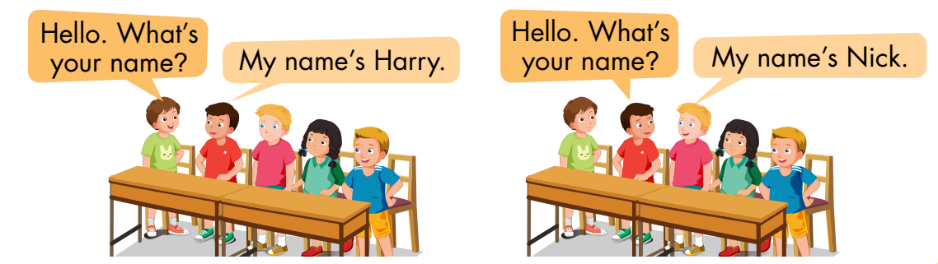
D
Play the Chain game.

Slide 17
Further Practice

Slide 18
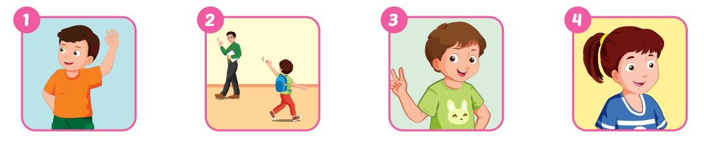
A
Complete the words.
hello
goodbye
Tom
Lucy

Slide 19
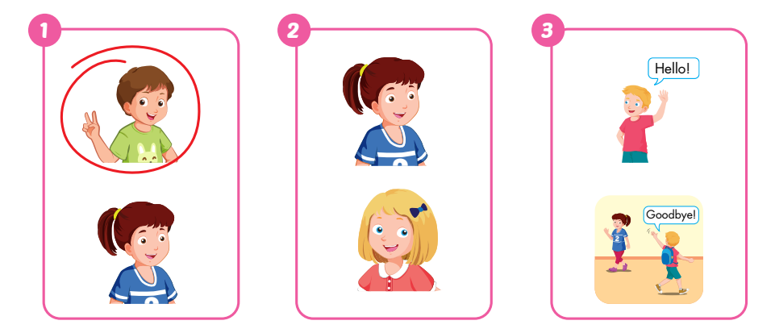
B
Listen and circle. (WB Track 04)

Slide 20
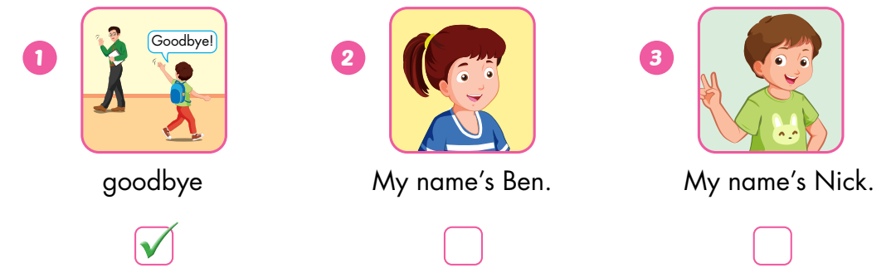
C
Look, read, and put a tick (✓) or a cross (✗).
✗
✗

Slide 21

Consolidation

Slide 22

Bye Bye

Slide 23

WRAP-UP

Slide 24
Today’s lesson
Vocabulary:
Hello, goodbye, Tom, Lucy
Structures:
Hello, what’s your name?/ My name’s Tom./ Goodbye.

Slide 25
Homework
Practice vocabularies and structure. Make sentences using them.
Do the exercises in Tiếng Anh 3 i-Learn Smart Start Workbook (page 5).
Practice the vocabulary and structure in Tiếng Anh 3 i-Learn Smart Start Notebook (page 5).
Play the consolidation games in Tiếng Anh 3 i-Learn Smart Start DHA App on www.eduhome.com.vn
Prepare the next lesson (page 8).

Slide 26

Enjoy your day!

