Slide 2


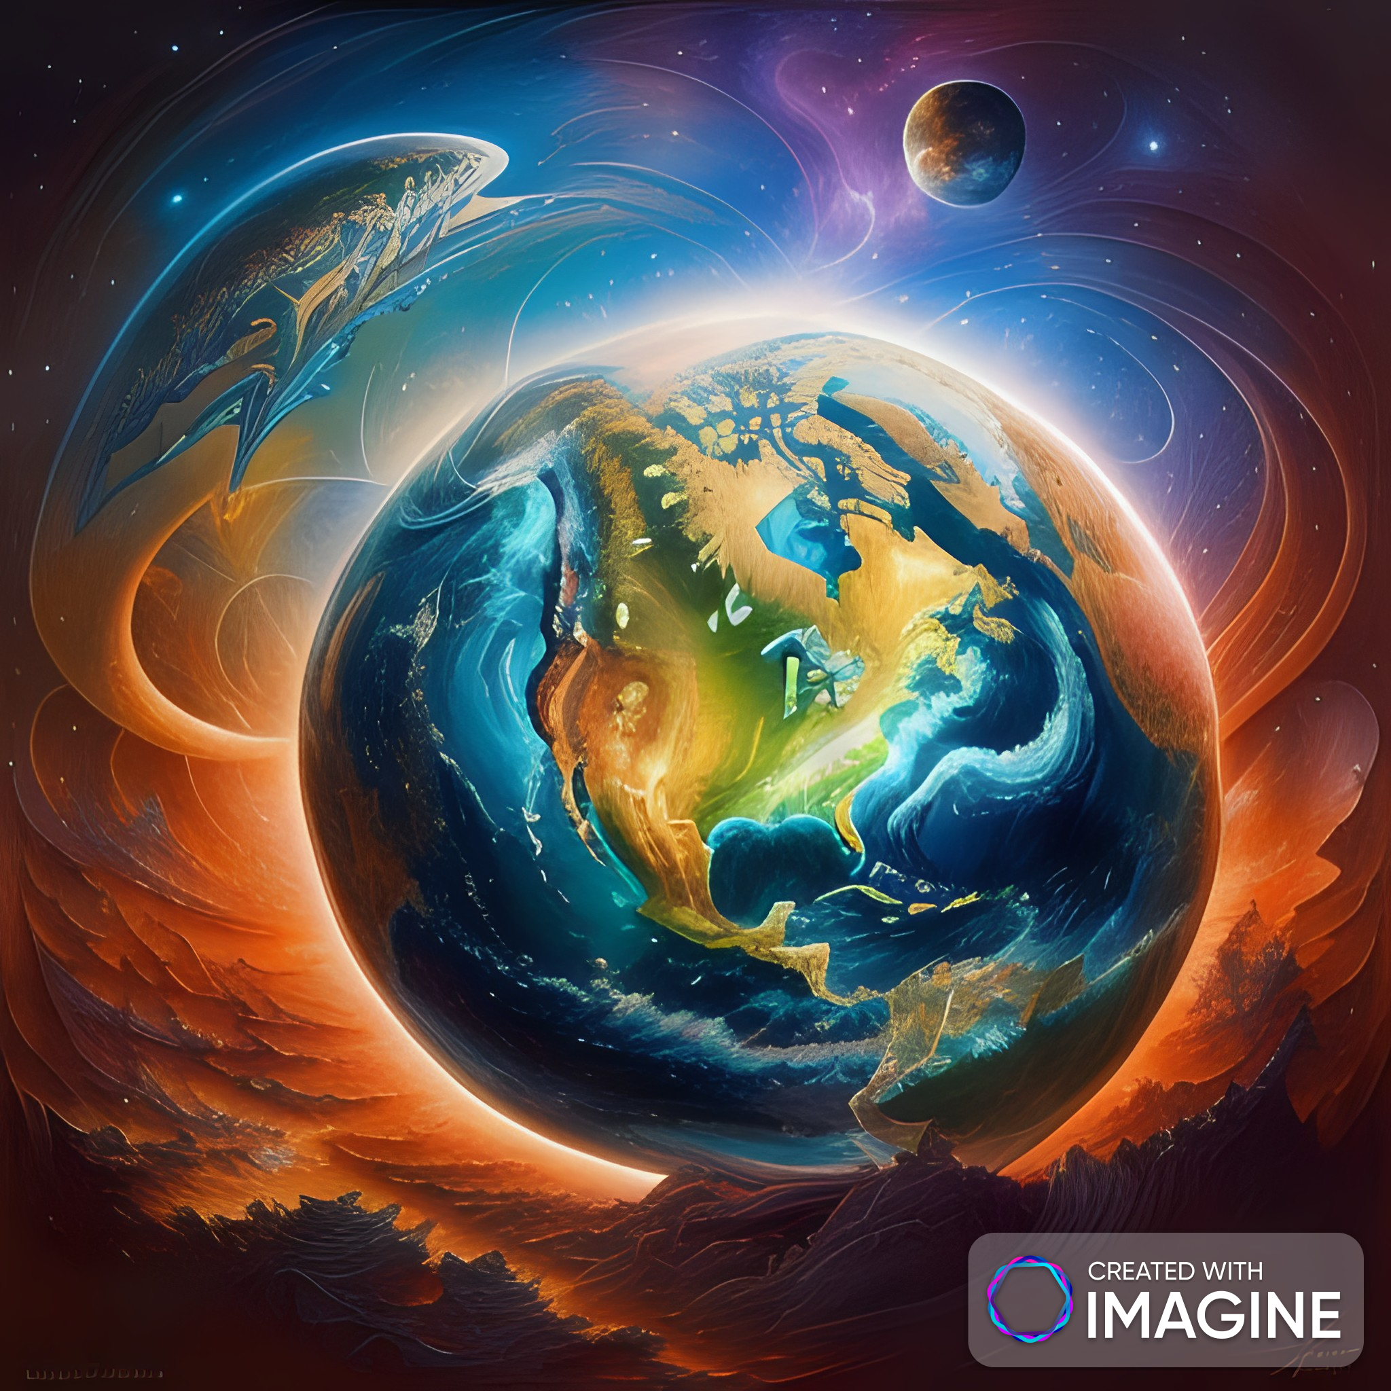
---------------------
Unit
10
PLANET EARTH
LESSON 6: SKILLS 2

Slide 3

OBJECTIVES
By the end of the lesson, students will be able to:
Listen about about the effects of living things
on the environment;
Write a summary.

Slide 4
LESSON 6: SKILLS 2
LESSON 1: GETTING STARTED
WARM-UP
Brainstorming
Task 1: Look at the pictures and answer the questions below.
Task 2: Listen to a conversation and choose the correct answer A, B, or C.
Task 3: Listen again and fill in each blank in the summary with ONE word.
LISTENING
WRITING
Task 4: Work in pairs. Ask and answer the questions below.
Task 5: Write a summary (100 - 120 words) of the main points of the conversation. Use the information in 3 and answers in 4.
CONSOLIDATION
Wrap-up
Homework

Slide 5

WARM-UP
OPTION 1
Brainstorming

Slide 6
WARM-UP
OPTION 1
- Work in groups to play games.
PLANTS | ANIMALS
- There are group a set of phrases on slips of paper about the roles plants and animals.
- Each group has to choose the correct slips about plants and the correct ones about animals and stick them in the right column.
Brainstorming
- If one is suitable for both columns, you can stick it between the two columns.

Slide 7
WARM-UP
OPTION 1
PLANTS | ANIMALS
Brainstorming

Slide 8
LESSON 6: SKILLS 2
LESSON 1: GETTING STARTED
WARM-UP
Brainstorming
Task 1: Look at the pictures and answer the questions below.
Task 2: Listen to a conversation and choose the correct answer A, B, or C.
Task 3: Listen again and fill in each blank in the summary with ONE word.
LISTENING

Slide 9
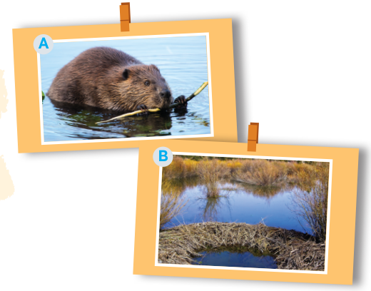
LISTENING
1
Look at the pictures and answer the questions below.
1. Which animal do you see in picture A?
2. What is it doing in picture A?
3. What do you see in picture B?
Questions:
A beaver.
It is gathering dead plants and tree branches.
A small / large pond which is divided into two by dead plants and branches.

Slide 10

LISTENING
2
Listen to a conversation and choose the correct answer A, B, or C.
Effects from plants | – They help or (1) ______ the environment. – They make a place more beautiful. – They (2) ______ over the resources of local plants.
Effects from animals | – They can cause harm to or (3) ________ a habitat. – Beavers can build dams and ponds, which helpssome plants and animals. – Beavers may (4) ______ the homes of other plants and animals.
We should | – (5) ___________ habitats. – stop destroying forest habitats. – stop using (6) ______.
1. Mr An is talking about ______.
A. effects of the habitats on plants and animals
B. the effects of habitat loss
C. effects of plants and animals on the habitats
2. What did Mr An suggest humans should do?
A. Bring plants and animals from one place to another.
B. Preserve habitats.
C. Use pesticides.

Slide 11
LISTENING
3
Listen again and fill in each blank in the summary with ONE word.
harm
Effects from plants | – They help or (1) ______ the environment. – They make a place more beautiful. – They (2) _____ over the resources of local plants.
Effects from animals | – They can cause harm to or (3) ________ a habitat. – Beavers can build dams and ponds, which helpssome plants and animals. – Beavers may (4) ______ the homes of other plants and animals.
We should | – (5) _________ habitats. – stop destroying forest habitats. – stop using (6) __________.
take
improve
flood
preserve
pesticides

Slide 12
EXTRA ACTIVITY
Work in pairs to ask and answer questions about
one of the aspects in 3:
1. the effects of plants on the environment
2. the effects of animals on the environment
3. the possible threats to the environment
4. the possible activities to deal with the threats
to the environment

Slide 13
EXTRA ACTIVITY
Example:
A: What are the eﬀects of plants on the environment?
B: Plants can beautify a place.
A: Exactly. Is there any other way they can aﬀect a habitat?
B: They can take over the resources of local plants.
A: What do you mean?
B: They grow very fast and use the soil and space of
surrounding plants.

Slide 14
Transition from Listening to Writing
- In the next part, you will write a summary of the listening.
- Look at the summary in 3 to orally list the effects from plants, and animals on the habitats.

Slide 15
LESSON 6: SKILLS 2
LESSON 1: GETTING STARTED
WARM-UP
Brainstorming
Task 1: Look at the pictures and answer the questions below.
Task 2: Listen to a conversation and choose the correct answer A, B, or C.
Task 3: Listen again and fill in each blank in the summary with ONE word.
LISTENING
WRITING
Task 4: Work in pairs. Ask and answer the questions below.
Task 5: Write a summary (100 - 120 words) of the main points of the conversation. Use the information in 3 and answers in 4.

Slide 16
WRITING
4
Work in pairs. Ask and answer the following questions.
1. What is the main topic of Mr An’s talk?
2. How do plants affect their habitat?
3. How do animals affect their habitat?
4. What should humans do?

Slide 17
WRITING
Model answers:
1. What is the main topic of Mr An’s talk?
Mr An and Mi are talking about the effects of plants and animals on the habitats.
2. How do plants affect their habitat?
3. How do animals affect their habitat?
Plants can help or harm the environment. Plants can make places more beautiful, but they can harm the environment by taking over the natural resources of local plants.
4. What should humans do?

Slide 18
2. How do plants affect their habitat?
1. What is the main topic of Mr An’s talk?
WRITING
Model answers:
3. How do animals affect their habitat?
Animal can harm or improve the environment. An example is beavers. Beavers can build dams and ponds, which help other plants and animals. But they can cause floods to homes of other plants and animals.
4. What should humans do?
Humans should preserve habitats, stop destroying the habitats of many species, and stop using pesticides.

Slide 19
WRITING
5
Write a summary (100 - 120 words) of the main points of the conversation. Use the information in 3 and answers in 4.
- Use the information in 3 and answers in 4.
Mr An talked about the effects of plants and animals on their habitat and the things people should do. Firstly, plants help _________________________________________________
_________________________________________________
_________________________________________________
_________________________________________________
Mr. An talks about the effects of plants and animals on the habitats. He said that plants can harm or protect the environment. Plants can make places more beautiful and they can harm the environment by taking over the natural resources of local plants. He also said that animal can harm or improve the environment as well. He gave an example of beavers. Beavers can build dams and ponds which help some plants and animals. But beavers can cause flood to homes of other plants and animals. He concluded that humans should preserve habitats, stop destroying forest habitats, and stop using pesticides.

Slide 20
WRITING
Example:
Mr An talks about the effects of plants and animals on the habitats. He said that plants can harm or protect the environment. Plants can make places more beautiful and they can harm the environment by taking over the natural resources of local plants. He also said that animal can harm or improve the environment as well. He gave an example of beavers. Beavers can build dams and ponds which help some plants and animals. But beavers can cause flood to homes of other plants and animals. He concluded that humans should preserve habitats, stop destroying forest habitats, and stop using pesticides.

Slide 21
LESSON 6: SKILLS 2
LESSON 1: GETTING STARTED
WARM-UP
Brainstorming
Task 1: Look at the pictures and answer the questions below.
Task 2: Listen to a conversation and choose the correct answer A, B, or C.
Task 3: Listen again and fill in each blank in the summary with ONE word.
LISTENING
WRITING
Task 4: Work in pairs. Ask and answer the questions below.
Task 5: Write a summary (100 - 120 words) of the main points of the conversation. Use the information in 3 and answers in 4.
CONSOLIDATION
Wrap-up
Homework

Slide 22

CONSOLIDATION
1
Wrap-up
What have we learnt in this lesson?
Listen about about the effects of living things on the environment;
Write a summary.

Slide 23

CONSOLIDATION
2
Homework
- Rewrite the paragraph in the notebooks.
Do exercises in the
workbook.

Slide 24
Website: hoclieu.vn
Fanpage: facebook.com/www.tienganhglobalsuccess.vn/

