Slide 1


Slide 2
Unit
10
The ecosystem
Unit
FAMILY LIFE
LESSON 4
SPEAKING
Ways to protect local biodiversity

Slide 3
LESSON 4
SPEAKING
WARM-UP
Watch a video
Task 1. Which of the followings are ways to protect local biodiversity?
Task 2. Choose a way to protect local biodiversity from the list in Task 1.
CONTROLLED PRACTICE
LESS CONTROLLED PRACTICE
Task 3: Read the situations and think of possible responses.
Task 4. Report your answer to the whole class.
CONSOLIDATION
Wrap-up
Homework

Slide 4

WATCH A VIDEO
What did the group of students do in the video to protect biodiversity?
Notes:
https://www.youtube.com/watch?v=kHhspf5IfdE

Slide 5
WARM-UP
Suggested answers:
- Discuss reasons for deforestation and the effects
- Develop a list of actions to restore the forest
- Animate a community radio program
- Organize role-play activities to raise awareness

Slide 6
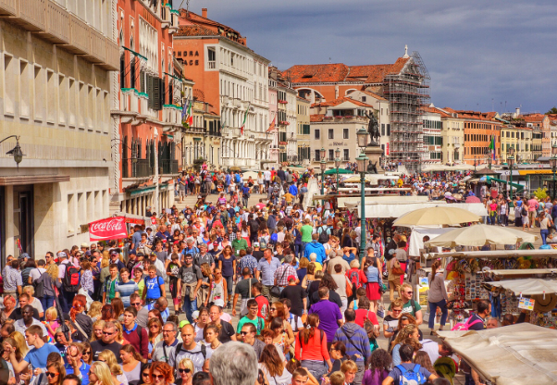

CONTROLLED PRACTICE
mass tourism (n.phr)
/mæs ˈtʊərɪzəm/
a kind of tourism in which there is huge gathering of tourist in a destination and creates huge impact upon its carrying capacity

Slide 7
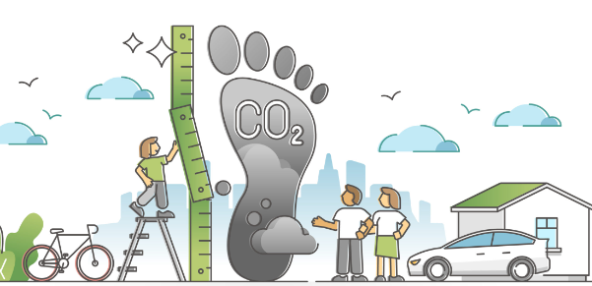
CONTROLLED PRACTICE
carbon footprint (n.phr)
/ˌkɑːbən ˈfʊtprɪnt/
a measure of the amount of carbon dioxide that is produced by the activities of a person or company

Slide 8
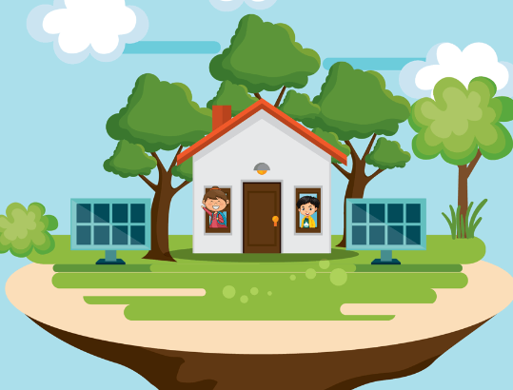
CONTROLLED PRACTICE
shelter (n)
/ˈʃeltə(r)/
a structure built to give protection, especially from the weather or from attack

Slide 9
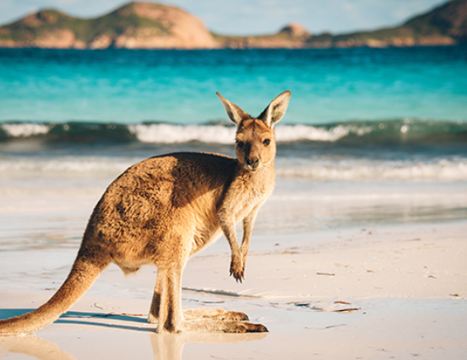
CONTROLLED PRACTICE
native (adj)
/ˈneɪtɪv/
(of animals and plants) existing naturally in a place

Slide 10
Form | Pronunciation | Meaning
1. mass tourism (noun phrase) | /mæs ˈtʊərɪzəm/ | a kind of tourism in which there is huge gathering of tourist in a destination and creates huge impact upon its carrying capacity.
2. carbon footprint (noun phrase) | /ˌkɑːbən ˈfʊtprɪnt/ | a measure of the amount of carbon dioxide that is produced by the activities of a person or company
3. shelter (n) | /ˈʃeltə(r)/ | a structure built to give protection, especially from the weather or from attack
4. native (adj) | /ˈneɪtɪv/ | (of animals and plants) existing naturally in a place

Slide 11


CONTROLLED PRACTICE
1
Which of the followings are ways to protect local biodiversity. Tick the correct boxes.
1. banning the hunting of wild animals
2. planting local trees, flowers, and other plants
3. promoting mass tourism
4. educating people about the importance of biodiversity
5. increasing your carbon footprint

Slide 12
CONTROLLED PRACTICE
2
Work in pairs. Choose a way to protect local biodiversity from the list in Task 1, and tell your partner about it.
Why is it important? How will it help protect local biodiversity? What can you do to help?
Example:
Plants play an important role in ecosystems. They provide food and shelter for many animal species. Each plant supports the ecosystem and biodiversity of the local area. We can help by researching the local flora, and planting more native plants.

Slide 13
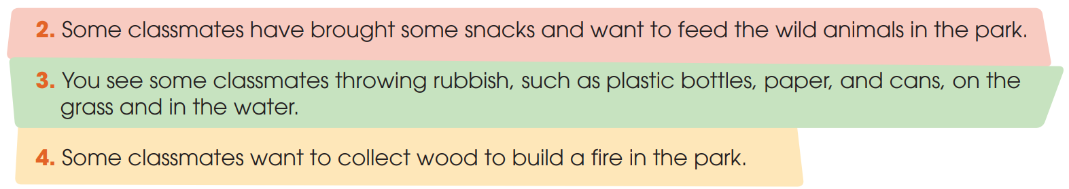
LESS CONTROLLED PRACTICE
3
Work in groups. Your class is on a field trip to a national park. Read the situations below and think of some possible responses. Provide reasons for each answer.

Slide 14

LESS CONTROLLED PRACTICE
4
Report your answer to the whole class. Vote for the best answer.

Slide 15
CONSOLIDATION
1
Wrap-up
What have you learnt today?
How to protect local biodiversity;
Vocabulary to talk about how to protect local biodiversity.

Slide 16
CONSOLIDATION
2
Homework
Do the exercises in the workbook.
Prepare for Lesson 5 - Unit 10.

Slide 17

Website: hoclieu.vn
Fanpage: facebook.com/www.tienganhglobalsuccess.vn
Website: hoclieu.vn
Fanpage: facebook.com/sachmem.vn/

