Slide 1


Slide 2


REVIEW
3
UNITS 7 – 8 – 9
LESSON 2: SKILLS
1

Slide 3
LESSON 1: GETTING STARTED
WARM-UP
Warm-up
READING
Task 1: Read the passage and tick T (True) or F (False) for each sentence.
SPEAKING
Task 2: Work in pairs. Take turns to ask your classmate the following question.
LISTENING
Task 3: Listen to the passage and fill in each blank with no more than TWO words.
WRITING
Task 4: Write a paragraph (80 – 100 words) about where your family shops and give reasons for your choice.
CONSOLIDATION
Wrap-up
Homework

Slide 4
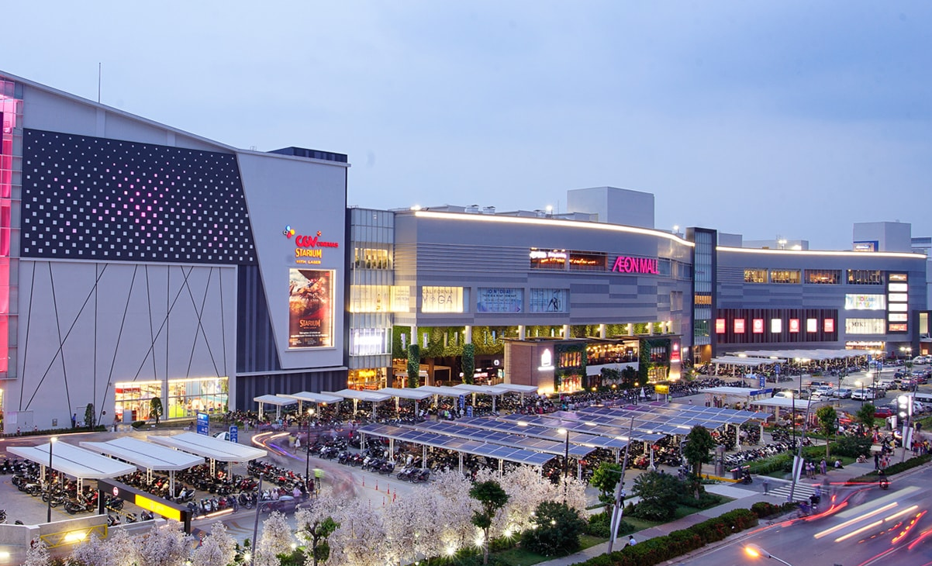
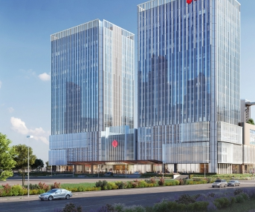

WARM-UP
AEON MALL
LOTTE
VINCOM

Slide 5
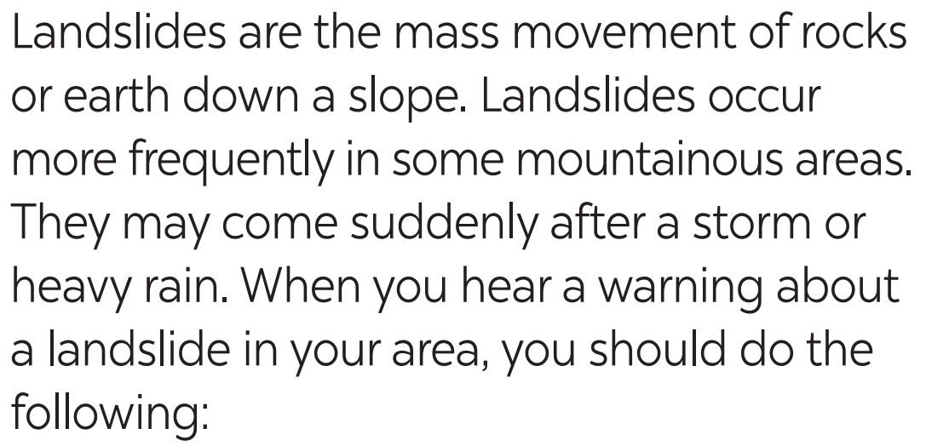
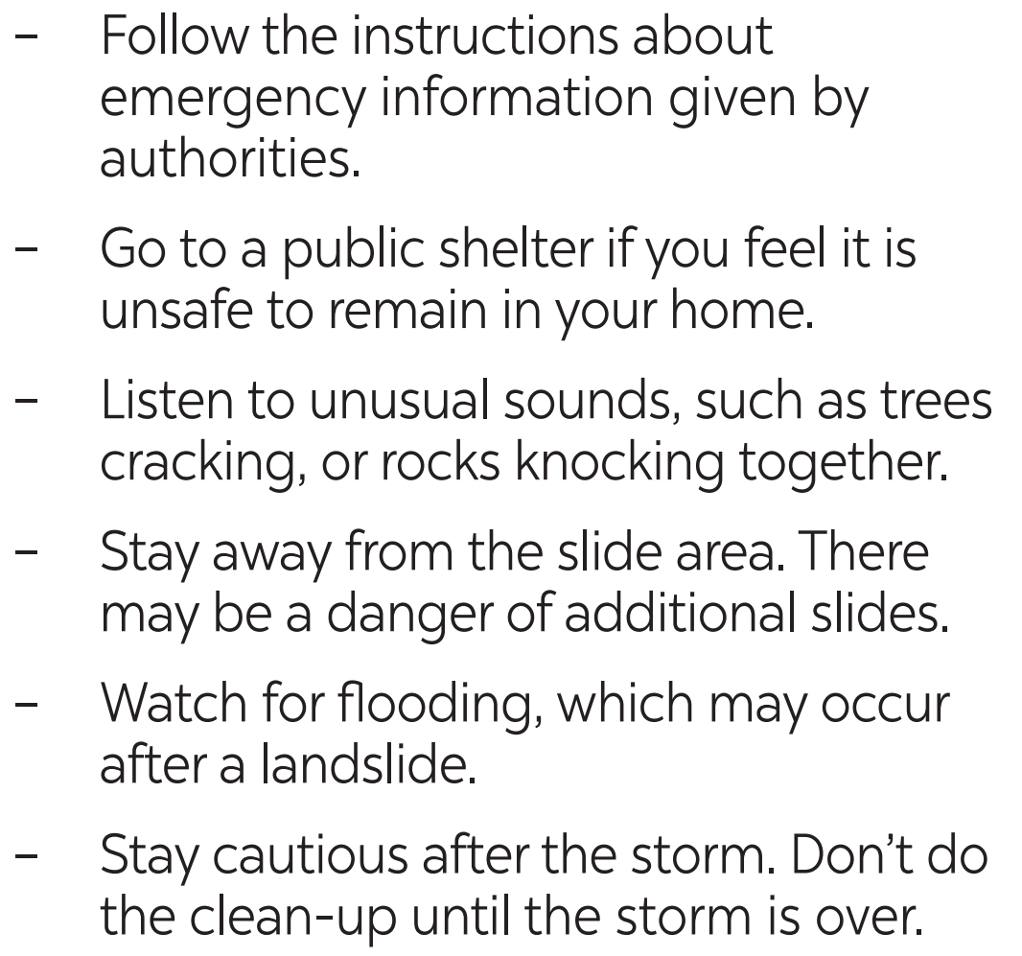

READING
1
Read the passage and tick T (True) or F (False) for each sentence.
Landslides are the mass movement of rocks or earth down a slope. Landslides occur more frequently in some mountainous areas. They may come suddenly after a storm or heavy rain. When you hear a warning about a landslide in your area, you should do the following:
– Follow the instructions about emergency information given by authorities.
– Go to a public shelter if you feel it is unsafe to remain in your home.
– Listen to unusual sounds, such as trees cracking, or rocks knocking together.
– Stay away from the slide area. There may be a danger of additional slides.
– Watch for flooding, which may occur after a landslide.
– Stay cautious after the storm. Don’t do the clean-up until the storm is over.

Slide 6

READING
1
Read the passage and tick T (True) or F (False) for each sentence.
Statements | T | F
1. Landslides hardly ever occur in mountainous areas.
2. You should follow the instructions about landslide emergencies.
3. Avoid going to public shelters as they are unsafe.
4. Landslides may occur one after another.
5. You should stay cautious until the storm is over.
Landslides are the mass movement of rocks or earth down a slope. Landslides occur more frequently in some mountainous areas. They may come suddenly after a storm or heavy rain. When you hear a warning about a landslide in your area, you should do the following:
– Follow the instructions about emergency information given by authorities.
– Go to a public shelter if you feel it is unsafe to remain in your home.
– Listen to unusual sounds, such as trees cracking, or rocks knocking together.
– Stay away from the slide area. There may be a danger of additional slides.
– Watch for flooding, which may occur after a landslide.
– Stay cautious after the storm. Don’t do the clean-up until the storm is over.

Slide 7

SPEAKING
2
Work in pairs. Take turns to ask your classmate the following question.
Do you face any of the following disasters where you live?
– volcanic eruptions – earthquakes
– droughts – floods
– storms – landslides
Then talk about the damage that the disaster(s) may cause.

Slide 8
LISTENING
3
Listen to the passage and fill in each blank with no more than TWO words.
pollution
1. The exhaust fumes from vehicles are the main cause of ________ in our cities.
2. Bad gases can be very _________ for children.
3. Transport is not the only reason why we have ___________.
4. Less pollution today comes from ____ than in the past.
5. Bad gases are being released into the air from ____________.
dangerous
air pollution
coal
other sources

Slide 9
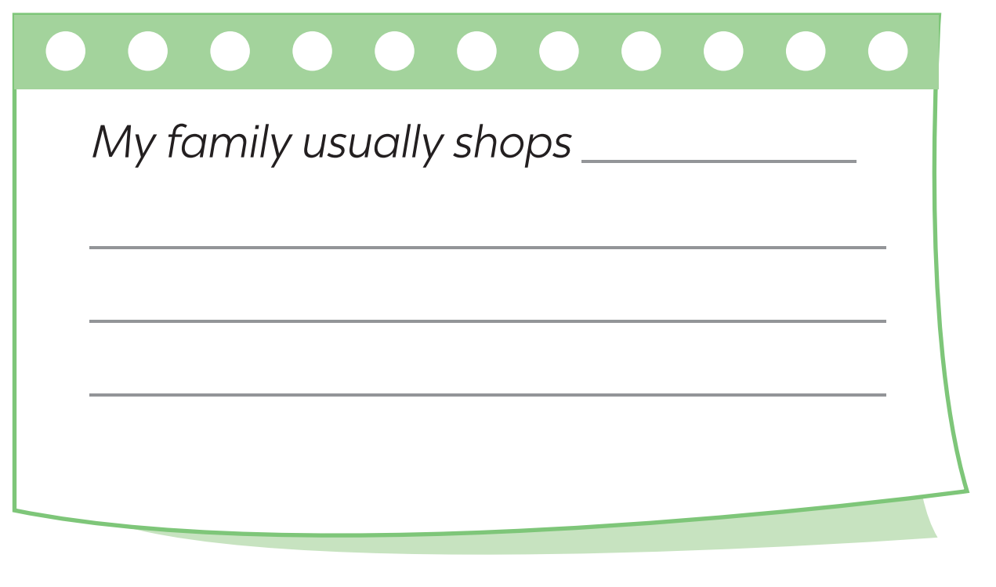

WRITING
4
Write a paragraph (80 – 100 words) about where your family shops and give reasons for your choice.
Name?
Address?
Prices?
Services?
Goods?
Any other reasons?

Slide 10
WRITING
4
Write a paragraph (80 – 100 words) about where your family shops and give reasons for your choice.
Suggested answer:
My family usually shops at the open-air market in my neighbourhood. My mum goes shopping there once every two days. It is only about five minutes’ walk from my home, so it is very convenient. There is a wide variety of goods, from groceries to vegetables, from clothes to kitchen utensils, etc. And their price is reasonable. Moreover, the food there is good and fresh as farmers bring their products to sell there every day. We are lucky to have a good shopping place nearby.

Slide 11

CONSOLIDATION
1
Wrap-up
What have we learnt in this lesson?
The skills students have practised in Units 7-8-9.

Slide 12

CONSOLIDATION
2
Homework
Do exercise in the workbook.

Slide 13

Website: hoclieu.vn
Fanpage: facebook.com/tienganhglobalsuccess.vn/

