Slide 2



Unit
4
MY NEIGHBOURHOOD
LESSON 5: SKILLS 1
1

Slide 3
LESSON 5: SKILLS 1
LESSON 1: GETTING STARTED
WARM-UP
Game: Miming
Task 1: Find the words and give definitions.
Vocabulary
Task 2: Read and fill the table.
Task 3: Answer the questions.
READING
SPEAKING
Task 4: Make notes.
Task 5: Discussion.
Wrap-up
Homework
CONSOLIDATION

Slide 4
WARM-UP
GUESS THE DIRECTIONS
Work in groups.
Send 1 person to mime the direction.
MIMING GAME
TURN RIGHT
TAKE THE SECOND TURNING ON THE LEFT
GO STRAIGHT
GO ALONG THE STREET
TURN LEFT

Slide 5
READING
1
Find the words and give definitions.
MY NEIGHBOURHOOD
I live in the suburbs of Da Nang City. There are many things I like about my neighbourhood.
It’s great for outdoor activities because it has beautiful parks, sandy beaches and fine weather. There’s almost everything I need here: shops, restaurants, and markets. The people here are friendlier, and the food is better than in other places.
However, there are two things I dislike about it: there are many modern buildings and offices; and the streets are busy and crowded.

Slide 6
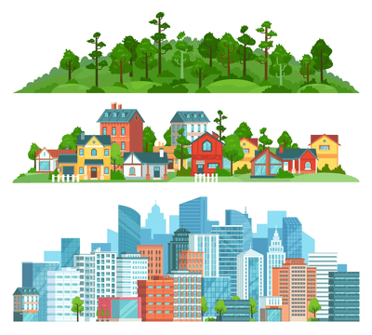
VOCABULARY
suburb(n)
/ˈsʌbɜːb/
khu ngoại ô

Slide 7
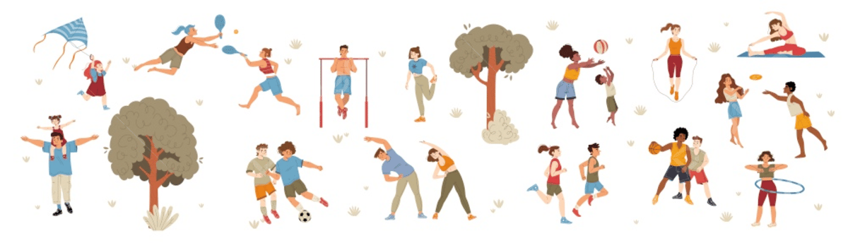
VOCABULARY
outdoor activity (n)
/ˈaʊtˌdɔːr ækˈtɪvəti/
hoạt động ngoài trời

Slide 8
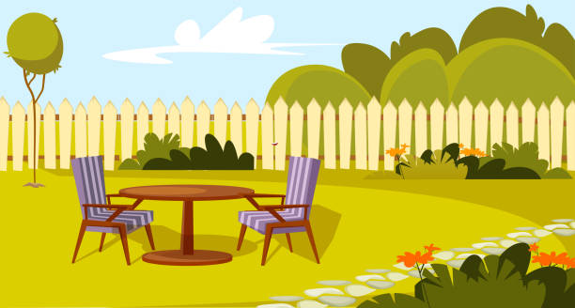
VOCABULARY
backyard (n)
/ˌbækˈjɑːrd/
sân sau

Slide 9

VOCABULARY
dislike (v)
/dɪsˈlaɪk/
không thích

Slide 10
VOCABULARY
New words | Pronunciation | Meaning
1. suburb (n) | /ˈsʌbɜːb/ | khu ngoại ô
2. outdoor activity (n) | /ˈaʊtˌdɔːr ækˈtɪvəti/ | hoạt động ngoài trời
3. backyard (n) | /ˌbækˈjɑːrd/ | sân sau
4. dislike (v) | /dɪsˈlaɪk/ | không thích

Slide 11
READING
2
Read Khang’s blog again and fill the table with the information.
LIKES | DISLIKES
beautiful parks
modern buildings and offices
sandy beaches
busy and crowed streets
fine weather
shops, restaurant, markets
friendly people
good food

Slide 12
READING
3
Read Khang’s blog again. Then answer the questions.
1. Where is Khang’s neighbourhood?
2. Why is his neighbourhood great for outdoor activities?
3. What are the people in his neighbourhood like?
4. How are the streets in his neighbourhood?
It is in the suburbs of Da Nang City.
Because it has beautiful parks, sandy beaches and fine weather.
They are very friendly.
They are busy and crowed.

Slide 13
SPEAKING
4
Make notes about your neighbourhood. Think about what you like / dislike about it.
LIKES | DISLIKES
- It’s great for outdoor activities.
- The streets are busy and crowded during the day.
- There’s almost everything here.
- The people here are incredibly friendly.
- The food is very good.

Slide 14
SPEAKING
5
Work in pairs. Ask and answer about what you like and dislike about your neighbourhood.
Example:
A: Where do you live?
B: I live in the suburbs of Da Nang City.
A: What do you like about it?
B: The weather is fine. The people are friendly and the food is good.
A: What do you dislike about it?
B: The streets are busy and crowded.

Slide 15

CONSOLIDATION
1
Wrap-up
What have we learnt in this lesson?
2
Homework
Do exercises in the workbook

Slide 16






Website: hoclieu.vn
Fanpage: facebook.com/www.tienganhglobalsuccess.vn/

