Slide 1



Unit 3: On Screen
Lesson 3B: Grammar

Slide 2


VIDEO GAMES QUIZ

Slide 3


HOW TO PLAY
1. Pay attention to the pictures, GIFs or short clips about a video game
2. Choose the correct genre of the video game given
3. Use some types of video games in the box to help you

Slide 4



Choose the correct genre of the game below:
A. racing
B. role-playing
C. puzzle
D. sports

Slide 5
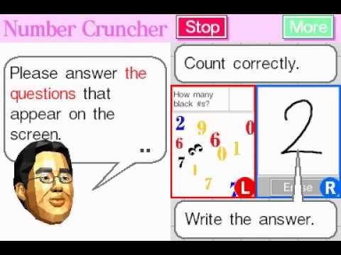

Choose the correct genre of the game below:
A. adventure
B. combat
C. city-building
D. puzzle

Slide 6

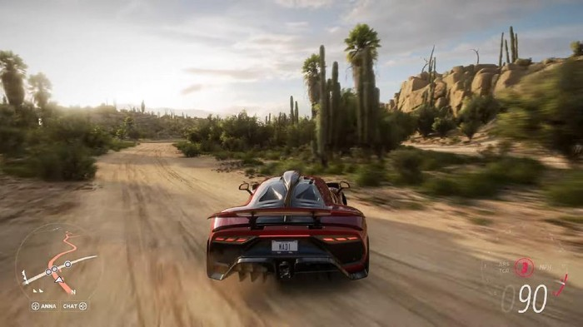
Choose the correct genre of the game below:
A. puzzle
B. city-building
C. racing
D. combat

Slide 7

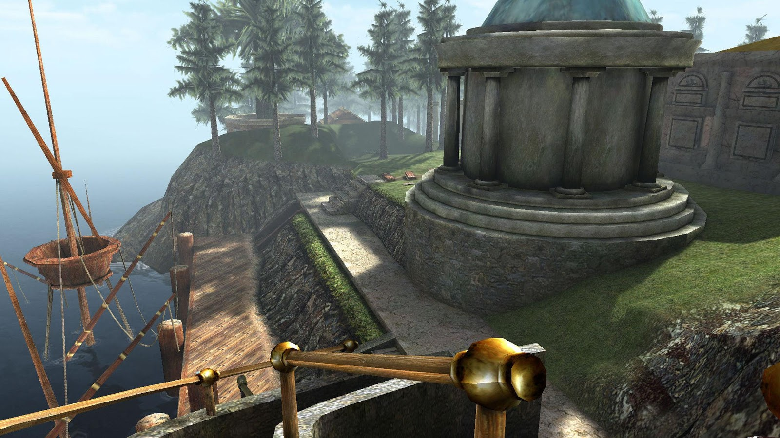
Choose the correct genre of the game below:
A. adventure
B. racing
C. city-building
D. combat

Slide 8


Choose the correct genre of the game below:
A. puzzle
B. sports
C. adventure
D. racing

Slide 9

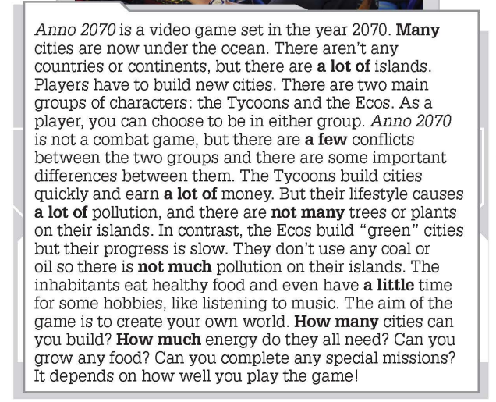

www.phuongnam.edu.vn

Slide 10



www.phuongnam.edu.vn

Slide 11
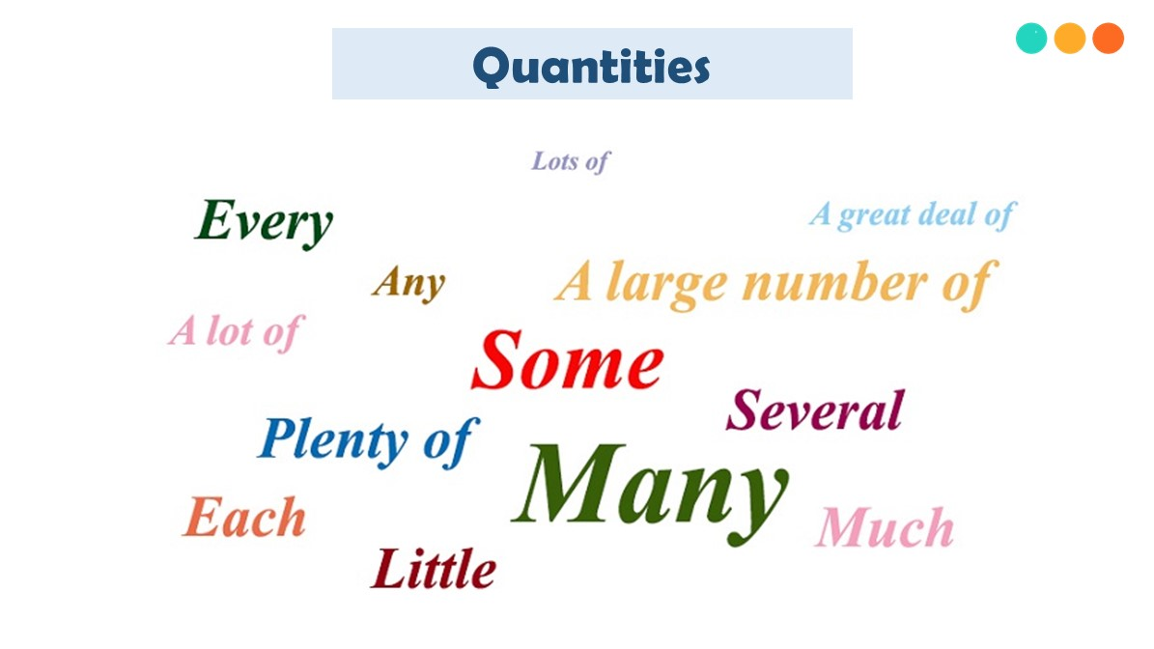
EXPRESSIONS OF QUANTITY
www.phuongnam.edu.vn

Slide 12

www.phuongnam.edu.vn

Slide 13
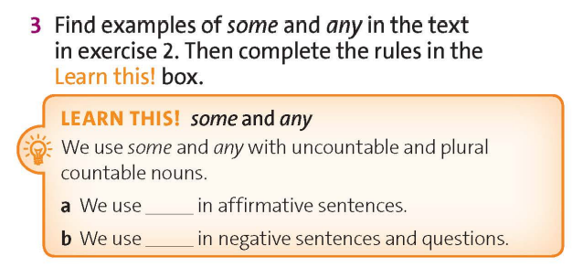
some
any
www.phuongnam.edu.vn

Slide 14
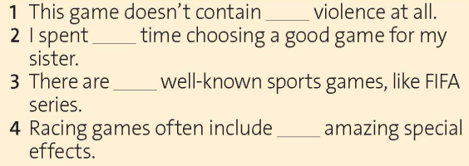

any
some
some
some
any
any
www.phuongnam.edu.vn

Slide 15
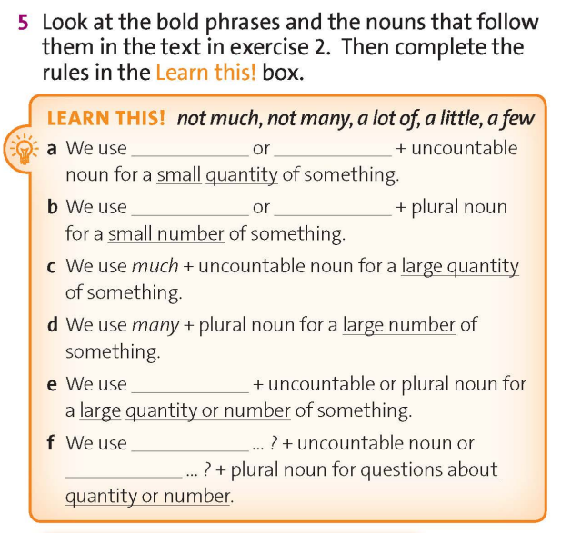
www.phuongnam.edu.vn

Slide 16
not much
a little
not many
a few
a lot of
how much
how many
www.phuongnam.edu.vn

Slide 17

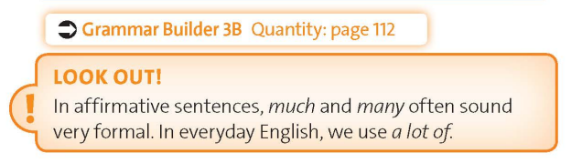
www.phuongnam.edu.vn

Slide 18
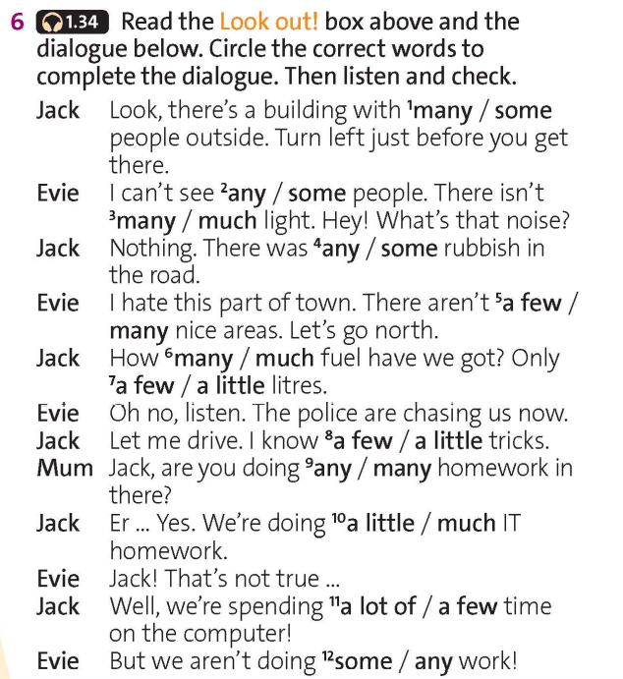

Then listen and check
www.phuongnam.edu.vn

Slide 19

Discussion
Work in pairs. Share with your partners about your favorite video game.
Describe some of its setting by using quantities.
I really like puzzle games, especially Brain Age. It has many logic puzzles to solve.
Use the language in the box below to help you
I’m into sports games. FIFA game doesn’t contain any violence
at all!
www.phuongnam.edu.vn

Slide 20
01
Homework
02
1. Learn by heart all the grammar rules
2. Finish all the tasks
3. Prepare U3-C (P.37)
03
04
?
05
06

Slide 21

www.phuongnam.edu.vn

Slide 22



Thank you!
CTCP ĐẦU TƯ VÀ PHÁT TRIỂN GIÁO DỤC PHƯƠNG NAM

