Slide 1
Time allowed - 8-10 minutes
Normally you will do the speaking test with another candidate. The two of you will meet two examiners. One of the examiners will talk to you, the other does not particpate in the conversations.
There are two parts to the speaking test:
Speaking part 1: short questions and answers between you and the examiner
Speaking part 2: the examiner gives you some information or a card with some ideas for questions. You have to talk with the other candidate and ask or answer questions.
How to prepare for KET Speaking
Speak as much as you can, with your friends
Practise asking and asnwering questions about daily life
Practise giving information about yourself

Slide 2
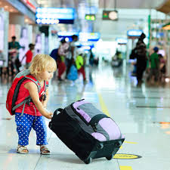
Part 1: Tell about your trip last summer

Slide 3
Brain storm
when and where was your trip?
what did you prepare?
who did you go with?
how did you get there?
what did you do?
how did you feel?
how about your next trip?

Slide 4
Grammar
Past tenses
S + was/were + …
Ved
S + was/were + Ving …
S + had + participle

Slide 5
Useful vocabulary

Slide 6
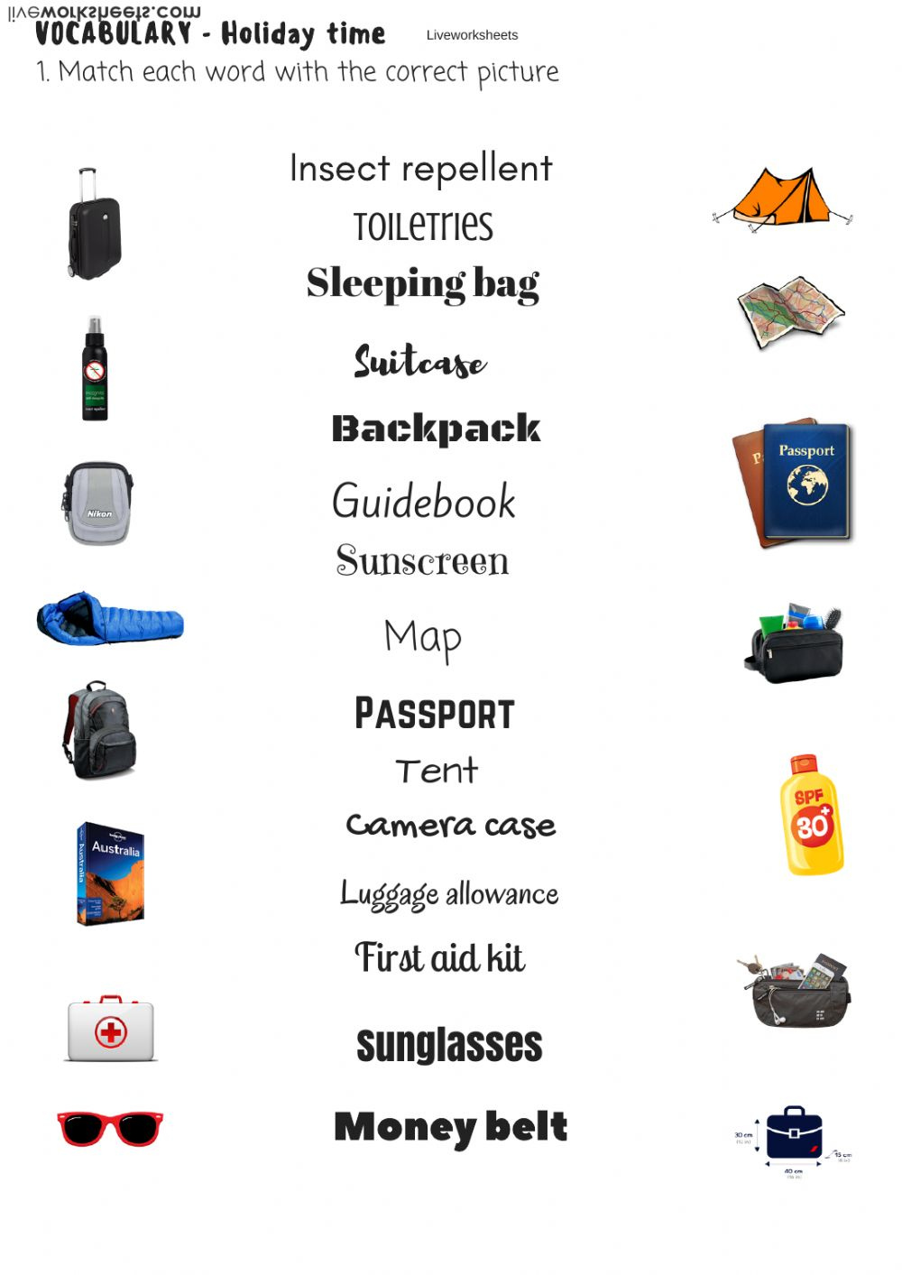
Traveling items

Slide 7
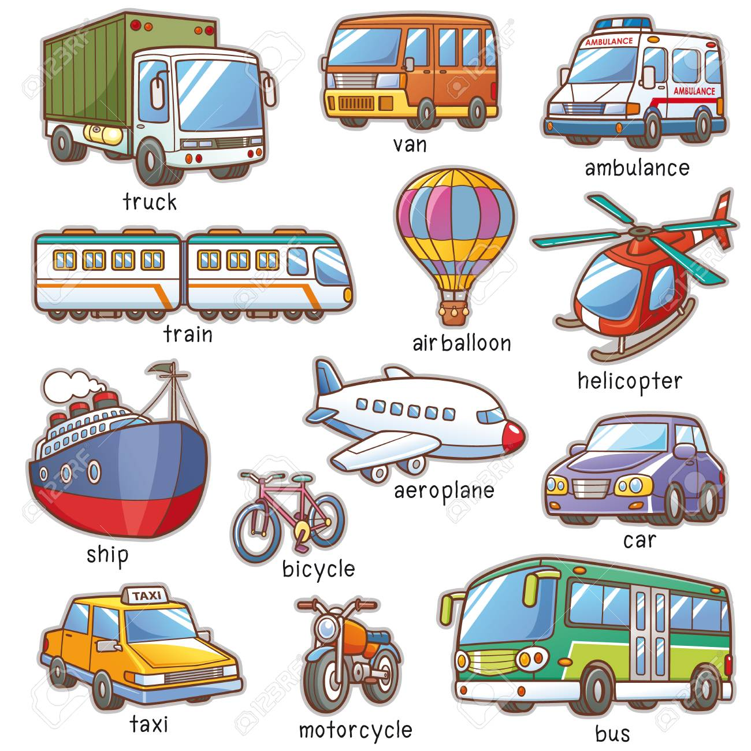
Transportations

Slide 8
What did you do?
- firstly, secondly
- then, next
- before, after
- in the end…
Make 3 sentences about your trip activities

Slide 9

Feelings

Slide 10
Useful language:
Last …,
…enjoyed/went/took … with …
I was …
I went …
I think …

Slide 11
Tell about your last trip
(3 – 4 mins)

Slide 12
Speaking part 2:
Asking and answering questions using these prompt cards

Slide 13

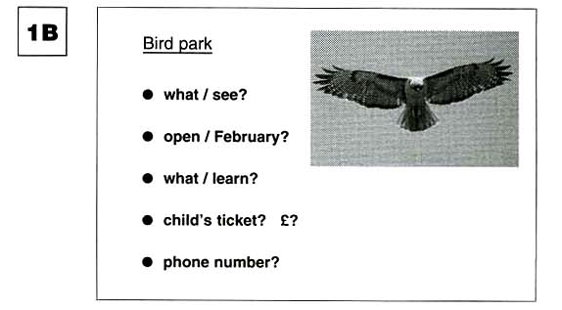
Ask and answer questions using the words given.
What are other questions and answers you can think of?

Slide 14
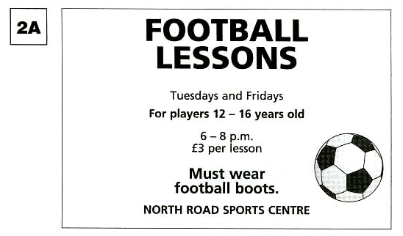
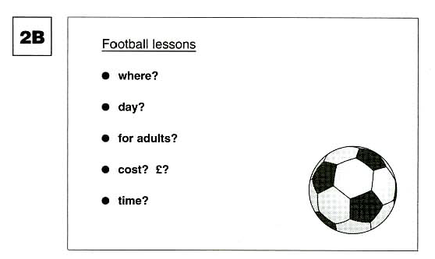
Ask and answer questions using the words given.
What are other questions and answers you can think of?

Slide 15
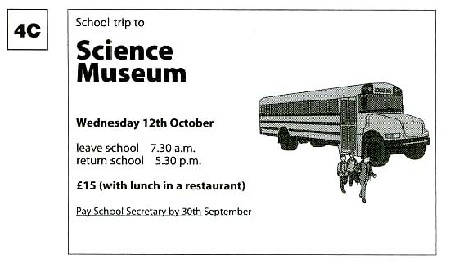
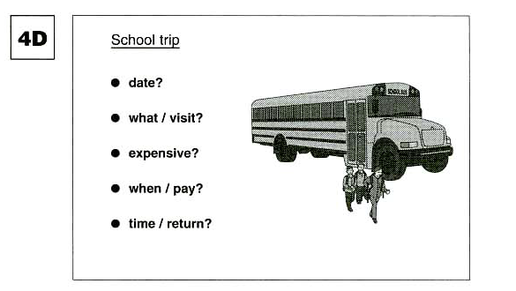
Ask and answer questions using the words given.
What are other questions and answers you can think of?

