Slide 1
Time allowed - 8-10 minutes
Normally you will do the speaking test with another candidate. The two of you will meet two examiners. One of the examiners will talk to you, the other does not particpate in the conversations.
There are two parts to the speaking test:
Speaking part 1: short questions and answers between you and the examiner
Speaking part 2: the examiner gives you some information or a card with some ideas for questions. You have to talk with the other candidate and ask or answer questions. How to prepare for KET Speaking
Speak as much as you can, with your friends
Practise asking and asnwering questions about daily life
Practise giving information about yourself

Slide 2
Part 1: Tell about your school

Slide 3
Brain storm
What is the name of your school?
Where is it?
What is the type of your school?
What is it like?
Do you like your school? Why?

Slide 4
Useful vocabulary

Slide 5
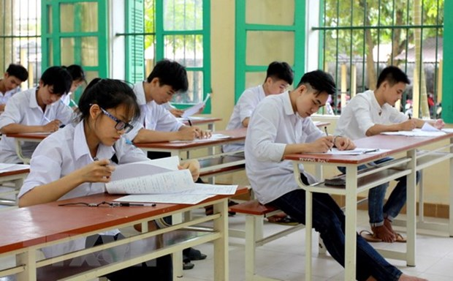
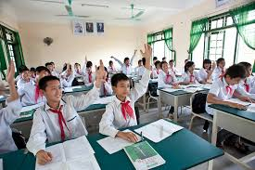
Levels of school
Kinder-garten
Primary
school
High school
Secondary
school

Slide 6
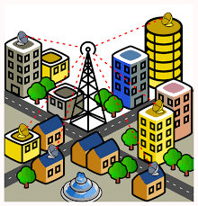
Where is it?
city
town
country
urban
area
rural
area

Slide 7
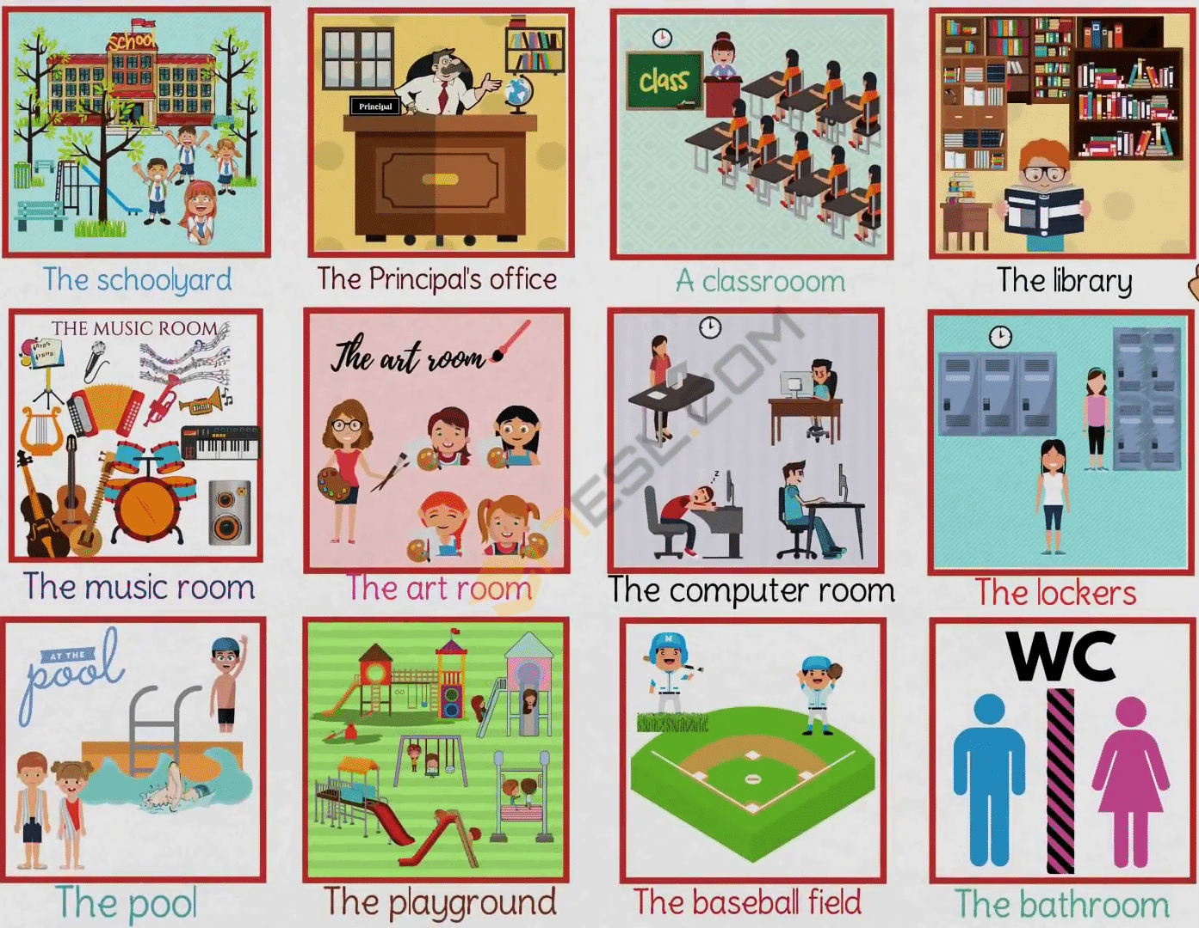
School buildings

Slide 8
What is it like?

Slide 9
prepositions

Slide 10
Make sentences with these prepositions 1. on: 2. in: 3. between … and …:

Slide 11
Useful language:
I live in …
It is …
There is a …
There are …

Slide 12
Tell about your school (3 – 4 mins)

Slide 13
Speaking part 2:
Asking and answering questions using these prompt cards

Slide 14
Ask and answer questions using the words given.
What are other questions and answers you can think of?

Slide 15
Ask and answer questions using the words given.
What are other questions and answers you can think of?

Slide 16
Ask and answer questions using the words given.
What are other questions and answers you can think of?

