Slide 1

Unit 2: Every day
Overview
Pages 36 & 37

Slide 2
Lesson Outline
Warm-up
Vocabulary
Speaking
Consolidation
Wrap-up

Slide 3
Objectives
By the end of this lesson, students will be able to…
Learn vocabulary about daily routine and free-time activities.
Talk about what they do every day and in their free-time.

Slide 4

WARM-UP

Slide 5

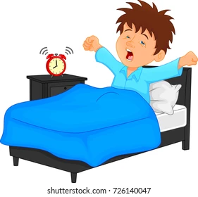
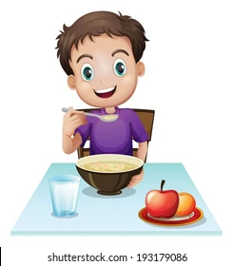

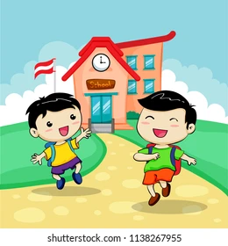
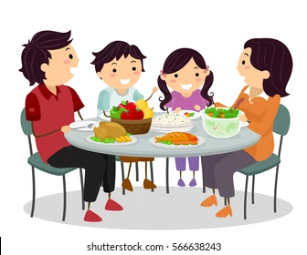
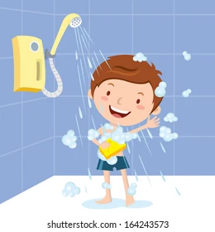
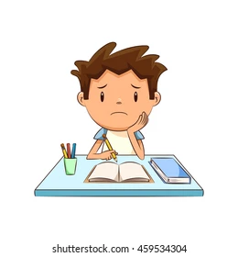
DISCUSSION
Put the activities in the order you do them every day.
3
1
2
4
5
7
6
8

Slide 6

It’s time to learn …

Slide 7

Presentation

Slide 8





Match the phrases with the correct pictures.
brush my teeth
have breakfast
take a shower
walk to school
get up
get up
take a shower
brush my teeth
walk to school
have breakfast
Notes:
Focus on the vocab that may be difficult to your students. Review / go through quickly those your students are familiar with.

Slide 9
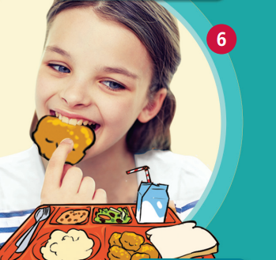




have lunch
finish school
come back home
do my homework
go to basketball practice
finish school
have lunch
go to basketball practice
do my homework
come back home
Notes:
Focus on the vocab that may be difficult to your students. Review / go through quickly those your students are familiar with.

Slide 10
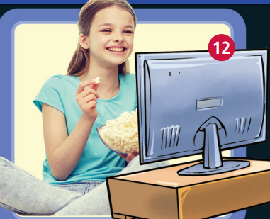
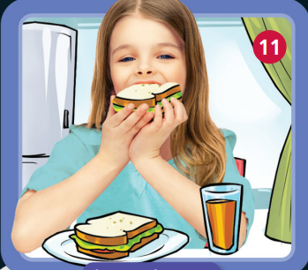
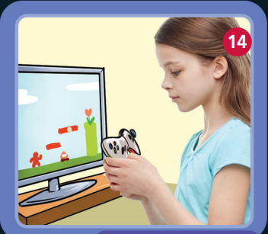

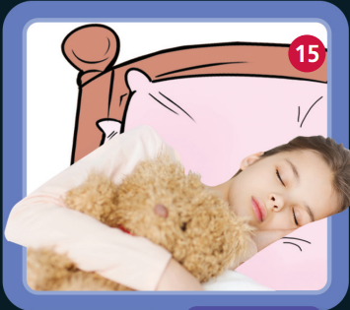
watch TV
have dinner
go to bed
play video games
watch videos online
watch TV
have dinner
watch videos online
play video games
go to bed
Notes:
Focus on the vocab that may be difficult to your students. Review / go through quickly those your students are familiar with.

Slide 11

get up (v phr) /ˈɡet ʌp/: thức dậy
take a shower (v phr) /teɪk ə ˈʃaʊə/: tắm
have breakfast (v phr) /hæv ˈbrekfəst/: ăn sáng
brush my teeth (v phr) /ˈbrʌʃ maɪ ˌtiːθ/: đánh răng
walk to school (v phr) /ˈwɔːk tə skuːl/: đi bộ đến trường
Notes:
Focus on the vocab that may be difficult to your students. Review / go through quickly those your students are familiar with.

Slide 12
have lunch (v phr) /hæv ˈlʌntʃ/: ăn trưa
finish school (v phr) /ˈfɪnɪʃ skuːl/: kết thúc giờ học
come back home (v phr) /ˈkʌm ˈbæk ˈhəʊm/: về nhà
do my homework (v phr) /ˈduː maɪ ˈhəʊmwɜːk/: làm bài tập về nhà
go to basketball practice (v phr) /ˈɡəʊ tə ˈbɑːskɪtbɔːl ˈpræktɪs/: luyện tập bóng rổ
Notes:
Focus on the vocab that may be difficult to your students. Review / go through quickly those your students are familiar with.

Slide 13
have dinner (v phr) /hæv ˈdɪnə/: ăn tối
watch TV (v phr) /wɒtʃ tiːˈviː/: xem ti vi
watch videos online (v phr) /wɒtʃ ˈvɪdiəʊz ˈɒnˌlaɪn/: xem phim trực tuyến
play video games (v phr) /ˈpleɪ ˈvɪdiəʊ ˈɡeɪmz/: chơi trò chơi điện tử
go to bed (v phr) /ˈɡəʊ tu bed/: đi ngủ
Notes:
Focus on the vocab that may be difficult to your students. Review / go through quickly those your students are familiar with.

Slide 14
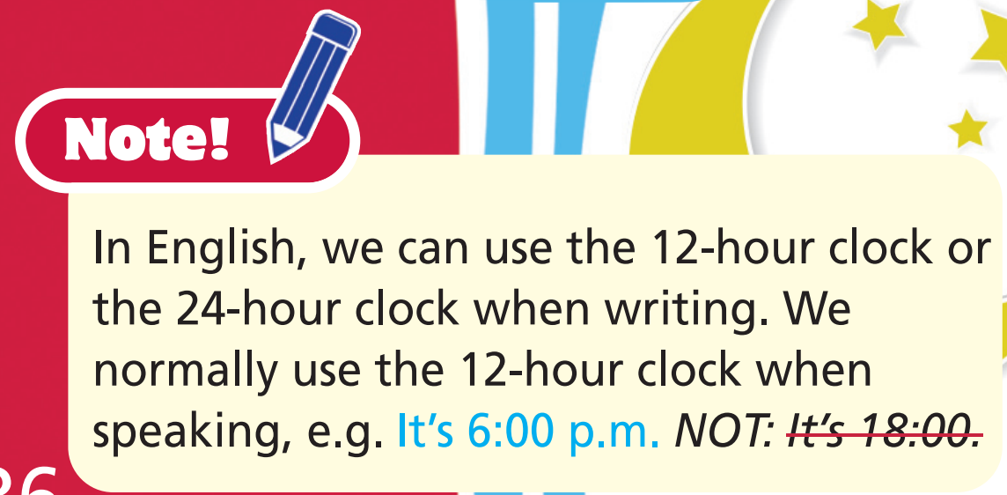

Slide 15

Practice

Slide 16

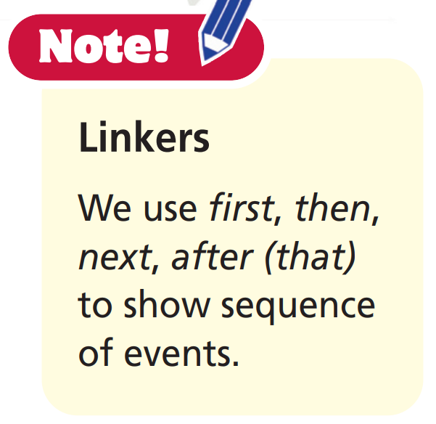
2. Imagine you are Mary. Use phrases from Exercise 1 to tell the class about your morning/ afternoon/evening routine on Mondays.
In the morning, I get up and take a shower. Then, I … .

Slide 17
Sample
I get up at 7 o’clock in the morning, take a shower
and have breakfast. Then, I brush my teeth. After that, I walk to school.
At noon, I have lunch. In the afternoon, I finish school and come back home. I do my homework and then I go to basketball practice.
In the evening, I have dinner. Then, I watch TV, and
after that, I watch videos online. Then, I play video
games and after that, I go to bed.

Slide 18

Production

Slide 19
PAIRWORK
Ask and answer about what you do in the morning, afternoon, and evening every day.
What do you do every morning?
I get up at six. Then, I brush my teeth and wash my face. Next, I have breakfast. After that, I go to school at 6:30.

Slide 20

CONSOLIDATION

Slide 21
Write six sentences (about 50 words) about your daily routines and your free time activities, using the vocabulary you have studied today.

Slide 22

WRAP-UP

Slide 23
Today’s lesson
Vocabularies
get up
take a shower
have breakfast
brush your teeth
walk to school
have lunch
finish school
come back home
do my homework
go to basketball practice
have dinner
watch TV
watch videos online
play video games
go to bed

Slide 24
Homework
Practise the vocabularies and make sentences with them.
Do exercise 1 in TA 6 Right on WB (p. 22).
Do the exercises in TA 6 Right on Notebook (pp. 18-19).
Prepare the next lesson (p. 38 SB).

Slide 25
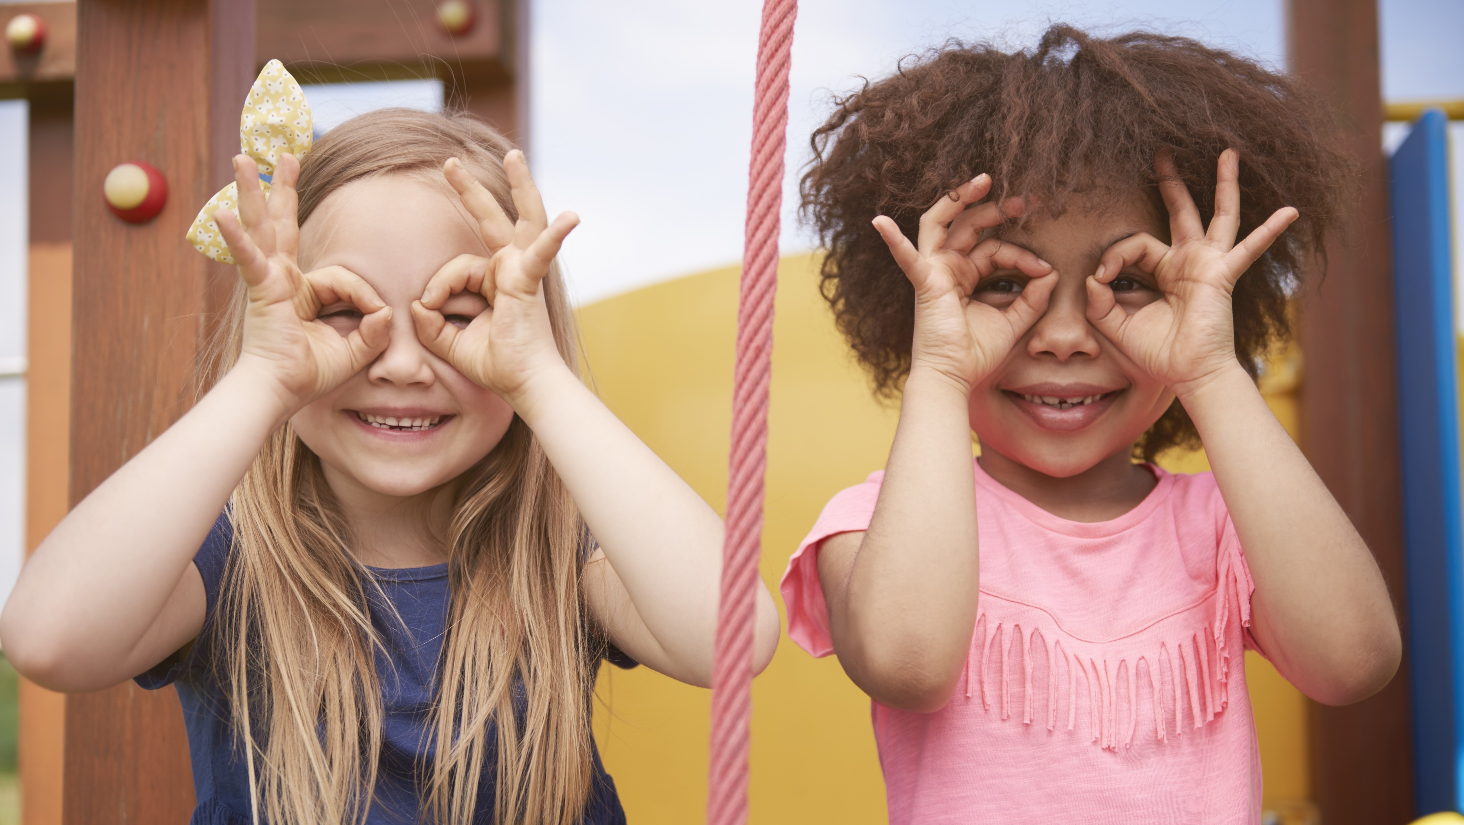
Enjoy your day!

