Slide 1
Simple Data Visualization MK Plan Infographics
Here is where this template begins

Slide 2
About simple data visualization MK plan infographics
This template contains an assortment of complementary infographic resources for the Simple Data Visualization MK Plan presentation
These infographics are adapted to the style of the aforementioned presentation, so you can insert them easily and have them completely integrated at once. You just need to do the following:
Select the element that you want to copy
Right-click and choose “Copy”
Go to the slide where you want the element to appear
Right-click and choose “Paste”

Slide 3
Simple data visualization MK plan
01
Objectives
Mercury is the smallest planet of them all
You can write a task here
You can write a task here
You can write a task here
02
Budget
Neptune is the farthest planet from the Sun
Write the budget here
Write the budget here
Write the budget here

Slide 4
Simple data visualization MK plan
STEP 1
STEP 2
20XX
20XX
20XX
20XX
20XX
20XX
Mercury is the closest planet to the Sun
Venus has a beautiful name, but it’s really hot
Despite being red, Mars is actually a cold planet
Saturn is a gas giant and has several rings

Slide 5
Simple data visualization MK plan
Mercury is the closest planet to the Sun
90%
Venus has a beautiful name, but it’s really hot
50%
Despite being red, Mars is actually a cold planet
75%

Slide 6
Simple data visualization MK plan
Brand value
Mercury is the smallest planet in the Solar System
Target audience
Despite being red, Mars is a very cold place
Key Metrics
Neptune is the farthest planet from the Sun

Slide 7
Simple data visualization MK plan
Objectives
Establish
Mercury is the smallest planet in the Solar System
Despite being red, Mars is actually a very cold place
01
02
03
04
Activities
Measure
Neptune is the farthest planet from the Sun
Jupiter is the biggest planet in the entire Solar System

Slide 8
Simple data visualization MK plan
85%
50%
8%
Mercury
Venus
Earth
Mercury is the closest planet to the Sun and the smallest of them all
Venus has a beautiful name and is the second planet from the Sun
Earth is the third planet from the Sun and the only that harbors life

Slide 9
Simple data visualization MK plan
S
W
Strengths
Weaknesses
Despite being red, Mars is a very cold place
Jupiter is the biggest planet of them all
Opportunities
Threats
Saturn is a gas giant and has several rings
Venus is the second planet from the Sun
O
T

Slide 10
Simple data visualization MK plan
Motivations
Interests
Mars
Despite being red, Mars is a very cold place
Saturn
Saturn is a gas giant and has several rings
32 years old
Female
United States
$1,500
Graphic designer
Venus
Venus is the second planet from the Sun
70%
80%
20%

Slide 11
Simple data visualization MK plan
Earth is the third planet from the Sun
01
Despite being red, Mars is a very cold place
Mercury is quite a small planet
Goals
Jupiter is the biggest planet of them all
02
Saturn is a gas giant and has several rings
Neptune is very far from the Sun

Slide 12
Simple data visualization MK plan
Product
Price
Mercury is the smallest planet in the Solar System
Despite being red, Mars is a very cold place
Promotion
Place
Neptune is the farthest planet from the Sun
Jupiter is the biggest planet in the Solar System

Slide 13
Simple data visualization MK plan
Partner 1 | Partner 2 | Partner 3 | Partner 4
Despite being red, Mars is a cold place | Saturn is a planet that has rings | Jupiter is an enormous planet | Neptune is very far from the Sun
20XX-20XX | 20XX-20XX | 20XX-20XX | 20XX-20XX
50K | 100K | 25K | 85K

Slide 14
Simple data visualization MK plan
Mercury
Mars
Neptune
Mercury is the smallest planet of them all
Despite being red, Mars is a very cold place
Neptune is the farthest planet from the Sun

Slide 15
Simple data visualization MK plan
Objectives
Analysis
Mercury is the closest planet to the Sun
Despite being red, Mars is a cold place
Channels
Competition
Venus is the second planet from the Sun
Jupiter the biggest planet of them all
Budget
Target
Neptune is the farthest planet from the Sun
Saturn is composed of hydrogen and helium

Slide 16
Simple data visualization MK plan
Mercury is the smallest planet of them all
Jupiter was named after a Roman god
Mars is actually a very cold place
Mercury
Venus is the second planet from the Sun
The Moon is Earth's only natural satellite
Ceres is located in the main asteroid belt
Jupiter
Uranus is the seventh planet from the Sun
Earth is the third planet from the Sun
Neptune is very far from the Sun
Uranus

Slide 17
Simple data visualization MK plan
 | Jan | Feb | Mar | Apr | May | Jul | Aug | Sep | Oct | Nov | Dec
Project 1
Project 2
Project 3
Project 4
Done
In progress
Scheduled

Slide 18
Simple data visualization MK plan
Objectives
Target
Budget
Mercury is the closest planet to the Sun and the smallest in the Solar System
Venus has a beautiful name and is the second planet from the Sun
Earth is the third planet from the Sun and the only one that harbors human life

Slide 19
Simple data visualization MK plan
Mercury
Mars
Neptune
Mercury is the closest planet to the Sun
Despite being red, Mars is a very cold place
Neptune is the farthest planet from the Sun

Slide 20
Simple data visualization MK plan
35%
60%
85%
Mercury
Venus
Mars
Mercury is the closest planet to the Sun and the smallest of them all
Venus has a beautiful name and is the second planet from the Sun
Despite being red, Mars is a cold place. It’s full of iron oxide dust

Slide 21
Simple data visualization MK plan
01
90%
Data 1
50%
02
40%
Data 2
75%
03
85%
Data 3
65%

Slide 22
Simple data visualization MK plan
 | Awareness | Consideration | Purchase | Retention
User 1
User 2
User 3
Positive experience
Negative experience

Slide 23
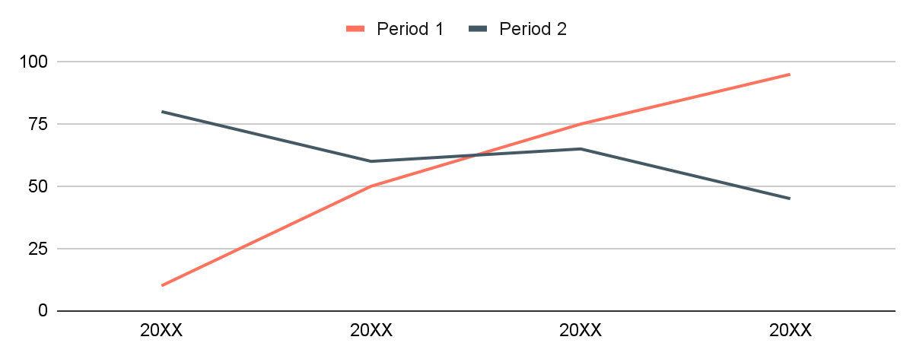
Simple data visualization MK plan
Budget
Channel:
Multimedia
85,000,000
Earth is a planet that harbors life
Goals
Mercury is the smallest planet of them all
Jupiter was named after a Roman god
Mars is actually a very cold place
Follow the link in the graph to modify its data and then paste the new one here. For more info, click here

Slide 24
Simple data visualization MK plan
Channels | Key messages | Goals
Mail | Despite being red, Mars is a very cold place
Print | Jupiter is the biggest planet in the Solar System
App | Venus is the second planet from the Sun

Slide 25
Simple data visualization MK plan
+Budget
A
D
C
-Reach
+Reach
B
-Budget

Slide 26
Simple data visualization MK plan
20%
80%
40%
60%
50%
50%
Mercury
Venus
Mars
Mercury is the closest planet to the Sun and the smallest of them all
Venus has a beautiful name and is the second planet from the Sun
Despite being red, Mars is a cold place. It’s full of iron oxide dust

Slide 27
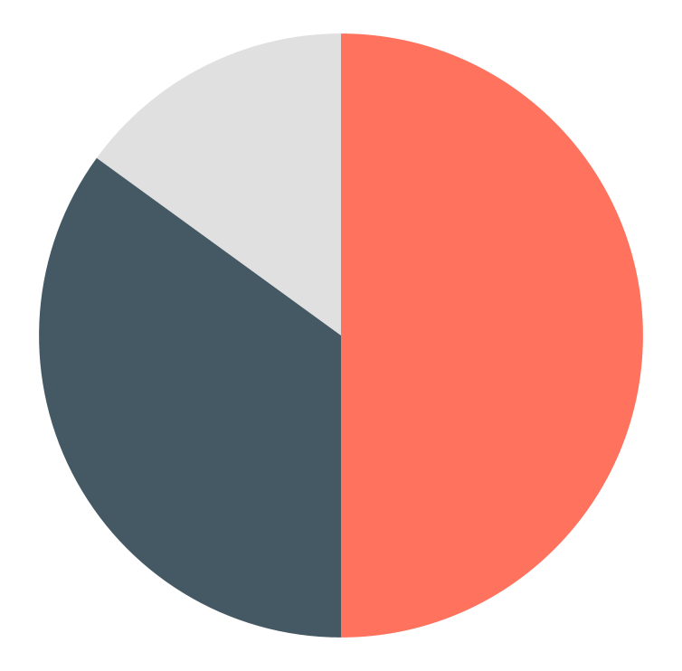
Simple data visualization MK plan
Budget
85,000,000
Earth is a planet that harbors life
Mercury
50%
Mars
35%
Jupiter
15%
Follow the link in the graph to modify its data and then paste the new one here. For more info, click here

Slide 28
Simple data visualization MK plan
Analysis
Target
Mercury is the smallest planet of them all
Despite being red, Mars is a very cold place
Marketing plan
Budget
Channels
Neptune is the farthest planet from the Sun
Jupiter is the biggest planet of them all

Slide 29
Simple data visualization MK plan
Data 1
Data 2
Data 3
Data 4
Describe the characteristics
Describe the characteristics
Describe the characteristics
Describe the characteristics
Describe the characteristics
Describe the characteristics
Describe the characteristics
Describe the characteristics
Describe the characteristics
Describe the characteristics
Describe the characteristics
Describe the characteristics

Slide 30
Simple data visualization MK plan
01
Mercury is the smallest planet in the Solar System
Venus
Venus has a beautiful name and is the second planet from the Sun. Venus is terribly hot, even hotter than Mercury, which is closer to the Sun. Its atmosphere is poisonous
02
Despite being red, Mars is a very cold place
03
Neptune is the farthest planet from the Sun

Slide 31
Simple data visualization MK plan
Determine your target audience
Set your marketing strategic objectives
Ground your roadmap in goals
Write your tasks
Write your tasks
Write your tasks
Write your tasks
Write your tasks
Write your tasks
Write your tasks
Write your tasks
Write your tasks
Write your tasks
Write your tasks
Write your tasks
STEP 1
STEP 2
STEP 3

Slide 32
Simple data visualization MK plan
Saturn
Jupiter
Venus
Earth
Mercury
Mars
Pluto

Slide 33
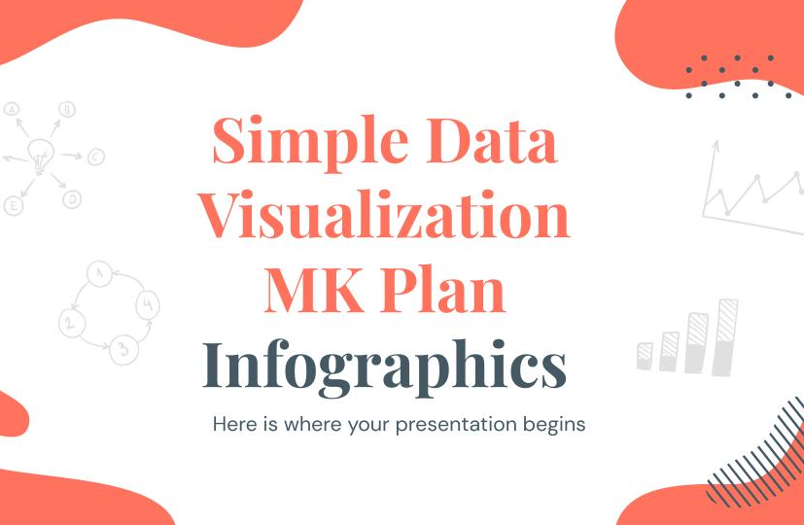
Simple data visualization MK plan
Jupiter is the biggest planet of them all
Venus has a nice name, but also high temperatures
Despite being red, Mars is actually a very cold place
Saturn is one of the planets with rings in the Solar System

Slide 34
Instructions for use (premium users)
As a Premium user, you can use this template without attributing Slidesgo.
You are allowed to:
Modify this template.
Use it for both personal and commercial purposes.
Share this template in an editable format with people who are not part of your team.
You are not allowed to:
Sublicense, sell or rent this Slidesgo Template (or a modified version of this Slidesgo Template).
Distribute this Slidesgo Template (or a modified version of this Slidesgo Template) or include it in a database or in any other product or service that offers downloadable images, icons or presentations that may be subject to distribution or resale.
Use any of the elements that are part of this Slidesgo Template in an isolated and separated way from this Template.
Register any of the elements that are part of this template as a trademark or logo, or register it as a work in an intellectual property registry or similar.
For more information about editing slides, please read our FAQs or visit our blog:
https://slidesgo.com/faqs and https://slidesgo.com/slidesgo-school

Slide 35
Infographics
You can add and edit some infographics to your presentation to present your data in a visual way.
Choose your favourite infographic and insert it in your presentation using Ctrl C + Ctrl V or Cmd C + Cmd V in Mac.
Select one of the parts and ungroup it by right-clicking and choosing “Ungroup”.
Change the color by clicking on the paint bucket.
Then resize the element by clicking and dragging one of the square-shaped points of its bounding box (the cursor should look like a double-headed arrow). Remember to hold Shift while dragging to keep the proportions.
Group the elements again by selecting them, right-clicking and choosing “Group”.
Repeat the steps above with the other parts and when you’re done editing, copy the end result and paste it into your presentation.
Remember to choose the “Keep source formatting” option so that it keeps the design. For more info, please visit our blog.

