Slide 1

Unit 2: Family
Lesson 3
Page 31

Slide 2
Lesson Outline
Warm-up
Listening
Consolidation
Wrap-up

Slide 3
Objectives
By the end of this lesson, students will be able to learn & use …
Vocabulary:
do your homework,
clean your room,
wake up,
go to bed
Structure:
Clean your room!
Imperative for giving command
Phonics:
/pl/ sound:
play,
please

Slide 4

WARM UP

Slide 5

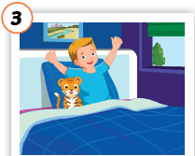
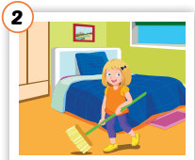
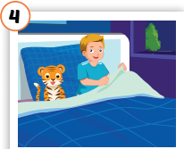
WARM UP
Look, match and say.
wake up
go to bed
____________________________
clean your room
______________________
do your homework
___________________________
______________________

Slide 6
WARM UP
Fill in the gaps.
room
homework
Wake
room
Go
1. Clean your _____!
Wake
2. _____up!
homework
3. Do your _________!
Go
4. ___ to bed!

Slide 7

It’s time to learn …

Slide 8
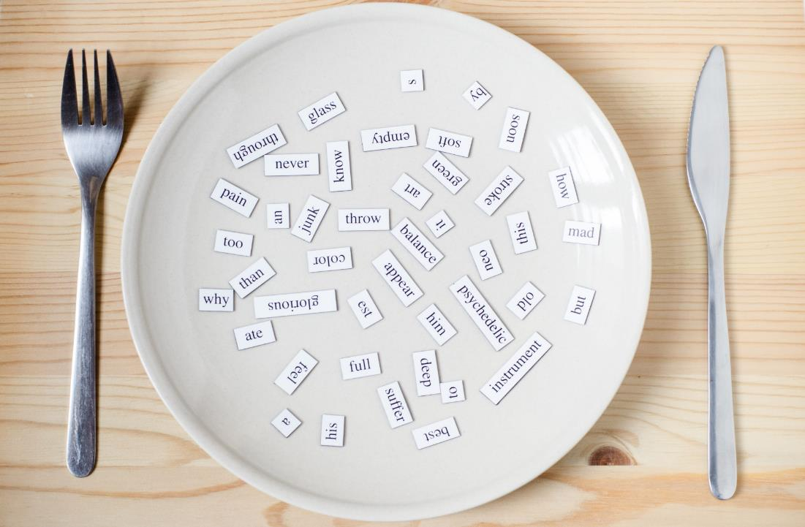
Phonics
/pl/ sound:
play,
please

Slide 9


C. Listen and repeat
play /pleɪ/
pl
Sound
please /pliːz/

Slide 10

C.2. Chant.
/pl/, /pl/, /pl/,
/pl/, /pl/, /pl/,
play, please,
/pl/, /pl/, /pl/.

Slide 11

Listening

Slide 12
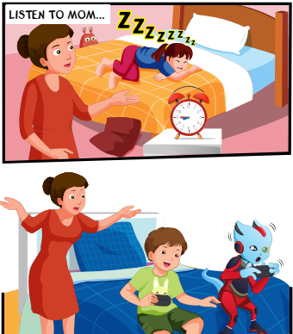
Pre-Listening
1. Who can you see?
Lucy
Mom/Mrs. Brown
Alfie
Tom
2. Does Mom look happy?
No

Slide 13
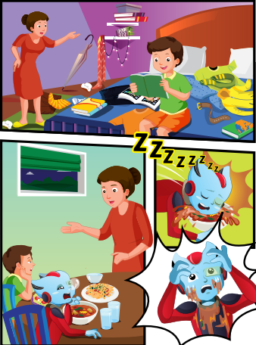
Pre-Listening
reading
3. What are the kids doing?
eating

Slide 14
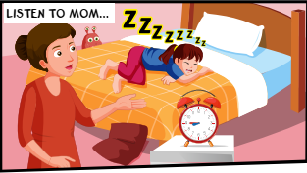


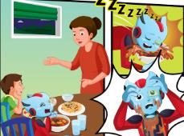
While Listening
D.1. Look and listen

Slide 15
Structures
Clean your room.
Wake up.
Do your homework.

Slide 16

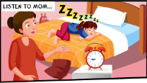

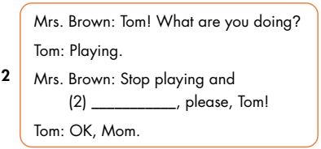


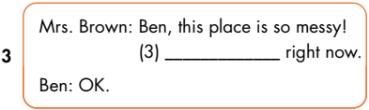
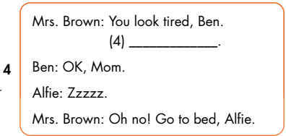
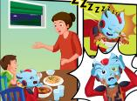
do your homework
clean your room
Go to bed

Slide 17

Which words?
Practice

Slide 18

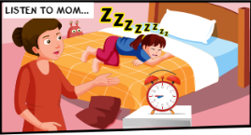


Practice: Which words are missing?
ucy, ake up
1
Mrs. Brown: L____w_____!
Mrs. Brown: Tom! Wh_____y___d____?
Tom: Pl_____
Mrs. Brown: ____playing_____do__
___________, please, ____!
Tom: ___, M______
at are ou oing
aying.
2
Stop and your
homework Tom
OK om.

Slide 19


Practice: Which words are missing?
Mrs. Brown: Ben,____ place____________
Clean _____________ now.
Ben: ____
this is so messy!
your room right
3
OK
You tired Go
Mrs. Brown: ___ look ____, Ben. ___to bed.
Ben: OK,_____
Alfie: _____
Mrs. Brown: ___ no! ______ bed, Alfie
Mom.
Zzzzz.
4
Oh Go to

Slide 20
Practice
Role-play

Slide 21
Practice: Role-plays
Mrs. Brown: ____________
1
Lucy, wake up!
Tom! What are you doing?
Mrs. Brown: ______________________
Tom: _______
Mrs. Brown: ______________________
______________________
Tom: _________
Playing.
2
Stop playing and do your homework, please, Tom!
OK, Mom.

Slide 22
Practice: Role-plays
Ben, this place is so messy! Clean your room right now.
Mrs. Brown: _______________________
_______________________
Ben: ____
3
OK
You look tired, Ben. Go to bed.
Mrs. Brown: __________________________
Ben: _________
Alfie: _____
Mrs. Brown: ____________________
OK, Mom.
Zzzzz.
4
Oh no! Go to bed, Alfie

Slide 23
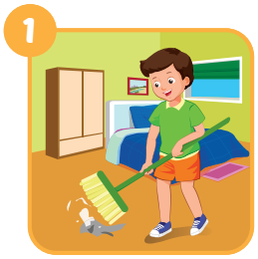


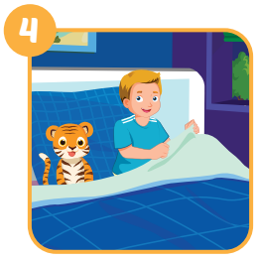
Extra Practice
Look and write.
Clean your room!
Wake up!
Do your homework!
Go to bed!
_______________________
_______________
___________________________
__________________

Slide 24

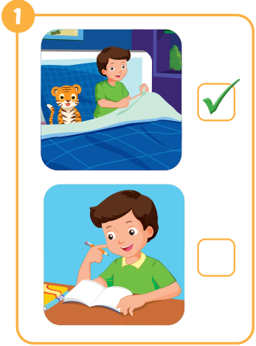
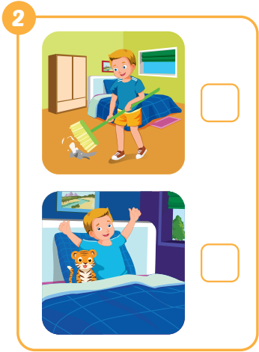
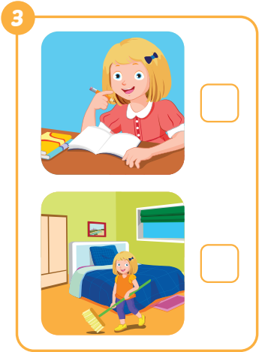

Extra Practice

Slide 25

CONSOLIDATION

Slide 26
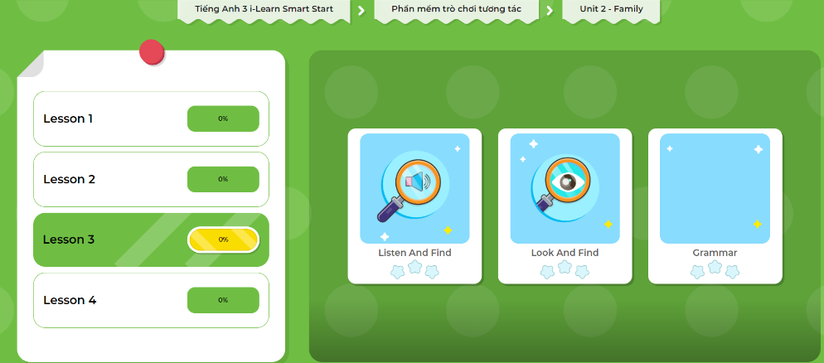
LET’S PLAY!
Click here to play the game.

Slide 27

WRAP-UP

Slide 28
Today’s lesson
Vocabularies
do your homework,
clean your room,
wake up,
go to bed
Structures/ Sentence patterns
Do your homework!
Clean your room!
Wake up!
Go to bed!

Slide 29
Lesson 3
Homework
Review the vocabularies, structures and make sentences using them.
Do the exercises on page 23 WB
Do the exercises in Tiếng Anh 3 i-Learn Smart Start Notebook on page 18.
Prepare the next lesson (page 32 SB)
Play the consolidation games in Tiếng Anh 3 i-Learn Smart Start DHA App on www.eduhome.com.vn

Slide 30

Enjoy your day!

