Slide 2
Unit 8
WILDLIFE CONSERVATION
LESSON 2
LANGUAGE

Slide 3
LESSON 2
LANGUAGE
WARM-UP
Say it out loud
PRONUNCIATION
Assimilation
Task 1: Match the words with their meanings.
Task 2: Complete the sentences
VOCABULARY
Task 1: Combine the sentences
Task 2: Make sentences
GRAMMAR
CONSOLIDATION
Wrap-up
Homework

Slide 4
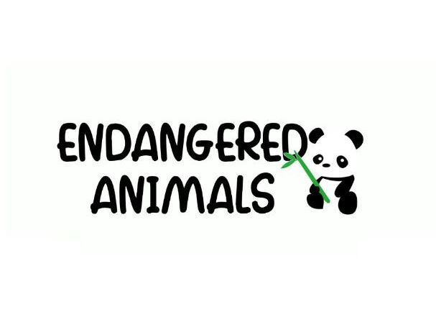
WARM-UP

Slide 5

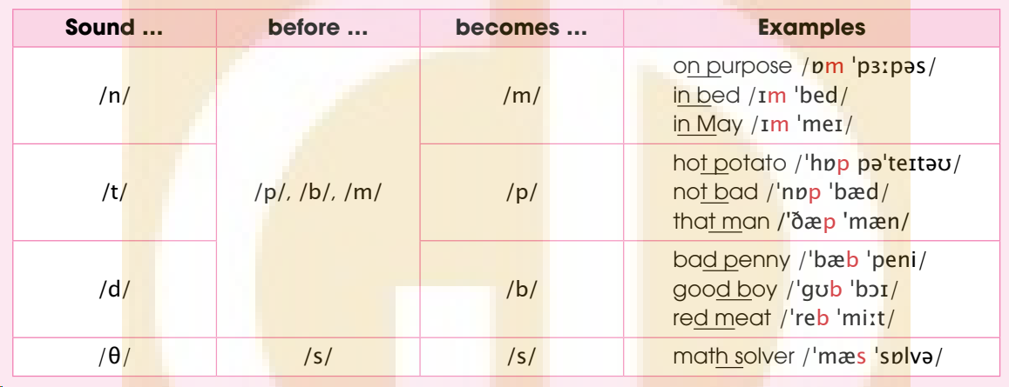
PRONUNCIATION
Listen and repeat. Pay attention to the highlighted sounds.
1

Slide 6
PRONUNCIATION
Listen and underline the parts where assimilation occurs. Then practice reading the sentences in pairs.
2
1. Apes are larger than monkeys.
2. If fed properly, the bear will recover soon.
3. Both species benefit from living together.
4. Ten per cent of the world’s population was infected by the virus.

Slide 7
PRONUNCIATION
Listen and underline the parts where assimilation occurs. Then practice reading the sentences in pairs.
2
1. Apes are larger than monkeys. /ˈðəm ˈmʌŋkiz/
2. If fed properly, the bear will recover soon. /ˈʃeb ˈprɑːpərli/
3. Both species benefit from living together. /ˈbəʊs ˈspiːʃiːz/
4. Ten per cent of the world’s population was infected by the virus.
/ˈtem pəˈsent/

Slide 8
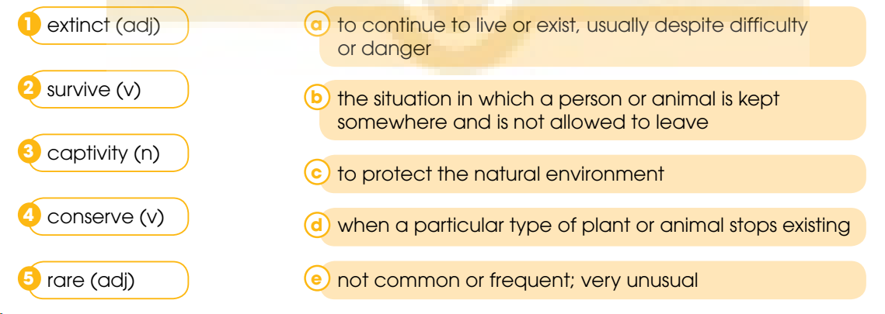
VOCABULARY
1
Match the words with their meanings.

Slide 9
VOCABULARY
2
Complete the sentences using the words in Task 1.
1. Wild animals need to live in their natural habitats in order to _________.
2. Many _________ animals are in urgent need of protection.
3. Scientists estimate that every day around 150 species become _________.
4. All the animals looked well after being released from _________.
5. A new law has been introduced to _________ wildlife in the area.
survive
rare
extinct
captivity
conserve

Slide 10
GRAMMAR
ADVERBIAL CLAUSES OF CONDITION AND COMPARISON
CONDITION | COMPARISON
- Subordinating conjunctions: if, provided that, unless. - Give the potential outcome of a situation or condition, real or imagined. | - Subordinating conjunctions: than, as … as, as. - Describe how something such as a skill, size, or amount compares to something else.

Slide 11
GRAMMAR
Combine the sentences using adverbial clauses of condition or comparison. Use the conjunctions in brackets and make any necessary changes.
1
1. You must release the sea turtle into the sea. Otherwise, it will die soon. (if)
-> ________________________________________________________
2. Raising people’s awareness is important to preserve wildlife. Imposing strict laws is also important. (as … as)
-> ___________________________________________________
3. We must stop poaching. Otherwise, many endangered species will become extinct. (unless)
-> __________________________________________________
4. A monkey is very intelligent. You may not think it is. (more … than)
->_________________________________________________________
If you don’t release the turtle into the sea, it will die soon.
Raising people’s awareness is as important as imposing strict laws to preserve wildlife.
Unless we stop poaching, many endangered species will become extinct.
A monkey is more intelligent than you may think.

Slide 12
GRAMMAR
2
Work in pairs. Make sentences about endangered animals using adverbial clauses of condition or comparison.

Slide 13
CONSOLIDATION
1
Wrap-up
What have you learnt today?
Assimiliation
Vocabulary about Wildlife conservation
Adverbial clauses of condition and comparison

Slide 14
CONSOLIDATION
2
Homework
Do exercises in the workbook.
Prepare for Lesson 3 – Reading.

Slide 15
Website: hoclieu.vn
Fanpage: facebook.com/www.tienganhglobalsuccess.vn

