Slide 1
Unit 8: Traditions of
Ethnic Groups in Vietnam
Lesson 2.2: Grammar
Pages 79 & 80

Slide 2
Lesson Outline
Warm-up
Grammar
Consolidation
Wrap-up

Slide 3
By the end of this lesson, students will be able to…
practice and use reported speech for questions correctly

Slide 4
WARM UP

Slide 5
Arrange the letters to make the words.
crno
corn
elubso
blouse
msateed
steamed
ytiksc irec
sticky rice
niuselt
utensil

Slide 6
Presentation

Slide 7
Grammar Meaning and Use
direct speech
indirect speech

Slide 8
Look at the pictures. What do you see in each picture?

Slide 9
a. Read about the reported speech for questions and fill in the blanks.

Slide 10
b. Listen and check your answers. Listen again and repeat.
asked her
she grew

Slide 11
Grammar Form and Practice

Slide 12
Practice

Slide 13
Task a
Read the instruction and the words quickly:
Pay attention on the change of tense
Read the notes and examples above, then circle the correct word

Slide 14
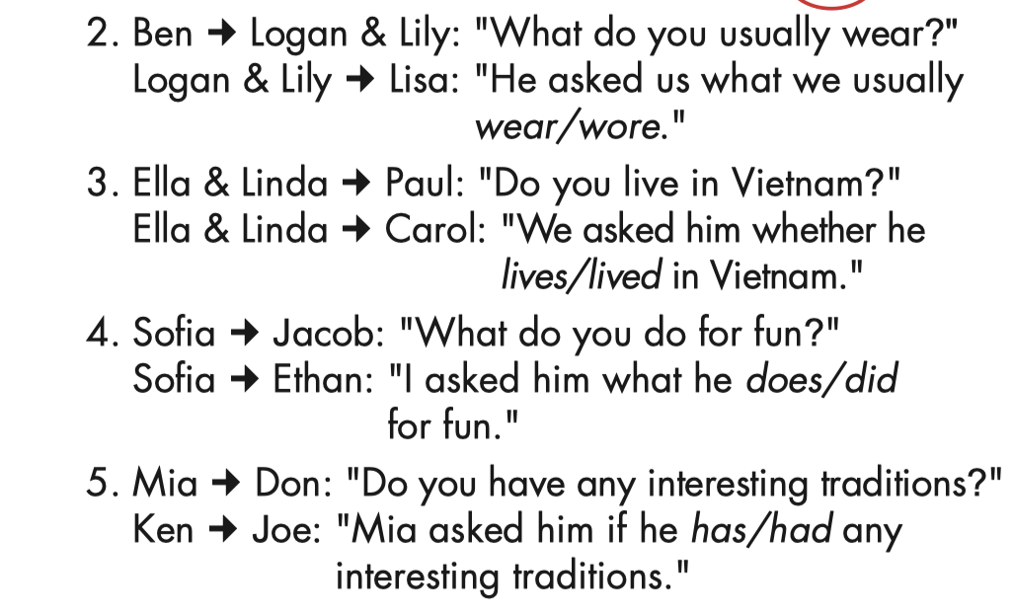
a. Read the notes and examples above, then circle the correct word.

Slide 15
Task b
Read the instruction and the words quickly:
Identify the Wh-question or Yes/No questions
Pay attention on the change of pronouns
Pay attention on the change of tense
b. Complete the sentences to report what these people asked.

Slide 16
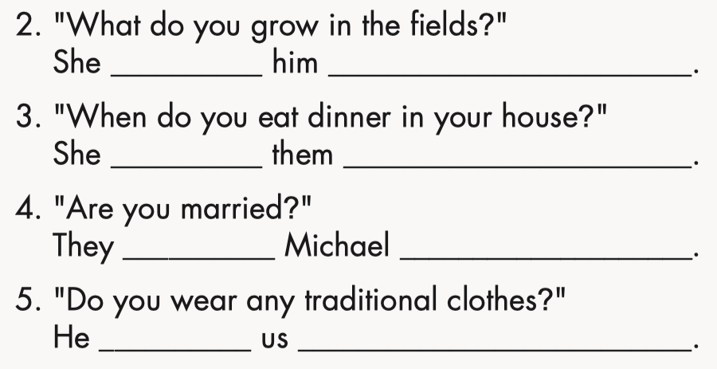
b. Complete the sentences to report what these people asked.
asked
what he grew on the fields
asked
when they ate dinner in their house
asked
if/whether he was married
asked
if/whether we wore any traditional clothes

Slide 17
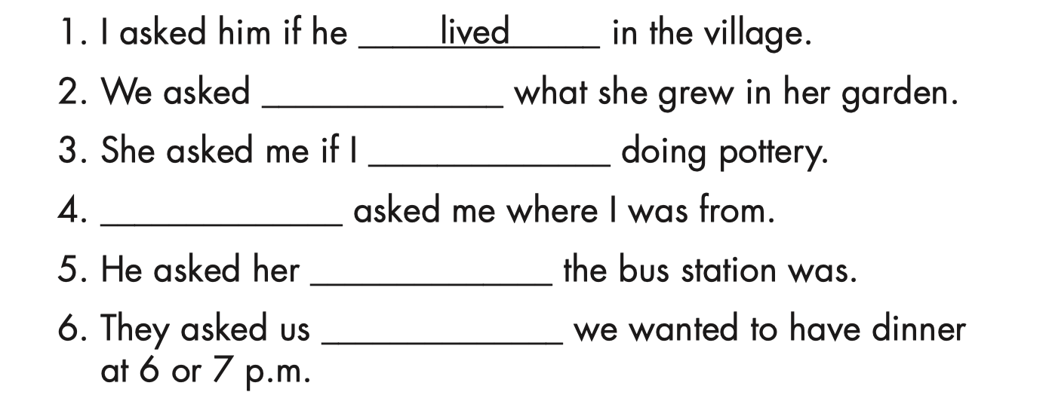
Workbook – Page 47
a. Fill in the blanks using the words in the box.
her
where
she
lived
if
liked
her
liked
She
where
if

Slide 18
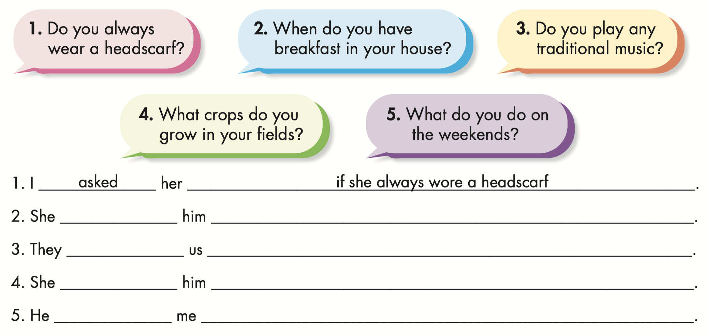
Workbook – Page 47
b. Complete the sentences to report what these people asked.
asked
when he had breakfast in his house
asked
if we played any traditional music
asked
what crops he gew on his fields
asked
what I did on the weekends

Slide 19
Production

Slide 20
Task c
Work in pairs
In fours: Take turns asking and answering questions in pairs from this page or using your own ideas. Then, report them to one of the other group members.
Who do you live with?
I live with my mom and dad.
I asked her who she lived with.
She said that she lived with her mom and dad.
And?

Slide 21
CONSOLIDATION

Slide 22
Match the numbers with the letters.
A. Speaker + asked + listener + Wh-question (in a past statement form)
1. We can use reported speech to say or …
B. yes/no questions, in stead of if in formal situations.
2. We can use whether when reporting ….
3. To report a Wh-question, we use
C. Speaker + asked + listener + if/whether* + Yes/No question (in a past statement form)
4. To report a Yes/No question, we use
D. repeat questions that someone asked before the time of speaking.

Slide 23
WRAP-UP

Slide 24
Today’s lesson
Grammar
Reported speech for questions
+ Wh-question
+ Yes/No question
Speaking
Ask and answer questions using reported speech for questions.

Slide 25
Homework
Learn by hearts the grammar points and make sentences using them. .
Do the exercises in Tiếng Anh 8 i-Learn Smart World Notebook on page 67.
Prepare the next lesson (pages 80 & 81 SB).
Play the consolidation games on www.eduhome.com.vn

Slide 26
Lesson 3
Stay positive and have a nice day!

