Slide 1
50/50
Which continent is Vietnam?
1
A
Asia
America
Europe
Africa

Slide 2
50/50
In the following animals, which one is domesticated?
2
Goat
C
Cat
horse
deer

Slide 3
50/50
Where is not a flower?
3
rose
Sun flower
eardrop
Sakura flower
B

Slide 4
50/50
Cell phones are too big, people are often like what?
4
lumber
rock
coals
D
brick

Slide 5
50/50
What is the traditional Chinese sausage stuff??
5
goat meat
beef
pork
Buffalo meat
B

Slide 6
50/50
April in English is the month?
6
4
6
A
5
7

Slide 7
50/50
The main method used to create hybrid superiority is?
7
hybrid improvement
C
another hybrid
hybrid of other species
another hybrid

Slide 8
50/50
There are several levels of preschool education?
8
3
5
A
4
6

Slide 9
50/50
Which of the following myths belonged to the Au Lac period??
9
Son Tinh- Thuy Tinh
Au Co
Thanh Giong
D
An Duong Vuong

Slide 10
Crazy in the space: "Eat the dinner, ... plow"?
10
again
butter
worry
please
B

Slide 11
What poetical poem is the poet's water?
11
Dolphin
C
blue whale
elephant
shark

Slide 12
In the following animals, which do not move by foot??
12
dog
mouse
cat
D
snake

Slide 13
In the following animals, which one is considered the heaven?
13
frog
bird
toad
bear
B

Slide 14
Doraemon is a smart cat, is that ...?
14
A
a wooden cat
a real cat
a plastic cat
D
a robot cat

Slide 15
Does the word "chao" in Vietnamese mean?
15
A
hello
sorry
Good bye
thank you

Slide 16
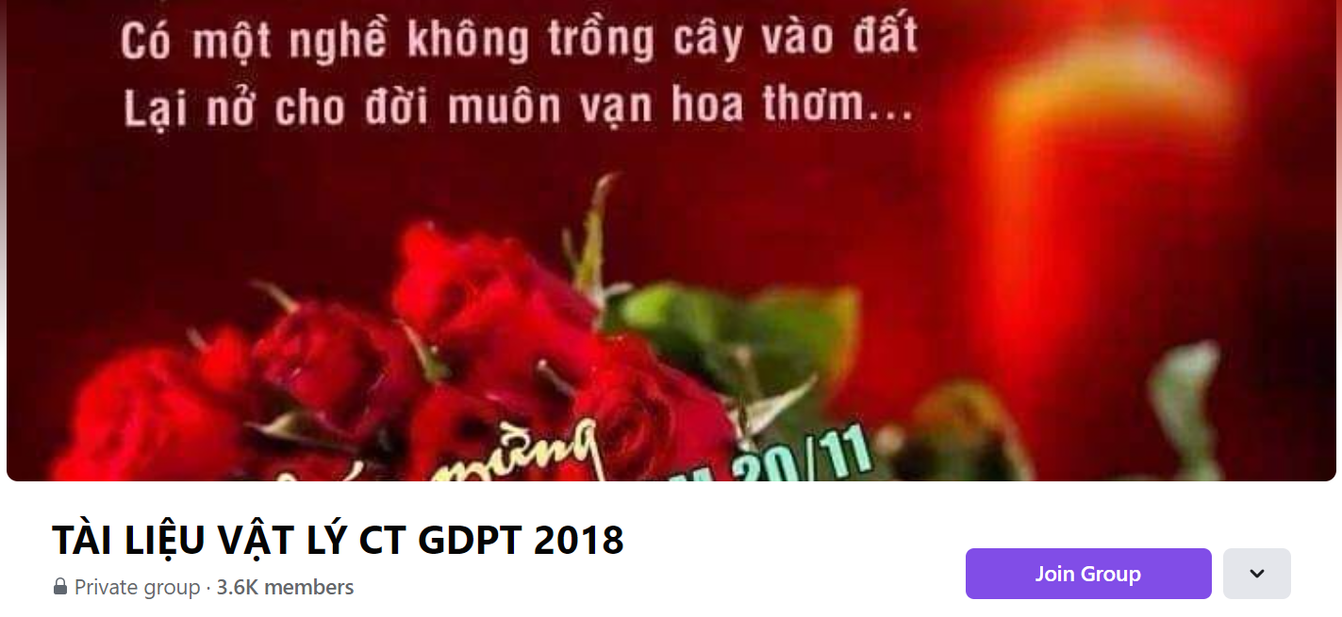
SƯU TẦM: ĐOÀN VĂN DOANH, NAM TRỰC, NAM ĐỊNH
LINK NHÓM DÀNH CHO GV BỘ MÔN VẬT LÝ TRAO ĐỔI TÀI LIỆU VÀ CHUYÊN MÔN CT 2018
https://www.facebook.com/groups/299257004355186

