Slide 1
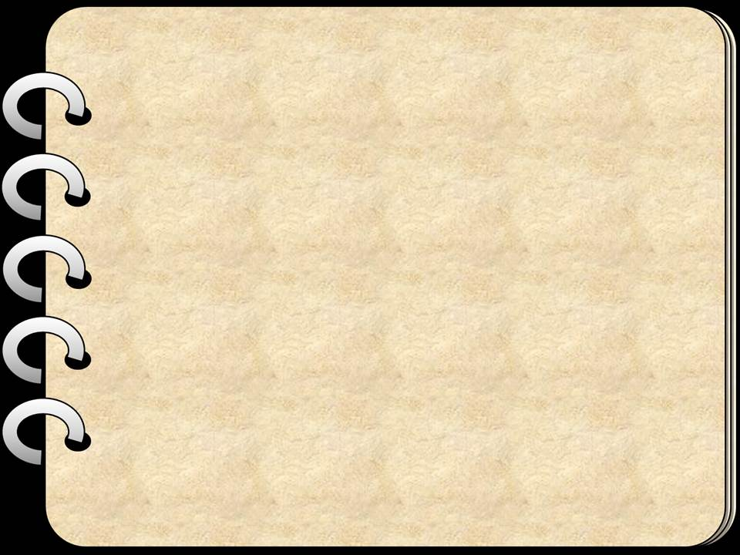







START

Slide 2

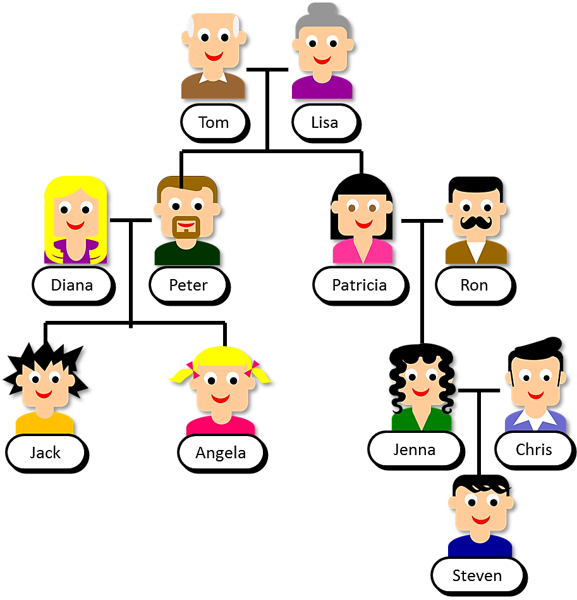


Look at Steven’s family tree and click on the right name
1/15
Tom
Lisa
Diana
Peter
Patricia
Ron
Jack
Angela
Jenna
Chris
He/She is Peter’s father
NEXT
Steven

Slide 3

Click on the right name
2/15
Tom
Lisa
Diana
Peter
Patricia
Ron
Jack
Angela
Jenna
Chris
He/She is Jack’s aunt
NEXT
Steven

Slide 4

Click on the right name
3/15
Tom
Lisa
Diana
Peter
Patricia
Ron
Jack
Angela
Jenna
Chris
He/She is Patricia’s niece
NEXT
Steven

Slide 5

Click on the right name
4/15
Tom
Lisa
Diana
Peter
Patricia
Ron
Jack
Angela
Jenna
Chris
He/She is Jack’s grandmother
NEXT
Steven

Slide 6
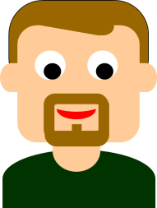
Click on the right name
5/15
Tom
Lisa
Diana
Peter
Patricia
Ron
Jack
Angela
Jenna
Chris
He/She is Patricia’s brother
NEXT
Steven

Slide 7

Click on the right name
6/15
Tom
Lisa
Diana
Peter
Patricia
Ron
Jack
Angela
Jenna
Chris
He/She is Patricia’s nephew
NEXT
Steven

Slide 8

Click on the right name
7/15
Tom
Lisa
Diana
Peter
Patricia
Ron
Jack
Angela
Jenna
Chris
He/She is Jack’s sister
NEXT
Steven

Slide 9

Click on the right name
8/15
Tom
Lisa
Diana
Peter
Patricia
Ron
Jack
Angela
Jenna
Chris
He/She is Steven’s mother
NEXT
Steven

Slide 10

Click on the right name
9/15
Tom
Lisa
Diana
Peter
Patricia
Ron
Jack
Angela
Jenna
Chris
He/She is Jenna’s uncle
NEXT
Steven

Slide 11

Click on the right name
10/15
Tom
Lisa
Diana
Peter
Patricia
Ron
Jack
Angela
Jenna
Chris
He/She is Jenna’s husband
NEXT
Steven

Slide 12

Click on the right name
11/15
Tom
Lisa
Diana
Peter
Patricia
Ron
Jack
Angela
Jenna
Chris
He/She is Peter’s wife
NEXT
Steven

Slide 13

Click on the right name
12/15
Tom
Lisa
Diana
Peter
Patricia
Ron
Jack
Angela
Jenna
Chris
He/She is Tom’s son
NEXT
Steven

Slide 14

Click on the right name
13/15
Tom
Lisa
Diana
Peter
Patricia
Ron
Jack
Angela
Jenna
Chris
He/She is Lisa’s daughter
NEXT
Steven

Slide 15

Click on the right name
14/15
Tom
Lisa
Diana
Peter
Patricia
Ron
Jack
Angela
Jenna
Chris
He/She is Jenna’s cousin
NEXT
Steven

Slide 16

Click on the right name
15/15
Tom
Lisa
Diana
Peter
Patricia
Ron
Jack
Angela
Jenna
Chris
He/She is Jack’s grandfather
Steven
EXIT

Slide 17
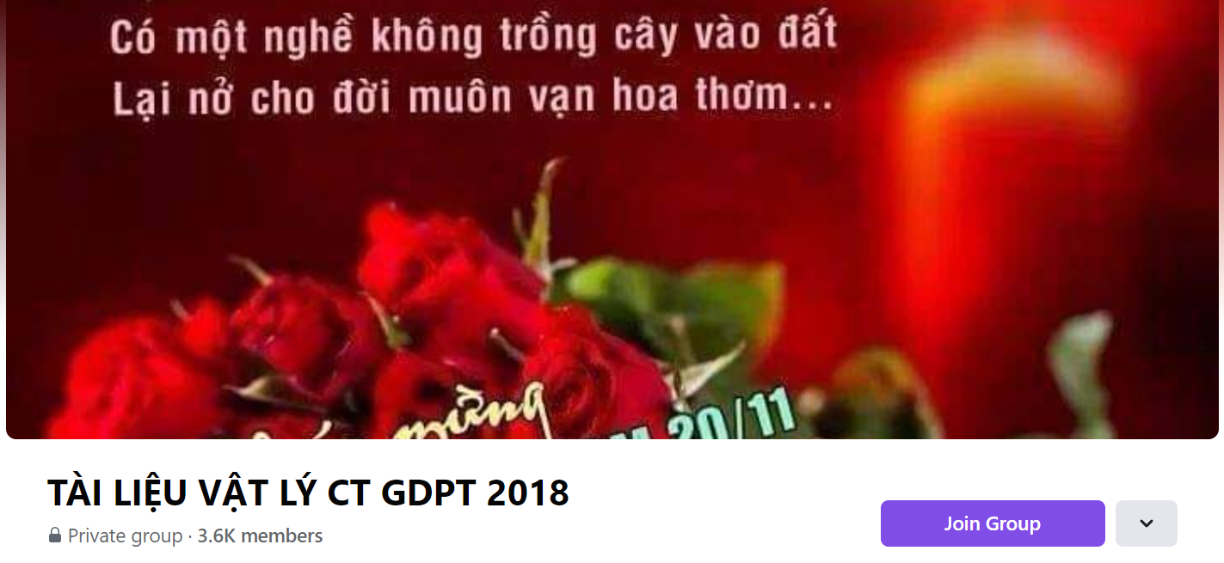
SƯU TẦM: ĐOÀN VĂN DOANH, NAM TRỰC, NAM ĐỊNH
LINK NHÓM DÀNH CHO GV BỘ MÔN VẬT LÝ TRAO ĐỔI TÀI LIỆU VÀ CHUYÊN MÔN CT 2018
https://www.facebook.com/groups/299257004355186

