Slide 1


Slide 2
GLOBAL WARMING
A presentation about global warming
Unit
5
Unit
FAMILY LIFE
LESSON I
GETTING STARTED
Student Book – page 52

Slide 3
LESSON I
GETTING STARTED
WARM-UP
Earth quiz
Vocabulary
PRESENTATION
- Task 1: Listen and read.
- Task 2: Complete the diagram.
- Task 3: Match the words to make phrases.
- Task 4: Complete the sentences.
PRACTICE
PRODUCTION
Discussion
- Wrap-up
- Homework
CONSOLIDATION

Slide 4
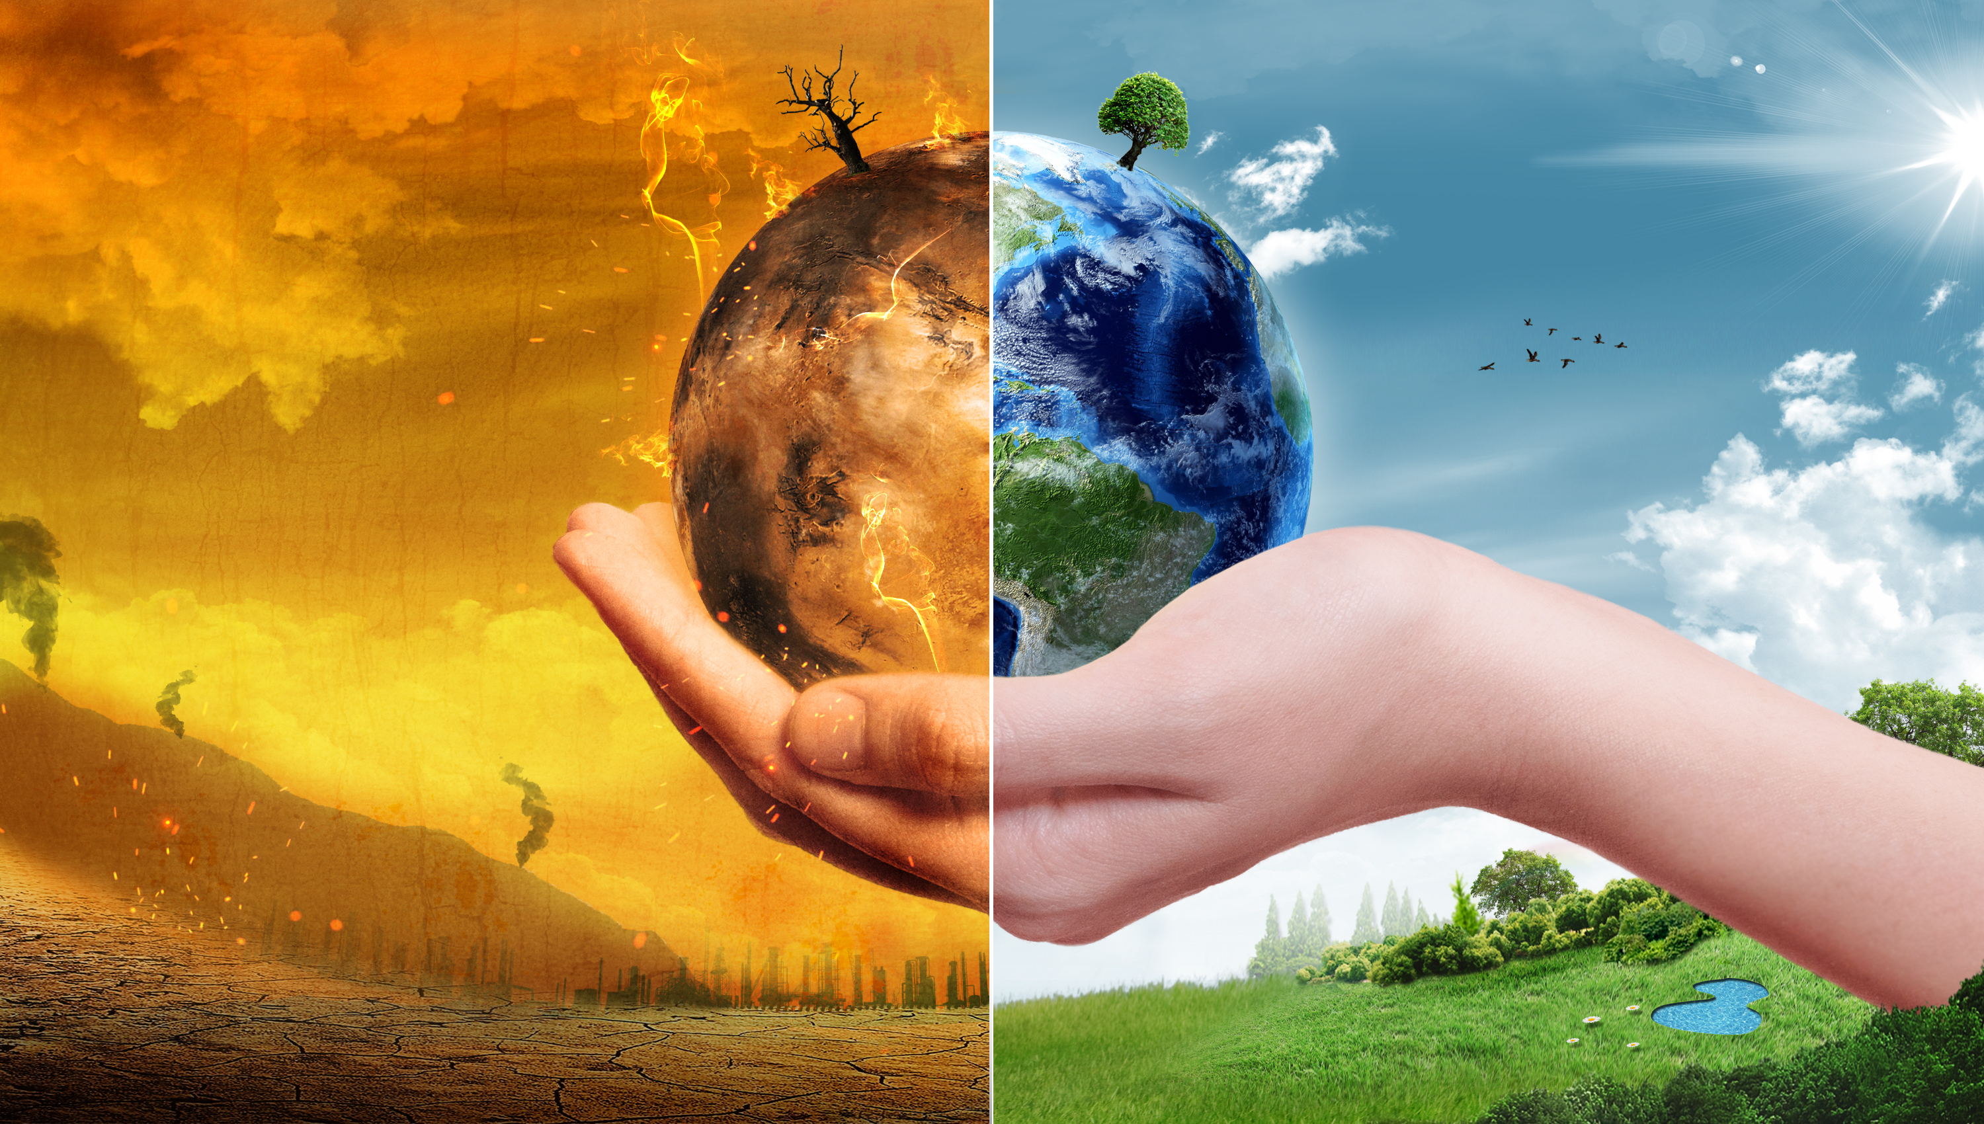
WARM-UP
What do you know
about global warming?

Slide 5
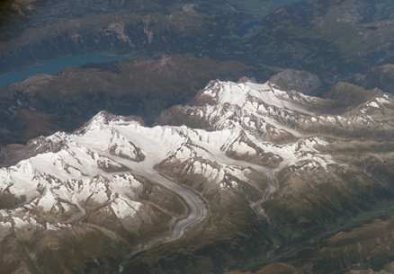
WARM-UP
Tick the correct answers.
1. Most places on Earth are warmer than they were 100 years ago.
True
False

Slide 6
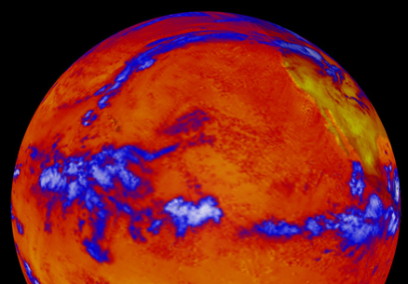
WARM-UP
Tick the correct answers.
2. Where have some of the strongest and earliest impacts of global warming occurred?
In the tropics
In the Northern latitudes
Impacts of global warming are distributed equally all over the planet.

Slide 7
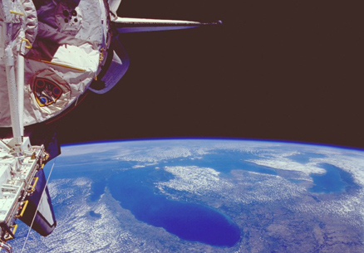
WARM-UP
Tick the correct answers.
3. How do scientists collect evidence about climate?
Using remote sensing from space with satellites
By ground-based measurements of surface temperature, carbon dioxide concentration and sea level
By collecting "proxy data" from tree rings, ice cores and historical records
All of the above

Slide 8
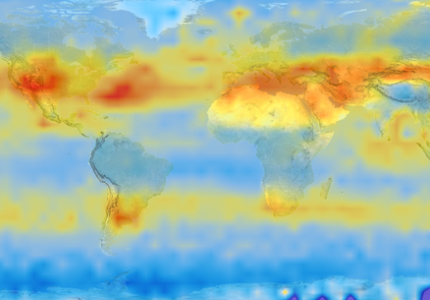
WARM-UP
Tick the correct answers.
4. Which of the following gases does not trap heat?
Carbon dioxide
Nitrogen
Water vapor
Methane

Slide 9
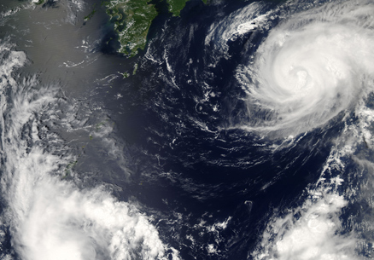
WARM-UP
Tick the correct answers.
5. As average global temperature rises, ___.
average rainfall increases
average rainfall decreases
average rainfall is unchanged

Slide 10
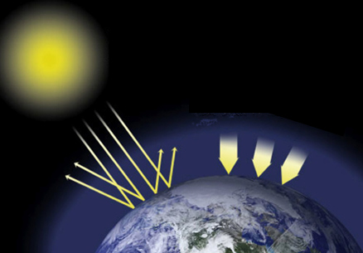
WARM-UP
Tick the correct answers.
6. Which greenhouse gas is the main driver of Earth’s current warming?
Carbon dioxide
Nitrous oxide
Water vapour
Methane

Slide 11
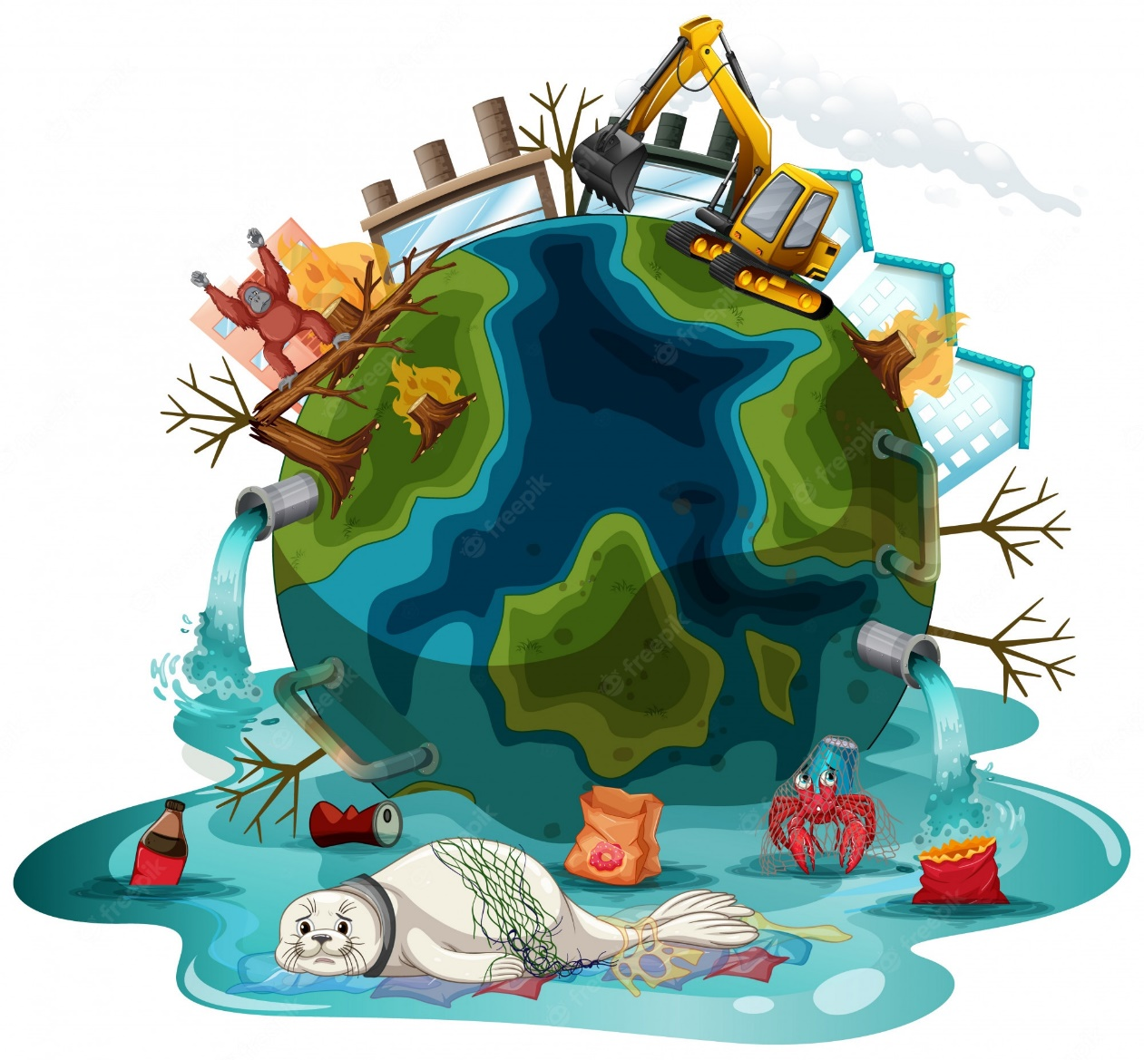

PRESENTATION
global warming (n)
/ˌɡləʊbəl ˈwɔːmɪŋ/
a gradual increase in world temperatures

Slide 12
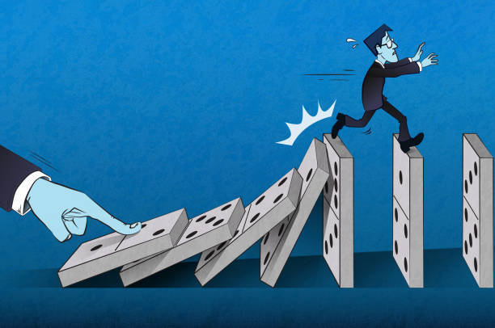
PRESENTATION
consequence (n)
/ˈkɒnsɪkwəns/
a result of a particular action or situation, often one that is bad or not convenient

Slide 13
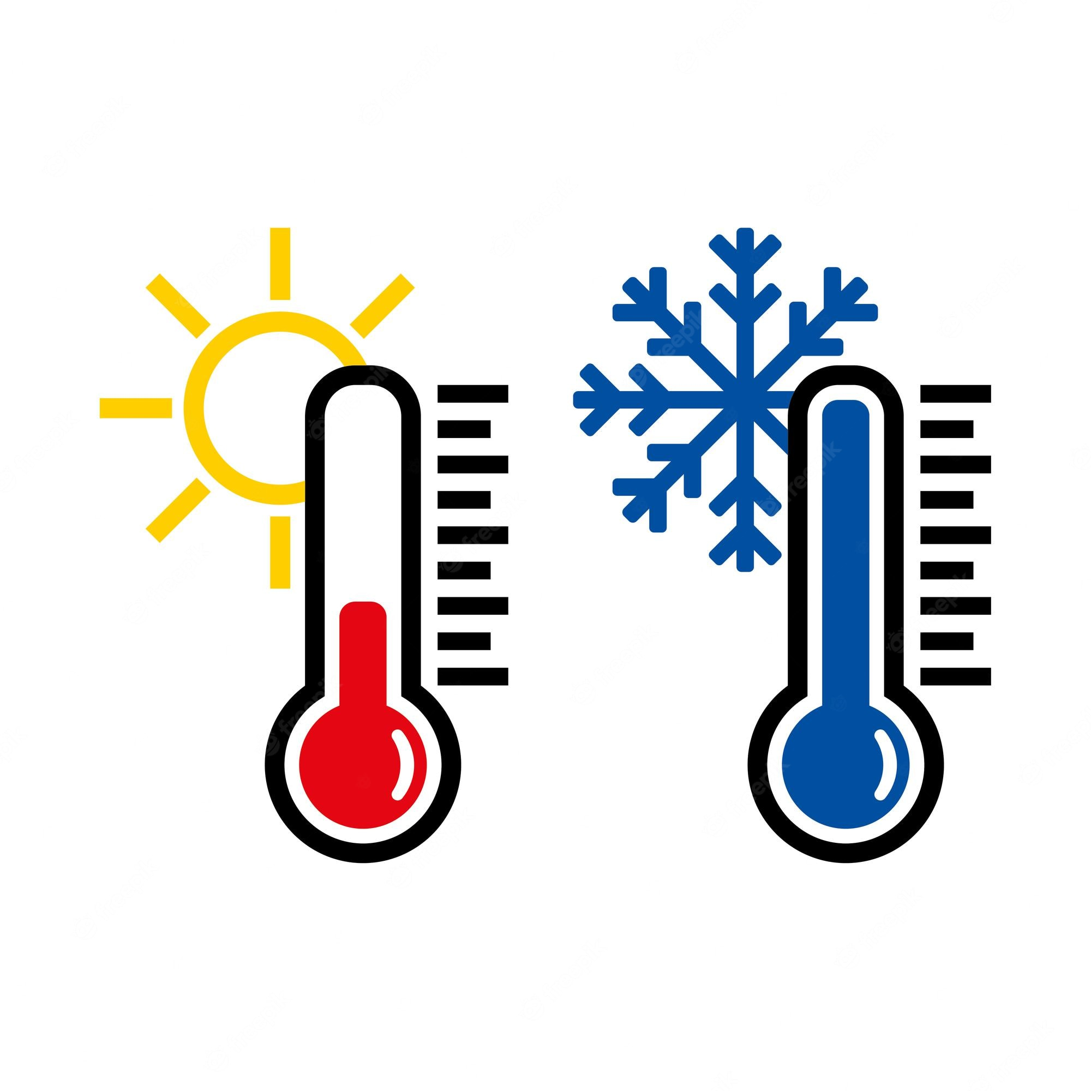
PRESENTATION
temperature (n)
/ˈtemprətʃər/
the measured amount of heat in a place or in the body

Slide 14
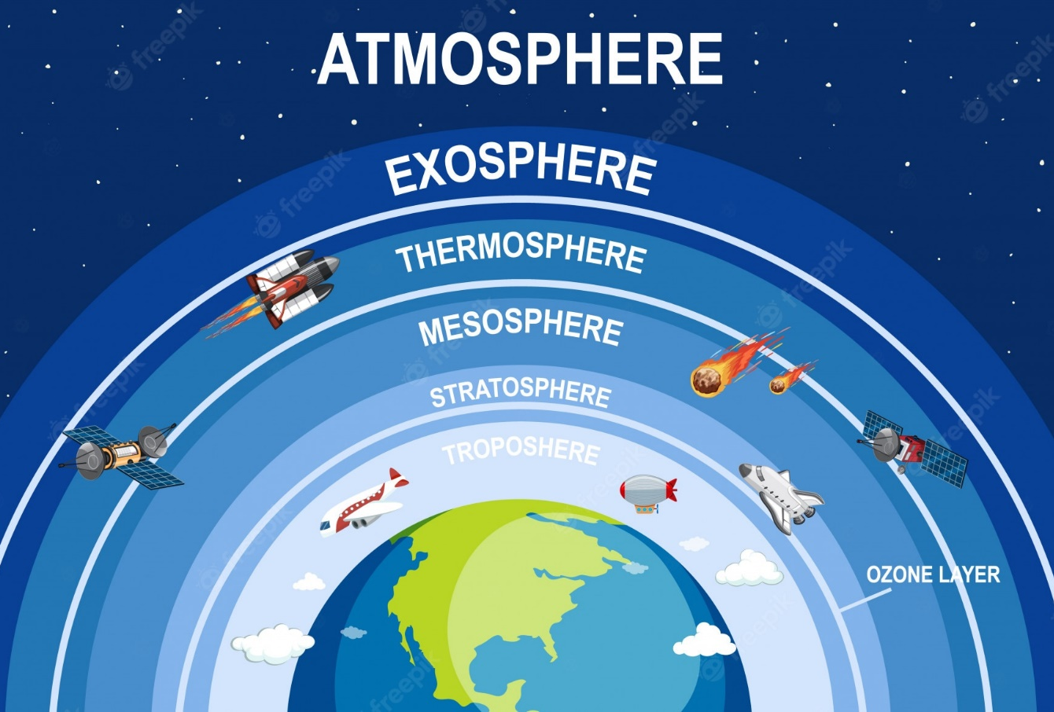
PRESENTATION
atmosphere (n)
/ˈætməsfɪər/
the mixture of gases around the earth

Slide 15
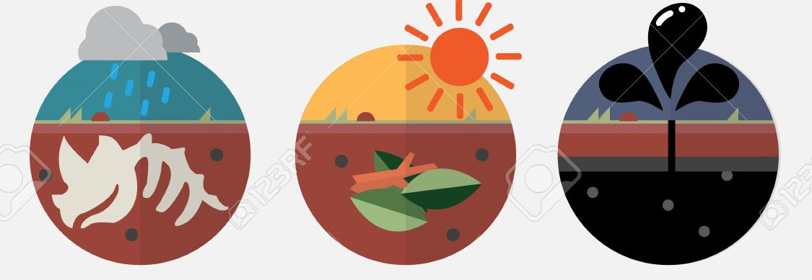
PRESENTATION
fossil fuel (n)
/ˈfɒsəl ˌfjuəl/
fuel, such as gas, coal, and oil, that were formed underground from plant and animal remains millions of years ago

Slide 16
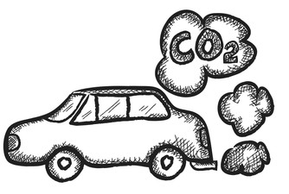
PRESENTATION
carbon dioxide (n)
/ˌkɑːbən daɪˈɒksaɪd/
the gas formed when carbon is burned, or when people or animals breathe out

Slide 17
Form | Pronunciation | Meaning
1. global warming (n) | /ˌɡləʊbəl ˈwɔːmɪŋ/ | a gradual increase in world temperatures
2. consequence (n) | /ˈkɒnsɪkwəns/ | a result of a particular action or situation, often one that is bad or not convenient
3. temperature (n) | /ˈtemprətʃər/ | the measured amount of heat in a place or in the body
4. atmosphere (n) | /ˈætməsfɪər/ | the mixture of gases around the earth
5. fossil fuel (n) | /ˈfɒsəl ˌfjuəl/ | fuel, such as gas, coal, and oil, that were formed underground from plant and animal remains millions of years ago
6. carbon dioxide (n) | /ˌkɑːbən daɪˈɒksaɪd/ | the gas formed when carbon is burned, or when people or animals breathe out

Slide 18
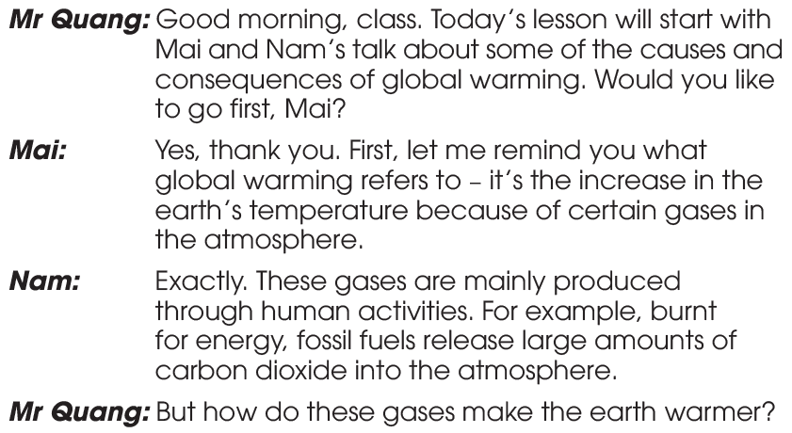
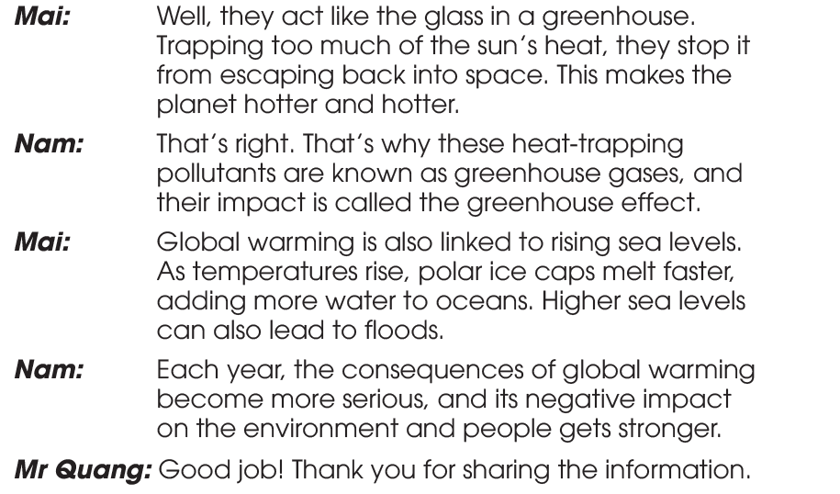
PRACTICE
1
Listen and read.

Slide 19
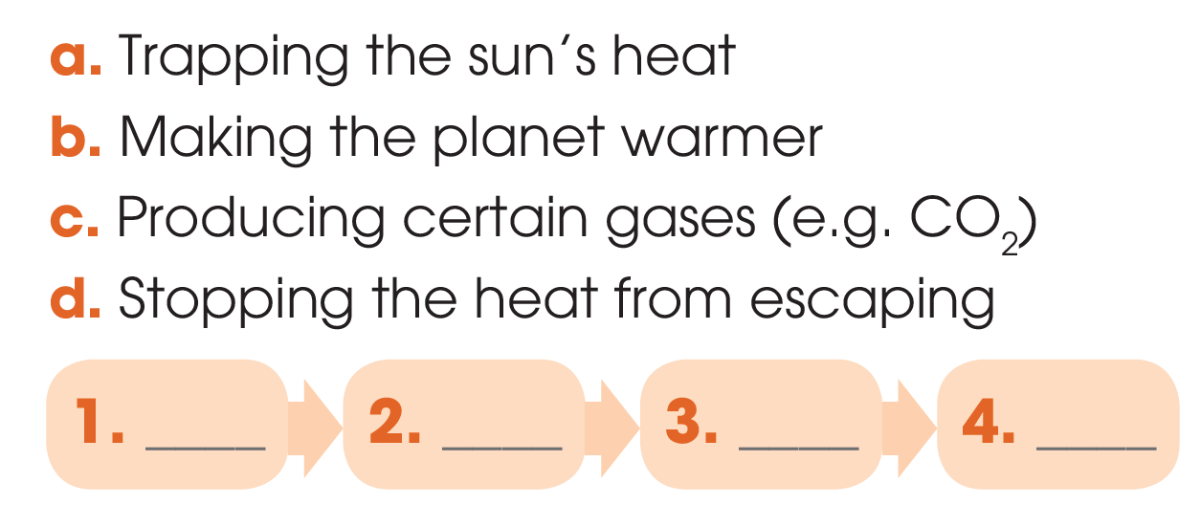

PRACTICE
2
Read the conversation again and complete the diagram, using the following phrases.
c
a
d
b

Slide 20
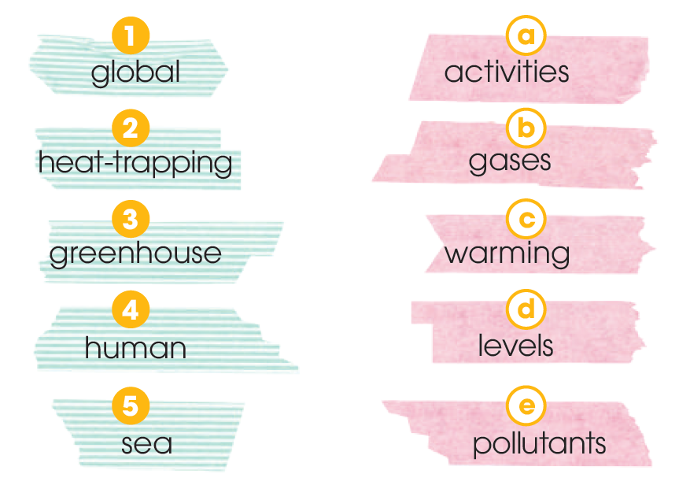
PRACTICE
3
Match the words to make phrases used in 1.

Slide 21
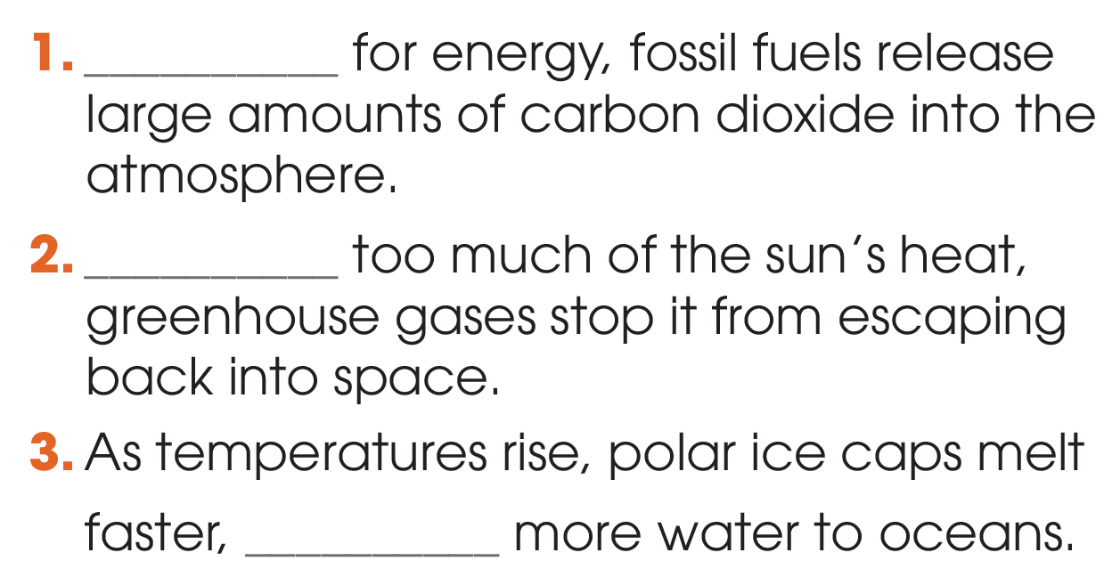
PRACTICE
4
Complete the sentences with the correct verb forms from 1.
Burnt
Trapping
adding

Slide 22
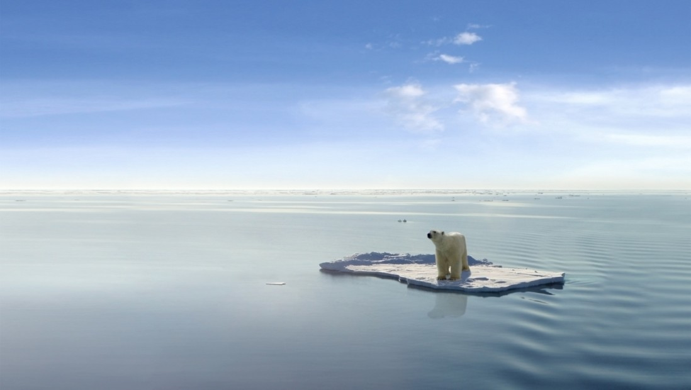
PRODUCTION
Discussion:
What is one effect of global warming that you have personally experienced?(You can tell more if possible.)

Slide 23
CONSOLIDATION
1
Wrap-up
What have you learnt today?
Understand and use words and phrases related to global warming
New vocabulary about global warming

Slide 24

CONSOLIDATION
2
Homework
Do exercises in the workbook.
Prepare for Lesson 2 - Unit 5.
Prepare materials for the project in lesson 8

Slide 25

Website: hoclieu.vn
Fanpage: facebook.com/tienganhglobalsuccess.vn/

