Slide 1

Unit 2: Every Day
Lesson 2f: Skills (Cont.)
Page 47

Slide 2
Lesson Outline
Warm-up
Vocabulary
Speaking
Listening
Writing
Consolidation
Wrap-up

Slide 3
Objectives
By the end of this lesson, students will be able to…
learn some more free time activities.
ask and answer Wh-questions.
listen and take notes.
write an email about their daily routine.

Slide 4

WARM-UP

Slide 5
PAIRWORK
List as many free time activities as possible.
go bowling
watch a movie
listen to music
play football
do puzzles
chat online
go shopping
hang out with friends
play video games
go to the theatre

Slide 6

It’s time to learn …

Slide 7

Vocabulary

Slide 8
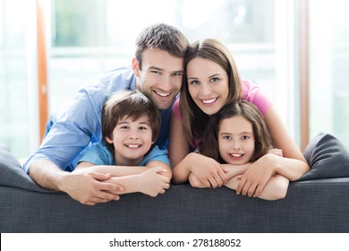
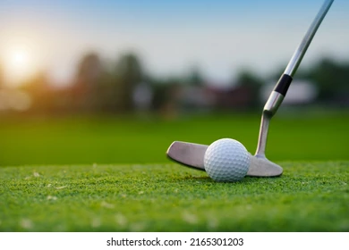
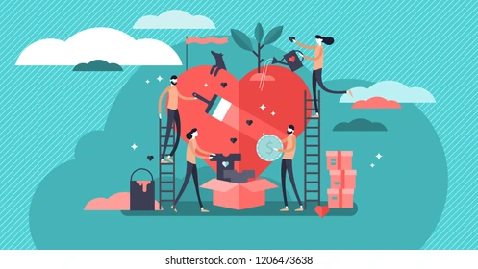
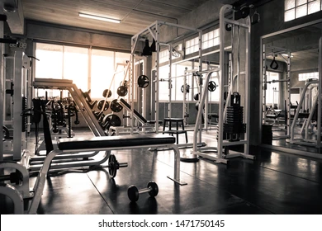
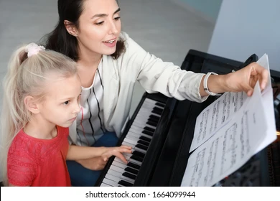
Label these pictures with the following words: golf, gym, charity, piano lesson, family.
family
golf
charity
gym
piano lesson

Slide 9
Free-time activities
4. Complete the sentences with goes, have, plays, helps or spend.
1 My dad _______ golf on Sundays.
2 Robin _________ to the gym in the afternoon.
3 At the weekend, I _______ time with my family and friends.
4 My mum ________ a charity for children at weekends.
5 I _________ piano lessons every Saturday.
plays
goes
spend
helps
have

Slide 10

Speaking

Slide 11
Question words
possession
people
specific information
age
place
time
manner
choice between two alternatives
Whose ball is this? Mark’s.
Who is he? He’s my best friend.
What is his surname? Harris.
How old is he? 12.
Where does he come from? New York.
When is his birthday? 2nd August.
How does he go to school? By bus.
Which school does he go to, Aston or Brigges?
Aston.

Slide 12
Note: We use falling intonation in Wh- questions.
e.g. What’s his favourite sport?

Slide 13
5 In pairs, ask and answer questions based on the reading text. Use question words.
A: When is his birthday?
B: 16th July. What time does he get up in the morning?
A: 7:00 a.m. Where does he go after he wakes up?
B: He goes to the gym. etc.

Slide 14

Listening

Slide 15
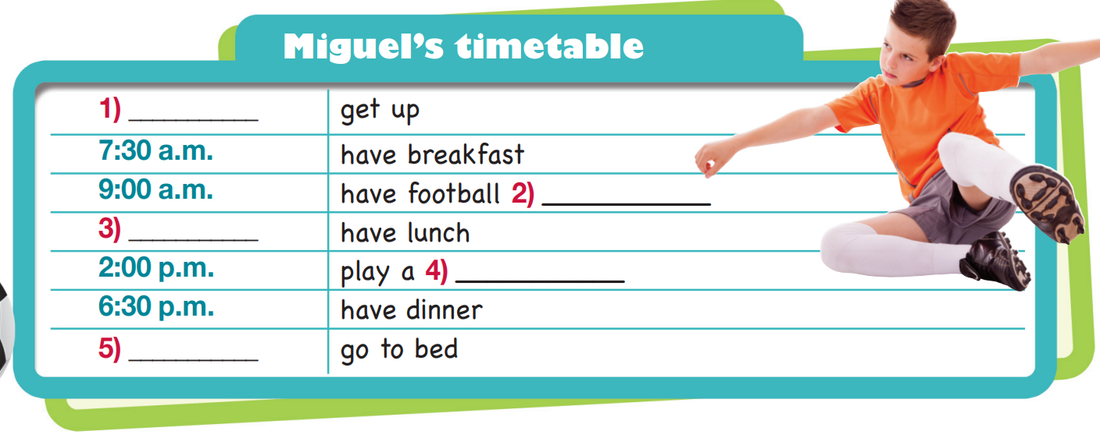
Look at Miguel’s timetable. Guess the missing information in the gaps.
time
noun
time
noun
time

Slide 16

6. Listen and complete Miguel’s timetable.
7:00 a.m.
practice
12:30 p.m.
match
9:30 p.m.

Slide 17
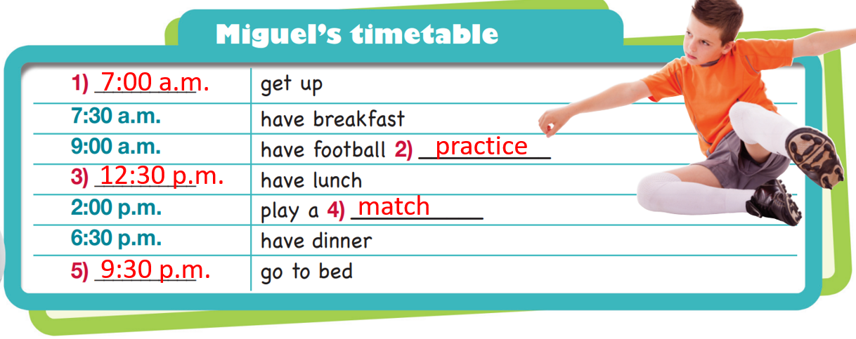
PAIRWORK
Ask and answer about Miguel’s timetable.
What time does Miguel get up?
He gets up at 7 a.m.

Slide 18

Writing

Slide 19
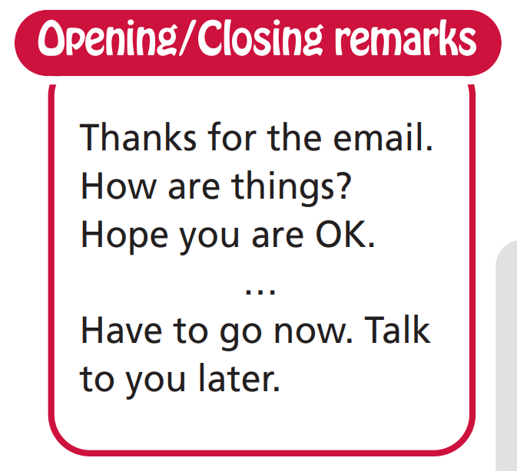
Writing (an email about your daily routine)

Slide 20
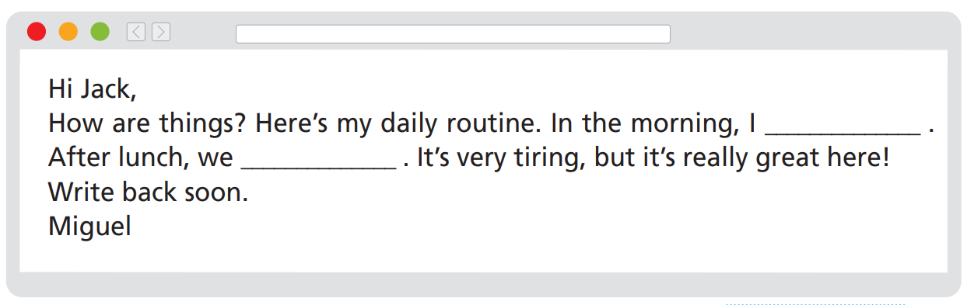
7 Imagine you are Miguel. Complete an email to your English e-friend, Jack, about your daily routine (about 50-60 words). You can use phrases from the box to start/end your email.

Slide 21
Sample
Complete the email with suitable words or phrases.
Hi Jack,
How are things? Here’s my daily routine. In the morning, I ……….. at 7:00 a.m. ……………………………starts at 9:00 a.m. and at 12:30 p.m. we………………... After lunch, we play a…………….. Dinner is at 6:30 p.m. Then, at 9:30 p.m., I…………………. It’s very tiring, but it’s really great here!
Write back soon.
Miguel
get up
Football practice
have lunch
match
go to bed

Slide 22

CONSOLIDATION

Slide 23
Write a similar email (about 60 words) to an e-friend about your daily routine.

Slide 24

WRAP-UP

Slide 25
Today’s lesson
Vocabularies
Free time activities
Speaking
Ask and answer Wh-questions
Listening
Listen and complete a timetable
Writing
Write an email about your routines

Slide 26
Homework
Learn the vocabularies and make sentences using them.
Do the exercises in TA 6 Right on Notebook (p. 25)
Prepare the next lesson (p. 48 SB)
Do Unit 1 Test 1 in Bài Tập Bổ Trợ TA 6 Right on (pp. 18-21)

Slide 27
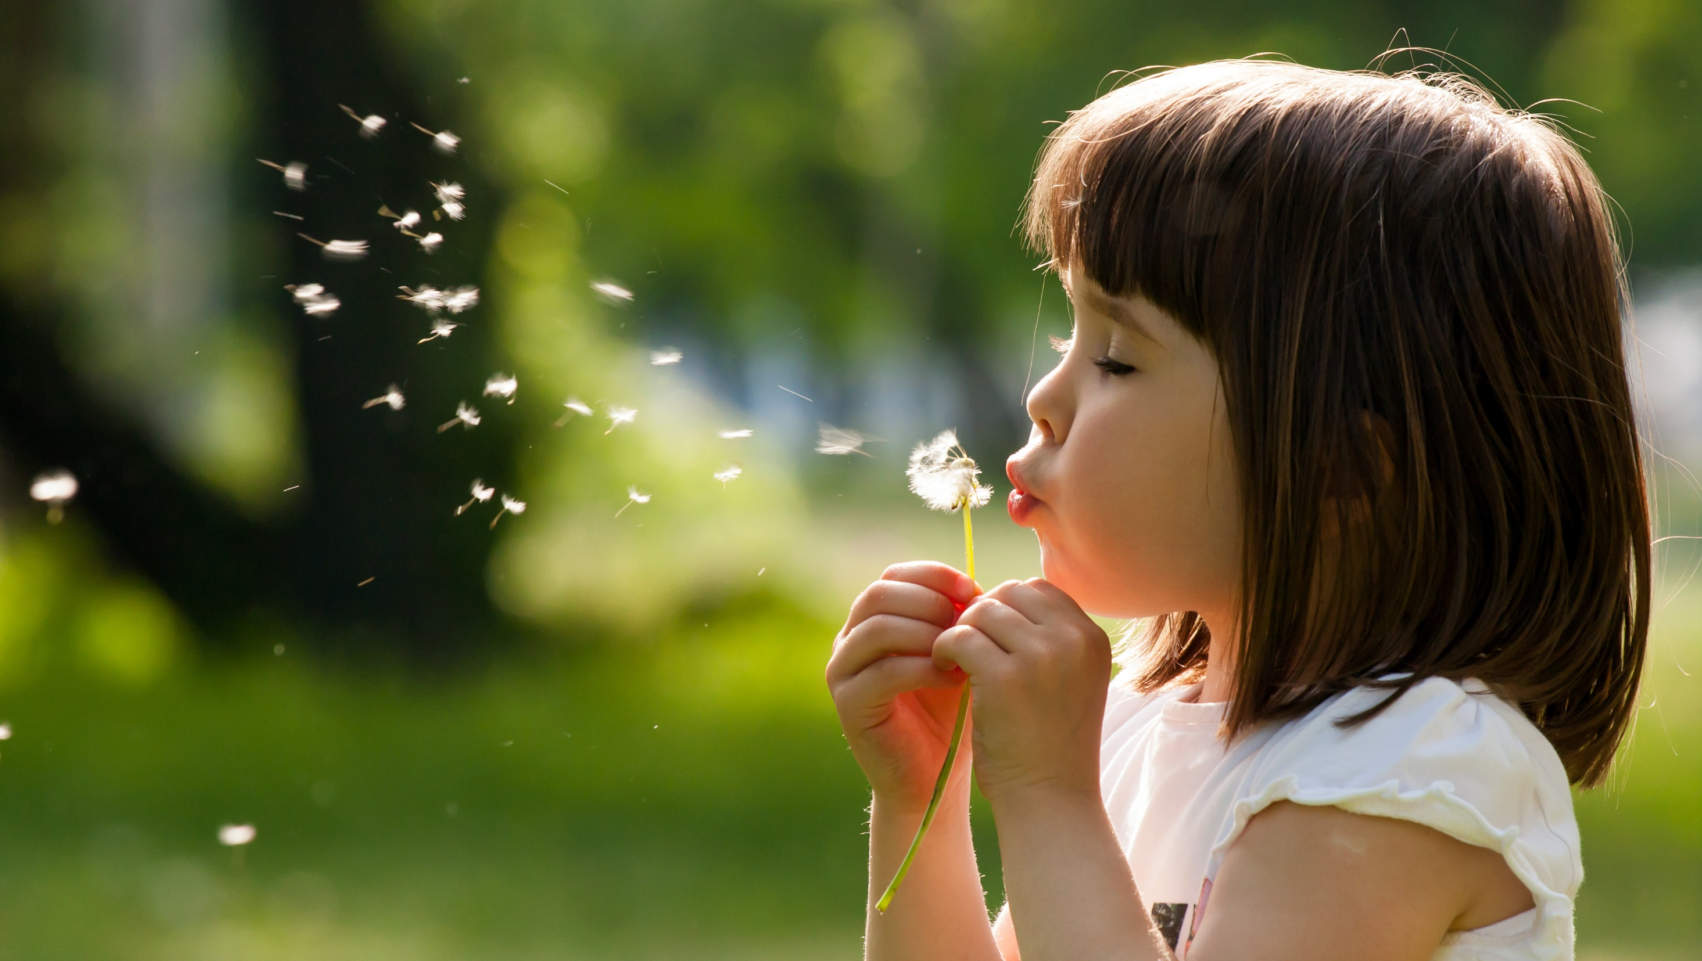
Enjoy your day!

