Slide 1

Unit 5: Around Town
Lesson 2.3: Pronunciation & Speaking
Page 43

Slide 2
Lesson Outline
Warm-up
Pronunciation
Practice
Speaking
Consolidation
Wrap-up

Slide 3
Objectives
By the end of this lesson, students will be able to…
- use sound changes in the question: “Would you like …?”
- order and take order at a restaurant.

Slide 4

WARM-UP

Slide 5

Work in pairs.
Choose the word whose main stress is placed
differently from the others.
1. A. order B. menu C. pizza D. bamboo
2. A. balloon B. candy C. seafood D. flower
3. A. performance B. tradition C. assistant D. customer
/ˈɔːrdər/
/ˈmenju:/
/ˈpi:tsə/
/bæmˈbu:/
/bəˈlu:n/
/ˈkændi/
/ˈsiːfuːd/
/ˈflaʊər/
/pəˈfɔ:rməns/
/trəˈdɪʃən/
/əˈsɪstənt/
/ˈkʌstəmər/

Slide 6
Work in pairs.
Choose the word whose underlined part is
pronounced differently from that of the other words.
A. pizza B. orange C. cola D. pasta
2. A. omelet B. chicken C. puppet D. dessert
3. A. stops B. thinks C. reads D. eats
/ˈpi:tsə/
/ˈɔ:rɪndʒ/
/ˈkoʊlə/
/ˈpɑ:stə/
/ˈɒmlət/
/ˈtʃɪkɪn/
/ˈpʌpɪt/
/dɪˈzɜ:rt/
/stɑ:ps/
/θɪŋks/
/riːdz/
/iːts/

Slide 7

Presentation

Slide 8
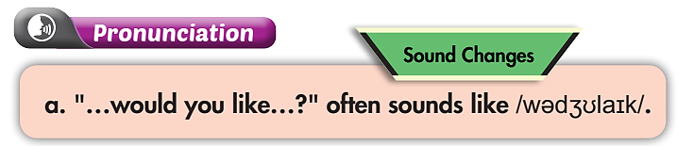

b. Listen. Notice the sound changes of the underlined words.
What would you like to eat?
Would you like some dessert?

Slide 9
c. Listen and cross out the one with the wrong sound changes.
What would you like to drink?
Would you like some milk?
d. Read the sentences with the correct sound changes to a partner.

Slide 10

Practice

Slide 11
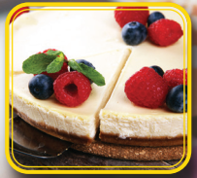





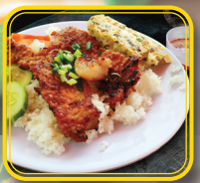
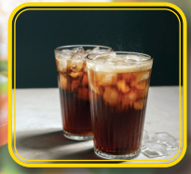
Work in pairs.
Put the following pictures in their correct groups.
1
2
3
4
Cake
Pizza
Bún bò Huế
Ice cream
5
6
7
8
Orange juice
Milk
Cơm tấm
Sweet soup
Food
Drink
Dessert

Slide 12
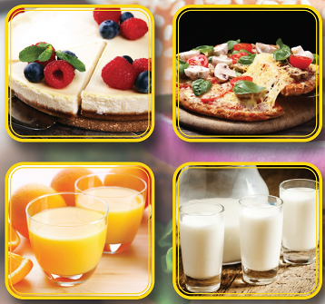
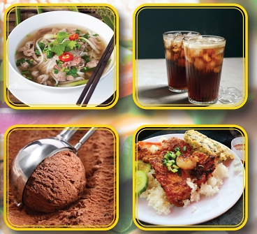
Work in pairs.
Take turns ordering. Swap roles and repeat.
What would you like to eat?
What would you like to drink?
Ok. Anything else?
What would you like for dessert?

Slide 13
STUDENT A
STUDENT B
What would you like to eat?
A pizza size M, please.
What would you like to drink?
Some orange juice.
Ok. Anything else?
An ice cream for dessert.

Slide 14

Production

Slide 15

Work in pairs.
Practice with your own ideas.

Slide 16
STUDENT A
STUDENT B
What would you like to eat?
Bún bò Huế, please.
What would you like to drink?
I’d like some lemon juice.
Would you like something for dessert?
That’s enough, thanks.

Slide 17

Speaking

Slide 18

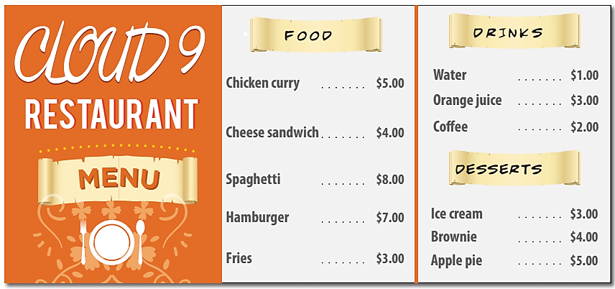
Pre-Speaking
Work in pairs.
What Would You Like to Order?
You're at a restaurant. Work in pairs.
Student A, you're a customer.
Order some food.
Student B, you're a waiter.
Take the customer's order.
Where are you? How many people are there in the conversation?
→ At a restaurant. Two – a customer and a waiter.
What are you going to do?
→ Customer: Order some food. Waiter: Take the customer's order.

Slide 19
Work in pairs.
While-Speaking
Student A - customer.
Order some food.
Student B - waiter.
Take Student A's order.

Slide 20
STUDENT A
STUDENT B
Can I see the menu?
Yes, here you are.
I’d like a humburger and some fries.
What would you like to drink?
Some coffee, please.
How much is it?
It’s $12.

Slide 21

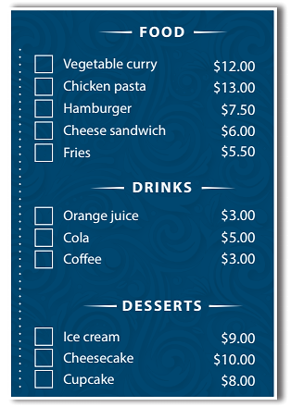
Work in pairs.
While-Speaking
Student A - waiter.
Take Student B's order.
Student B - customer.
Order some food.

Slide 22
STUDENT A
STUDENT B
What would you like to eat?
A cheese sandwich and some fries.
What would you like to drink?
I’d like some cola.
Anything else?
Ice cream for dessert, please.
How much is it?
That’ll be $24.50
Here you are. Thanks!

Slide 23
Post-Speaking
In groups, discuss what you ordered and how much you spent.
You can begin with:
Yesterday, I went to the restaurant and ordered……….

Slide 24

CONSOLIDATION

Slide 25
Write about what food you ordered.
When and where you ate.
How much you spent.
Write about 60-80 words.

Slide 26

WRAP-UP

Slide 27
Today’s lesson
- use sound changes in the question: “Would you like…?”
- order and take order at a restaurant.

Slide 28
Homework
Practice sound changes in the question: “Would you like…?”.
Prepare the next lesson (page 44 - SB).
Play the consolidation games in Tiếng Anh 6 i-Learn Smart World DHA App on www.eduhome.com.vn.

Slide 29
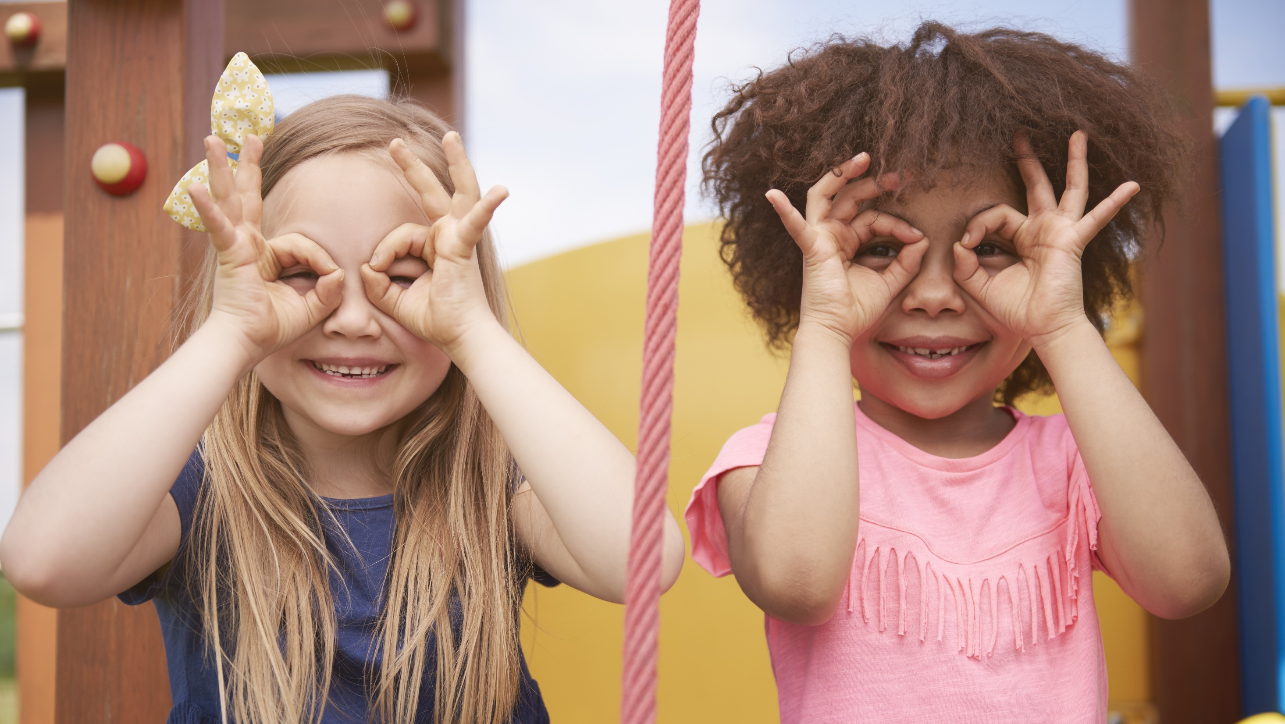
Enjoy your day!

