Slide 1

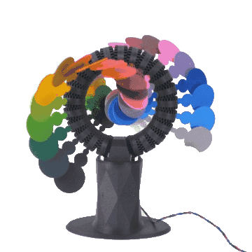

Slide 2
REVIEW 4
(UNITS 10-11-12)
REVIEW 4
(UNITS 10-11-12)
Lesson 2: Skills

Slide 3



LESSON 2: SKILLS
WARM-UP
Chatting
READING
Task 1: Read and choose the correct answer.
SPEAKING
Task 2: Describe your future house.
LISTENING
Task 3: Listen and tick.
Task 4: Write a paragraph about what we should do to improve the environment.
WRITING
CONSOLIDATION
Wrap-up
Homework

Slide 4
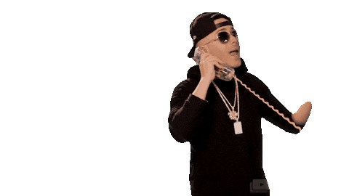
WARM-UP
CHATTING

Slide 5
WARM-UP
Answer the questions:
1. Have you ever thought of your house in the future?
2. What will your house in the future be like?

Slide 6

READING
Read the text and choose the correct answer.
What will our houses in the future be like?
In the future, the places we live in and the ways we live will change a lot. Our houses will be more eco-friendly. We will use wind energy or solar energy. We will use our voices to control our houses. It will make our lives more comfortable. There will be underground cities. There will be cities in the air and on other planets, too. We will have to build cities there because there will be too many people and not enough land for houses or buildings.

Slide 7
READING
1. Scientists predict where and how we live in the future _______.
A. will change a lot B. will not change much C. will change only a little
2. According to the text, which of the following is NOT true about future houses?
A. They will be more eco-friendly.
B. They will use energy from coal.
C. They will use wind energy.
3. We will control our future houses _______.
A. with our voices B. by clapping our hands C. with mobile phones
4. There will be cities in the air, on other planets, and underground because _______.
A. we won’t have enough land to build houses on
B. living there will be more comfortable
C. life on the Earth will become boring

Slide 8

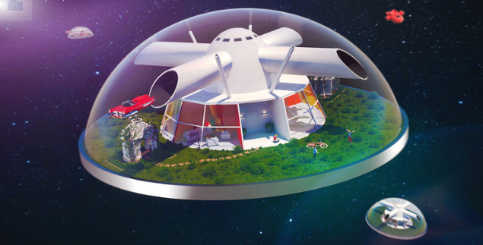
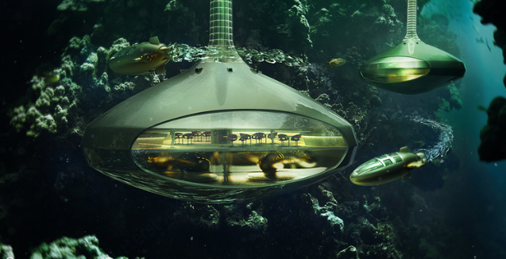
SPEAKING
Describe your future house.

Slide 9


LISTENING
Listen and tick.
1. Recycle more rubbish (for example, glass, paper and plastic, etc.).
2. Pick up rubbish in parks or in the streets.
3. Grow your own vegetables.
4. Save energy – turn off lights and TVs when you’re not using them.
5. Use reusable bags instead of plastic bags.





Slide 10

WRITING
Write a paragraph about what you think we should do to improve the environment.
I think we can do many things to improve the environment around us. Firstly, ...

Slide 11

CONSOLIDATION
1
Wrap-up
What have we learnt in this lesson?
To review and practice on the vocabulary items and grammar points you have already studied and the skills you have practised in Units 10, 11, 12
To practice 4 skills

Slide 12
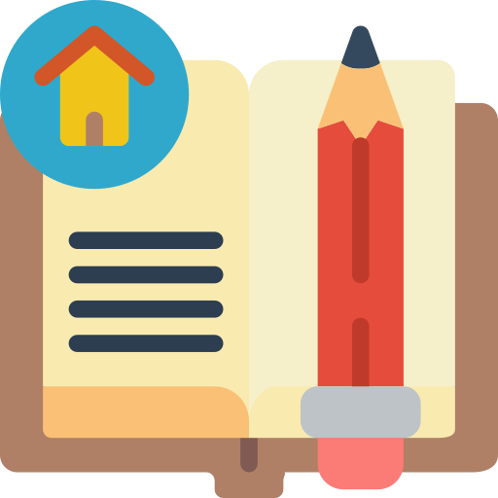
CONSOLIDATION
2
Homework
Prepare for the last term test.

Slide 13






Website: hoclieu.vn
Fanpage: facebook.com/www.tienganhglobalsuccess.vn/

