Slide 1

Hello 6
Pages 18 - 19

Slide 2
Lesson Outline
Warm-up
Reading
Project time
Presentation skills
Consolidation
Wrap-up

Slide 3
Objectives
By the end of this lesson, students will be able to…
Learn about the United Kingdom.
Practise presentation skills.
Draw a map of Vietnam.

Slide 4

WARM-UP

Slide 5
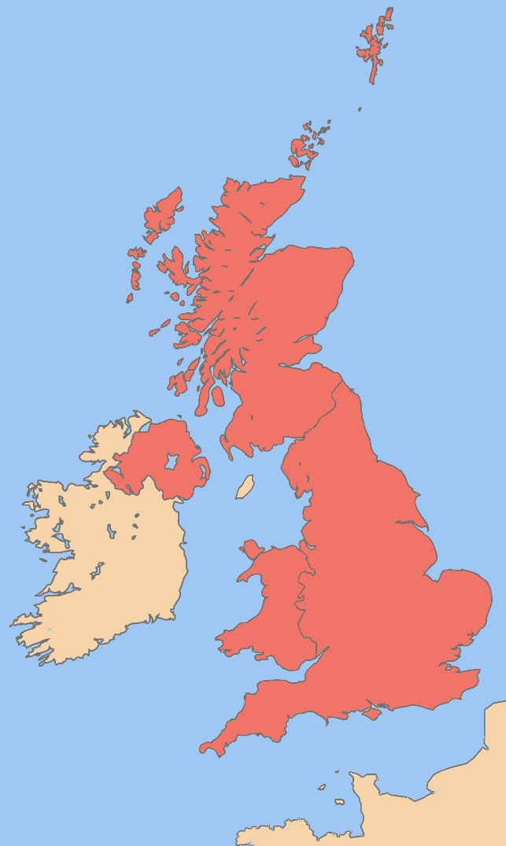
Look at the map. Which country is it?
=> The United Kingdom (the UK).
What is the main language people use in The UK?
=> English.
What are the benefits of speaking English? Discuss.

Slide 6

It’s time to learn …

Slide 7

Reading

Slide 8
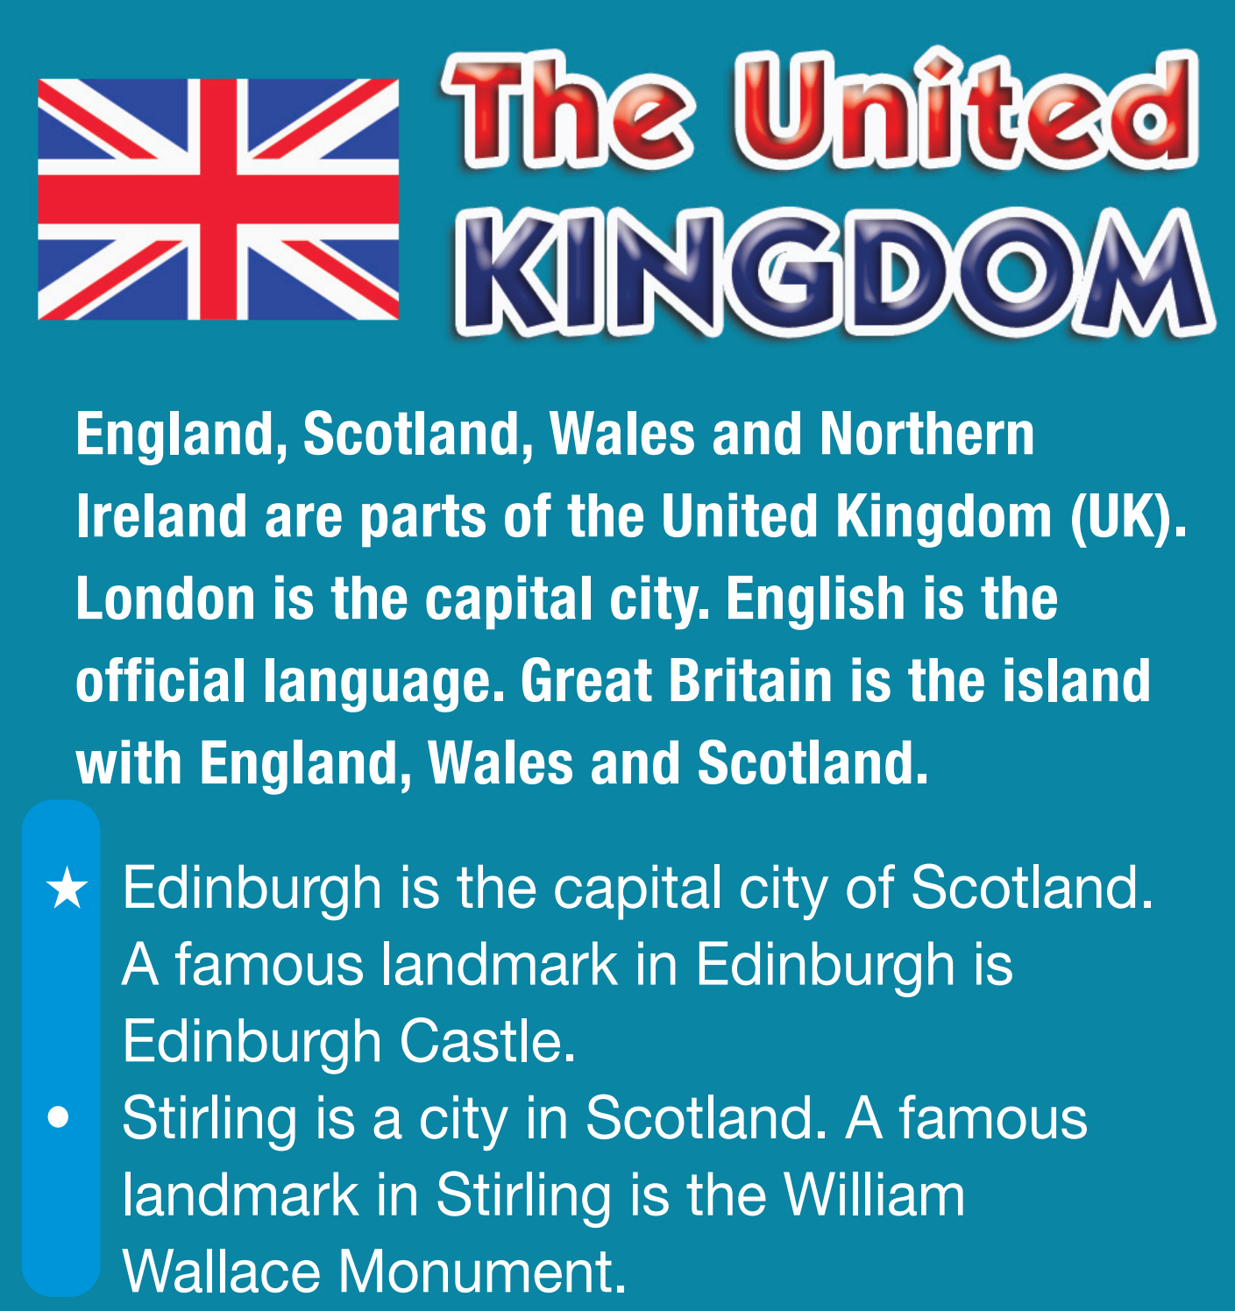
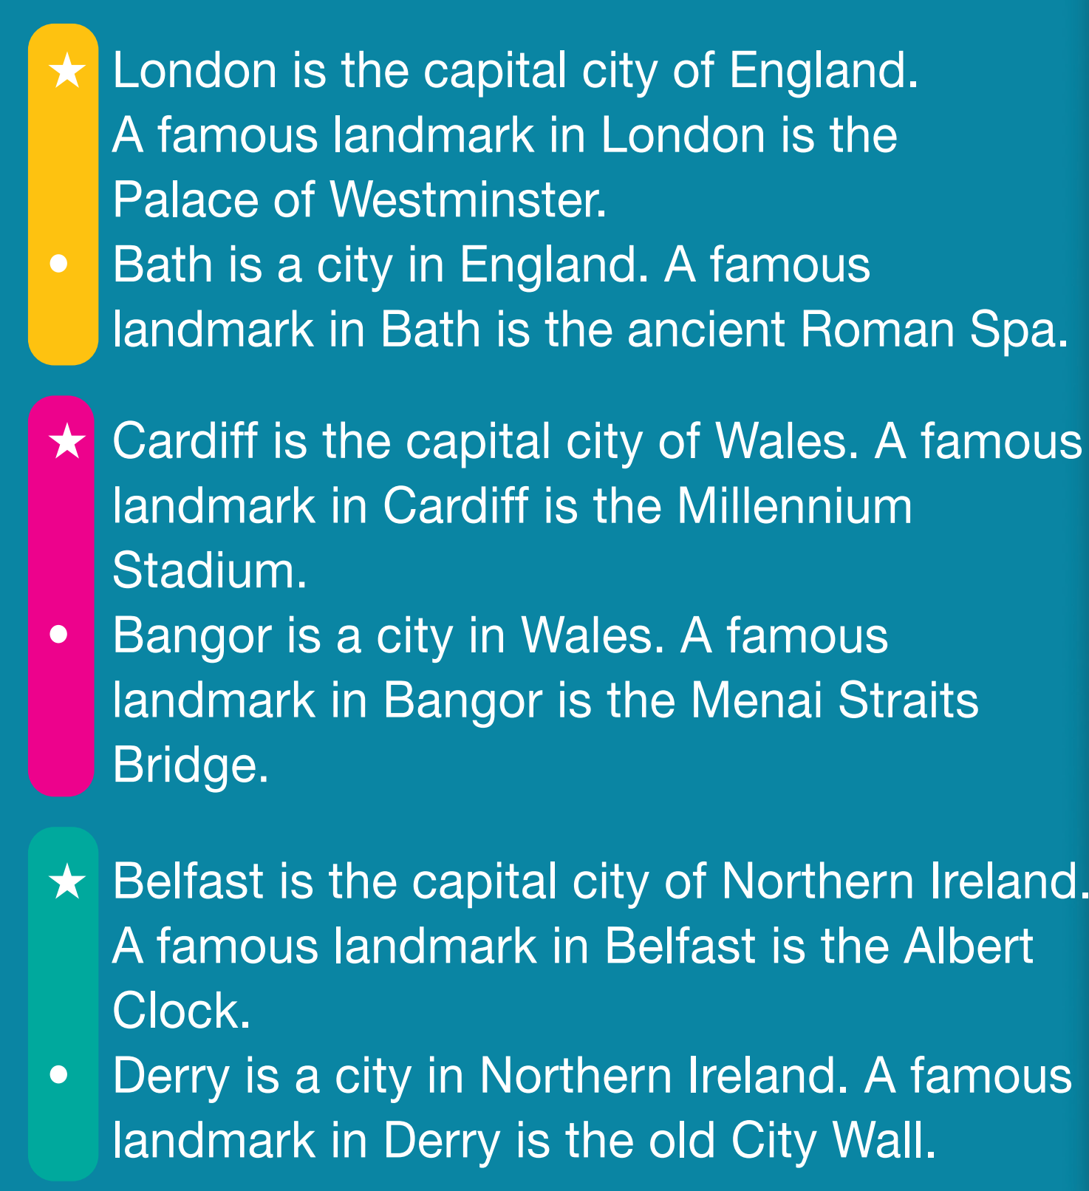
Pre-reading
Find the words in the text. Guess their meanings.
• official language
• island
• landmark
• monument
• stadium
• bridge
• wall

Slide 9

Vocabulary
• official language /əˌfɪʃəl ˈlæŋɡwɪdʒ/ (n.p): ngôn ngữ chính thức
• island /ˈaɪlənd/ (n): hòn đảo
• landmark /ˈlændmɑːk/ (n): danh thắng
• monument /ˈmɒnjumənt/ (n): tượng đài
• stadium /ˈsteɪdiəm/ (n): sân vận động
• bridge /brɪdʒ/ (n): cây cầu
• wall /wɔːl/ (n): bức tường

Slide 10
While-reading
1 Look at the map. Which countries are in Great Britain? Listen, read and check.

Slide 11
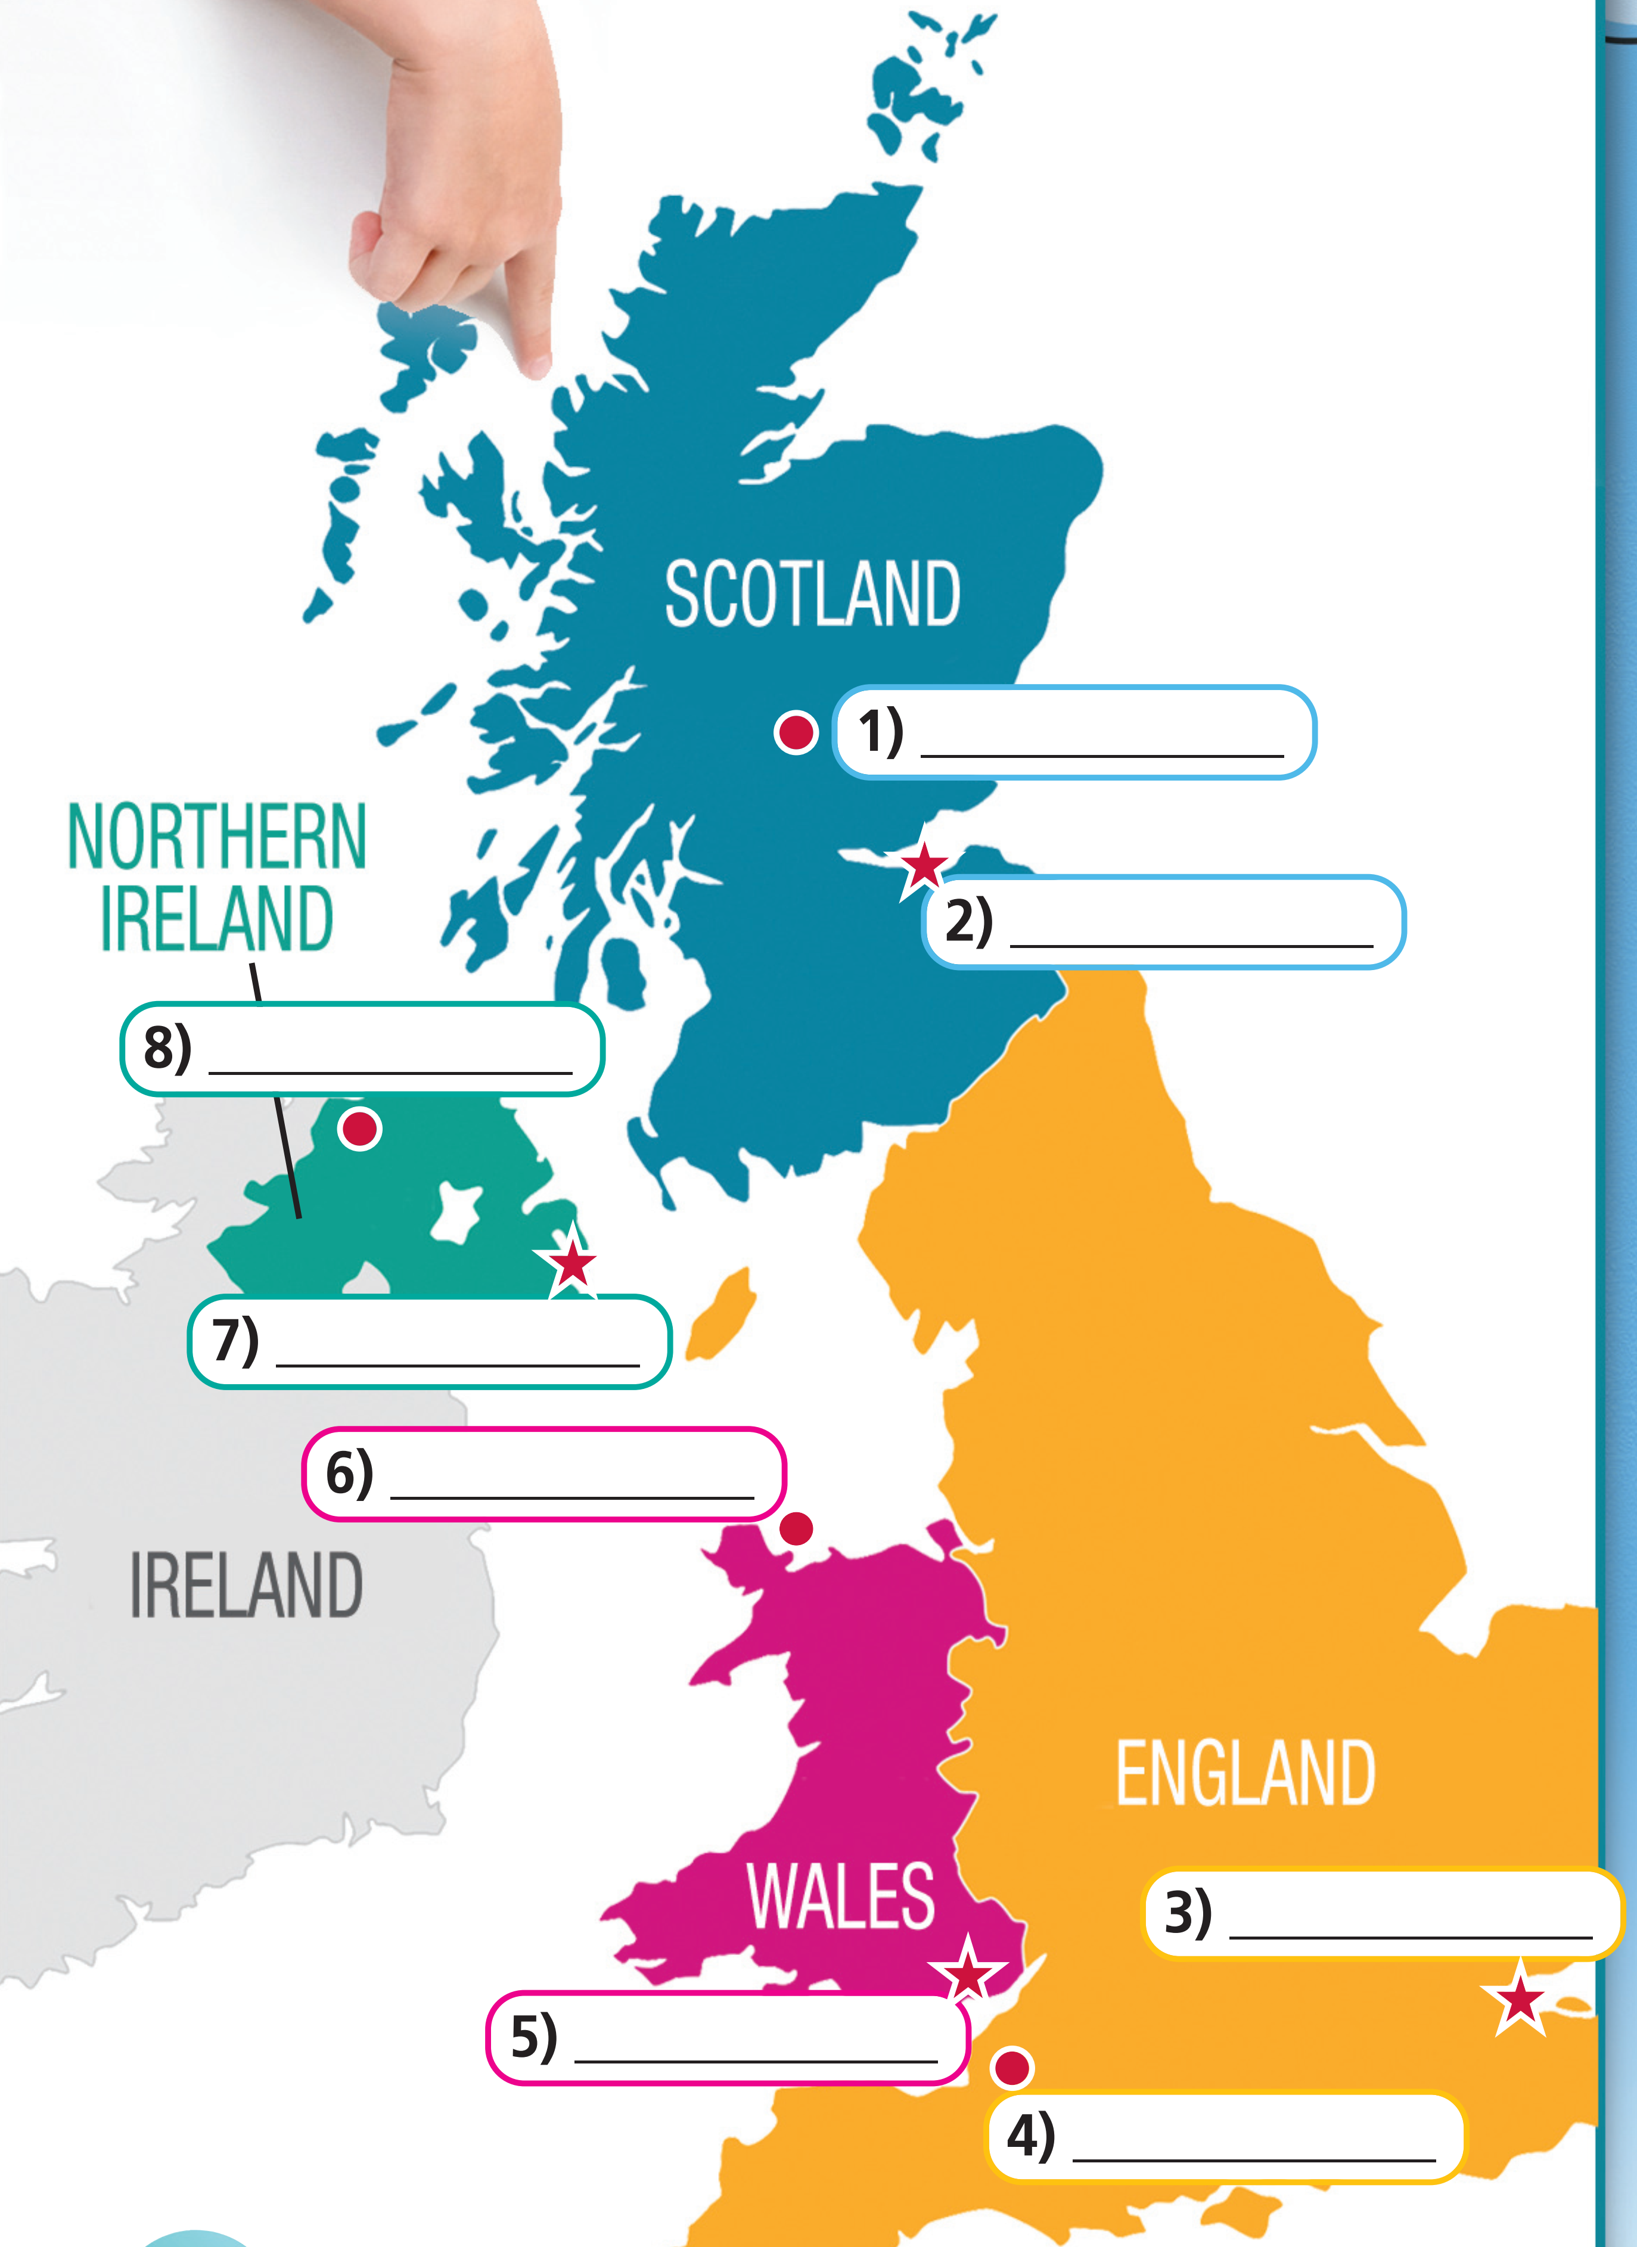
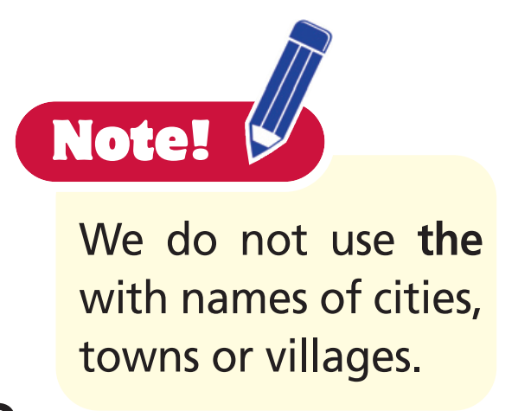
2 Read the texts and complete the cities on the map.

Slide 12
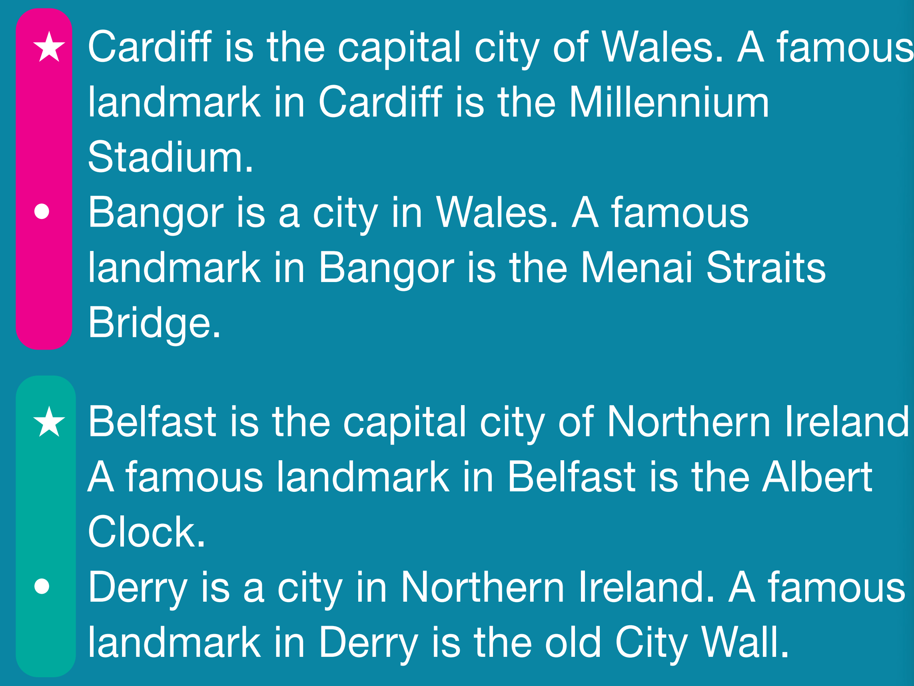
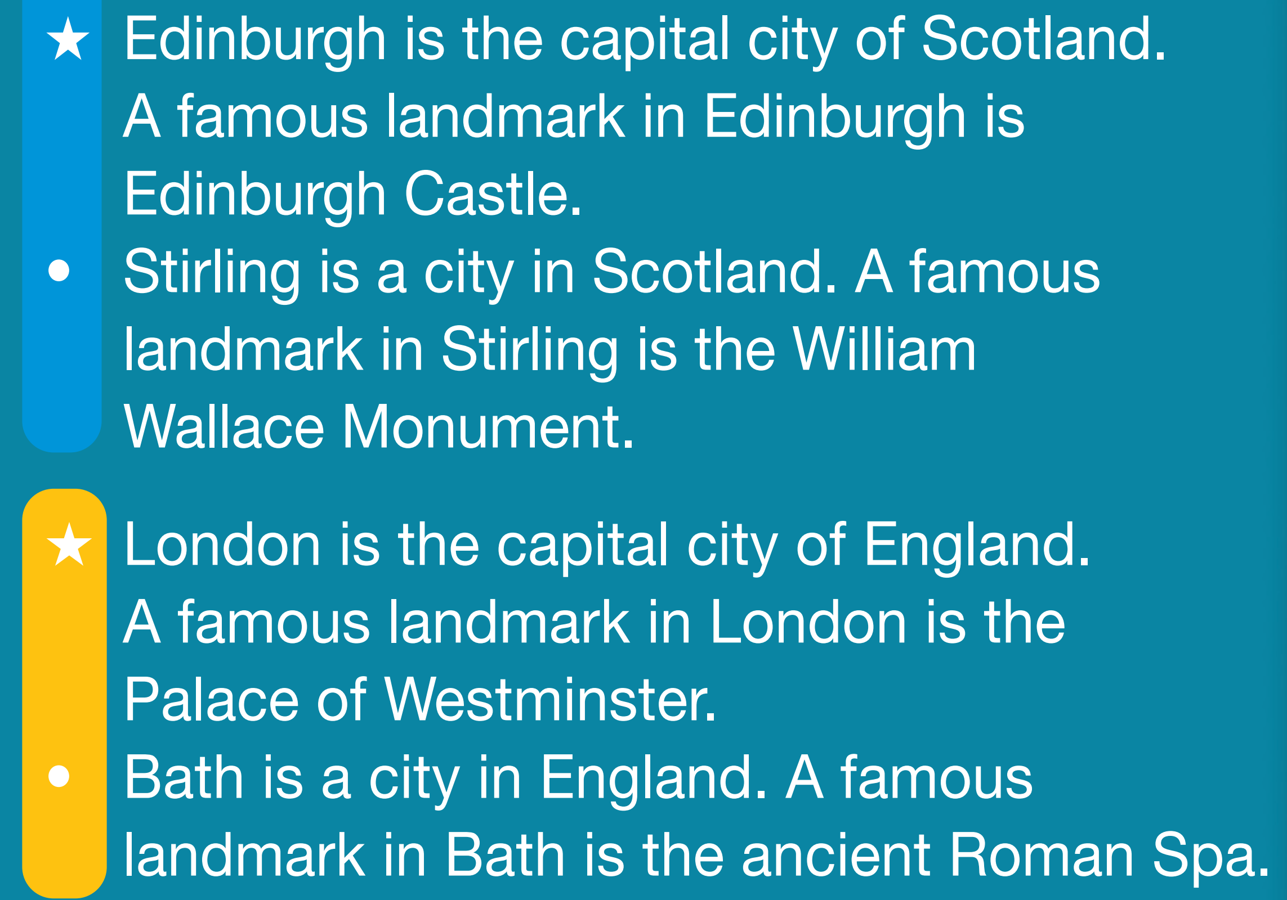
Stirling
Edinburgh
Derry
Belfast
Bangor
London
Cardiff
Bath

Slide 13
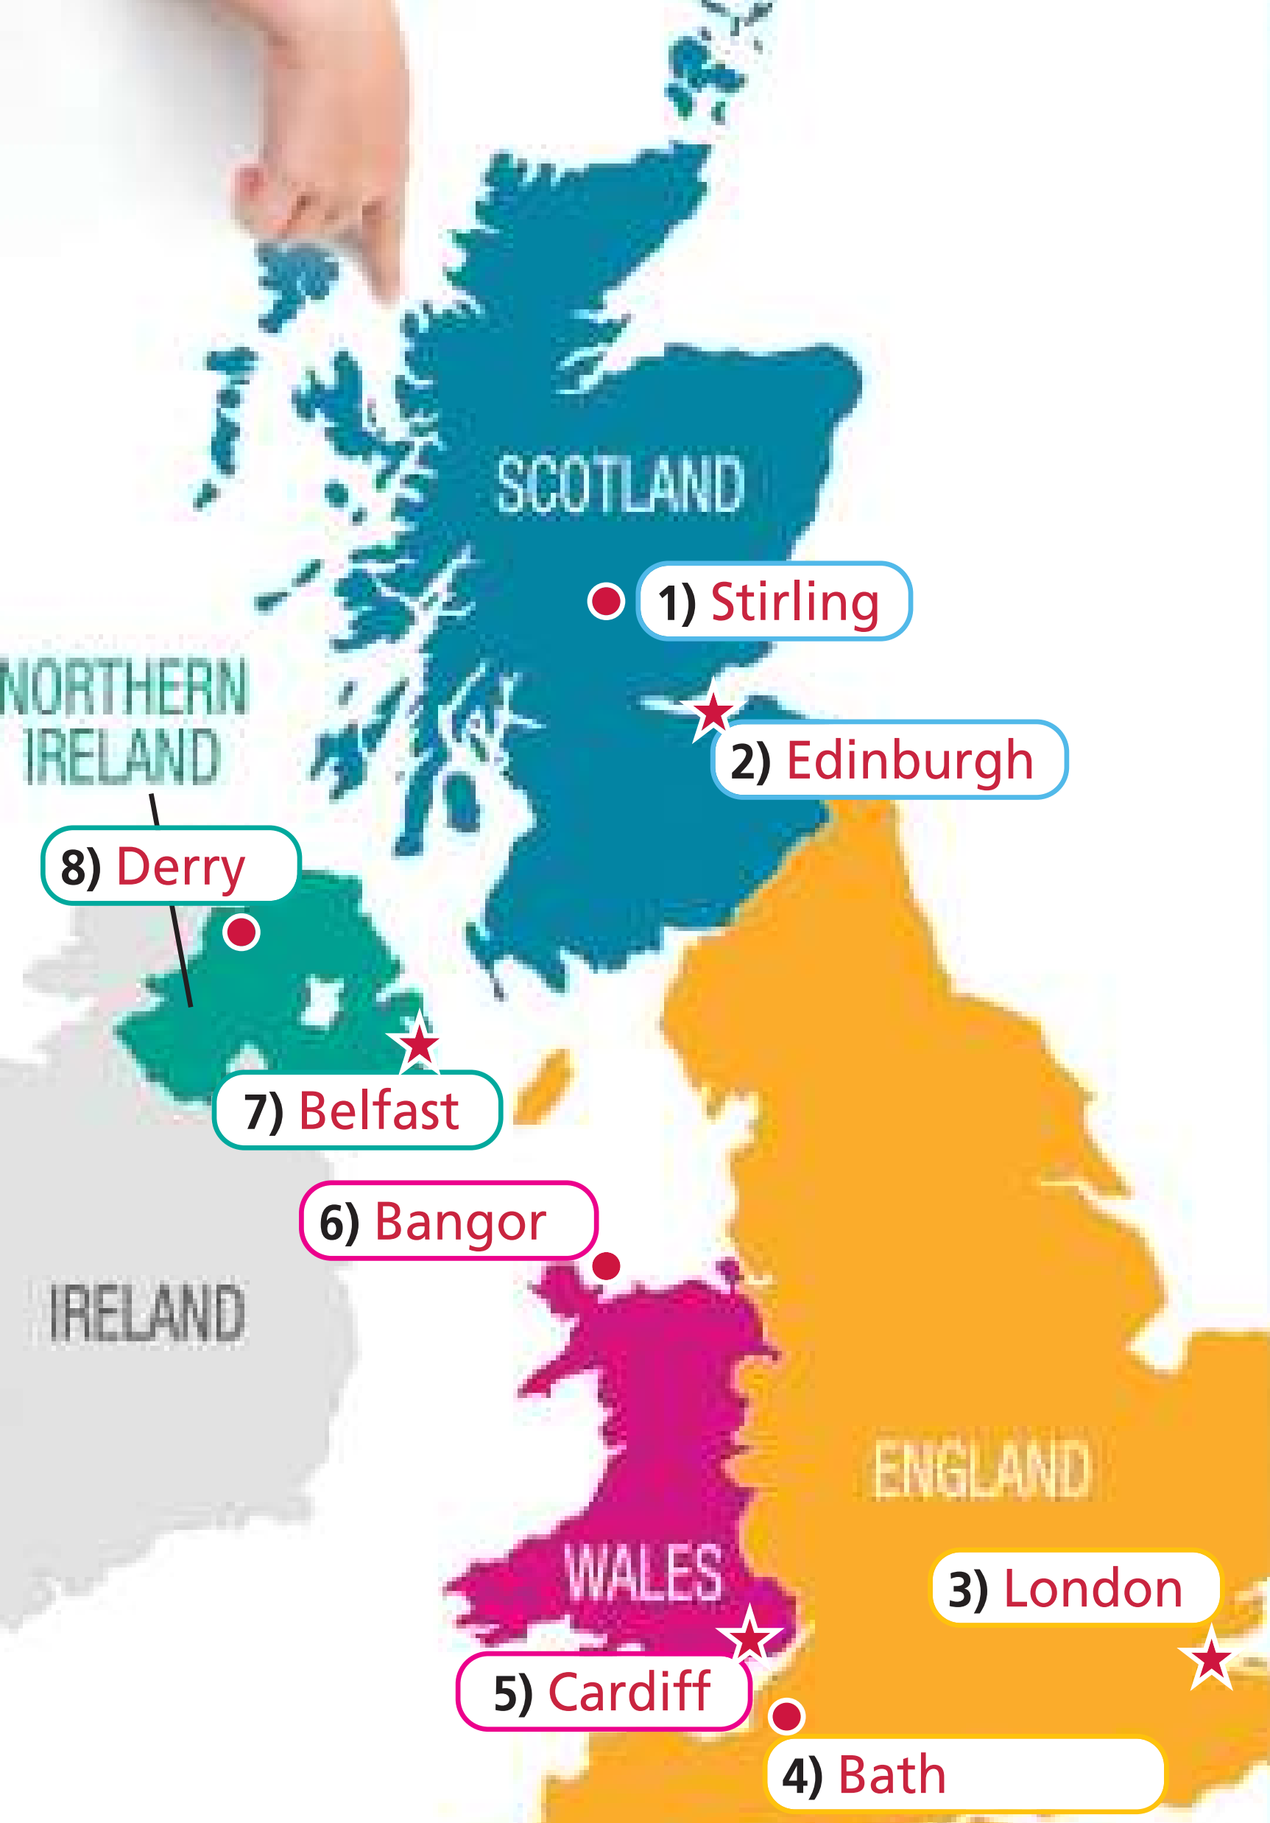
Post-reading
Choose one part of the UK and present it to the class.
Example
England is one part of the UK. The capital city of England is London. The Palace of Westminster is a famous landmark in London. Bath is another city in England, and a famous landmark in Bath is the ancient Roman Spa.

Slide 14
3 Work in groups of four. Collect information about your country under the headings: country – capital city – other cities – landmarks. Present your country to the class.
Example
Country: Vietnam
Capital city: Hanoi
Other cities: Ho Chi Minh City, Đà Nẵng, Huế
Landmarks: Hạ Long Bay, Hanoi Citadel, Khải Định Tomb
I am from Vietnam. The capital city of Vietnam is Hanoi. Other cities are Ho Chi Minh City, Đà Nẵng, and Huế. Some famous landmarks in Vietnam are Hạ Long Bay, Hanoi Citadel, and Khải Định Tomb.

Slide 15
Project time

Slide 16


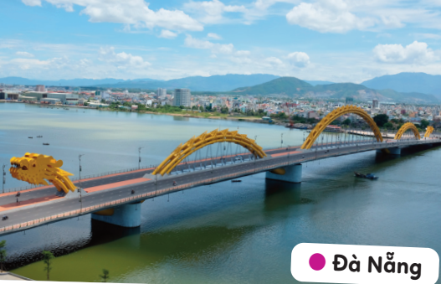
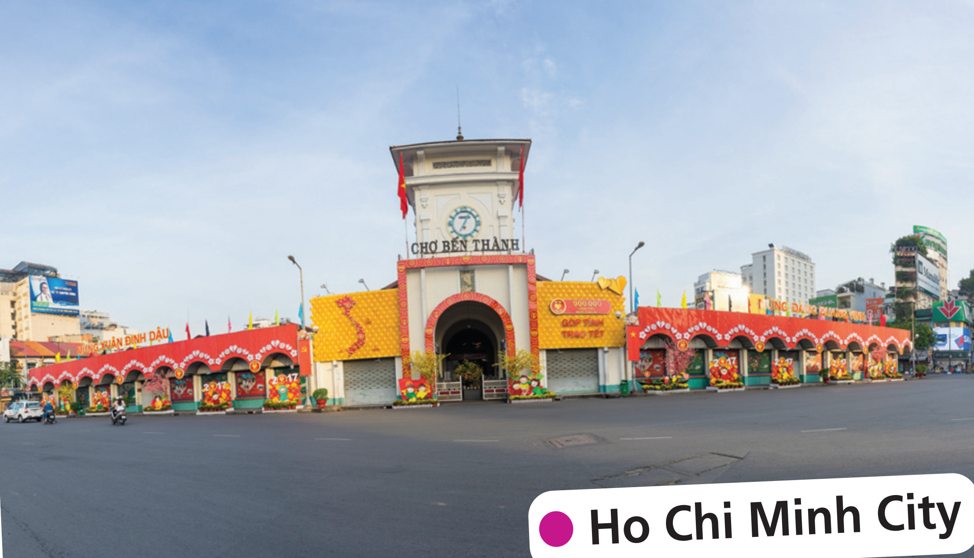
1 Draw the map of Vietnam in your notebook and complete it with the name of the capital city and other cities/towns. Put photos of each city/town and label them.

Slide 17



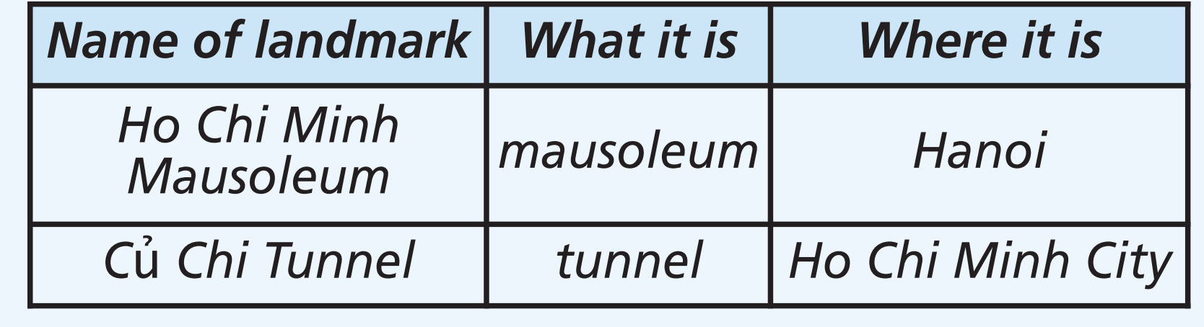
2 Copy the headings below in your notebook. Collect information about famous landmarks in each of the cities in Exercise 1 and write it under the headings. Prepare a poster. Label the photos.
Example

Slide 18
3 Use the map in Exercise 1 and your notes in Exercise 2 to present the
landmarks to the class.
Example
My country is famous for its landmarks. Ho Chi Minh Mausoleum is a mausoleum in Hanoi. The Cu Chi Tunnel is a system of tunnels in Ho Chi Minh City.

Slide 19
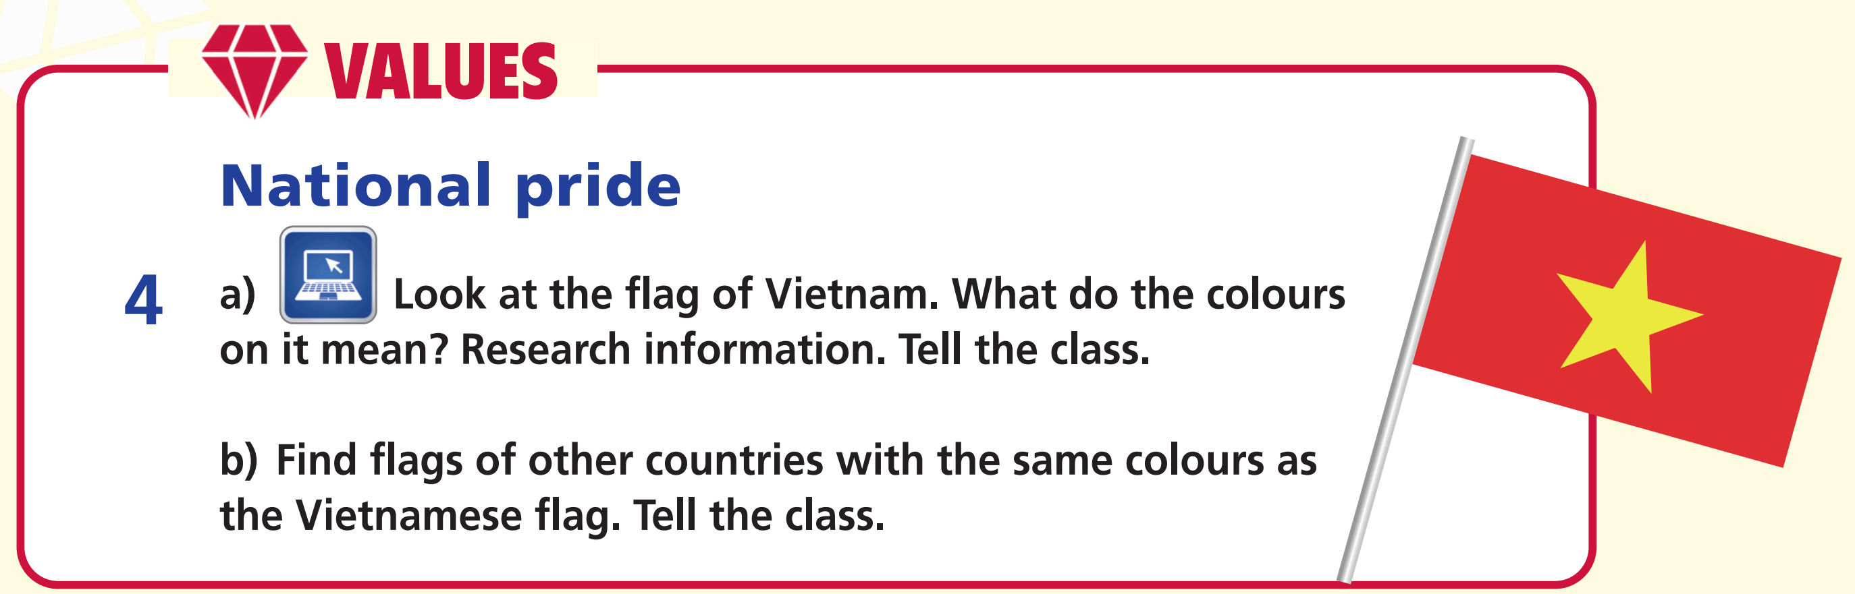
=> The colours of the Vietnamese flag are red and yellow. Red is for bloodshed during the struggle for liberation, and yellow is for the colour of Vietnamese people’s skin.

Slide 20
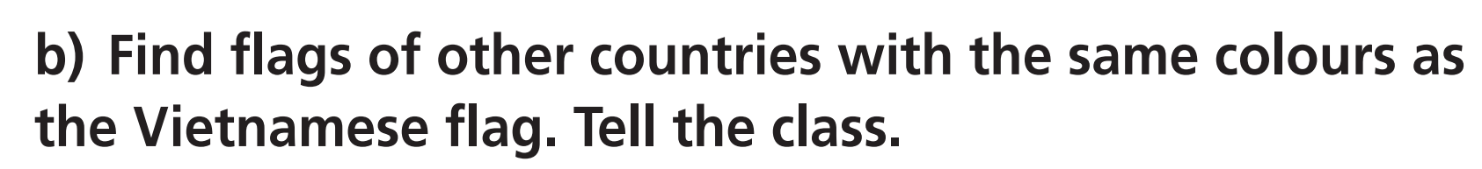



China
Spain
Kyrgyzstan

Slide 21

CONSOLIDATION

Slide 22
Write a paragraph (60-80 words) to introduce your city/province.
What’s your city/province’s name?
Where is the city/province? (Northern/Central/Southern Vietnam)
What is the landmark of your city/province?
What is it?

Slide 23

WRAP-UP

Slide 24
Today’s lesson
Vocabularies
Cities
Countries
Places in a city
Grammar
Sentences to introduce a place.

Slide 25
Homework
Practise the vocabularies and grammar and make sentences using them.
Prepare the next lesson (pp. 20, 21 SB).
Do Test 2 in Bài Tập Bổ Trợ TA 6 Right on (pp. 6-9).

Slide 26

Enjoy your day!

