Slide 1

Unit 1: My World
Lesson 1e: Grammar (cont.)
Pages 21

Slide 2
Lesson Outline
Warm-up
Grammar
Consolidation
Wrap-up

Slide 3
Objectives
By the end of this lesson, students will be able to…
- revise and practise Present Continuous and Present Simple.
- talk about what they are doing these days, what they are doing now, and what they are doing later today.

Slide 4

WARM-UP

Slide 5
Write the plural form and -ing ending form of these verbs.
plural
-ing ending
Option 1
work
study
visit
play
watch
think
works
working
studies
stuying
visits
visiting
plays
playing
watches
watching
thinks
thinking

Slide 6
Choose the word whose main stress is placed differently from the others.
1. A. example B. measure C. wonder D. pleasure
/ig'zɑ:mpl/ /'meʒər/ /'wʌndə/ /ˈpleʒər/
2. A. develop B. interview C. describe D. produce
/di'veləp/ /'intəvju:/ /dis'kraib/ /prəˈdjuːs/
3. A. polite B. funny C. bossy D. cozy
/pəˈlait/ /'fʌni/ /ˈbɒsi/ /ˈkəʊzi/
Option 2

Slide 7

It’s time to learn …

Slide 8

Presentation

Slide 9
 | Present Simple | Present Continuous
Structure | S + V(s/es) S + do/does + not + V-inf Do/Does + S + V-inf? | S + am/is/are + V-ing S + am/is/are + not + V-ing Am/Is/Are + S + V-ing?
Usages | • habits and routines • general states and facts • timetables | actions happening now/around the time of speaking • temporary situations • fixed future arrangements
Adverbs of expressions | every day/morning/weekend, often, always, never, on Mondays, once/twice a week/month, etc. | now, at the moment, at present, tonight, these days, etc.

Slide 10

Some verbs don’t have continuous forms because they describe a state rather than an action (want, like, love, hate, know, believe, need, etc.).
E.g. She knows him. (NOT: She’s knowing him.)

Slide 11

Practice

Slide 12
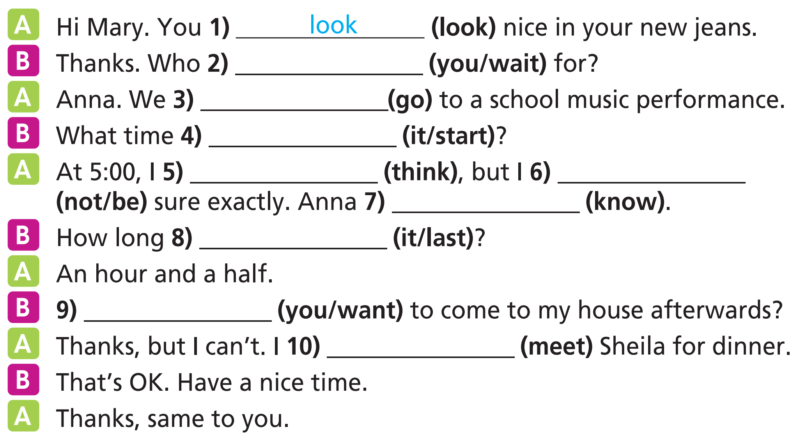
are you waiting
action happening now
are going
action happening now
does it start
timetable
think
am not
knows
general state and fact
does it last
timetable
general state and fact
Do you want
am meeting
fixed future arrangement

Slide 13

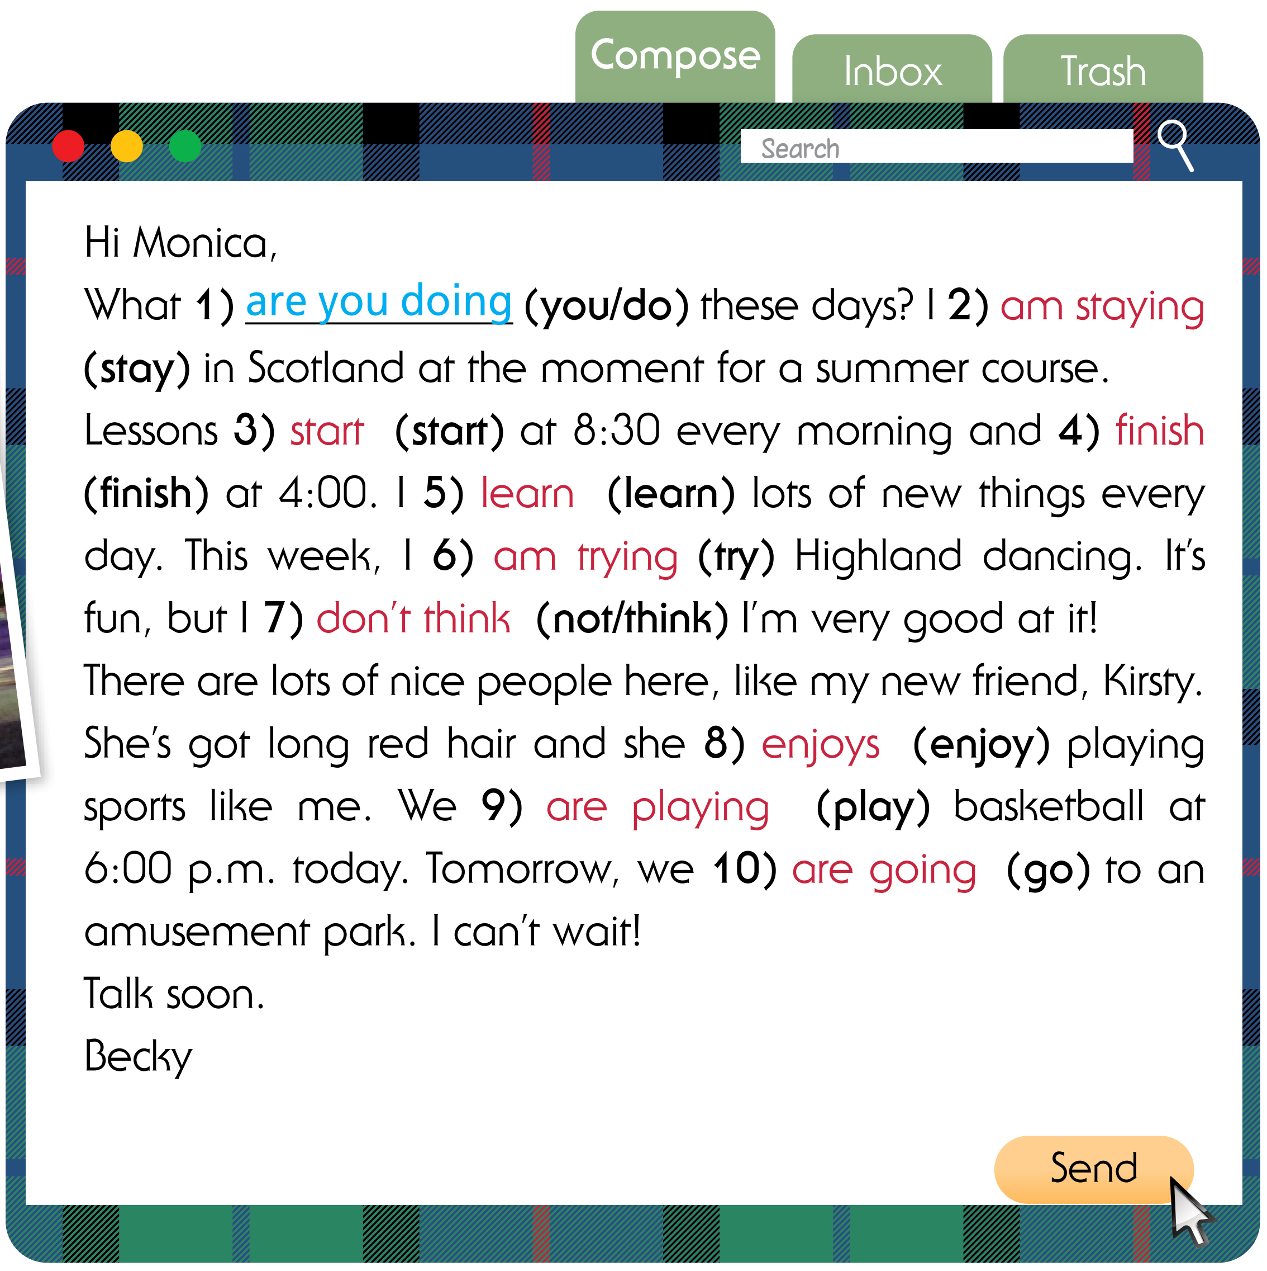
Put the verbs in brackets into the Present Simple or the Present Continuous.
First, underline adverbs of time expressions in the text.
Hi Monica,
What 1) are you doing (you/do) these days? I 2) ____________ (stay) in Scotland at the moment for a summer course. Lessons 3) ____________ (start) at 8:30 every morning and 4) ____________ (finish) at 4:00. I 5) ____________ (learn) lots of new things every day. This week, I 6) ____________ (try) Highland dancing. It’s fun, but I 7) ____________ (not/think) I’m very good at it!
There are lots of nice people here, like my new friend, Kirsty. She’s got long red hair and she 8) ____________ (enjoy) playing sports like me. We 9) ____________ (play) basketball at 6:00 p.m. today. Tomorrow, we 10) ____________ (go) to an amusement park. I can’t wait!
Talk soon.
Becky

Slide 14
Put the verbs in brackets into the Present Simple or the Present Continuous.
action happening around the time of speaking
temporary situation
timetable
Hi Monica,
What 1) are you doing (you/do) these days? I 2) ____________ (stay) in Scotland at the moment for a summer course. Lessons 3) ____________ (start) at 8:30 every morning and 4) ____________ (finish) at 4:00. I 5) ____________ (learn) lots of new things every day. This week, I 6) ____________ (try) Highland dancing. It’s fun, but I 7) ____________ (not/think) I’m very good at it!
There are lots of nice people here, like my new friend, Kirsty. She’s got long red hair and she 8) ____________ (enjoy) playing sports like me. We 9) ____________ (play) basketball at 6:00 p.m. today. Tomorrow, we 10) ____________ (go) to an amusement park. I can’t wait!
Talk soon.
Becky
am staying
start
finish
learn
am trying
don’t think
enjoys
am playing
am going
general state and fact
general state and fact
fixed future arrangement
fixed future arrangement

Slide 15
23 ★ Choose the correct option.
1 Alice reads / is reading a book at the moment.
2 I drink / ’m drinking a glass of milk every morning.
3 My parents don’t eat / aren’t eating dinner right now.
4 Does Andy live / Is Andy living on New Street?
5 We work / ’re working on a school project now.
6 Do you go / Are you going to football practice tomorrow?
Extra Practice
WB, page 65

Slide 16
Extra Practice
WB, page 14
Put the verbs in brackets into the Present Simple or the Present Continuous.
action happening around the time of speaking
1 A: __________________ (Tom/sleep) now?
B: No, he ___________________ . He ___________________ (read) a book.
2 A: What ____________________ (you/ usually/do) in the afternoon?
B: I ___________________ (meet) my friends and we __________________ (play) football.
3 A: __________________ (Helen/study) for her maths test at the moment?
B: No, she ___________________ (have) a guitar lesson.
4 A: Max __________________ (not/like) surfing the Net.
B: I know. He __________________ (prefer) watching TV series.
Is Tom sleeping
isn’t
is reading
do you usually do
meet
play
Is Helen studying
is having
doesn’t like
prefers
general state and fact
general state and fact
action happening around the time of speaking
habits and routines

Slide 17
Extra Practice
WB, page 14
2. Choose the correct option.
1 A: Do you have/Are you having dance classes every Tuesday?
B: No, it’s usually on Wednesdays, but I have/am having an extra lesson today.
2 A: Sam is looking/looks for a new ﬂat these days.
B: Yes, I know. He is wanting/wants something bigger.
3 A: Is Tom living/Does Tom live in a small ﬂat?
B: No, it’s big. I am thinking/think it has four bedrooms.
4 A: Do you want/Are you wanting to see that new action film at the cinema tonight?
B: No, I am hating/hate those kinds of films. Let’s stay in and watch TV.
5 A: Where’s Emily? Does she talk/ Is she talking on the phone?
B: No, she chats/is chatting online with her friends.

Slide 18
24 ★★ Put the verbs in brackets into the Present Simple or the Present Continuous.
1 A: I ’m going (go) to the cinema. _____________ (want) to come with me?
B: I can’t. I _____________ (meet) Jane tonight.
2 A: What _____________ (you/do)?
B: I _____________ (set) the table; it’s time for lunch.
3 A: _____________ (you/know) that woman with long blond hair?
B: Yes. That’s my aunt, Jane. She _____________ (live) in York.
4 A: My dad _____________ (not/work) this week. He’s on holiday.
B: That’s great. My parents always _____________ (take) two weeks off in August.
5 A: _____________ (Paul/play) football tonight?
B: Yes. His team always _____________ (practise) on Fridays.
6 A: _____________ (we/wait) for Jessica?
B: No. She’s tired, so she _____________ (not/come).
Do you want
am meeting
are you doing
am setting
Do you know
lives
is not working
take
Is Paul playing
practises
Are we waiting
Extra Practice
WB, page 65
is not coming

Slide 19
25 ★★ Put the verbs in brackets into the Present Simple or the Present Continuous.
Hi Joshua,
How are you? I’m on holiday in Hội An, Vietnam, with my family and we 1) __________ (have) a great time. My family 2) __________ (love) it here. We usually come here for our holidays. This time, we 3) __________ (stay) in a hotel near the Cửa Đại Beach. My brother and I 4) __________ (go) swimming every day! Tomorrow, we 5) __________ (fly) to Ho Chi Minh City. What 6) _____________ (you/do) on your holidays?
Write back soon.
Bảo
are having
loves
are staying
go
are flying
are you doing
Extra Practice
WB, page 65

Slide 20

Production

Slide 21
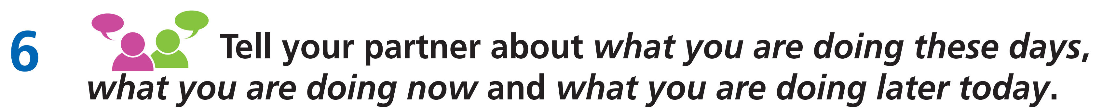
Example

Slide 22

CONSOLIDATION

Slide 23
Write a paragraph (60-80 words) about yourself by using the Present Simple and the Present Continuous.

Slide 24

WRAP-UP

Slide 25
Today’s lesson
Vocabularies
Stative verbs: love, like, want, believe, need…
Grammar
Present Simple
Present Continuous

Slide 26
Homework
Practise the vocabularies and structure and make sentences using them.
Do the exercises in TA 7 Right on WB (page 14)
Prepare the next lesson (page 22 SB)

Slide 27

Lesson 3
Stay positive and have a nice day!

