Slide 1


Slide 2
Unit
4
Asean and Viet Nam
Unit
FAMILY LIFE
LESSON 2
LANGUAGE

Slide 3
LESSON 2
LANGUAGE
LESSON 2
WARM-UP
Matching game
PRONUNCIATION
Task 1: Listen and repeat.
Task 2: Listen and repeat.
Task 1: Match the word and phrases with their meanings.
Task 2: Complete the sentences.
VOCABULARY
Task 1: Rewrite the sentences.
Task 2: Make sentences.
GRAMMAR
CONSOLIDATION
Wrap-up
Homework

Slide 4
WARM-UP
MATCHING
Work in 4 groups.
Match the pronunciation to the real word.

Slide 5
WARM-UP
MATCHING
/pˈteɪtoʊ/
/tˈnaɪt/
police
/ˈevri/
tonight
/pˈliːs/
history
every
potato
/ˈhɪstri/

Slide 6


WARM-UP
ELISION OF VOWELS
‘his- to- ry’
history
/ˈhɪstri/
‘e-ve-ry’
every
/ˈevri/
Notes:
Link video phát âm về nuốt âm: https://www.youtube.com/watch?v=vCnLuB_xclo

Slide 7

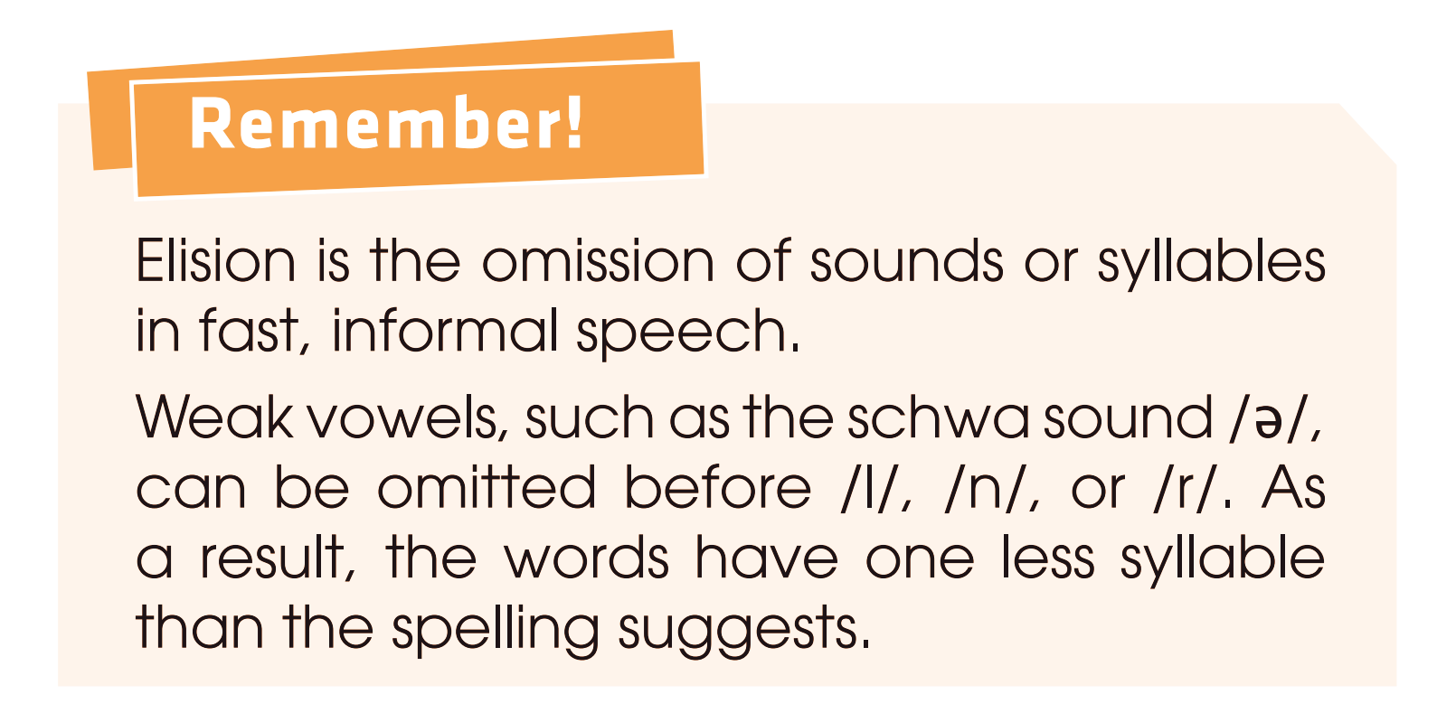
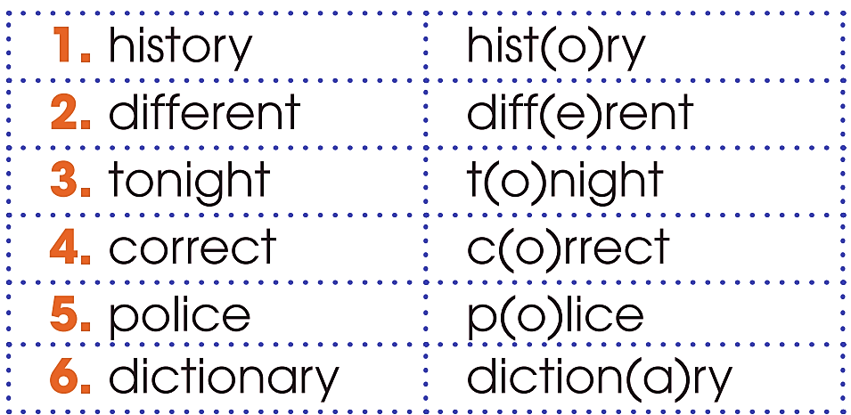
PRONUNCIATION
1
Listen and repeat.

Slide 8


PRONUNCIATION
2
Listen and repeat.
1. Let’s find the correct answer!
2. We also provide mobile library services in rural areas.
3. My family will move to a different country.
4. Please bring your dictionary to the history
class.
c(o)rrect
libr(a)ry
fam(i)ly - diff(e)rent
diction(a)ry - hist(o)ry

Slide 9
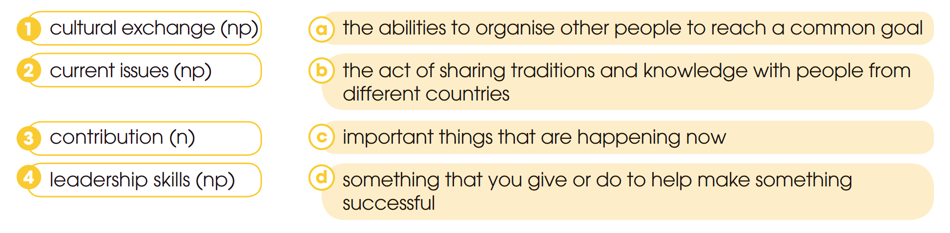

VOCABULARY
1
Match the word and phrases with their meanings.

Slide 10
VOCABULARY
2
Complete the sentences using the word and phrases in Task 1.
1. Communicating with people and managing teamwork well are important _______________.
2. ASEAN has made a major ____________ to peace in the region.
3. A _______________ is the best way for young people to understand other countries’ values and ideas.
4. The aim of this meeting is to discuss ____________ such as climate change and pollution.
leadership skills
contribution
cultural exchange
current issues

Slide 11

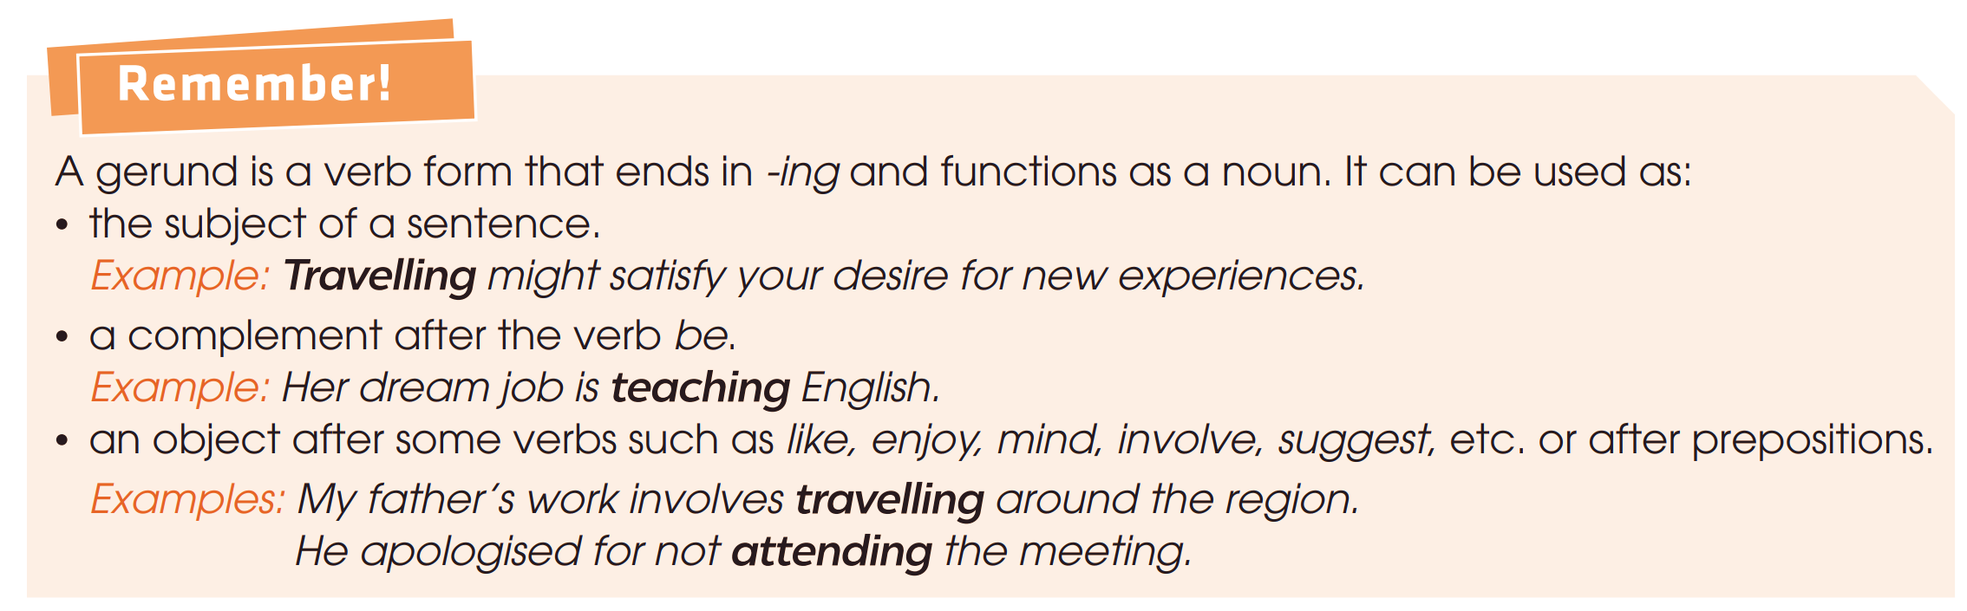
GRAMMAR

Slide 12
GRAMMAR
1
Rewrite the following sentences using gerunds.
1. It is more convenient for students to apply for ASEAN scholarships online.
→ ______________________________________ is more convenient for students.
Applying for ASEAN scholarships online

Slide 13
GRAMMAR
1
Rewrite the following sentences using gerunds.
2. My sister usually listens to music in her free time.
→ My sister’s hobby is _______________ in her free time.
listening to music

Slide 14
GRAMMAR
1
Rewrite the following sentences using gerunds.
3. Could you help me translate the documents for the workshop?
→ Do you mind ______________________________ for the workshop?
helping me translate the documents

Slide 15
GRAMMAR
1
Rewrite the following sentences using gerunds.
4. They managed to start a youth programme in Southeast Asia.
→ They succeeded in ________________________ in Southeast Asia.
starting a youth programme

Slide 16
GRAMMAR
1
Rewrite the following sentences using gerunds.
4. Maria can’t forget the conference she participated last year.
→ __________________________________ was an unforgettable experience for Maria.
Participating in the conference last year

Slide 17
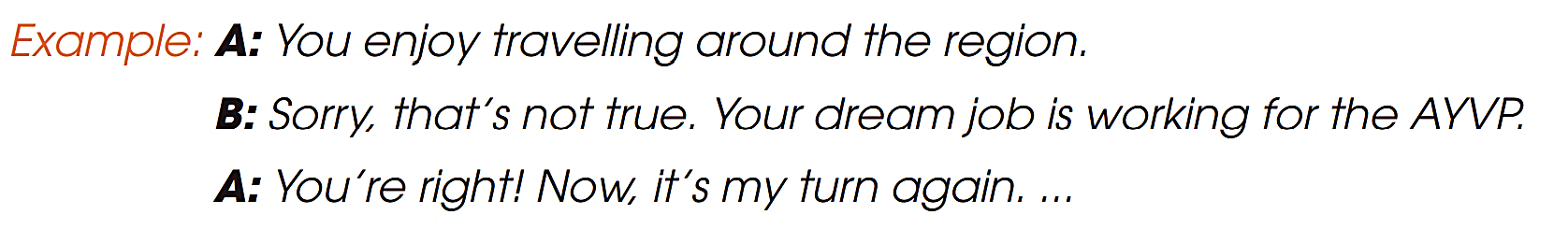

GRAMMAR
2
Work in pairs. Take turns to make sentences about your partner, using gerunds. He or she should tell you if they are true.

Slide 18
CONSOLIDATION
1
Wrap-up
What have you learnt today?
Identify and pronounce words with elision of vowels in isolation and in sentences.
Understand and use words and phrases related to ASEAN.
Use gerunds as subjects and objects.

Slide 19

CONSOLIDATION
2
Homework
Do exercises in the workbook.
Prepare for Lesson 3 - Unit 4.

Slide 20

Website: hoclieu.vn
Fanpage: facebook.com/www.tienganhglobalsuccess.vn

