Slide 1

Cùng nhóm Doraemon tìm hiểu những nước thuộc châu Á nha !
Picture
Ensign
Name of Country

Slide 2
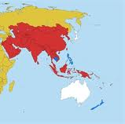

4
3
5
2
1

Slide 3

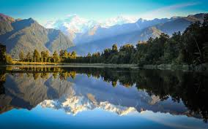
….. New Zealand

Slide 4
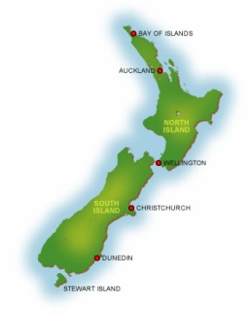
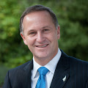
Size: 268 . 021 km²
Population: 4,471,000 people (2013)
New Zealand's prime minister : John Phillip Key

Slide 5
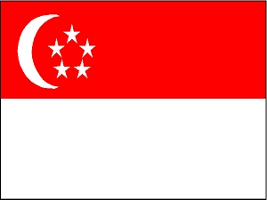
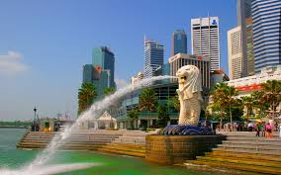
…. Singapore

Slide 6
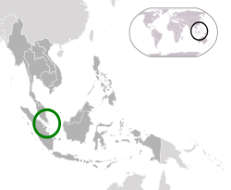
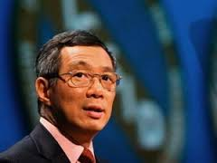
Size: 716.1 km²
Population: 5,399,000 people (2013)
Prime Minister of Singapore Lee Hsien Loong

Slide 7
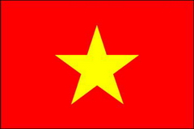
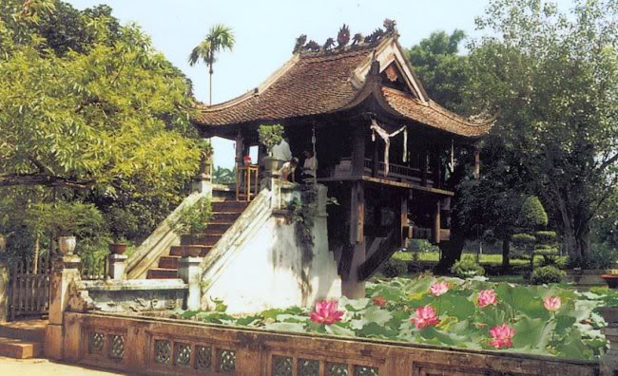
…. Vietnam

Slide 8
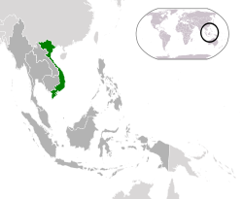
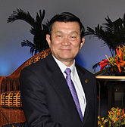
Size: 331 210 km²
Population: 89.71 million people
Vietnam President: Truong Tan Sang

Slide 9
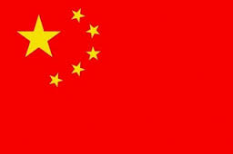
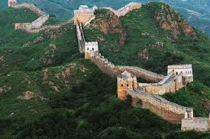
….. China

Slide 10
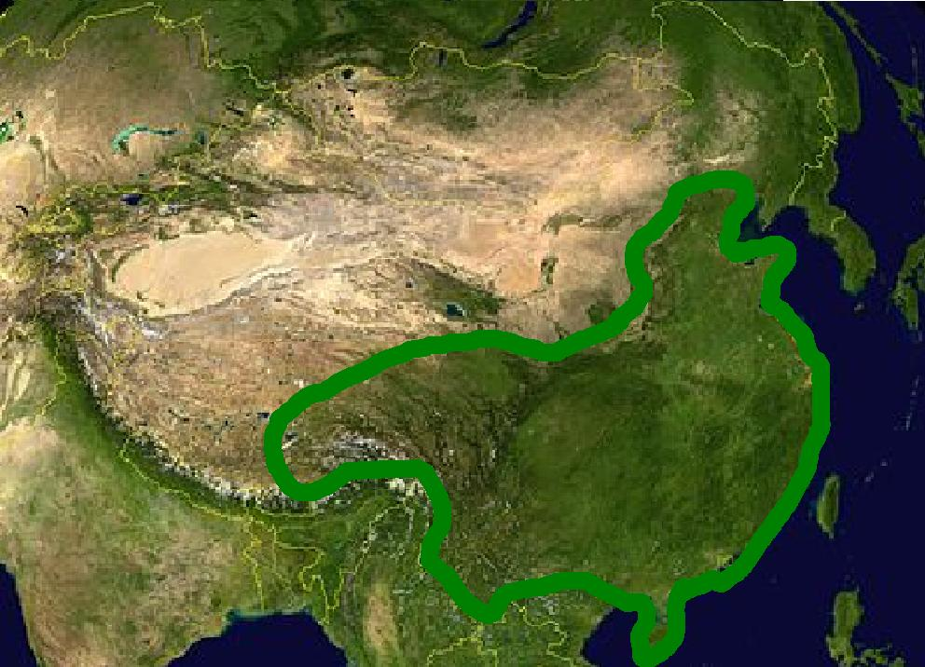
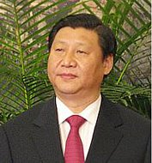
Size: 9.596.961 km²
Population: 1.357 billion people (2013)
Chinese premier: Xi( Tập Cân Bình )

Slide 11
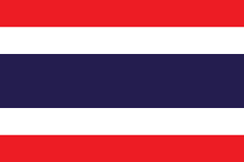
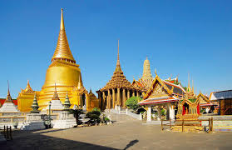
….. Thailand

Slide 12
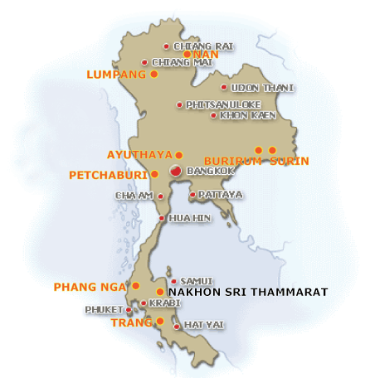
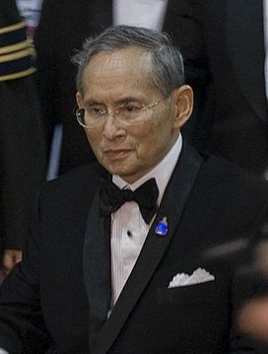
Size: 513 120 km²
Population: 67.01 million people
The King of Thailand: Bhumibol Adulyadej

Slide 13
Together they learn about the country Thailand and Thailand's Bangkok home!

Slide 14
Unit 16: Peoples and Places
Section A: Famous Places in Asia. Lesson 1. A₁-₂ . Page from 154 to 155

Slide 15
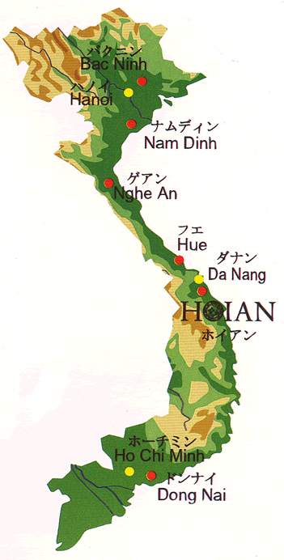
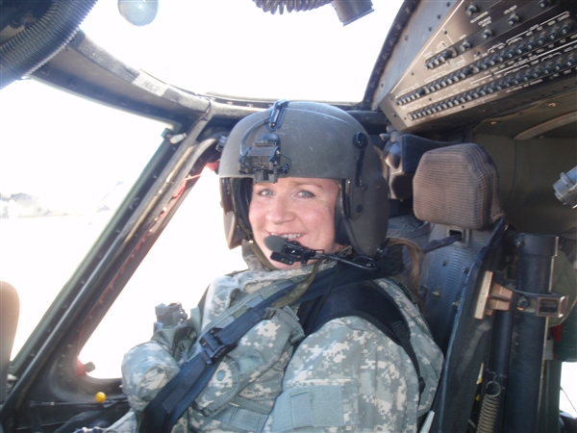
Unit 16: Peoples and Places
Section A: Famous Places in Asia. Lesson 1. A₁-₂ . Page from 154 to 155
I. Listen. Then practice with a partner
1 Vocabulary
(to) send – sent ( past form)
: gửi
Pilot(n)
: Phi công
Region (n)
: Vùng miền
Occasionally (adv)
:Thỉnh thoảng
Both (adv)
(adj)
: anh và tôi
: cả hai

Slide 16
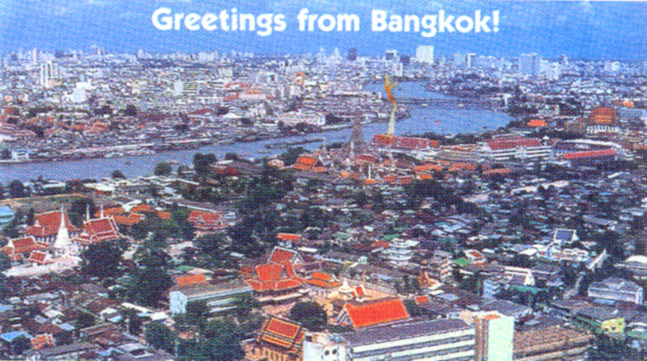
Bangkok is the capital and is also the most populous city of Thailand. Bangkok has an area 1568.7 km2 and is located in the Chao Phraya River Basin in central Thailand with a population of about 8 million people. If including the Bangkok metropolitan area of the city's population of over 14 million, representing more than 1/5 of the national population and surpassed all other urban areas in Thailand.

Slide 17

Hoa: What is this, Ba ?
Ba: It’s a postcard from my uncle Nghia. He sent it from Bangkok
Hoa: What is he doing in Bangkok?
Ba: He’s a pilot. It’s his job to fly there.
Hoa: How execting! Does he fly only to Bangkok ?
Ba: No. He flies all over the region. He usually flies to Hong Kong as well as Bangkok. Sometimes he flies to Kuala Lumpur, or Singapore or Jakarta. Occasionally he goes to Phnom Penh, Vientiane or Yangon
Hoa: I’d love to see all those places.
Ba: Me, too. My uncle sends me postcards every time he goes away, so I have both postcards and stamps from all those cities.
Hoa: Can I see the stamps ?
Ba: Sure. I’ll bring my album to school tomorrow.

Slide 18
Unit 16: Peoples and Places
Section A: Famous Places in Asia. Lesson 1. A₁-₂ . Page from 154 to 155
I. Listen. Then practice with a partner
1 Vocabulary
2. Now match the half - sentences

Slide 19

a, Ba’s uncle is
b, Uncle Nghia sends postcards
c, Ba keeps the postcards
d, Ba puts the stamps
e, Hoa wants to
f, Ba and Hoa would like to visit
A. see the stamps.
B. as well as the stamps.
C. in a special book.
D. a pilot.
E. many different places.
F. to Ba from the cities he visits.

Slide 20
Unit 16: Peoples and Places
Section A: Famous Places in Asia. Lesson 1. A₁-₂ . Page from 154 to 155
I. Listen. Then practice with a partner
1 Vocabulary
2. Now match the half - sentences
II. Complete the table. Use the names of the countries in the box
1. Complete the table

Slide 21
Capital | Countries
Bangkok
Beijing
Kuala Lumpur
Phnom Penh
Vientiane
Yangon
Jakarta
Thailand
China
Malaysia
Cambodia
Laos
Myanmar
Indonesia

Slide 22
Unit 16: Peoples and Places
Section A: Famous Places in Asia. Lesson 1. A₁-₂ . Page from 154 to 155
I. Listen. Then practice with a partner
1 Vocabulary
2. Now match the half - sentences
II. Complete the table. Use the names of the countries in the box
1. Complete the table
2. Now ask and answer questions with a partner.

Slide 23
Eg dialogue:
Alan : Where does Ba’s uncle fly to ?
Alex : He usually flies to Phnom Penh.
Alan : Where is that ?
Alex : It’s in Cambodia
Based on the suggestions below to make conversation with you next!
Hanoi
Tokyo
Singapore City
Jakarta

Slide 24



*Choose the best answer and circle it:
1. Kuala Lumpur is the capital of ………..
A.Australia B.Malaysia C.Japan
2. Ba’s uncle is a ………
A.farmer B.doctor C.pilot.
3. Mr Nghia …….. flies to Kuala Lumpur.
A.usually B.sometimes C.occasionally
4.Bangkok is the capital of …………
A.Thailand B.Malaysia C.Indonesia

Slide 25
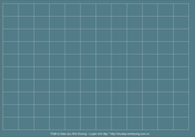
Guide to home
+ Memorize new words. Write each of 2 lines
+ Exercise 1 + 2 in English workbooks 7

Slide 26






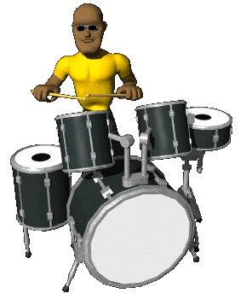



THANK YOU
FOR YOUR ATTENTION
GOODBYE !

