Slide 1

UNIT 3: SHOPPING
Lesson 1.2 – Grammar
Page 21

Slide 2


Unit 3 Lesson 1.2
Lesson 1.2
LESSSON OUTLINE
Consolidation

Slide 3

Unit 3 Lesson 1.2
By the end of this lesson,
students will be able to:
- to practice and use comparative and superlative adjectives correctly.

Slide 4
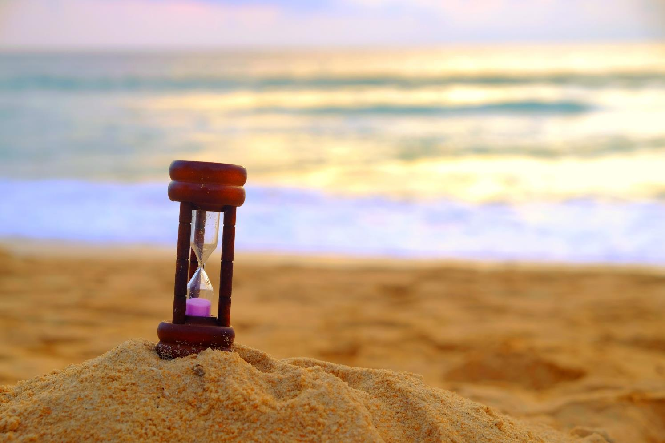


Slide 5

Unit 3 Lesson 1.2
Work in pairs.
Who is taller, you or your partner?
Who is shorter, you or your partner?
Who is more intelligent, you or your partner?
I am taller than my partner.

Slide 6



Slide 7

Presentation

Slide 8



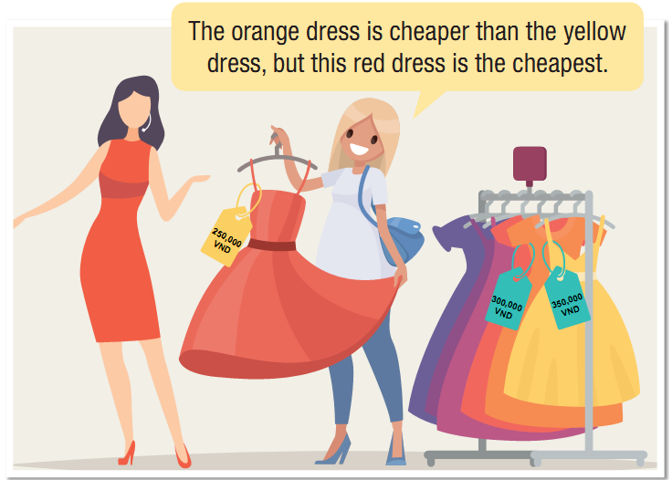
Unit 3 Lesson 1.2
Notes:
Please, click on each phrase to hear the sound

Slide 9
Unit 3 Lesson 1.2
1. What is the comparative adjective?
→ cheaper (than)
2. What is the superlative adjective?
→ the cheapest
Notes:
Please, click on each phrase to hear the sound

Slide 10
Unit 3 Lesson 1.2
3. How can we form the comparative and superlative adjectives?
Notes:
Please, click on each phrase to hear the sound

Slide 11
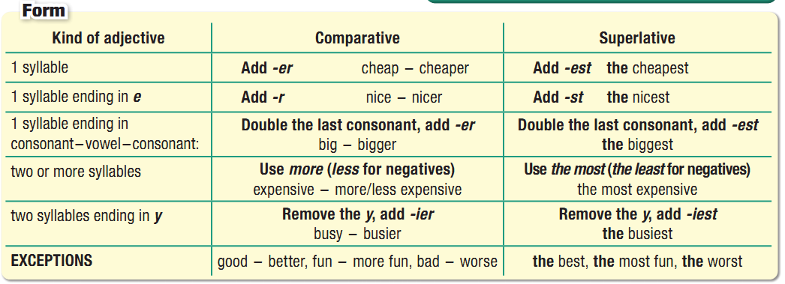
Unit 3 Lesson 1.2
Comparative and Superlative Adjectives
Notes:
Please, click on each phrase to hear the sound

Slide 12
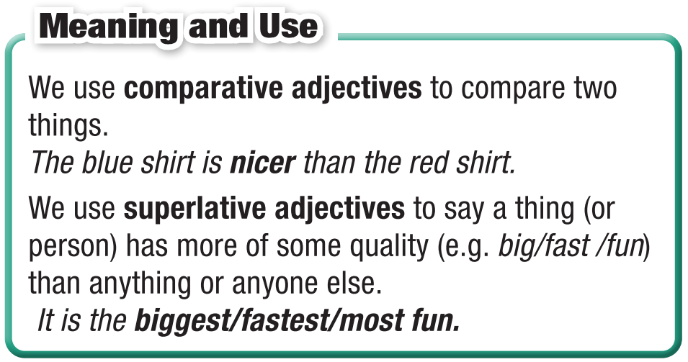
Unit 3 Lesson 1.2
Comparative and Superlative Adjectives
Notes:
Please, click on each phrase to hear the sound

Slide 13
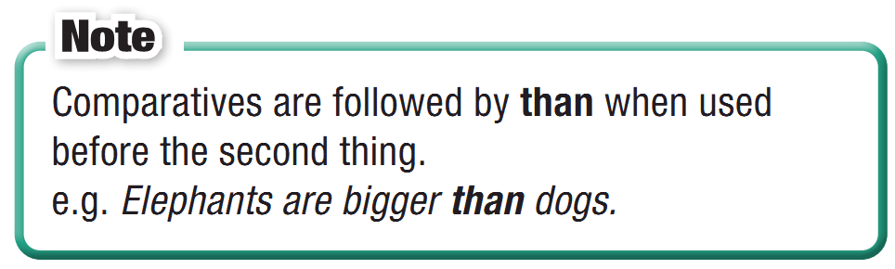
Unit 3 Lesson 1.2
Comparative and Superlative Adjectives
Notes:
Please, click on each phrase to hear the sound

Slide 14
Unit 3 Lesson 1.2
Comparative and Superlative Adjectives
Notes:
Please, click on each phrase to hear the sound

Slide 15
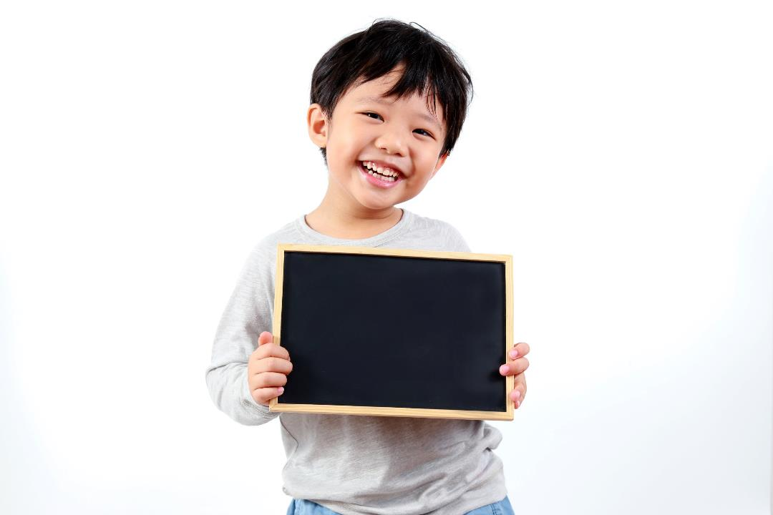
Practice

Slide 16
Unit 3 Lesson 1.2
b. Circle the correct words.
1. I think you should buy this pair of sunglasses. It looks cooler/coolest than the other pair.
2. Can I borrow some money? This dress is more/most expensive than I thought.
3. This restaurant may not have the greatest food in town but their customer service is definitely the best/better. We eat here at least twice a month.
4. It's best if you come on Wednesday, when I'm less busy/busiest. We'll have time to chat.
5. Shopping is my less/least favorite thing to do. It's boring and takes a lot of time.
Notes:
Please, click on each phrase to hear the sound

Slide 17
Unit 3 Lesson 1.2
c. Fill in the blanks with the right forms of the adjectives.
prettier than
1. I think this dress is _________________ (pretty) the other one.
2. This is _________________ (good) place to shop for shoes in town. All the other stores are too expensive.
3. I rarely wear my green jacket. It's _______________________ (comfortable) my red one.
4. Do you have a _________________ (expensive) bag? This one is a bit too much.
5. We'll never go back to that restaurant. It has _________________ (bad) customer service ever.
6. The black shirt is _________________ (good) the white one, so it will last longer.
the best
less comfortable than
less expensive
the worst
better than
Notes:
Please, click on each phrase to hear the sound

Slide 18
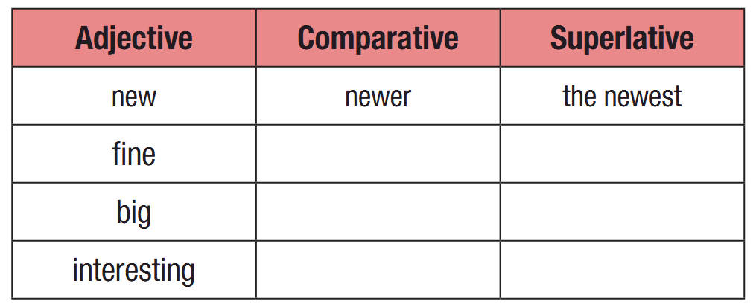
Unit 3 Lesson 1.2
Extra Practice
WB, page 15
a. Complete the table with the correct comparative and superlative adjectives.
finer
the finest
bigger
the biggest
more interesting
the most interesting
Notes:
Taken from TA 10 i-Learn Smart World WB, page 2

Slide 19
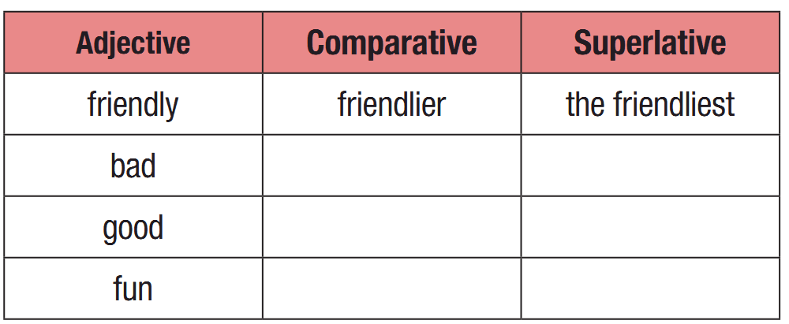
Unit 3 Lesson 1.2
Extra Practice
WB, page 15
a. Complete the table with the correct comparative and superlative adjectives.
worse
the worst
better
the best
more fun
the most fun
Notes:
Taken from TA 10 i-Learn Smart World WB, page 2

Slide 20
Unit 3 Lesson 1.2
Extra Practice
WB, page 15
b. Fill in the blanks using comparatives or superlatives.
1. (good) Dime Time is a very good clothing store. It's the best store in Blackwater Falls.
2. (good) Dime Time is ____________________ the shopping mall for people who want to save money.
3. (cheap) Dime Time is ____________________ store in town.
better than
the cheapest
Notes:
Taken from TA 10 i-Learn Smart World WB, page 2

Slide 21
Unit 3 Lesson 1.2
Extra Practice
WB, page 15
b. Fill in the blanks using comparatives or superlatives.
bigger than
4. (big) The shopping mall has a ____________________ range of clothes than Dime Time.
5. (expensive) The shopping mall is ____________________ place to shop in town.
6. (noisy) The shopping mall is ____________________ Dime Time.
7. (crowded) On the weekends, Dime Time can be ____________________ the shopping mall.
the most expensive
less noisy/ noisier
less crowded than
Notes:
Taken from TA 10 i-Learn Smart World WB, page 2

Slide 22
Unit 3 Lesson 1.2
Extra Practice
WB, page 15
b. Fill in the blanks using comparatives or superlatives.
4. (big) The shopping mall has a ____________________ range of clothes than Dime Time.
5. (expensive) The shopping mall is ____________________ place to shop in town.
6. (noisy) The shopping mall is ____________________ Dime Time.
7. (crowded) On the weekends, Dime Time can be ____________________ the shopping mall.
bigger than
the most expensive
less noisy/ noisier
less crowded than
Notes:
Taken from TA 10 i-Learn Smart World WB, page 2

Slide 23

Production

Slide 24

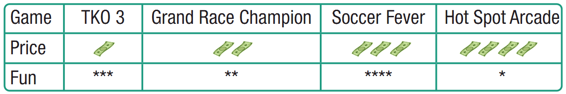
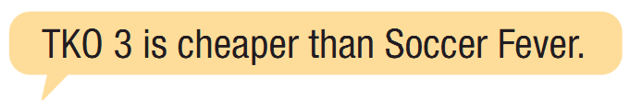
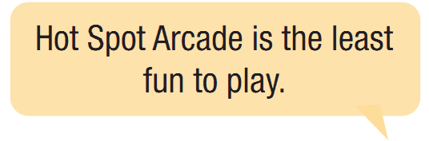
Unit 3 Lesson 1.2
d. In pairs: Compare computer games.
Use the prompts from the box.
Notes:
Please, click on each phrase to hear the sound

Slide 25

Unit 3 Lesson 1.2
e. In pairs:
Are you more similar to Sam or Alice? Why?
I am similar to Same/Alice because ……

Slide 26

Consolidation

Slide 27
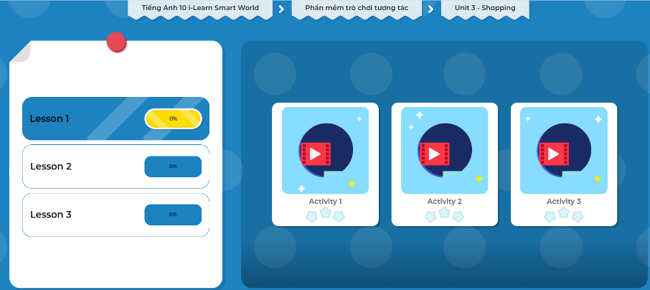
Let’s play!
Click here to play the games!

Slide 28
Unit 3 Lesson 1.2
Today’s lesson
Wrap-up
Grammar: Comparative and Superlative Adjectives

Slide 29


Slide 30
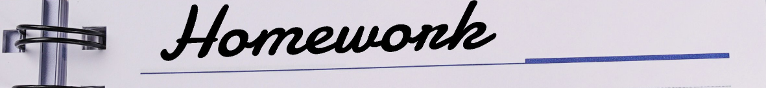
Unit 3 Lesson 1.2
Make 10 sentences, using comparative and superlative adjectives.
Do the exercises in WB on page 15.
Do the exercises in Tiếng Anh 10 i-Learn Smart World Notebook on page 15.
Prepare the next lesson – Pronunciation, SB (page 22)
Play the consolidation games in Tiếng Anh 10 i-Learn Smart World DHA on www.eduhome.com.vn

Slide 31
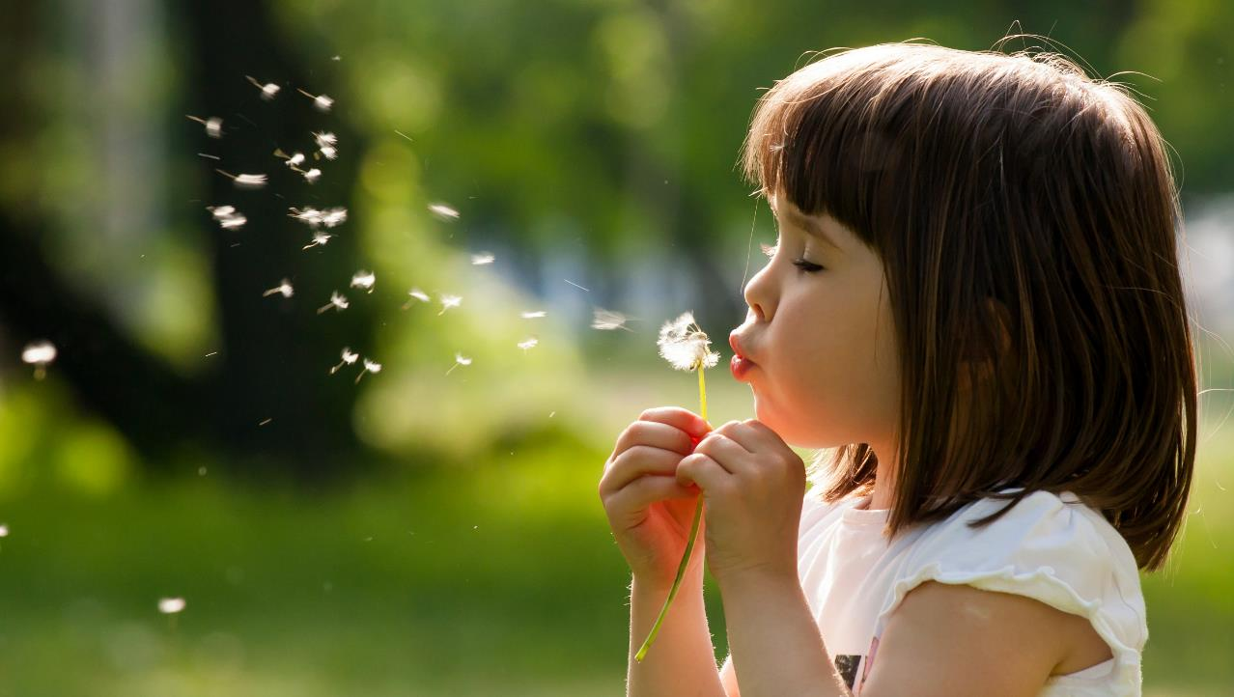
Enjoy your day!

