Slide 1
KET SPEAKING
Time allowed - 8-10 minutes
Normally you will do the speaking test with another candidate. The two of you will meet two examiners. One of the examiners will talk to you, the other does not participate in the conversations.
There are two parts to the speaking test:
Speaking part 1: short questions and answers between you and the examiner.
Speaking part 2: the examiner gives you some information or a card with some ideas for questions. You have to talk with the other candidate and ask or answer questions.
Scoring The Speaking section is worth 25% of the total score for the exam.
How to prepare for KET Speaking:
Speak as much as you can, with your friends
Practise asking and answering questions about daily life
Practise giving information about yourself

Slide 2
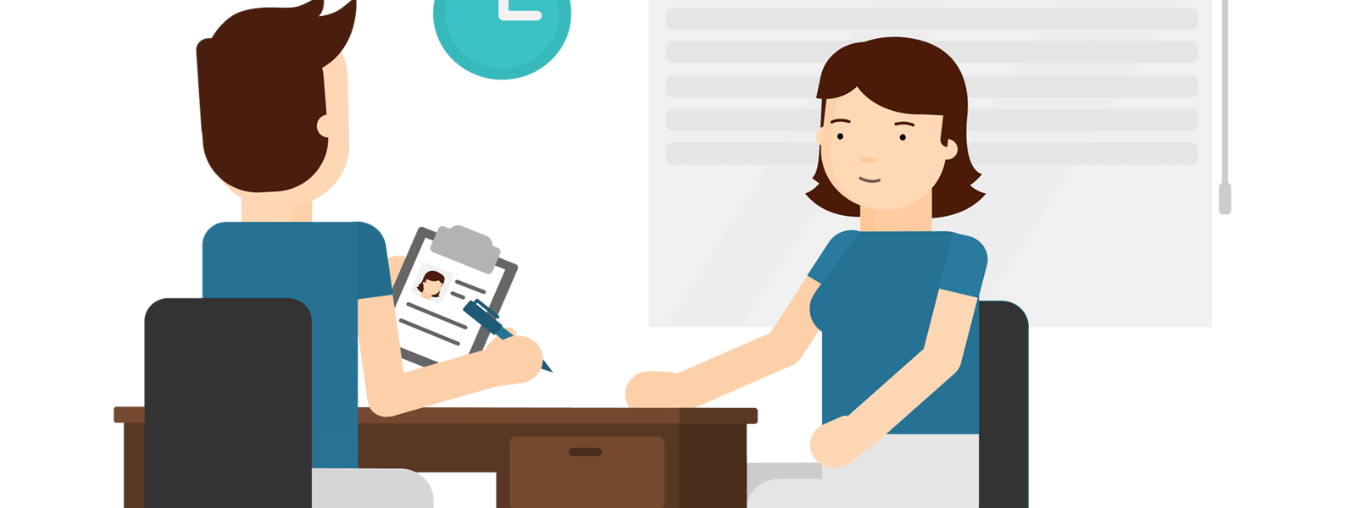
KEY ENGLISH TEST 5
Test 4 - Speaking

Slide 3
Part 1: Student – examiner interaction
Section 1:
The examiner will ask you:
Your name
Where you come from?
Provide full-sentence answers

Slide 4
Part 1: Student – examiner interaction
Section 2: You will be asked some questions that require longer answers. For example:
Why you like something
Details about a hobby…

Slide 5
Popular topic
family
best friend
hometown
your house
sport
computer
collecting
music

Slide 6
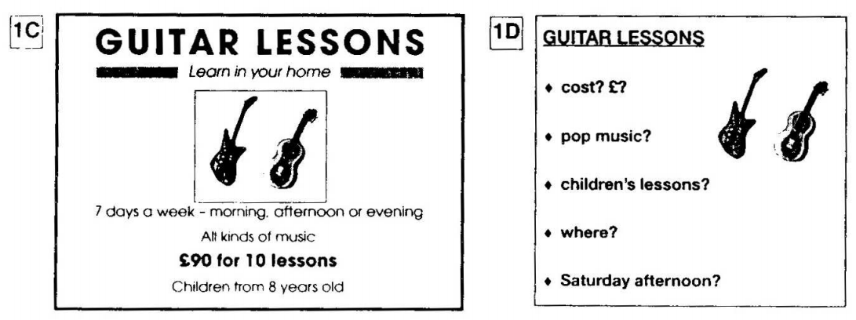
PART 2: Student – student interaction
Ask and answer questions based on the cue cards
For example:
Do not just read from the cards. Answer in full sentences.
Pay attention to the grammar.

Slide 7
SPEAKING PART 1

Slide 8
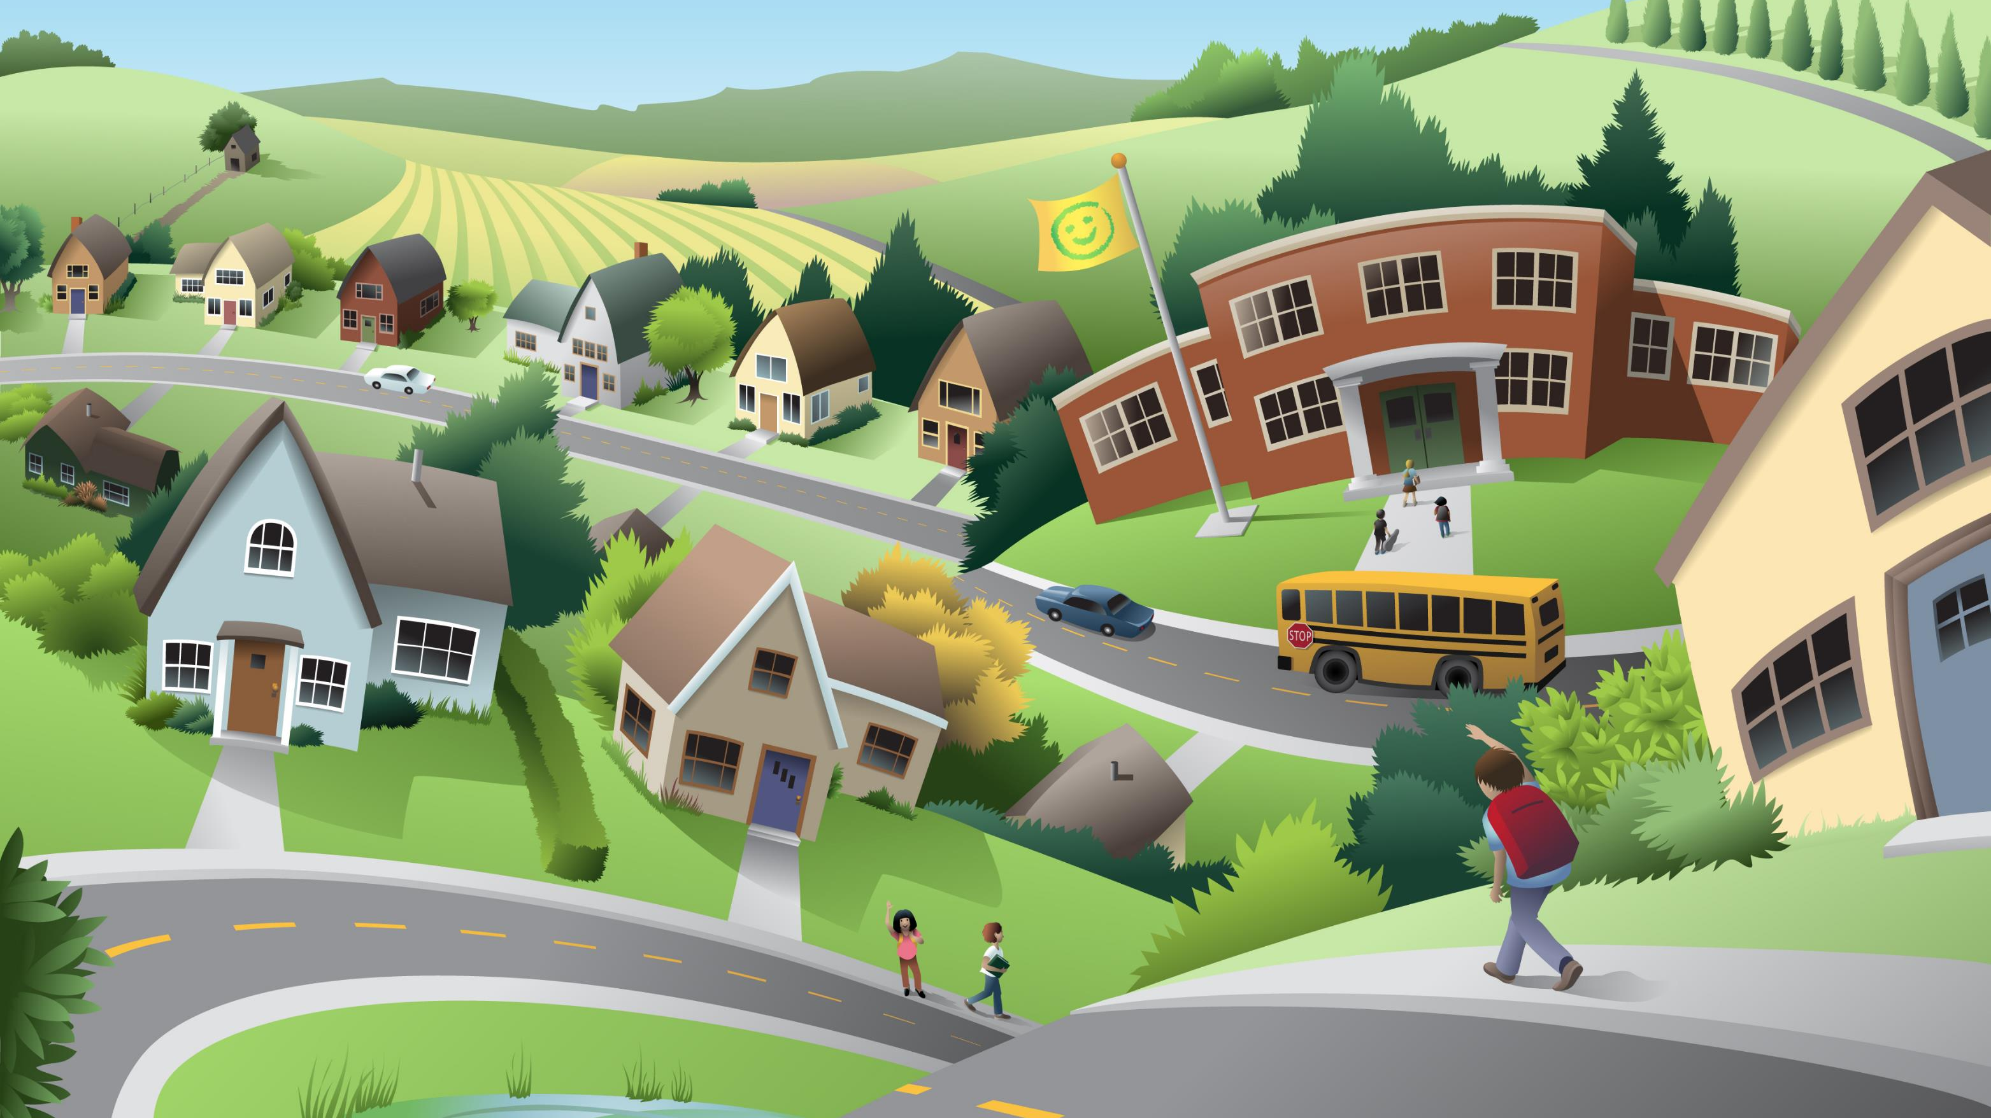
Part 1
What's the name of your hometown?
How long have you been living there?
What do you like most about your hometown?
Do you think you will continue living there for a long time?
Has your hometown changed much since you were a child?

Slide 9
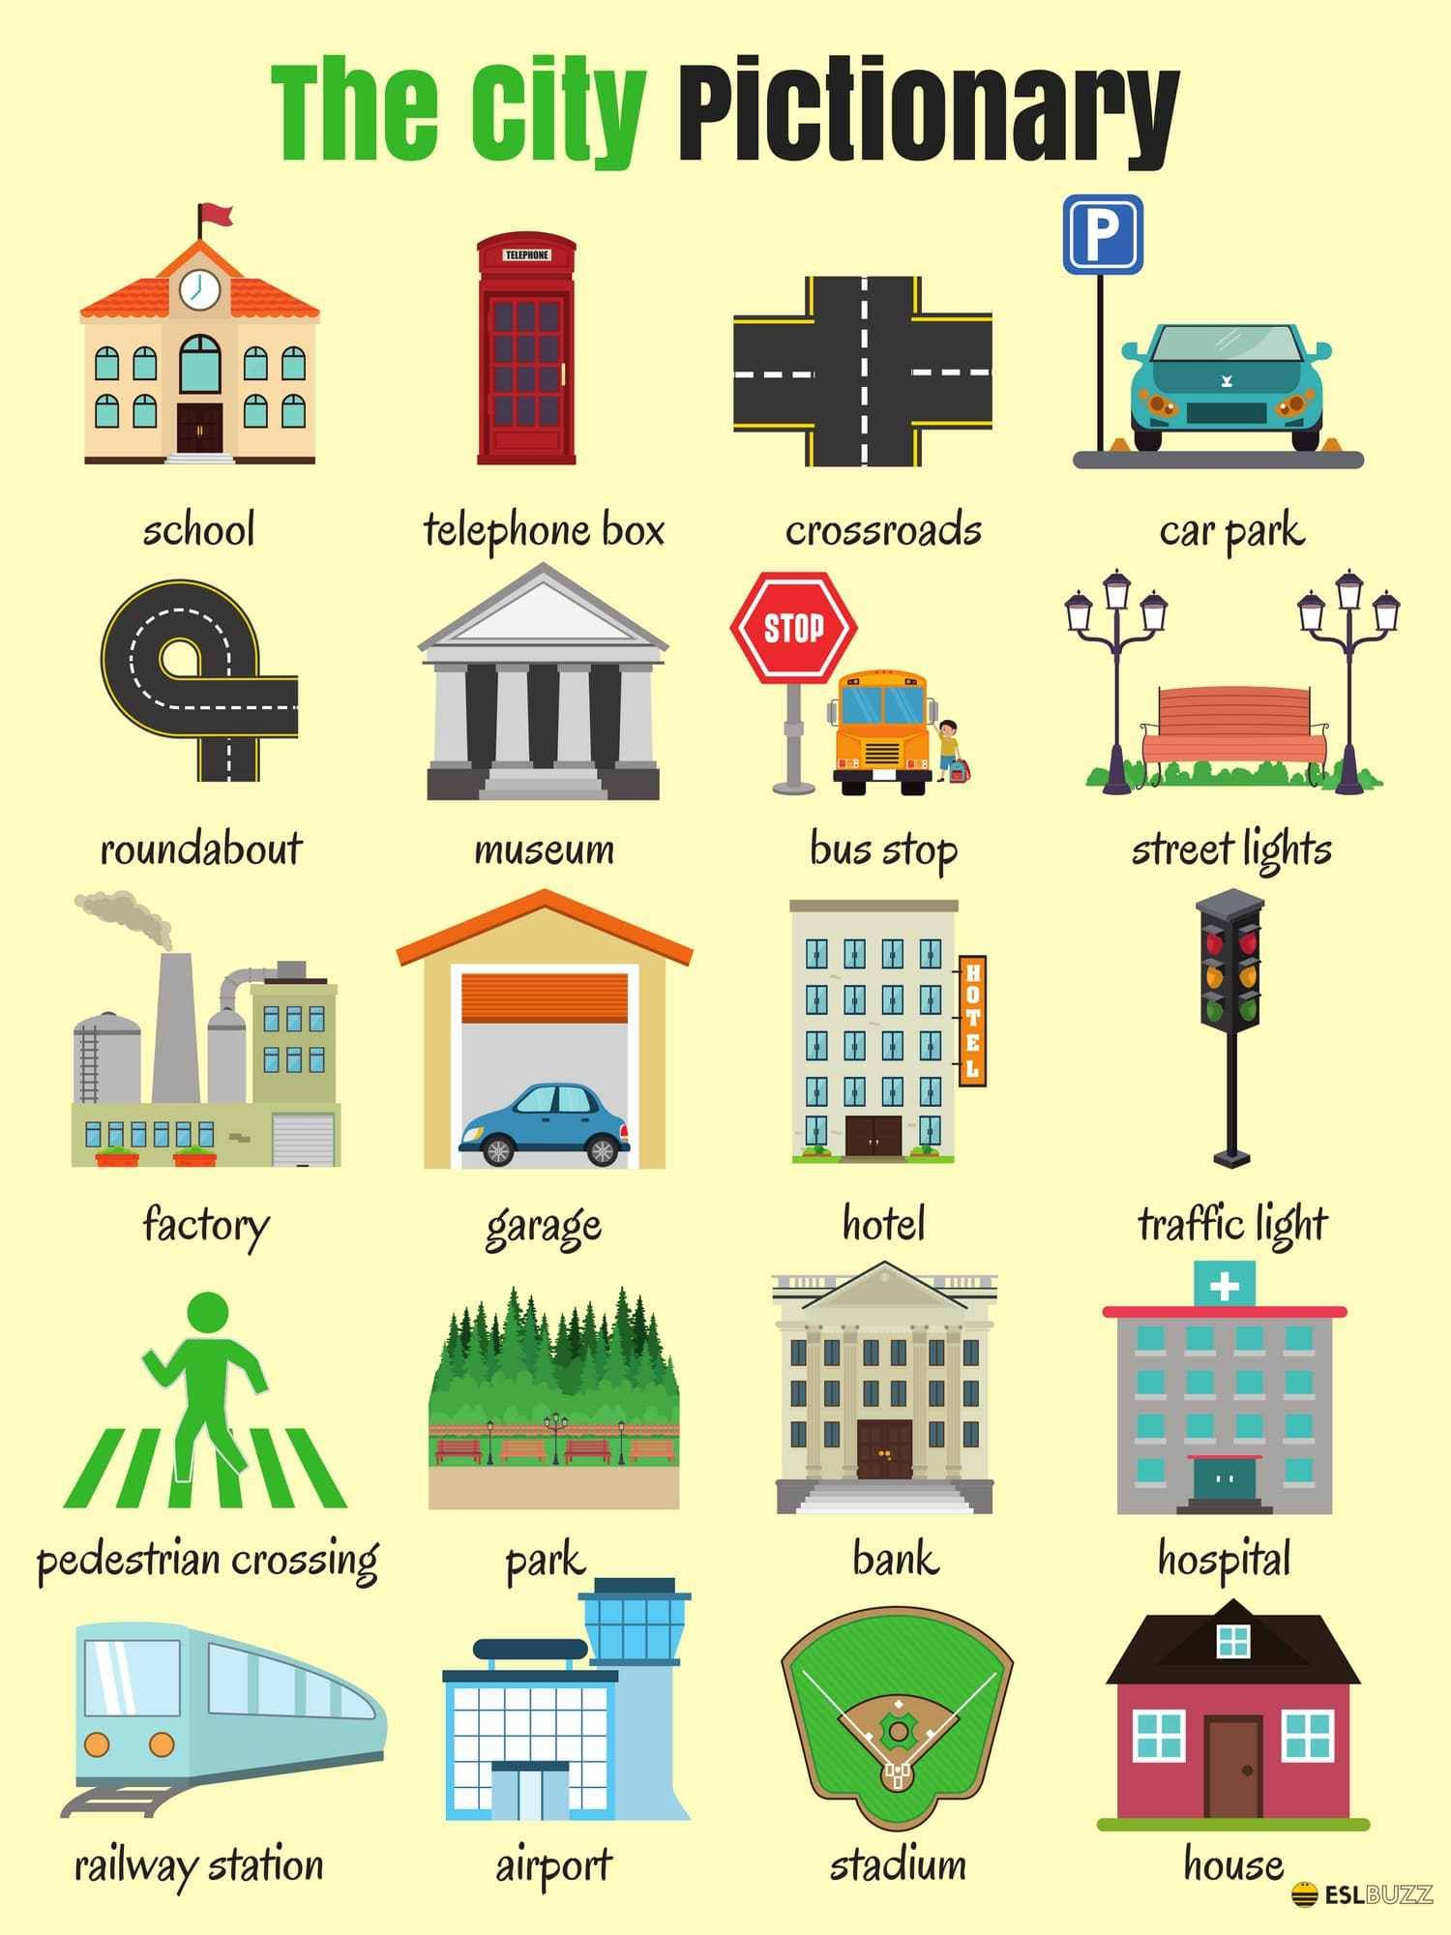
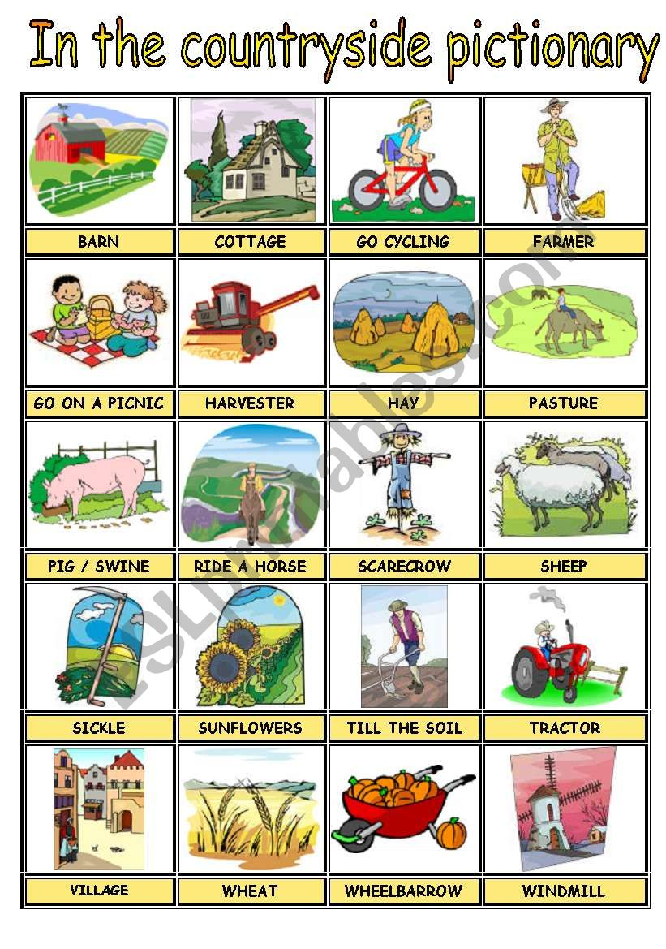

Slide 10
How long have you been living there?

Slide 11
USEFUL VOCABULARY
sprawling city: a city that has grown over time and which covers a wide area
office block: a large building that contains offices
inner-city: the central part of a city where people live and where conditions are often poor
tourist attraction: a place of interest to tourists
pace of life: nhịp sống
lively = bustling = vibrant
quiet = peaceful = tranquil

Slide 12
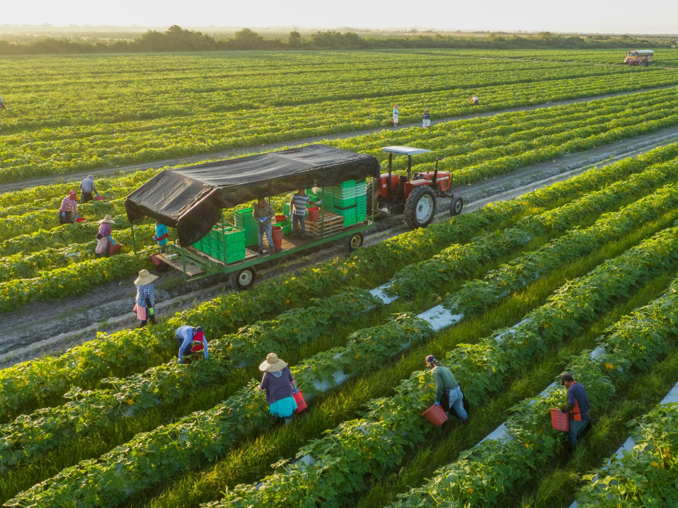
What do people in your town do?

Slide 13
Are there any changes you would like to make in your hometown? What is it?

Slide 14
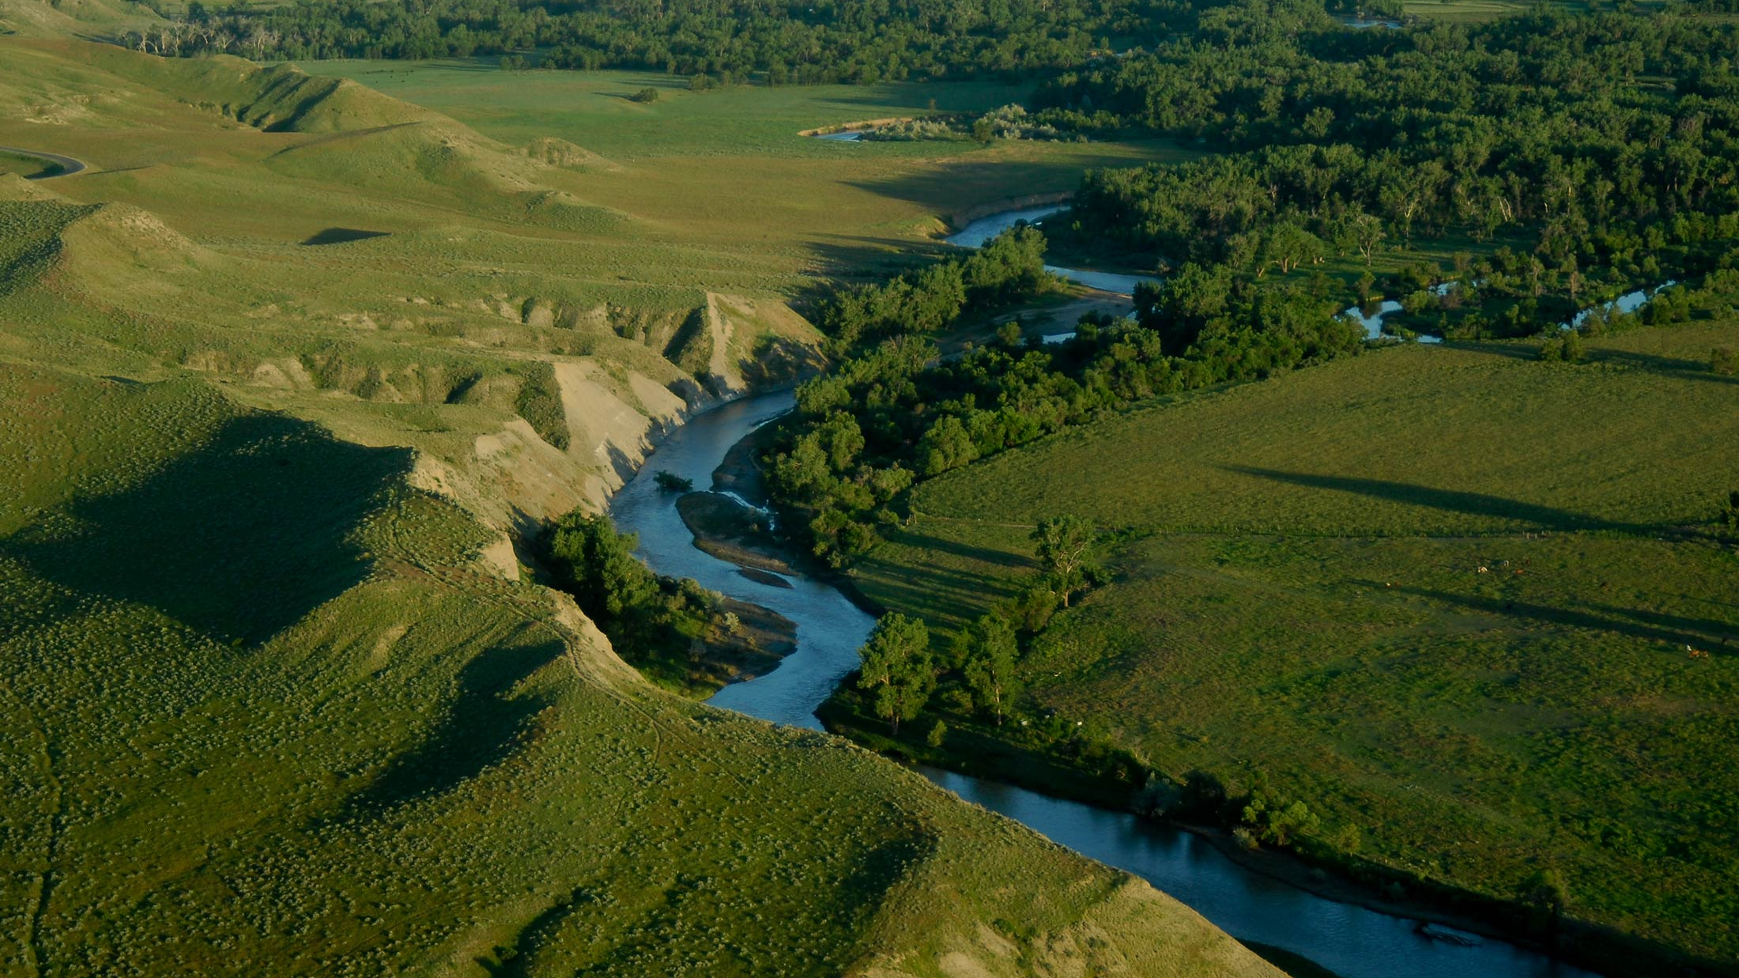
Talk about a place you like most in your hometown.
Describe the place
Where is it
What is special about it
And explain why you liked it

Slide 15
SPEAKING PART 2
Asking and answering questions using these prompt cards

Slide 16
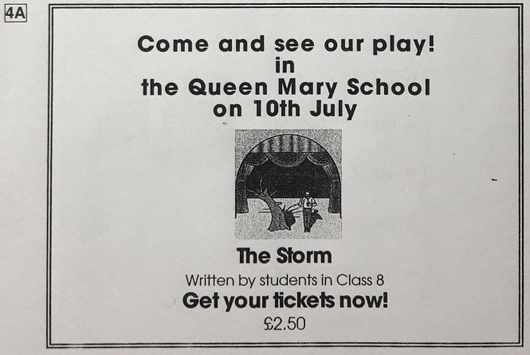
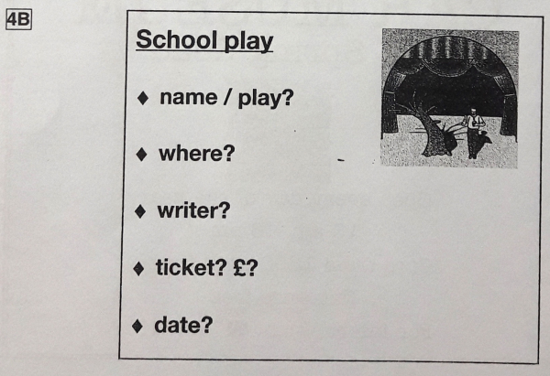
Ask and answer
Ask and answer questions using the words given.

Slide 17
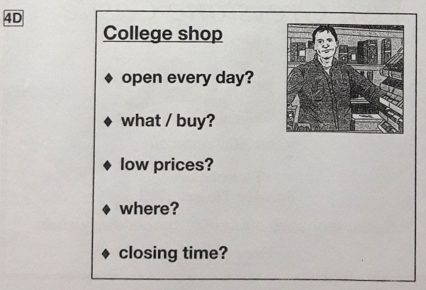
Ask and answer
Ask and answer questions using the words given.
What are other questions and answers you can think of?

Slide 18
Based on the given information, talk about College Shop.

