Slide 1










Unit 12
ENGLISH-SPEAKING COUNTRIES

Slide 2
TABLE OF CONTENTS
Communication Skills
Theory
Language
01
02
03

Slide 3

PART 1
THEORY
I. VOCABULARY

Slide 4


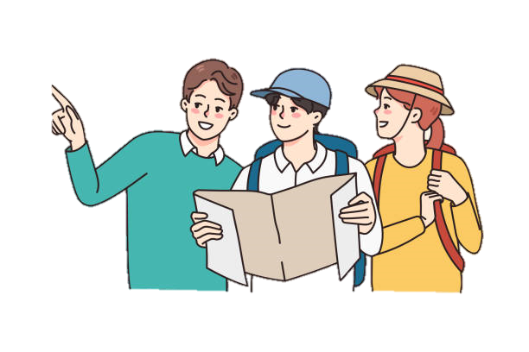

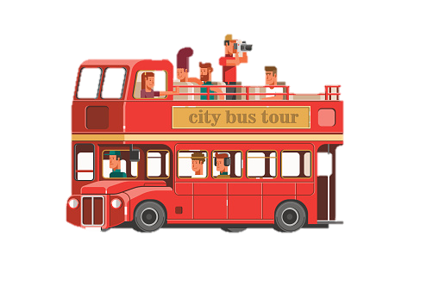

1. Fantastic (adj):
2. ask for direction (vPhr):
/fæn'tæstɪk/ tuyệt vời
/æsk fɒr də'rekʃn/
hỏi đường
3. take a tour (Vphr):
4. Wonderful (adj):
/'wʌndəfl/
tuyệt vời
/teɪk ə tʊr/
đi dạo một vòng
Notes:
CT: 0869444191

Slide 5
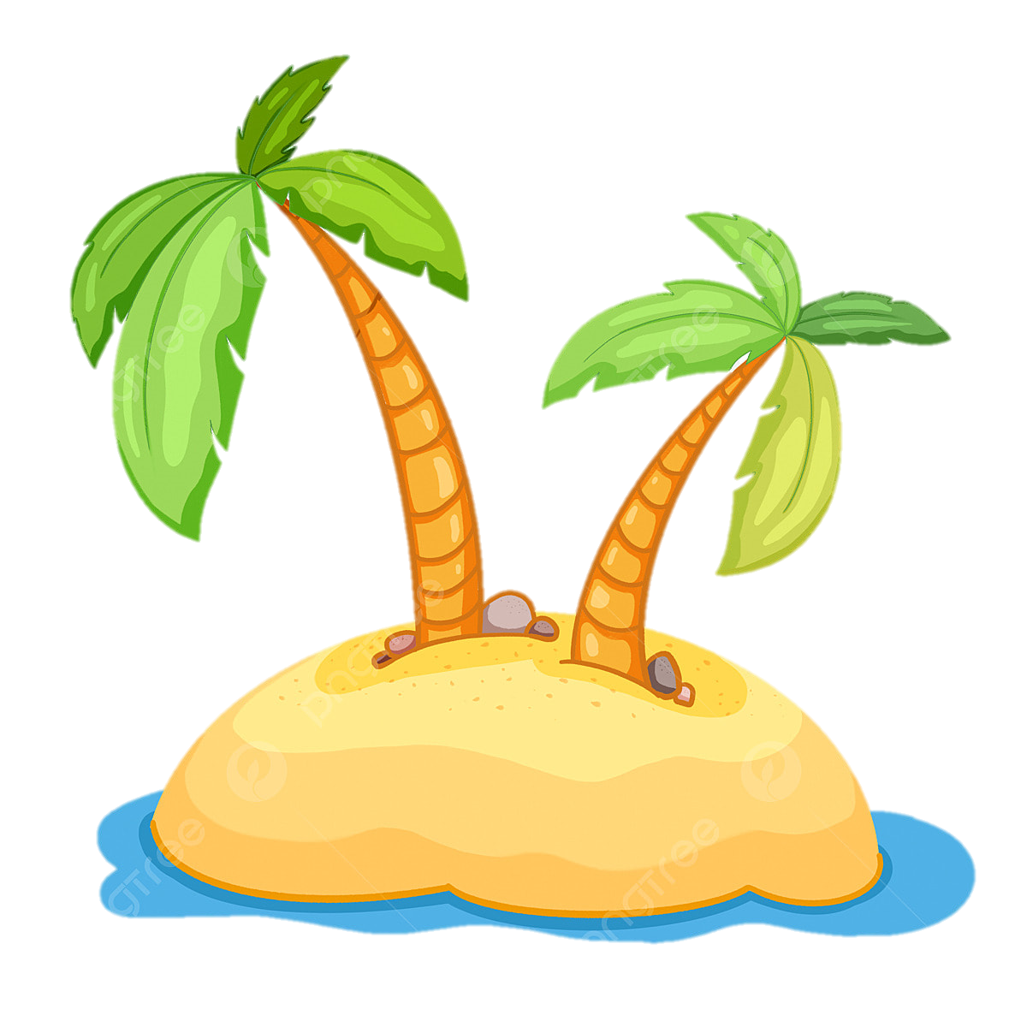
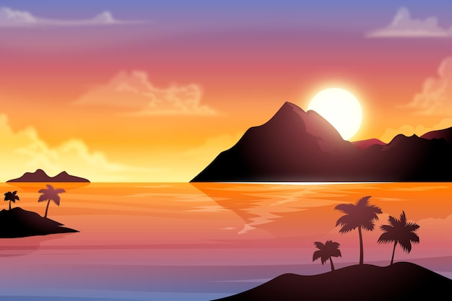
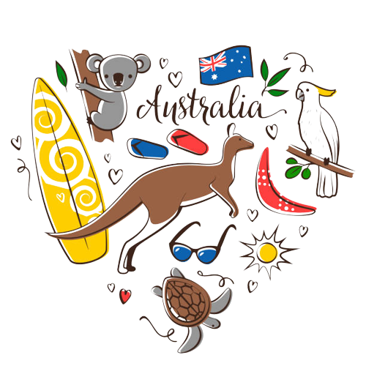

/'sʌnset/
cảnh mặt trời lặn
5. island (n):
6. sunset (n):
/'aɪlənd/
hòn đảo
8. Australia (n):
7. landscape (n):
/ɒ'streɪljə/
thuộc nước Úc, người Úc
/'lænd.skeɪp/
khung cảnh

Slide 6
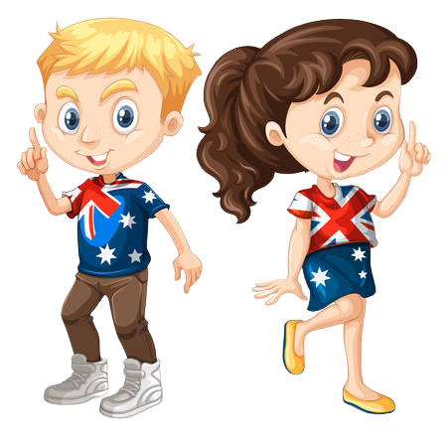

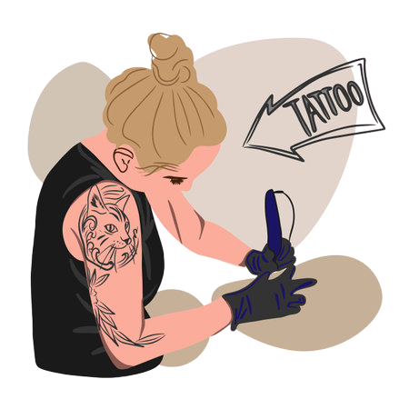
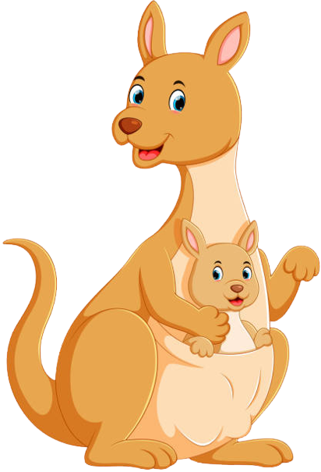
9. Australian (adj, n):
10. penguin (n):
/ɒ'streɪljən/
người Úc
/'peηgwɪn/
chim cánh cụt
12. kangaroo (n):
11. tattoo(n):
/.kæηgə'ru:/
con chuột túi
/tə'tu:/
hình xăm

Slide 7
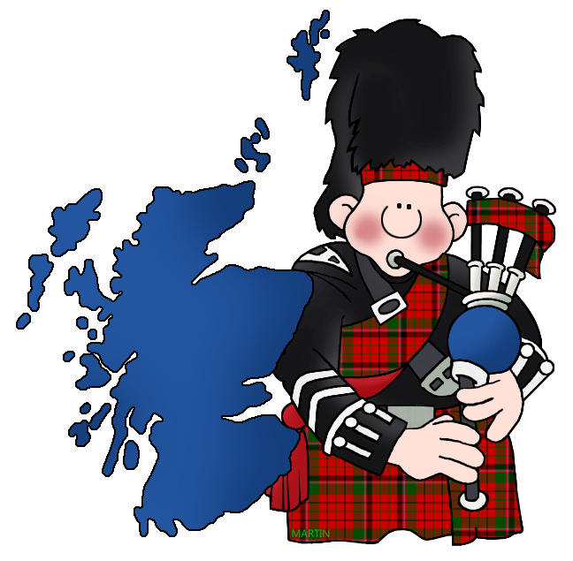
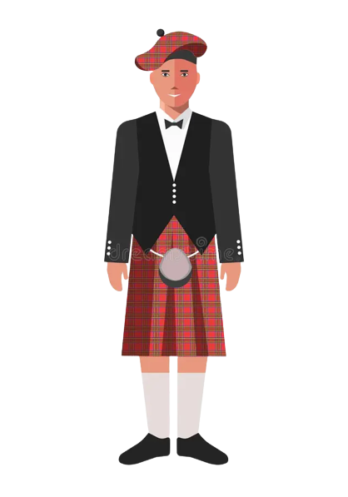
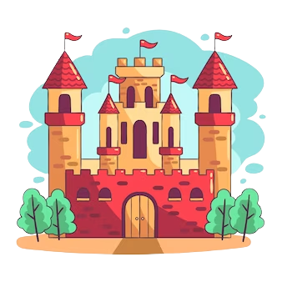
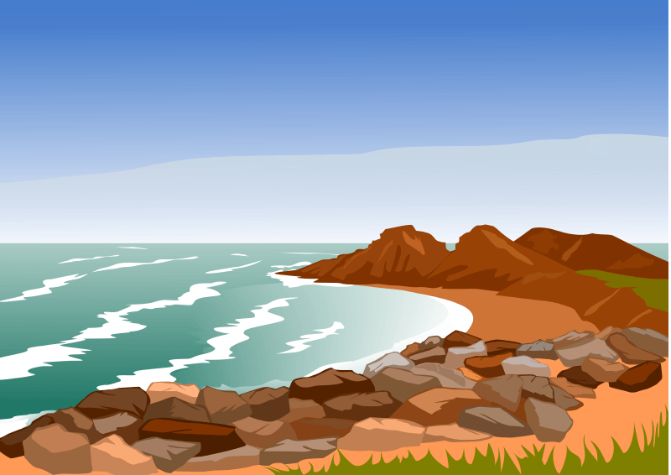
/kilt/
váy kilt (váy của đàn ông Xcốt-len)
13. Scottish (adj, n):
14. kilt (n):
/'skɒtɪʃ/
(thuộc) xứXcốt-len; người Xcốt-Ien
/'kɑ:sl/
lâu đài
16. coastline (n):
15. castle(n):
/'kəʊst.laɪn/
bờ biển

Slide 8
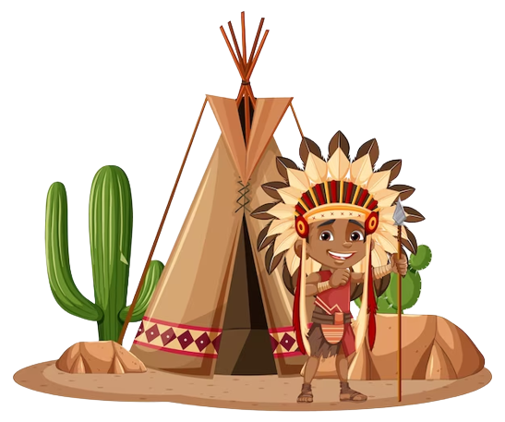
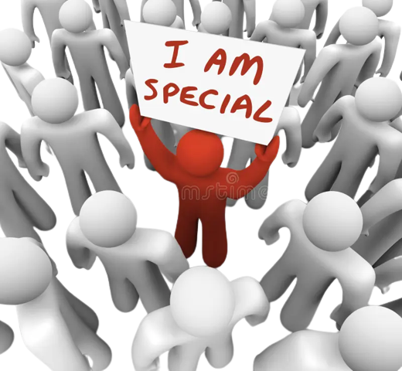
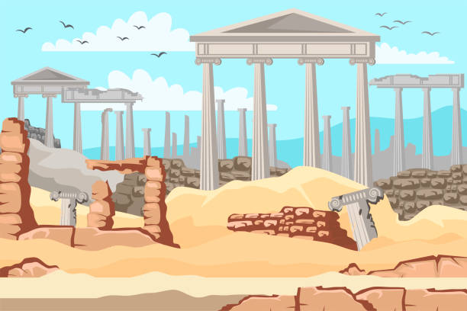
17. native (adj):
18. unique (adj):
/'neɪtɪv/
bản xứ
/ju'ni:k/
độc đáo, duy nhất
19. amazing (adj):
/ə'meɪzɪη/ Kì thú, kì lạ
20. ancient (adj):
/'eɪnʃənt/
Cổ xưa
21. local (adj):
/'ləʊkl/
thuộc về địa phương

Slide 9

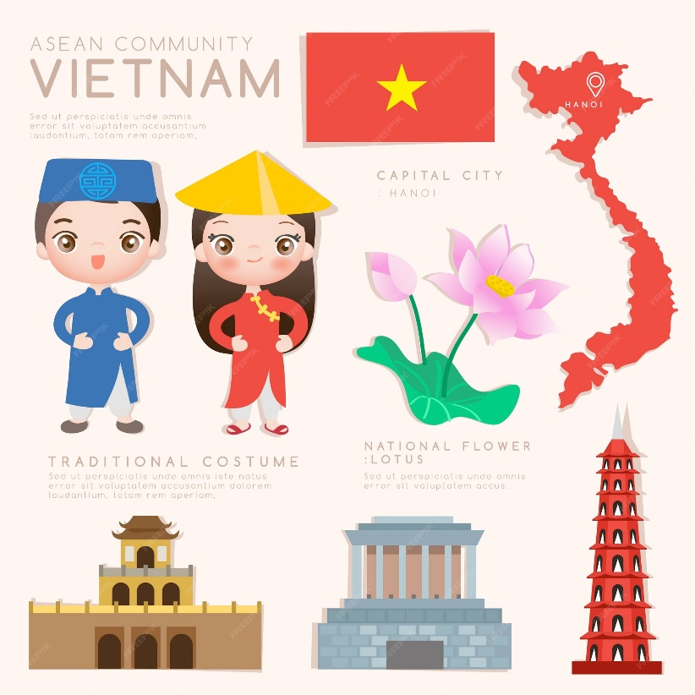
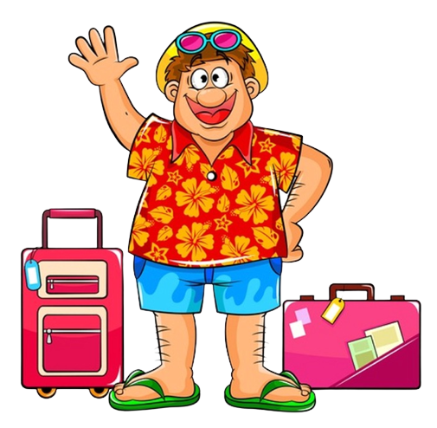
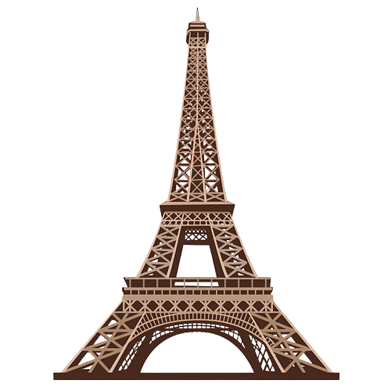
/'kæpɪtl/
thủ đô
22. symbol (n):
23. capital (n):
/'sɪmbl/
biểu tượng
/'taʊər/
tòa tháp
/'tʊrəst/
Du khách
25. tourist (n):
24. tower (n):

Slide 10
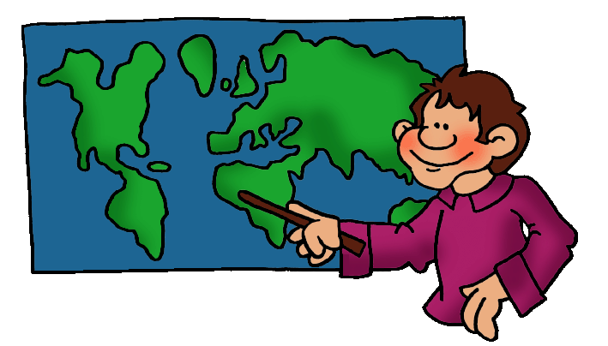
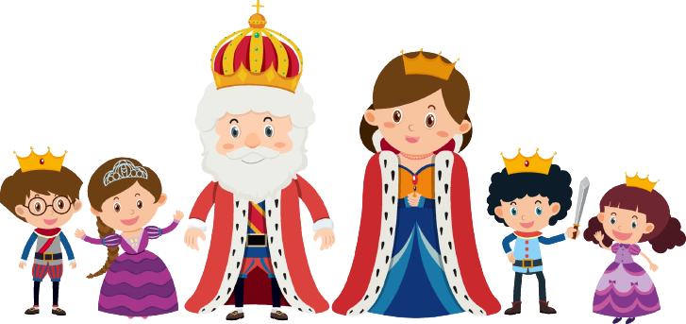
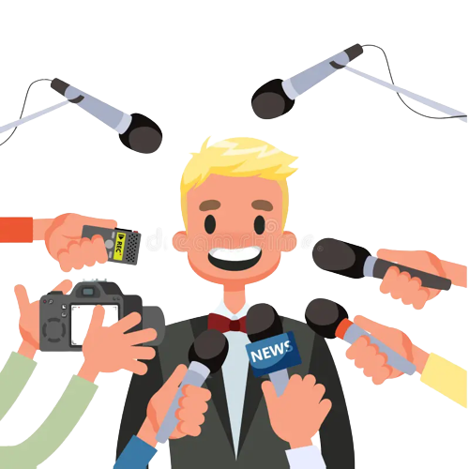
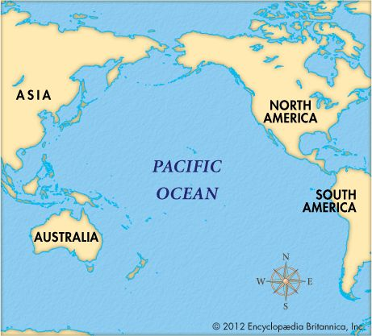
/'rɔɪəl/
thuộc hoàng gia
26. country (n):
27. royal (adj):
/'kʌntrɪ/
đất nước
28. famous (adj):
29. (the) Pacific Ocean (n):
/'feɪməs/
nổi tiếng
/pə’sɪfɪk 'əʊʃən/
Thái Bình Dương

Slide 11
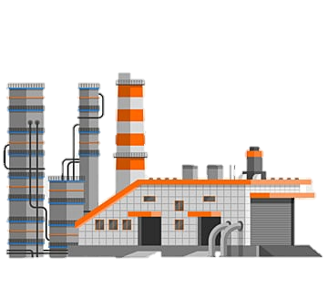
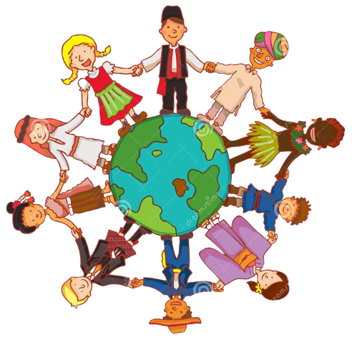

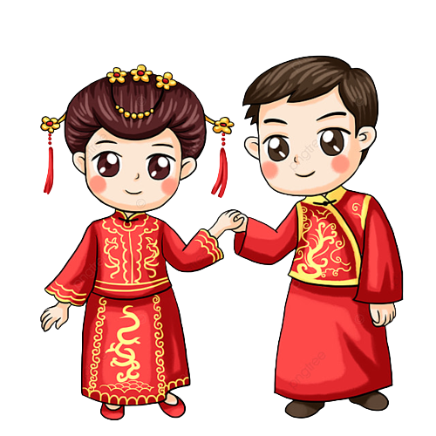
/'kʌltʃər/
văn hóa
30. industry (n):
31. culture (n):
/'ɪndəstrɪ/
nền công nghiệp
33. traditional (adj):
32. attraction (n):
/trə'dɪʃənl/
thuộc truyền thống
/ə'trækʃn/
sự hấp dẫn

Slide 12
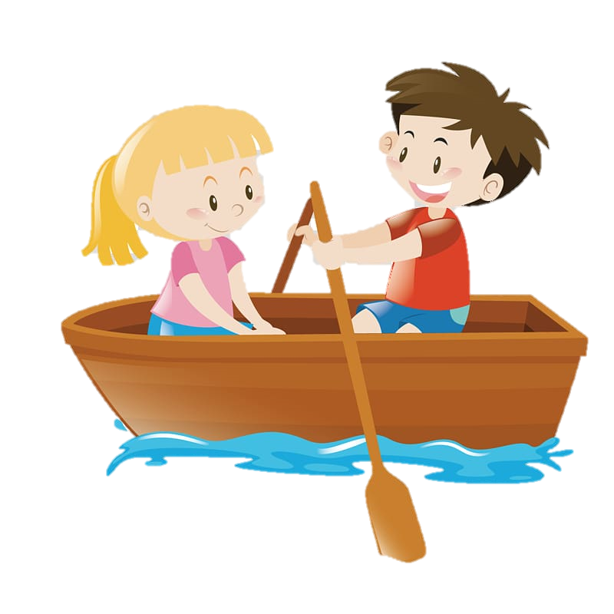
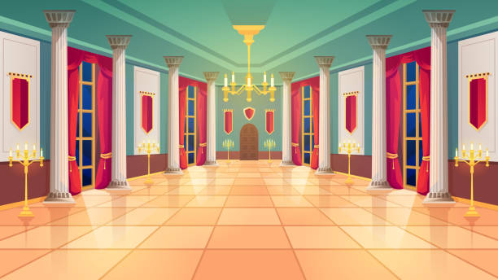
34. palace (n):
35. boat ride (n):
/'pæləs/
lâu đài, dinh thự
/bəʊt raɪd/
sự đi thuyền

Slide 13
1 | fantastic | adj
2 | ask for direction | Vphr
3 | take a tour | Vphr
4 | wonderful | adj
5 | island | n
6 | sunset | n
7 | landscape | n
8 | Australia | n
9 | Australian | adj, n
10 | penguin | n
11 | tattoo | n
12 | kangaroo | n
13 | Scottish | adj, n
14 | kilt | n
15 | castle | n
16 | coastline | n
17 | native | adj
18 | unique | adj

Slide 14
19 | amazing | adj
20 | ancient | adj
21 | local | adj
22 | symbol | n
23 | capital | n
24 | tower | n
25 | tourist | n
26 | country | n
27 | royal | adj
28 | famous | adj
29 | (the) Pacific Ocean | n
30 | industry | n
31 | culture | n
32 | attraction | n
33 | traditional | adj
34 | palace | n
35 | boat ride | n

Slide 15
Game
https://wordwall.net/resource/52138019/g8-u8-english-speaking-countries-getting-started
https://wordwall.net/resource/52823072/english-speaking-countries-vocab

Slide 16
PART 1
THEORY
II. GRAMMAR

Slide 17
 ARTICLES (MẠO TỪ)
1. Cách dùng mạo từ bất định a, an.
• A/ an được sử dụng trước một danh từ số ít đếm được.
Ex: We need a book. (Chúng tôi cần 1 cuốn sách.)
✓ Mạo từ "a" đứng trước một phụ âm (trong cách phát âm).
Ex:
a game (một trò chơi); a boat (một chiếc tàu thủy).
Chú ý: a university (một trường đại học); a year (một năm).
- a European (một người Âu); a one-legged man (một người thọt chân).
✓ Mạo từ "an" đúng trước từ bắt đầu bằng một nguyên âm (a, e, i, o, u) hoặc âm câm
Ex:
- an egg (một quả trứng); an ant (một con kiến)
Chú ý: an honour (một niềm vinh dự); an hour (một giờ đồng hồ)

Slide 18
 ARTICLES (MẠO TỪ)
2. Cách dùng mạo từ xác định “the”
• The được dùng khi danh từ chỉ đối tượng được cả người nói lẫn người nghe biết rõ: đối tượng đó là ai, cái gì. Cụ thể mạo từ “the” thường gặp nhất trong các trường hợp sau:
• Khi vật thể hay nhóm vật thể là duy nhất hoặc được xem là duy nhất | The Sun (mặt trời), the world (thế giới), the Earth (Trái đất)
• Trước một danh từ nếu danh từ này vừa được đê' cập trước đó | I see a dog. The dog is chasing a cat. The cat is chasing a mouse. (Tôi thấy 1 chú chó. Chú chó đó đang đuổi theo 1 con mèo. Con mèo đó đang đuổi theo 1 con chuột.)
• Trước một danh từ nếu danh từ này được xác bằng 1 cụm từ hoặc 1 mệnh đề | The teacher that I met yesterday is my sister in law. (Cô giáo tôi gặp hôm qua là chị dâu tôi.)
• Đặt the trước một tính từ để chỉ một nhóm người nhất định | the old (người già), the poor (người nghèo), the rich (người giàu)
• The được dùng trước những danh từ riêng chỉ biển, sông, quần đảo, dãy núi, tên gọi số nhiều của các nước, sa mạc, miền,... | The Pacific Ocean (Thái Bình Dương), The United States (Hợp chủng quốc Hoa Kỳ), the Alps (Dãy An pơ)
Notes:
CT: 0869444191

Slide 19
Game
https://www.baamboozle.com/game/75374
https://wordwall.net/resource/20776148/determiners-a-an-the-no-article

Slide 20
PART 1
THEORY
III. PHONETICS

Slide 21
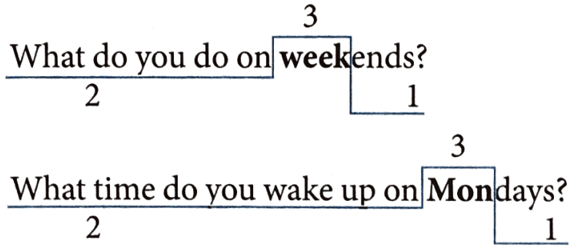
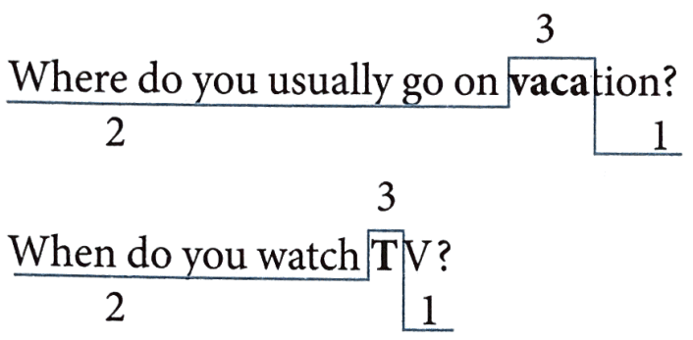
Rising and falling intonation for questions (Giọng điệu lên và xuống trong câu hỏi).  Track 16
1. Khi câu hỏi đó là dạng câu wh-question, giọng điệu của câu sẽ đi xuống
Examples with falling intonation

Slide 22
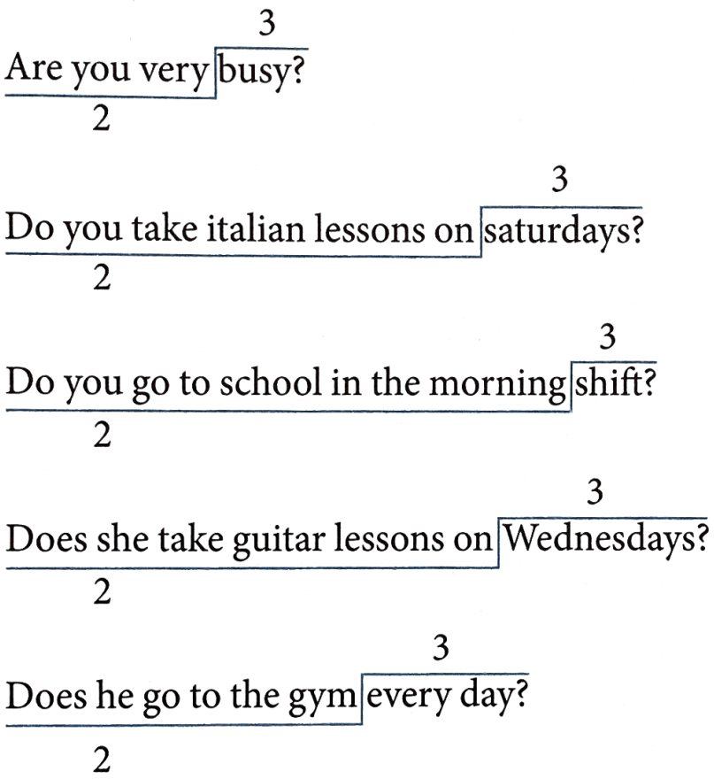
Rising and falling intonation for questions (Giọng điệu lên và xuống trong câu hỏi).  Track 16
2. Khi câu hỏi đó là dạng câu Yes/ No question, giọng điệu của câu sẽ đi lên
Examples with rising intonation

Slide 23
CT: 0869444191
PART 2
LANGUAGE
I. VOCABULARY
Notes:
CT: 0869444191

Slide 24

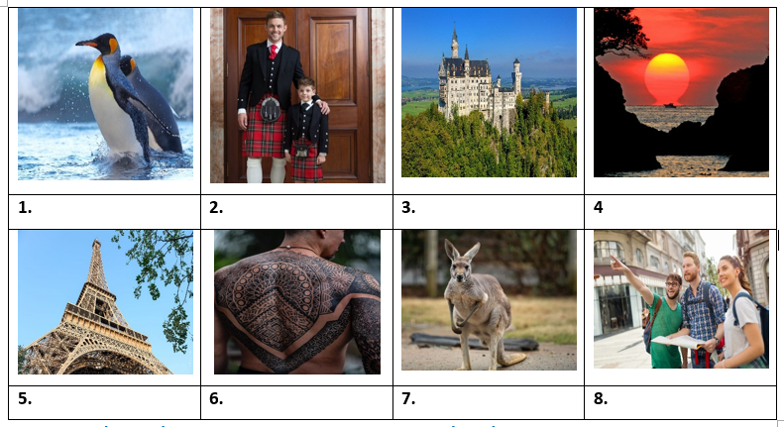
Exercise 1. Look at the photo and put the correct words/ phrases under them.
sunset
kilt
castle
tower
kangaroo
penguin
tattoo
tourist

Slide 25
Exercise 2. Choose the correct option A, B, C or D to complete the sentences.
1. Singapore is famous for its ______________ and green trees.
A. cleanliness B. cleanly C. cleaning D. clean
2. On Christmas Eve, most big cities, especially London are ______________ with coloured lights across the streets and enormous Christmas trees.
A. decorated B. hang C. put D. Made
3. In the United State, there are 50 ______________ and six different time zones across the country.
A. states B. nations C. towns D. Countries
4. I once tried to ______________ an apple pie when I was in London. It was really delicious.
A. do B. cook C. make D. show
5. You should go to Canada in summer because it is the most popular time for visitors to ______________ Niagara Falls and see the beautiful sights there.
A. stay B. look C. tour D. Visit

Slide 26
Exercise 2. Choose the correct option A, B, C or D to complete the sentences.
6. Nowadays you still see the ______________ men wear kilts (skirts) to wedding or other formal occasions.
A. Scottish B. Scotland C. Scots D. Scot
7. The USA has a population of about 304 million, and it’s the third ______________ country in the world.
A. smallest B. largest C. narrowest D. highest
8. In some English speaking countries, turkey and pudding are ______________ food at Christmas.
A. national B. historical C. traditional D. Possible
9. New Zealand ______________ lovers of nature and fans of dangerous sports.
A. attracts B. keeps C. calls D. Asks
10. Queenstown in New Zealand has got beautiful ______________ and a dry climate, so its ideal for outdoor activities.
A. look B. viewing C. atmosphere D. scenery

Slide 27
Exercise 3. Complete the sentences with the words in the box.
brigade | cattle | symbol | native | igloo
loch | accent | monument | fence | football
1. The silver fern is a national _________ of New Zealand.
2. Mount Rushmore is a national ______________ carved into a mountain in South Dakota, USA.
3. Trung speaks English like a _________ though he comes from Viet Nam.
4. I sometimes thought John’s _________ sounded English, sometimes American.
5. In Scotland, the word “_______” is used to describe any large, enclosed expanse of water.
symbol
monument
native
accent
loch

Slide 28
Exercise 3. Complete the sentences with the words in the box.
brigade | cattle | symbol | native | igloo
loch | accent | monument | fence | football
6. It took six years to build the rabbit-proof ______ in Australia.
7. England is the original home of __________ because the sport was invented there.
8. Edinburgh, Scotland was the first city in the world to have its own fire _________ in 1824.
9. Anna Creek Station in South Australia is the worlds largest ________ with an area of 24,000 km².
10. An ______ is a type of shelter built of snow by the Inuit, the Aboriginal peoples in Canada.
fence
football
brigade
cattle
igloo

Slide 29
Exercise 4. Give the correct form of the words given to complete the sentences.
1. Both French and English are ________ languages in Canada. (office)
2. NSW is the ______________ of New South Wales, the most populous state in Australia. (abbreviate)
3. The Gold Coast is famous for its most _______ theme parks in Australia such as Dreamworld and White Water World. (icon)
4. Do you know that the telephone, the television and penicillin are Scottish ______________? (invent)
5. Visitors can spend ________ days exploring amazing natural beauty of New Zealand. (end)
official
abbreviation
iconic
inventions
endless

Slide 30
Exercise 4. Give the correct form of the words given to complete the sentences.
6. There are different kinds of ______________ provided throughout Disneyland. (entertain)
7. Scotland is a ______________ land and this is noted for its rich and interesting history. (legend)
8. We’ll take the early _______ from Sydney to Wellington. (fly)
9. Niagara Falls, on the border of the USA and Canada, is one of the most ______________ sceneries in the world. (spectacle)
10. There are many tourist ______________ in London such as British Museum, London Eye and Tower of London. (attract)
entertainment
legendary
flight
spectacular
attractions

Slide 31
PART 2
LANGUAGE
II. GRAMMAR

Slide 32
Exercise 1. Put in a correct article: a/an.
1. ______ unreasonable decision | 2. _____ universal problem
3. ______ unit of work. | 4. ______ eucalyptus tree
5. ______ honorable man. | 6. ______ X- ray
7. ______ UFO | 8. ______ T-shirt
9. ______ happy girl | 10. ______ H-bomb
11. ______ elephant | 12. ______ hospital
13. ______ BBC programme | 14. ______ UNESCO worker
an
a
a
a
an
an
a
a
a
an
an
a
a
a

Slide 33
Exercise 2. Put in a correct article: a/an. Write (✗) if it’s not necessary.
1. Have you got ______ camera?
2. Would you like to be _____ actor?
3. Bill's got ______ umbrella.
4. Do you collect ______ stamps?
5. Tom always gives Ann ______ flowers on her birthday.
6. Those are ______ really nice trousers. Where did you get them?
a
an
an
X
X
X

Slide 34
Exercise 2. Put in a correct article: a/an. Write (✗) if it’s not necessary.
7. What ______ beautiful garden!
8. What ______ lovely children!
9. Jack has got very long legs, so he's ______ fast runner.
10. You need ______ visa to visit our country.
11. Jane is ______ teacher. Her parents were ______ teachers, too.
12. When I was ______ child, I used to be very shy.
a
X
a
a
a
X
a

Slide 35
Exercise 3. Put in a correct article: a/ an/ the.
1. Can you recommend me ______ luxury restaurant?
2. I saw _____ accident this morning.
3. My friend lives in the city. It is ______ most developed region of Vietnam.
4. This house is very beautiful. Do you have ______ garden?
5. We ate dinner at ______ luxury restaurant in the city.
6. There isn’t ______ airport near where we live.
7. There are two cars in the parking lot: ______ black one and a white one. My neighbor’s black one.
8. Today is a fine day. Let’s sit in ______ garden.
9. Are you going for business next week? - No, ______ week after next.
10. ______ teacher is Lan’s aunt.
a
an
the
a
a
an
a
the
the
The

Slide 36
Exercise 4. Put in a correct article: a/ an/ the. Write (✗) if it’s not necessary.
1. I have ______ cat.
2. We have _____ breakfast at 6:00 a.m.
3. ______ girl wearing ______ red dress is beautiful.
4. He is ______ most gallant boy I have ever met.
5. She often goes to ______ church to pray in spring.
6. ______ Taylor Swift is my favorite singer.
7. ______ government should build more nursing homes for ______ old.
8. Would you like to play ______ football with me?
9. Do you want to study in ______ United States?
10. Have you ever traveled to ______ Canada?
a
X
The
the
the
the
X
The
the
X
the
X

Slide 37
Exercise 5. Put in a correct article: a/ an/ the. Write (✗) if it’s not necessary.
the
the
1. Which one do you prefer, ______ red car or ______ green car?
2. She is ______ first person to own this bag.
3. Do you know ______ boy sitting next to Lan?
4. I travel to ______ Ho Chi Minh City by ______ plane.
5. He lives on ______ Brown Street.
6. ______ patience plays ______ important role in everyone’s ______ success.
7. This is ______ first time she has traveled to ______ Europe.
8. I have _____ beautiful pen.
9. ______ milk is my favorite drink.
10. ______ Viet Nam is _____ developing country.
the
the
X
X
X
X
an
X
the
X
a
X
X
a

Slide 38
Exercise 6. Choose the best article to complete the sentence.
1. Mrs. Lan went to ______ school to meet her son's teacher.
A. no article B. a C. an D. the
2. The workmen went to ______ church to repair the roof.
A. no article B. the C. a D. an
3. Carol went to prison to meet her brother.
A. the B.a C. an D. no article
4. This morning I bought a newspaper and a magazine. ______ newspaper is in my bag but I don't know where ______ magazine is.
A. A/ a B. A/ the C. The/ the D. The/ a
5. My parents have ______ cat and ______ dog. The dog never bites the cat.
A. a/ a B. a/ the C. the/ the D. the/ a

Slide 39
Exercise 6. Choose the best article to complete the sentence.
6. We live in ______ big house in ______ middle of the village.
A. a/ a B. a/ the C. the/ the D. the/ a
7. I'm looking for ______ job. Did Mary get ______ job she applied for?
A. a/ the B. the/ a C. a/ a D. the/the
8. Did ______ police find ______ person who stole your bicycle?
A. a/ a B. the/ the C. a/ the D. the/ a
9. We went out for ______ meal last night. ______ restaurant we went was excellent.
A. a/ A B. the/ The C. a/ The D. the/ A
10. As I was walking along the street, I saw ______ $10 note on ______ pavement.
A. a/ a B. the/ the C. a/ the D. the/ a

Slide 40
Exercise 6. Choose the best article to complete the sentence.
11. The Soviet Union was ______ first country to send a man into ______ space.
A. the/ the B. no article I no article
C. no article / the D. the/ no article
12. Did you watch "Titanic" on ______ television or at ______ cinema?
A. the/ the B. no article/ no article
C. no article/ the D. the/ no article
13. After ______ lunch, we went for a walk by ______ sea.
A. the/ the B. no article/ no article
C. no article/ the D. the/ no article
14. Peru is ______ country in south America. ______ capital is Lima.
A. a/ A B. a/ The C. the/ The D. the/ A
15. I never listen to ______ radio. In fact I haven't got ______ radio.
A. a/ a B. a/the C. the/ the D. the/ a

Slide 41
Exercise 6. Choose the best article to complete the sentence.
16. It was a beautiful day. ______ sun shone brightly in ______ sky.
A. a/ A B. a/ The C. the/ The D. the/ A
17. It is said the Robinhood robbed ______ rich and gave the money to ______ poor.
A. a/ a B. a/ the C. the/ the D. the/ a
18. Life is not so easy for ______ unemployed.
A. the B. a C. an D. no article
19. Many people were killed in the accident. The bodies of ______ dead were taken away.
A. the B. a C. an D. no article
20. Lan has been a nurse all her life. She has spent her life caring for ______ sick.
A. the B. a C. an D. no article

Slide 42
PART 2
CT: 0869444191
LANGUAGE
III. PHONETICS

Slide 43
Listen and mark the rising intonation () or falling intonation ().  Track 17
1. Do you like pop music?
2. When do you go shopping?
3. What do you do in your free time?
4. Is Mary a basketball player?
5. What time does she go to school?
6. Do you brush your teeth three times a day?
7. What do you watch on Netflix?
8. Does she play in a famous orchestra?
9. Are you a talented boy?
10. What do they do in the morning?











Slide 44
PART 3
CT: 0869444191
COMMUNICATION SKILLS
I. LISTENING

Slide 45
☞ Listen and do the tasks followed.  Track 18
Exercise 1. Listen and decide if each statement is True (T) or False (F).
Statement | True/ False
1. Kiwis live in Australia and New Zealand.
2. A kiwi has a tail but no wings.
3. It sleeps during the day because light hurts its eyes.
4. People in New Zealand do not want the kiwis to live.
5. The kiwi is a strange New Zealand bird.
F
F
T
F
T

Slide 46
Exercise 2. Listen again and complete the sentences.
1. The kiwi (1) ______________ only in New Zealand.
2. A kiwi does not have any (2) ______________ like other birds.
3. The kiwi can (3) ______________ better than most birds do.
4. The kiwi’s (4) ______________ are very big.
5. There is a picture of a kiwi on New Zealand (5) ______________.
lives
feathers
smell
eggs
money

Slide 47
PART 3
COMMUNICATION SKILLS
II. SPEAKING

Slide 48
Match the questions to the answers.
1. What is the national flower of Wales? | A. Glasgow
2. What is the national symbol of the USA? | B. The beaver
3. What country has a dragon on their flag? | C. In 1492
4. What is the capital of New Zealand? | D. Canada
5. Where do Aborigines live? | E. Daffodil
6. Which is the national mascot of Canada? | E. Wales
7. How many countries have English as an official language? | G. Wellington
8. When was America discovered? | H. In Australia
9. Which country has two official languages? | I. The bald eagle
10. Which is Scotland’s biggest city? | J. Seventy-five
Your answer:
E
I
F
G
H
1. | 2. | 3. | 4. | 5.
6. | 7. | 8. | 9. | 10.
B
J
C
D
A

Slide 49
PART 3
CT: 0869444191
COMMUNICATION SKILLS
III. READING

Slide 50
Exercise 1. Read the text and answer the questions below.
In Canada and the United States, one of the most popular days in the year is Halloween. Halloween occurs on October 31st. It's a day when some people wear in strange or unusual costumes. For example, they may dress to look like an animal, a person from a book or movie or a famous person from history. After dark, many young children put on their costumes and visit their neighbors. They knock on the door and shout "Trick or treat". Then the neighbors give them some candy, and the children go on to the next house. Adults also enjoy dressing up for Halloween. There are usually Halloween parties in the evening and usually there is a prize for the best or most unusual costume.

Slide 51
1. Is Halloween one of the most popular days in Canada and the USA?
___________________________________________________________________
2. When does Halloween happen?
___________________________________________________________________
3. What do young children do after dark?
______________________________________________________________________________________________________________________________________
4. Who also enjoy dressing up for Halloween?
___________________________________________________________________
5. What are children given when they knock on their neighbors' door?
___________________________________________________________________
Yes, it is.
It happens on October 31 st.
After dark, many young children put on their costumes and visit their neighbors.
Adults also enjoy dressing up for Halloween./ Adults do.
They are given some candy.

Slide 52
Exercise 2. Fill each blank with a correct word to finish the passage.
Australia is the 6th biggest country in the world. Only Russia, China, Canada, USA and Brazil are (1) ________. It is the world’s largest island.
Even though the country is so big, it only has about 23 million inhabitants. 88% of all Australians (2) ______ in the big cities or smaller towns, which makes big areas of the country empty.
Australia lies in the (3) _____________ hemisphere which means that the more South you go, the cooler it gets. In the north parts of the country, it is always hot. The (4) ________ of the country has really hot summers and mild winters. Snow only falls in the Australian Alps and in Tasmania, when we have (5) _____________ in Europe and Asia, the Australians have summer. So they celebrate Christmas in the (6) _______ of the summer!
bigger
live
Southern
rest
Winter
middle

Slide 53
Exercise 2. Fill each blank with a correct word to finish the passage.
Australia is famous for its wildlife. The most famous (7) _________ is probably the kangaroo. The kangaroo, or room for short, has (8) _________ Australia’s national Symbol. The word “kangaroo” was the first Aboriginal (9) ________ in the English language. There are several spices of kangaroos. The red kangaroos (10) _______ the biggest ones and they are found in the middle of the country.
animal
become
word
are

Slide 54
Exercise 3. Read the follow passage and answer the questions.
New Zealand is a small country in the southern Pacific Ocean. There are two main islands, the North Island and the South Island, as well as many smaller islands. New Zealand is 268,000 square kilometres, about the same size as the United Kingdom.
Maori people arrived from the Pacific in the 10th century, and by the 12th century there were many Maori settlements along the coasts of New Zealand. The Maori name for New Zealand is Aotearoa, which means ‘The land of the long white cloud'. Seven hundred years later, large numbers of Europeans started to settle in New Zealand. According to Government figures, the population of New Zealand in 2015 was over four million, and of these, about 75 percent lived in the North Island.
There are four main cities. Auckland, in the north, is the largest city with a population of over one million people. Auckland's population includes many different nationalities. For example, there are large groups of European, Maori, Pacific Island, Chinese and Indian people. Together with other smaller groups, they make Auckland an interesting and exciting place to live.
Although Wellington is the capital, the centre of government, it is smaller and quieter than Auckland with a population of350,000. The main cities in the South Island are Christchurch, known as the Garden City, and Dunedin, which is often compared to a small Scottish city.

Slide 55
1. Where is New Zealand located?
_________________________________________________________________2. When did Maori people first come to New Zealand?
_________________________________________________________________
3. What does “Aotearoa” mean?
_________________________________________________________________
4. Where do most New Zealanders live?
_________________________________________________________________
5. Why is Auckland an interesting city?
_________________________________________________________________
(It is located) in the southern Pacific Ocean.
(They came there) in the 10th century.
‘The land of the long white cloud'.
(They live) in the North Island.
Because many different nationalities live there.

Slide 56
PART 3
CT: 0869444191
COMMUNICATION SKILLS
IV. WRITING

Slide 57
Exercise 1. Make up sentences using the words and phrases given.
1. USA/enormous/country.
_______________________________________________________________________2. This country/ both/ one of/ hot/ and cold/ places/ the world.
_______________________________________________________________________3. about/ half/ of/ Australia’s population/ go/ this event/ on Australia Day/.
_______________________________________________________________________
4. Kangaroo/ the unique/ animal/ Australia.
_______________________________________________________________________
5. Big Ben Tower/ one/ most famous/ symbol/ England.
_______________________________________________________________________
The USA is an enormous country.
This country is both one of the hottest and coldest places in the world.
About half of Australia’s population go to this event on Australia Day.
Kangaroo is the unique animal in Australia.
Big Ben Tower is one of the most famous symbols in England.

Slide 58
Exercise 2. Rewrite the sentences without changing the meaning of the original sentences.
1. There is a big library in Lan’s school.
→ Lan’s school
2. Lan learns Math very well.
→ Lan is very
3. Which subject do you like best?
→ What is your
4. Why don’t we go swimming?
→ What about
5. The birthday cake is very delicious.
→ What
has a big library.
good at Math.
favourite subject?
going swimming?
a delicious birthday cake!

Slide 59
Exercise 2. Rewrite the sentences without changing the meaning of the original sentences.
6. When is her birthday?
→ What
7. Nam works more hours than Lan.
→ Lan works
8. Nile River is longer than any rivers in the world.
→ Nile River is
9. The school library has over five thousand books.
→ There are
10. Ha Noi has many interesting places.
→ There are
is her date of birth?
fewer hours than Nam.
the longest river in the world.
over five thousand books in the school library,
many interesting places in Ha Noi.

Slide 60
CT: 0869444191
THANK YOU

