Slide 1



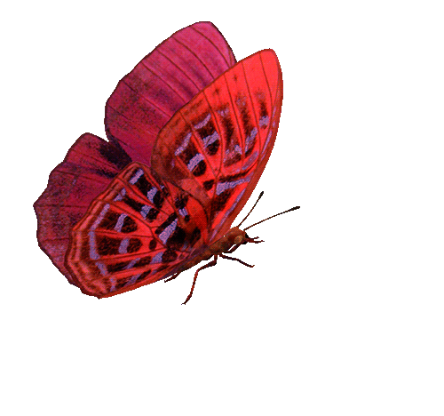



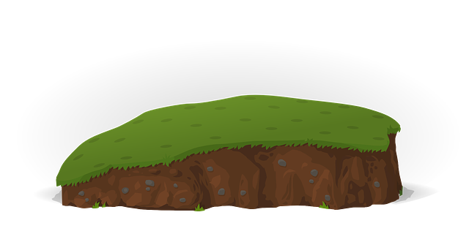



BẮT BƯỚM
Catch a Butterfly

Slide 2
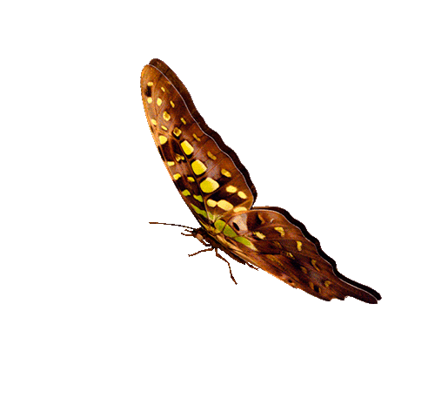


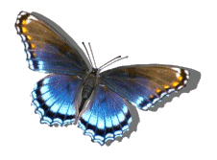




1
5
9
CHÚC MỪNG
ĐỘI A
CONGRATULATIONS
TEAM A
CHÚC MỪNG
ĐỘI B
CONGRATULATIONS
TEAM B
6
8
2
4
10
7
3
1
2
3
4
5
6
7
8
9
10
1
2
3
4
5
6
7
8
9
PIPI
10
TEAM A
TEAM B

Slide 3

Question 1
A. Right
B. Wrong
C. Wrong
D. Wrong
GO HOME

Slide 4
Question 2
A. Wrong
B. Wrong
C. Wrong
D. Right
GO HOME

Slide 5
Question 3
A. Wrong
B. Right
C. Wrong
D. Wrong
GO HOME

Slide 6
Question 4
A. Right
B. Wrong
C. Wrong
D. Wrong
GO HOME

Slide 7
Question 5
A. Wrong
B. Wrong
C. Right
D. Wrong
GO HOME

Slide 8
Question 6
A. Wrong
B. Wrong
C. Wrong
D. Right
GO HOME

Slide 9
Question 7
A. Wrong
B. Right
C. Wrong
D. Wrong
GO HOME

Slide 10
Question 8
A. Wrong
B. Wrong
C. Wrong
D. Right
GO HOME

Slide 11
Question 9
A. Right
B. Wrong
C. Wrong
D. Wrong
GO HOME

Slide 12
Question 10
A. Wrong
B. Wrong
C. Right
D. Wrong
GO HOME

