Slide 1


Slide 2
6TH GRADE
INTONATION IN CHOICE QUESTIONS
LESSON II – LANGUAGE
Unit
9
SOCIAL ISSUES
FAMILY LIFE
Unit

Slide 3
LESSON II
LANGUAGE
WARM-UP
Mini game
Task 1: Listen and repeat.
Task 2: Mark the intonation.
PRONUNCIATION
Task 1: Word search.
Task 2: Complete the sentences.
VOCABULARY
Task 1: Connect the sentences.
Task 2: Add more sentences to each item.
GRAMMAR
CONSOLIDATION
Wrap-up
Homework

Slide 4

Students work in 4 groups.
You will hear and find the words/ phrases with raised voice in 3 sentences below.
Raise your hands to answer.

Slide 5



WARM-UP
Listen and find the words/ phrases with a raised voice.
Thanks,
Andy.
That’s
really
helpful!

Slide 6


Listen and find the words/ phrases with a raised voice.
WARM-UP
Our
train
leaves
in
ten
minutes.

Slide 7


WARM-UP
Listen and find the words/ phrases with a raised voice.
You
and
your sister
always
argue
during
dinner.

Slide 8
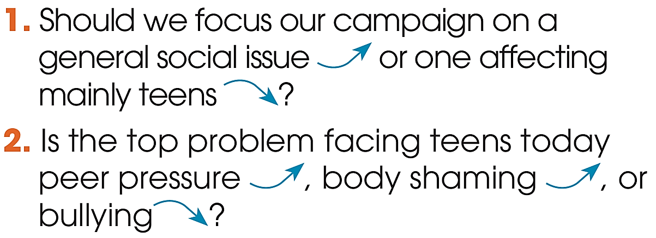
PRONUNCIATION
1
Listen and repeat. Pay attention to the intonation. Practise saying the questions in pairs.

Slide 9
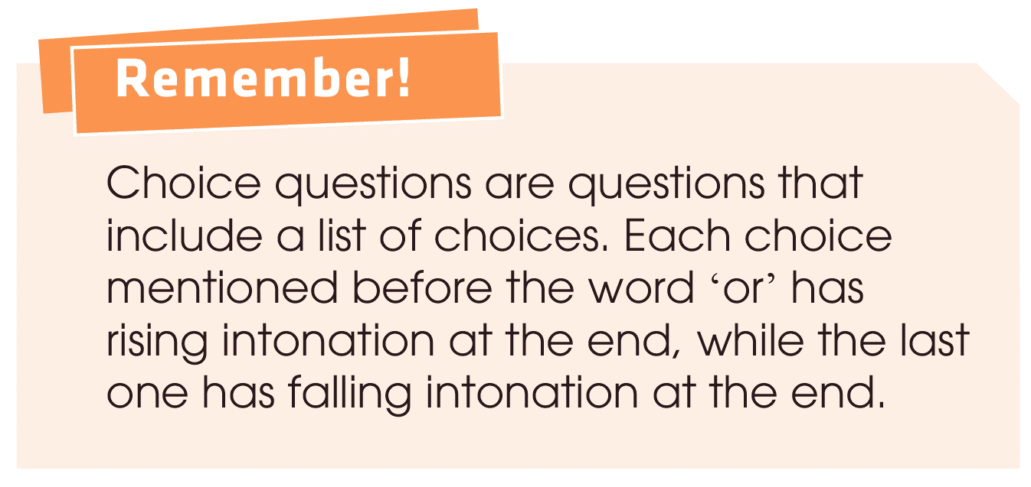
PRONUNCIATION

Slide 10
PRONUNCIATION
2
Mark the intonation in these questions.
1. Is peer pressure good or bad?
2. Is this a social or environmental issue?
3. Should our campaign focus on crime, overpopulation, or climate change?
4. Do you talk to your parents, share problems with your friends, or ask your teachers for advice?
1. Is peer pressure good or bad?
2. Is this a social or environmental issue?
3. Should our campaign focus on crime, overpopulation, or climate change?
4. Do you talk to your parents, share problems with your friends, or ask your teachers for advice?
up
down

Slide 11

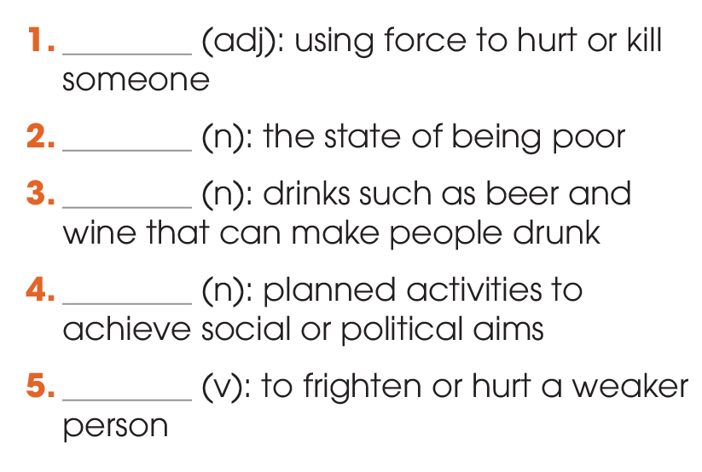
VOCABULARY
1
Find five words in the word search and write them next to the correct definition.
violent
poverty
alcohol
campaign
bully

Slide 12
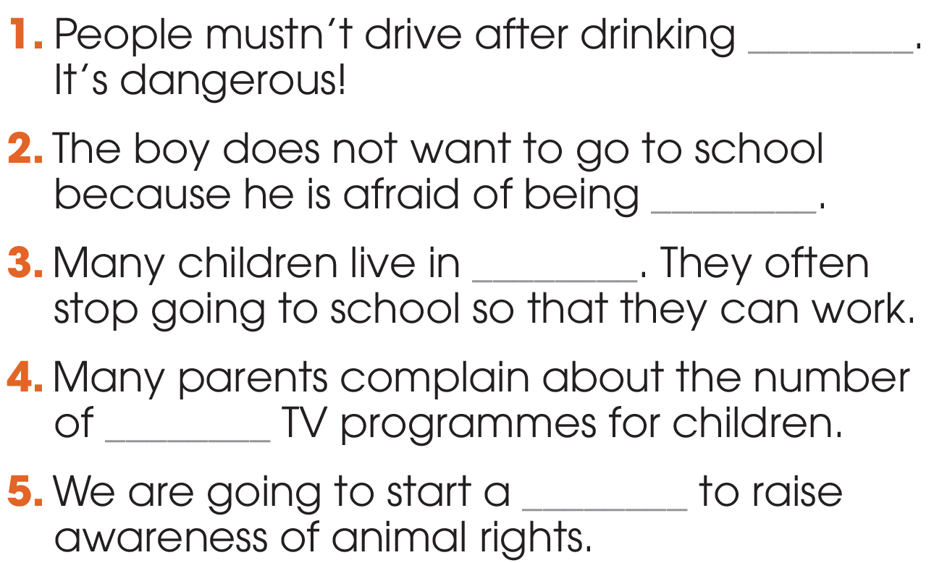
VOCABULARY
2
Complete the sentences using the correct forms of the words in 1.
alcohol
bullied
poverty
violent
campaign

Slide 13
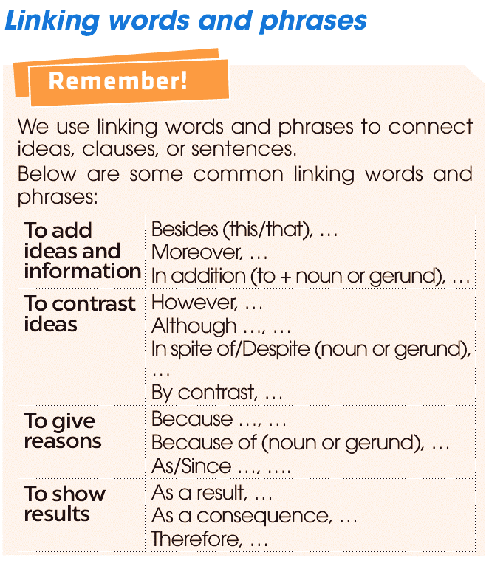
GRAMMAR

Slide 14
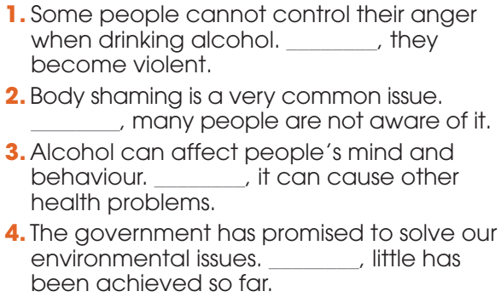
GRAMMAR
1
Connect these sentences, using linking words or phrases.
Therefore
However
Besides
However

Slide 15
GRAMMAR
2
Work in pairs. Add more sentences to each item. Use different linking words and/or phrases.
As a result, they cannot
2. Many people live in poverty. _______________________
__________________________________________________________________________________________________
afford basic things in life such as food, clothes, and education. Therefore, we should organise some charity events to help them.

Slide 16
GRAMMAR
2
Work in pairs. Add more sentences to each item. Use different linking words and/or phrases.
3. Awareness campaigns help to draw people's attention to social issues. ______________________________________
___________________________________________________________________________________________________________________________________________________
However, more should be done to ensure
that people will actually take actions about these issues. Therefore, I suggest we should set up some helplines to support people in need to deal with social issues in the
long term.

Slide 17
1. WRAP-UP
CONSOLIDATION
What have you learnt today?
Using linking words and phrases correctly
Intonation in choice question

Slide 18
2. HOMEWORK
CONSOLIDATION
Do exercises in the workbook.
Prepare for Lesson 3 - Unit 9.

Slide 19

Website: hoclieu.vn
Fanpage: facebook.com/www.tienganhglobalsuccess.vn/

