Slide 2
Unit 3
GREEN LIVING
LESSON 8
LOOKING BACK AND PROJECT

Slide 3
LESSON 8
LOOKING BACK AND PROJECT
WARM-UP
Guessing words
Task 1: Pronunciation
Task 2: Vocabulary
Task 3: Grammar
LOOKING BACK
PROJECT
Eco-friendly habits
Wrap-up
Homework
CONSOLIDATION

Slide 4
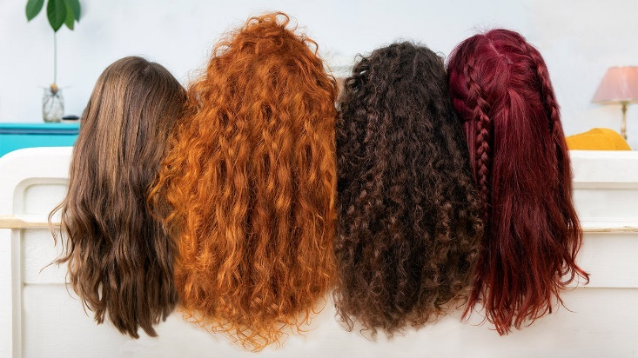
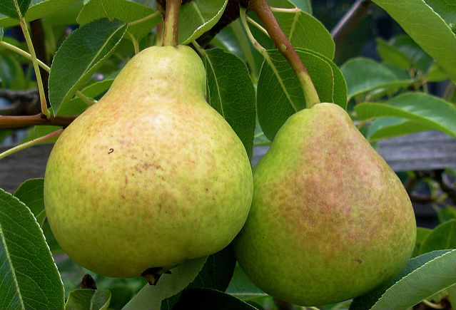

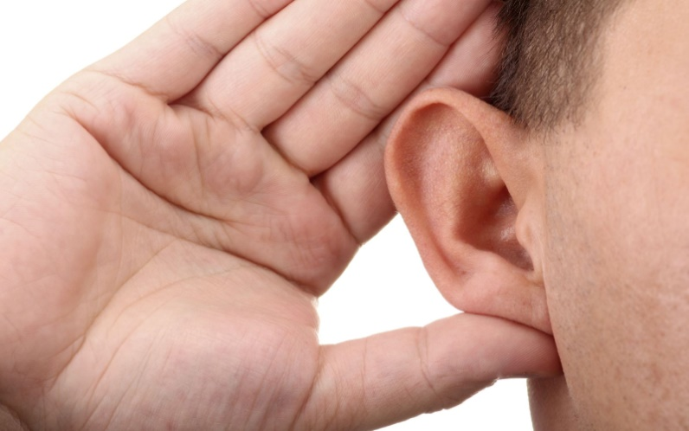
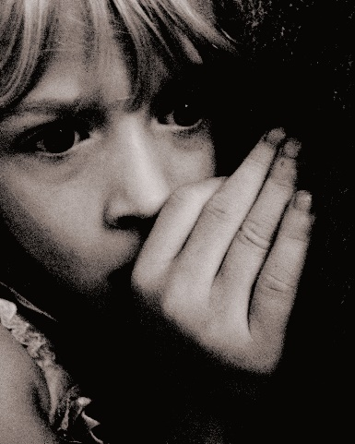
WARM-UP
GUESSING WORDS

Slide 5

PRONUNCIATION
Read the words and choose the odd one out.
1.
A. fair B. hair C. container D. pair
2.
A. near B. ear C. fear D. pear
3.
A. sure B. future C. literature D. culture
4.
A. bear B. year C. clear D. hear

Slide 6
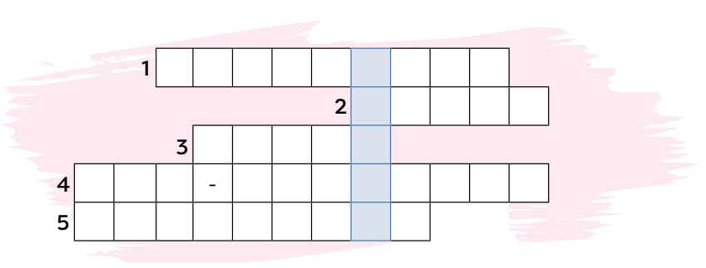
VOCABULARY
Solve the crossword.
P A C K A G I N G
R E U S E
W A S T E
E C O F R I E N D L Y
F O O T P R I N T

Slide 7
GRAMMAR
Circle the mistake in each sentence. Then correct it.
Children should learn to recycling from an
                A
early age so that they will be prepared to deal
B
with plastic pollution in the future.
C D
→ about

Slide 8
GRAMMAR
Circle the mistake in each sentence. Then correct it.
2. Many students are taking part in the Green
A
Campaign this year, that shows that nowadays
B C
people care more about the environment.
D
→ which

Slide 9
GRAMMAR
Circle the mistake in each sentence. Then correct it.
3. Many people neither believe in climate
A
change nor want to understand what is
B
happening with the environment, which is a big
C D
concern.
→ to

Slide 10
GRAMMAR
Circle the mistake in each sentence. Then correct it.
4. Instead of throwing the plastic bottles
A
over, why don’t you make some plant pots from
B C D
them?
→ away

Slide 11
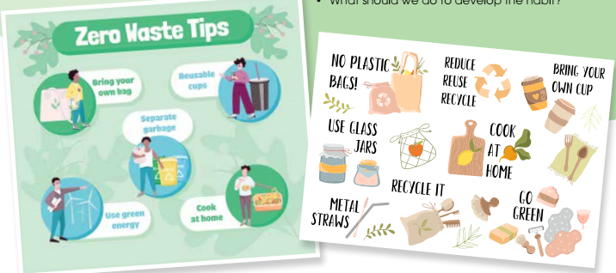
PROJECT
Eco-friendly habits

Slide 12
CONSOLIDATION
1
Wrap-up
What have you learnt today?
Revise all the knowledge of the whole unit.
Present a leaflet to give away on Green Day at school.

Slide 13
CONSOLIDATION
2
Homework
Do exercises in the workbook.
Prepare Unit 4 – Getting started.

Slide 14
Website: hoclieu.vn
Fanpage: facebook.com/www.tienganhglobalsuccess.vn

