Slide 1
ELECTRONIC CIRCUIT STYLE CV INFOGRAPHICS
Here is where this template begins

Slide 2
ABOUT ELECTRONIC CIRCUIT STYLE CV INFOGRAPHICS
This template contains an assortment of complementary infographic resources for the Electronic Circuit Style CV presentation.
These infographics are adapted to the style of the aforementioned presentation, so you can insert them easily and have them completely integrated at once. You just need to do the following:
Select the element that you want to copy
Right-click and choose “Copy”
Go to the slide where you want the element to appear
Right-click and choose “Paste”

Slide 3

ELECTRONIC CIRCUIT STYLE CV INFOGRAPHICS
EXPERIENCE
2022 | Mars
2020 | Venus
2018 | Neptune
2016 | Jupiter
EDUCATION
2016 | Earth
2014 | Venus
2012 | Neptune
2010 | Jupiter

Slide 4
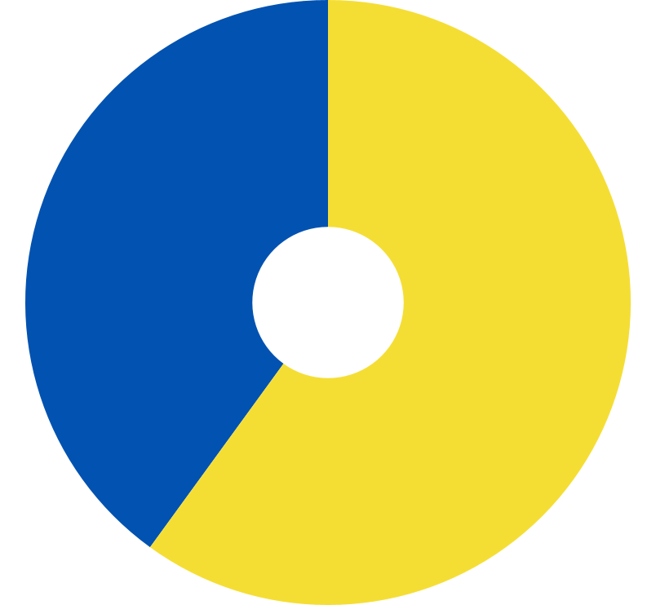
ELECTRONIC CIRCUIT STYLE CV INFOGRAPHICS
40%
60%
NEPTUNE
VENUS
Neptune is the farthest planet from the Sun
Venus is the second planet from the Sun
SKILL 1
20%
SKILL 3
40%
SKILL 2
80%
SKILL 4
60%
Follow the link in the graph to modify its data and then paste the new one here. For more info, click here

Slide 5
ELECTRONIC CIRCUIT STYLE CV INFOGRAPHICS
2,400
VENUS
Venus is the second planet from the Sun. It has a beautiful name
1,200
3,600
NEPTUNE
SATURN
Neptune is the farthest planet from the Sun. It’s a really cold place
Saturn is a gas giant. It’s composed of hydrogen and helium

Slide 6
ELECTRONIC CIRCUIT STYLE CV INFOGRAPHICS
NEPTUNE
VENUS
JUPITER
SATURN
Neptune is the fourth-largest planet in the Solar System
Venus is the second planet from the Sun. It has a nice name
Jupiter is a gas giant and the biggest planet of them all
Saturn is composed mostly of hydrogen and helium
30%
50%
70%
90%

Slide 7
ELECTRONIC CIRCUIT STYLE CV INFOGRAPHICS
SKILL 1
SKILL 2
SKILL 3
SKILL 4
SKILL 5
Neptune is the farthest planet from the Sun
Venus is the second planet from the Sun
Mercury is the closest planet to the Sun
Earth is the third planet from the Sun
Despite being red, Mars is a cold place

Slide 8
ELECTRONIC CIRCUIT STYLE CV INFOGRAPHICS
GOAL 2
GOAL 4
Venus is the second planet from the Sun
Earth is the third planet from the Sun
GOAL 1
GOAL 3
GOAL 5
Neptune is the farthest planet from the Sun
Mercury is the closest planet to the Sun
Despite being red, Mars is a cold place

Slide 9
ELECTRONIC CIRCUIT STYLE CV INFOGRAPHICS
10%
30%
NEPTUNE
VENUS
Neptune is the farthest planet from the Sun
Venus is the second planet from the Sun
20%
40%
EARTH
SATURN
Earth is the third planet from the Sun
Saturn is a gas giant and has several rings

Slide 10
ELECTRONIC CIRCUIT STYLE CV INFOGRAPHICS
10%
40%
Mercury is the closest planet to the Sun
Earth is the third planet from the Sun
20%
50%
Venus is the second planet from the Sun
Despite being red, Mars is actually a cold place
30%
60%
Jupiter is the biggest planet of them all
Saturn is not the only planet with rings

Slide 11
ELECTRONIC CIRCUIT STYLE CV INFOGRAPHICS
75%
EDUCATION
Mercury's name has nothing to do with the liquid metal, it was named after a god
25%
SKILLS
Jupiter is the biggest planet in the Solar System. It's the fourth-brightest object

Slide 12
ELECTRONIC CIRCUIT STYLE CV INFOGRAPHICS
MERCURY
Mercury is the closest planet to the Sun and the smallest one of them all
VENUS
Venus has a beautiful name and is the second planet from the Sun. It’s terribly hot
JUPITER
Jupiter is the biggest planet in the Solar System. It's the fourth-brightest object

Slide 13
ELECTRONIC CIRCUIT STYLE CV INFOGRAPHICS
EDUCATION
Mercury's name has nothing to do with the liquid metal, it was named after a god
EXPERIENCE
Venus has a beautiful name and is the second planet from the Sun. It’s terribly hot
SKILLS
Jupiter is the biggest planet in the Solar System. It's the fourth-brightest object

Slide 14
ELECTRONIC CIRCUIT STYLE CV INFOGRAPHICS
VENUS
MERCURY
Venus has a beautiful name and is the second planet from the Sun. It’s terribly hot
This planet's name has nothing to do with the liquid metal, was named after god
SATURN
JUPITER
Saturn is a gas giant and has several rings. It’s composed of hydrogen and helium
Jupiter is the biggest planet in the Solar System. It's the fourth-brightest object

Slide 15
ELECTRONIC CIRCUIT STYLE CV INFOGRAPHICS
JUPITER
VENUS
Jupiter was named after a god
Venus has a toxic atmosphere
SATURN
EARTH
Saturn is the ringed planet
Earth is the planet where we all live
NEPTUNE
MERCURY
Neptune is far away from us
Mercury is a small planet
PLUTO
MARS
Pluto is considered a dwarf planet
Mars was named after a god

Slide 16
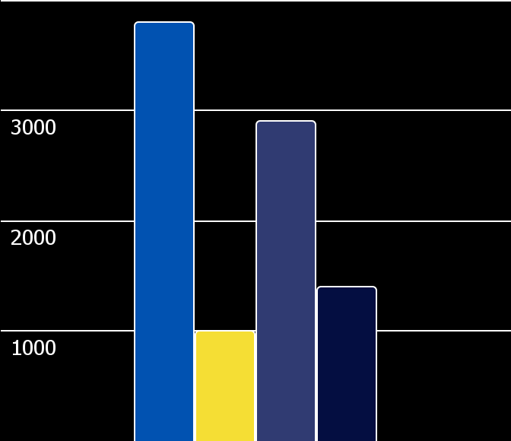
ELECTRONIC CIRCUIT STYLE CV INFOGRAPHICS
3,800
VENUS
Venus has a toxic atmosphere
1,000
EARTH
Earth is the planet where we all live
2,900
MERCURY
Mercury is a small planet
Follow the link in the graph to modify its data and then paste the new one here. For more info, click here
1,400
MARS
Mars was named after a god

Slide 17
ELECTRONIC CIRCUIT STYLE CV INFOGRAPHICS
VENUS
1/10
Venus has a toxic atmosphere
EARTH
2/10
Earth is the planet where we all live
MERCURY
3/10
Mercury is a small planet
MARS
4/10
Mars was named after a god

Slide 18
ELECTRONIC CIRCUIT STYLE CV INFOGRAPHICS
STUDIES
EXPERIENCE
SATURN
2012
2018
VENUS
Saturn is the ringed planet
Venus has a good name
NEPTUNE
2014
2020
MERCURY
It’s far away from Earth
Mercury is a small planet
PLUTO
2016
2022
MARS
Pluto is a dwarf planet
Mars is made of basalt

Slide 19
ELECTRONIC CIRCUIT STYLE CV INFOGRAPHICS
Jupiter was named after a Roman god
1ST
2ND
Venus has a beautiful name
Saturn was named after a Roman god
3RD
4TH
Earth is the planet where we all live
Neptune is far away planet from us
5TH
6TH
Mercury is the smallest planet
Pluto is considered a dwarf planet
7TH
8TH
Mars was named after a Roman god

Slide 20
ELECTRONIC CIRCUIT STYLE CV INFOGRAPHICS
A
B
C
1,200
2,400
3,600
NEPTUNE
VENUS
SATURN
Neptune is the farthest planet from the Sun
Venus is the second planet from the Sun
Saturn is a gas giant and has several rings

Slide 21
ELECTRONIC CIRCUIT STYLE CV INFOGRAPHICS
10%
20%
30%
40%
NEPTUNE
VENUS
JUPITER
SATURN
Neptune is the fourth-largest planet in the Solar System
Venus is the second planet from the Sun. It’s really hot there
Jupiter is a gas giant and the biggest planet of them all
Saturn is composed mostly of hydrogen and helium

Slide 22
ELECTRONIC CIRCUIT STYLE CV INFOGRAPHICS
SKILL 1
SKILL 2
SKILL 3
SKILL 4
SKILL 5
Neptune is the farthest planet from the Sun
Venus is the second planet from the Sun
Mercury is the closest planet to the Sun
Earth is the third planet from the Sun
Despite being red, Mars is a cold place
1/5
2/5
3/5
4/5
5/5

Slide 23
ELECTRONIC CIRCUIT STYLE CV INFOGRAPHICS
75%
VENUS
Venus is the second planet from the Sun
25%
SATURN
Saturn is a gas giant and has rings

Slide 24

ELECTRONIC CIRCUIT STYLE CV INFOGRAPHICS
25%
25%
NEPTUNE
VENUS
Neptune is the farthest planet from the Sun
Venus is the second planet from the Sun
25%
25%
EARTH
SATURN
Follow the link in the graph to modify its data and then paste the new one here. For more info, click here
Earth is the third planet from the Sun
Saturn is a gas giant and has rings

Slide 25
ELECTRONIC CIRCUIT STYLE CV INFOGRAPHICS
4/10
5/10
NEPTUNE
VENUS
Neptune is very far away from the Sun
Venus is the second planet from the Sun
6/10
7/10
JUPITER
SATURN
Jupiter doesn’t have a solid surface
Saturn is a gas giant and has several rings

Slide 26
ELECTRONIC CIRCUIT STYLE CV INFOGRAPHICS
1/10
3/10
5/10
NEPTUNE
VENUS
EARTH
Neptune is very far away from the Sun
Venus is the second planet from the Sun
Earth is the third planet from the Sun
2/10
4/10
6/10
JUPITER
SATURN
MERCURY
Jupiter doesn’t have a solid surface
Saturn is a gas giant and has several rings
Mercury is the closest planet to the Sun

Slide 27
ELECTRONIC CIRCUIT STYLE CV INFOGRAPHICS
NAME | Taufik Ahmmed | ADDRESS | Dhaka, Bangladesh
DESIGNATION | Manager | LAST DEGREE | Phd in Management
DEPARTMENT | Management | INSTITUTION | University of Mirpur
DATE OF JOINING | 01-04-2017 | MARITAL STATUS | Married
PRESENT SALARY | $ 40,000 | EXPERIENCE | 5 years

Slide 28
ELECTRONIC CIRCUIT STYLE CV INFOGRAPHICS
EDUCATION | EXPERIENCE | ABOUT ME
2005 - 2012 | 2010 - 2011 | Venus has a beautiful name
Mercury is very small | We all live on Earth | INFORMATION
2013 - 2018 | 2012 - 2017 |  | Frankfurt
Mars is made of basalt | Jupiter is a gas giant |  | + 987654321

Slide 29
ELECTRONIC CIRCUIT STYLE CV INFOGRAPHICS
SOFT SKILLS TRACKER
ATTITUDE |  | 1/10
FEEDBACK |  | 3/10
ADAPTABILITY |  | 5/10
WORK ETHIC |  | 7/10

Slide 30
ELECTRONIC CIRCUIT STYLE CV INFOGRAPHICS
SKILLS TRACKER
SKILL A |  |  |  |  |  |  | Neptune is very far away from the Sun
SKILL B |  |  |  |  |  |  | Venus is the second planet from the Sun
SKILL C |  |  |  |  |  |  | Jupiter doesn’t have a solid surface
SKILL D |  |  |  |  |  |  | Earth is the third planet from the Sun

Slide 31
ELECTRONIC CIRCUIT STYLE CV INFOGRAPHICS
PROJECT GOAL
GOAL | ACTION STEPS
Saturn is a gas giant and has several rings. It's composed mostly of hydrogen and helium. It was named after the Roman god of wealth | 1. You can enter the necessary actions here
 | 2. You can enter the necessary actions here
 | 3. You can enter the necessary actions here

Slide 32
ELECTRONIC CIRCUIT STYLE CV INFOGRAPHICS
SMART GOAL MAP
S | MAKE IT SPECIFIC | Neptune is very far away from the Sun
M | MAKE IT MEASURABLE | Venus is the second planet from the Sun
A | MAKE IT ATTAINABLE | Jupiter doesn’t have a solid surface
R | MAKE IT RELEVANT | Earth is the third planet from the Sun
T | MAKE IT TIMELY | Mercury is the closest planet to the Sun

Slide 33
Instructions for use (premium users)
As a Premium user, you can use this template without attributing Slidesgo.
You are allowed to:
Modify this template.
Use it for both personal and commercial purposes.
Share this template in an editable format with people who are not part of your team.
You are not allowed to:
Sublicense, sell or rent this Slidesgo Template (or a modified version of this Slidesgo Template).
Distribute this Slidesgo Template (or a modified version of this Slidesgo Template) or include it in a database or in any other product or service that offers downloadable images, icons or presentations that may be subject to distribution or resale.
Use any of the elements that are part of this Slidesgo Template in an isolated and separated way from this Template.
Register any of the elements that are part of this template as a trademark or logo, or register it as a work in an intellectual property registry or similar.
For more information about editing slides, please read our FAQs or visit Slidesgo School:
https://slidesgo.com/faqs and https://slidesgo.com/slidesgo-school

Slide 34
Infographics
You can add and edit some infographics to your presentation to present your data in a visual way.
Choose your favourite infographic and insert it in your presentation using Ctrl C + Ctrl V or Cmd C + Cmd V in Mac.
Select one of the parts and ungroup it by right-clicking and choosing “Ungroup”.
Change the color by clicking on the paint bucket.
Then resize the element by clicking and dragging one of the square-shaped points of its bounding box (the cursor should look like a double-headed arrow). Remember to hold Shift while dragging to keep the proportions.
Group the elements again by selecting them, right-clicking and choosing “Group”.
Repeat the steps above with the other parts and when you’re done editing, copy the end result and paste it into your presentation.
Remember to choose the “Keep source formatting” option so that it keeps the design. For more info, please visit Slidesgo School.

