Slide 1



Slide 2
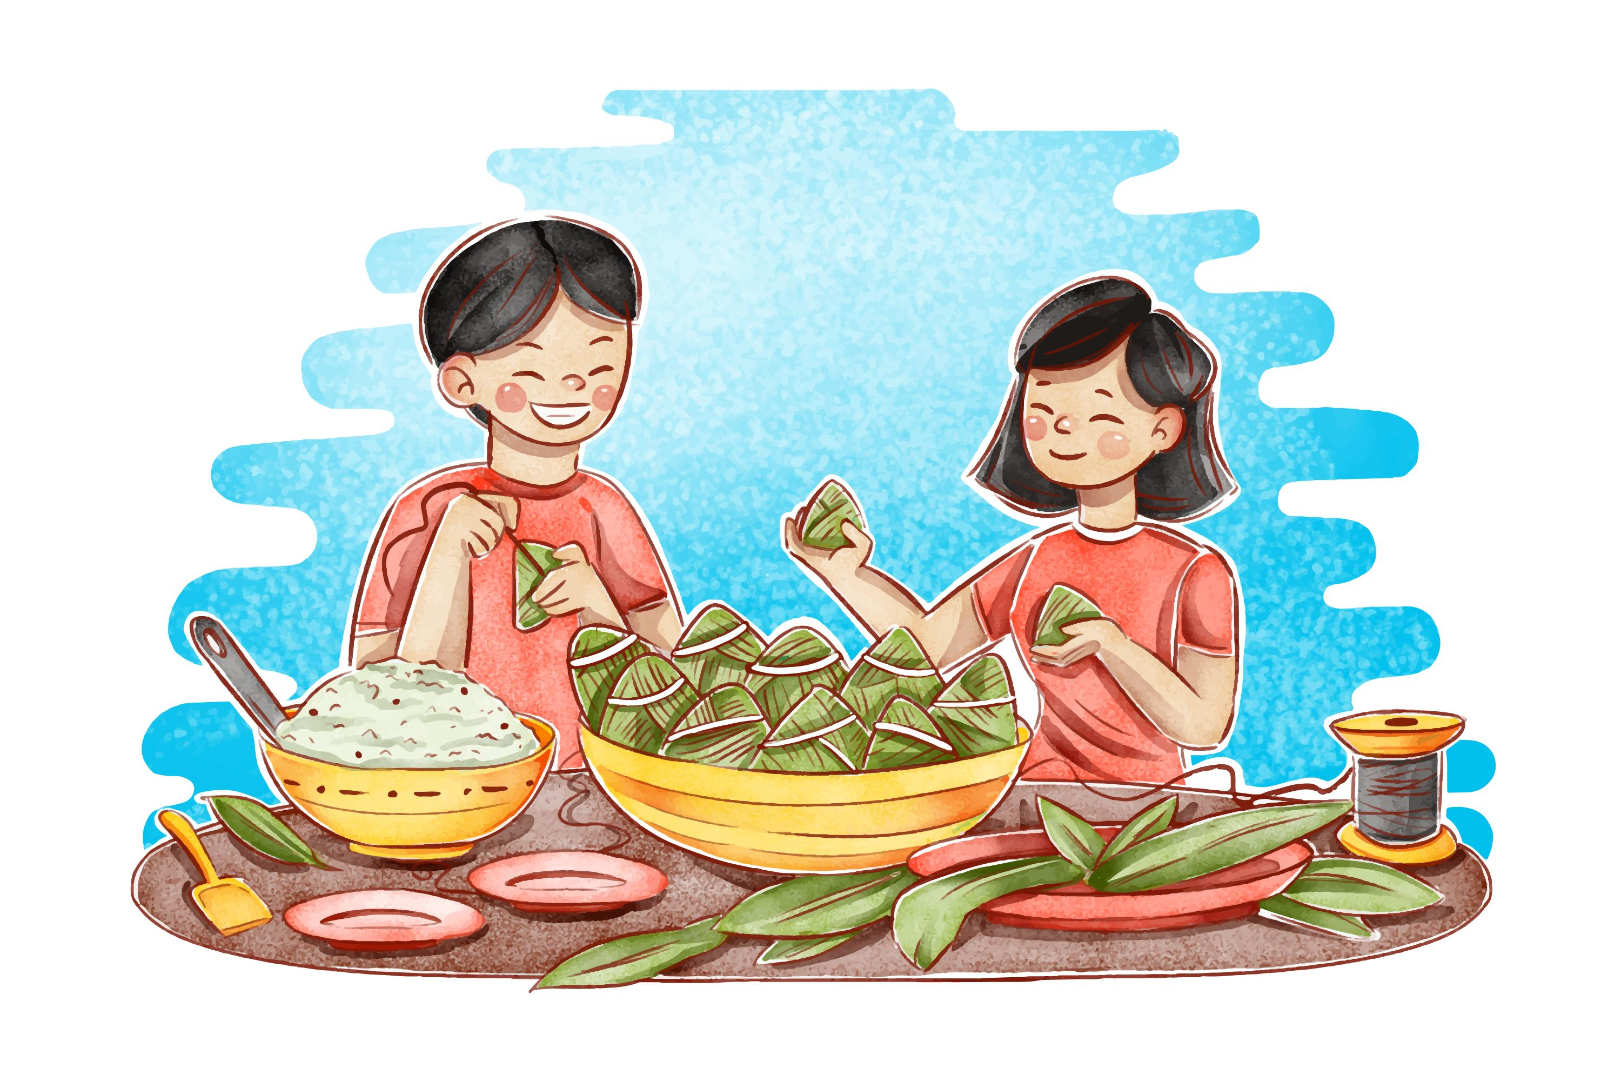


Unit
6
VIETNAMESE LIFESTYLE:
THEN AND NOW
LESSON 7: LOOKING BACK & PROJECT

Slide 3

OBJECTIVES
By the end of the lesson, students will be able to:
Review the vocabulary and grammar of Unit 6;
Apply what they have learnt (vocabulary and grammar) into practice through a project.

Slide 4

LESSON 7: LOOKING BACK & PROJECT
LESSON 1: GETTING STARTED
WARM-UP
Brainstorming
Task 1: Choose the correct answer A, B, C, or D to complete each sentence.
Task 2: Complete the sentences with the correct forms of the words in brackets.
VOCABULARY
GRAMMAR
Task 3: Circle the correct words or phrases to complete the following sentences.
Task 4: Make complete sentences from the clues. Make any changes and add more words if necessary.
PROJECT
Poster presentation
Wrap-up
Homework
CONSOLIDATION

Slide 5
WARM-UP
BRAINSTORMING
- Work in teams.
- Members of each team take turns and write as many vocabulary in Unit 6 as possible in ______ minutes.
- The group having more correct answers is the winner.

Slide 6
VOCABULARY
1
Choose the correct answer A, B, C, or D to complete each sentence.
1. I love animals and I’m determined to ______ my dream of becoming a vet.
A. have
B. pursue
C. do
D. depend on
2. ______ people tend to put the needs of their families ahead of their own.
A. Independent
B. Democratic
C. Kind
D. Family-oriented

Slide 7
VOCABULARY
1
Choose the correct answer A, B, C, or D to complete each sentence.
3. Rapid changes in society and lifestyle have made the ______ in many families wider.
A. generation gap
B. family relation
C. family values
D. experiences
4. She has found ______ sources of information about life in Viet Nam a century ago.
A. extended
B. alive
C. various
D. long

Slide 8
VOCABULARY
1
Choose the correct answer A, B, C, or D
5. Like adults, children sometimes want some ______.
A. opportunity B. relations C. values D. privacy

Slide 9
VOCABULARY
2
Complete the sentences with the correct forms of the words in brackets.
1. My parents taught me not to listen to other people’s _______ conversations. (privacy)
private
memorise
2. It’s amazing that the boy can __________ all the information in such a short time. (memory)
3. Living away from home to attend college has made me more ____________. (independence)
independent

Slide 10
VOCABULARY
2
Complete the sentences with the correct forms of the words in brackets.
freedom
4. In a modern society, we learn to value a person’s _________. (free)
democratic
5. In a ____________ classroom, every student has the right to speak as well as the responsibility to listen to others. (democracy)

Slide 11
LESSON 7: LOOKING BACK & PROJECT
LESSON 1: GETTING STARTED
WARM-UP
Brainstorming
Task 1: Choose the correct answer A, B, C, or D to complete each sentence.
Task 2: Complete the sentences with the correct forms of the words in brackets.
VOCABULARY
GRAMMAR
Task 3: Circle the correct words or phrases to complete the following sentences.
Task 4: Make complete sentences from the clues. Make any changes and add more words if necessary.

Slide 12
GRAMMAR
Circle the correct words or phrases to complete the following sentences.
3
1. Do you mind turning / to turn the volume down? I’m studying.
2.We decided spending / to spend this whole week learning to cook traditional foods
3. If you want seeing / to see the differences between the past and the present of a city, visit its museum.
4.He stayed in his room to avoid meeting / to meet his parents’ guests.
5. My brother promised taking / to take me to the exhibition of traditional farming tools.

Slide 13
GRAMMAR
4
4
Make complete sentences from the clues. Make any changes and add more words if necessary.
3. even / grandmother / enjoy / use / Facebook / communicate / her friends.
1. we / plan / visit / historical places / Cao Bang.
We plan / are planning to visit some historical places in Cao Bang.
4. last year / I / learn / make cakes / watch / cooking videos / Internet.
2. we / hope / have / bus station / near / village / soon.
We hope to have a bus station near our village soon.

Slide 14
GRAMMAR
Make complete sentences from the clues. Make any changes and add more words if necessary.
4
4
3. even / grandmother / enjoy / use / Facebook / communicate / her friends.
Even my grandmother enjoys using Facebook to communicate with her friends.
4. last year / I / learn / make cakes / watch / cooking videos / Internet.
5. this morning / I / suggest / do a survey / northern women’s traditional costumes.
Last year, I learned to make cakes by watching cooking videos on the Internet.

Slide 15
GRAMMAR
4
Make complete sentences from the clues. Make any changes and add more words if necessary.
4
5. this morning / I / suggest / do a survey / northern women’s traditional costumes.
This morning, I suggested doing a survey on northern women’s traditional costumes

Slide 16
LESSON 7: LOOKING BACK & PROJECT
LESSON 1: GETTING STARTED
WARM-UP
Brainstorming
Task 1: Choose the correct answer A, B, C, or D to complete each sentence.
Task 2: Complete the sentences with the correct forms of the words in brackets.
VOCABULARY
GRAMMAR
Task 3: Circle the correct words or phrases to complete the following sentences.
Task 4: Make complete sentences from the clues. Make any changes and add more words if necessary.
PROJECT
Poster presentation

Slide 17
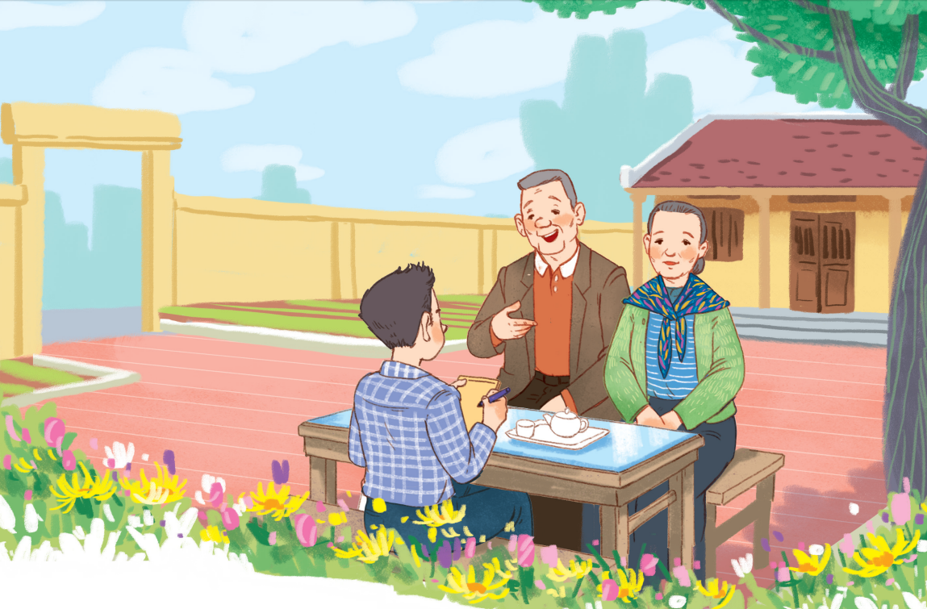
PROJECT
I KNOW MY ______ WELL!

Slide 18
PROJECT
- Work individually to prepare for your presentation.
- There are checklists for self and peer assessment.
- Check appropriate items while listening to your classmates’ presentations and write comments if you have any.

Slide 19
1/ Self-assessment
 | Tick where appropriate | Comments (in English or Vietnamese)
DELIVERY
1. I greeted the audience.
2. I spoke clearly and naturally.
3. I interacted with the audience.
4. I concluded the talk appropriately.
DESIGN OF THE POSTER
1. My poster was clearly organised.
2. The content and photos were suitable.
CONTENT: my poster includes the following information
1. The pictures of the family member.
2. The information about the member (relation, age, job, hobbies, and personal characteristics).

Slide 20

1/ Peer-assessment
 | Tick where appropriate | Comments (in English or Vietnamese)
DELIVERY
1. The presenter greeted the audience.
2. The presenter spoke clearly and naturally.
3.The presenter interacted with the audience.
4. The presenter concluded their talk appropriately.
DESIGN OF THE POSTER
1. His / her posterisclearly organised.
2. His / her content and photos are suitable.
CONTENT: His / her poster includes the following information
1. The pictures of the family member.
2. The information about the member (relation, age, job, hobbies, and personal characteristics).
PRESENTATION

Slide 21
PROJECT
PRESENTATION

Slide 22
NOW I CAN...
Complete the self-assessment table.
Now I can ...
- use the words about changes in lifestyle. - pronounce the sounds /fl/ and /fr/ correctly in words and sentences. - recognise and use verbs + to-infinitive / V-ing. - make promises. - read about learning styles in the past and at present. - talk about changes in my learning style. - listen about changes in family life. - write an email about changes in my family.

Slide 23
LESSON 7: LOOKING BACK & PROJECT
LESSON 1: GETTING STARTED
WARM-UP
Brainstorming
Task 1: Choose the correct answer A, B, C, or D to complete each sentence.
Task 2: Complete the sentences with the correct forms of the words in brackets.
VOCABULARY
GRAMMAR
Task 3: Circle the correct words or phrases to complete the following sentences.
Task 4: Make complete sentences from the clues. Make any changes and add more words if necessary.
PROJECT
Poster presentation
Wrap-up
Homework
CONSOLIDATION

Slide 24

CONSOLIDATION
1
Wrap-up
What have we learnt in this lesson?
Review the vocabulary and grammar of Unit 6;
Apply what they have learnt (vocabulary and grammar) into practice through a project.

Slide 25

CONSOLIDATION
2
Homework
- Prepare for the next lesson.

Slide 26
Website: hoclieu.vn
Fanpage: facebook.com/www.tienganhglobalsuccess.vn/

