Slide 1
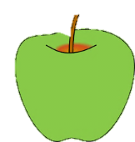
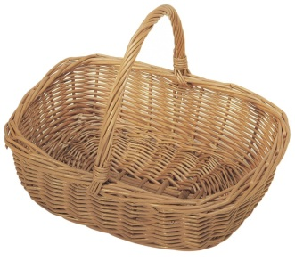
Question 1: How many pairs of wings does a honey bee have?
Question 1: What is the highest mountain in Japan?
Question 2: On what material is the Mona Lisa painted?
Question 2: When did the first man land on the moon?
Question 3: Who was the first person in space?
Question 3: What does a century present?
Question 4: What is the largest land animal in the world?
Question 4: Is share a fish or a mammal?
Question 5: Which animal is the largest primate in the world?
Question 5: Find the verb in the sentence “Take the dog out?”
Question 6: What is the name of the human body’s largest external organ?
Question 6: What is the capital of Australia?
Question 7: How many lungs does the adult human body have?
Question 7: What is the currency of Japan?
Question 8: What is the capital of Argentina?
Question 8: What is the country which has the Great Barrier Reef?
Question 9: Where is the Headquarter of the United Nations Organization?
Question 9: Which is the nearest star to planet Earth?
Question 10: Which is the animal referred as the ship of the desert?
Question 10: Can butterflies be classified as insects or reptiles?
4
4
3
5
3
5
6
6
2
2
7
8
7
8
1
1
10
9
10
9

