Slide 1

Unit 2: Fit for life
Lesson: CLIL
Page 40

Slide 2
Lesson Outline
Warm-up
Reading
Consolidation
Wrap-up

Slide 3
Objectives
By the end of this lesson, students will be able to…
learn and use some vocabulary: feel unpleasant, ginger tea, reduce, ingredient, cough syrup.
talk about medicine in the kitchen.

Slide 4

WARM-UP

Slide 5
Answer the questions
What are some common diseases?
What do you often do when you have those diseases?

Slide 6

It’s time to learn …

Slide 7

Reading

Slide 8


Pre-reading
1. Look at the pictures. Listen and repeat.

Slide 9
Vocabulary
Listen and repeat.
a headache /ˈhedeɪk/ (n) chứng nhức đầu, đau đầu
a sore throat /ˌsɔː ˈθrəʊt/ (n) đau họng
a stomach ache /ˈstʌmək ˌeɪk/ (n) đau bụng, đau dạ dày
a temperature /ˈtemprətʃər/ (n) cơn sốt
a cough /kɒf/ (n) cơn ho
ingredient /ɪnˈɡriːdiənt/ (n) thành phần
cough syrup /ˈkɒf ˌsɪrəp/ (n) sirô chữa bệnh ho

Slide 10
Vocabulary
Listen and repeat.
•
a headache /ˈhedeɪk/ (n) chứng nhức đầu, đau đầu
•
a sore throat /ˌsɔː ˈθrəʊt/ (n) đau họng
•
a stomach ache /ˈstʌmək ˌeɪk/ (n) đau bụng, đau dạ dày
•
a temperature /ˈtemprətʃər/ (n) cơn sốt
a cough /kɒf/ (n) cơn ho
•
ingredient /ɪnˈɡriːdiənt/ (n) thành phần
•
cough syrup /ˈkɒf ˌsɪrəp/ (n) sirô chữa bệnh ho

Slide 11
Vocabulary
Make sentences using these words.
•
a headache /ˈhedeɪk/ (n) chứng nhức đầu, đau đầu
•
a sore throat /ˌsɔː ˈθrəʊt/ (n) đau họng
•
a stomach ache /ˈstʌmək ˌeɪk/ (n) đau bụng, đau dạ dày
•
a temperature /ˈtemprətʃər/ (n) cơn sốt
a cough /kɒf/ (n) cơn ho
•
ingredient /ɪnˈɡriːdiənt/ (n) thành phần
•
cough syrup /ˈkɒf ˌsɪrəp/ (n) sirô chữa bệnh ho

Slide 12

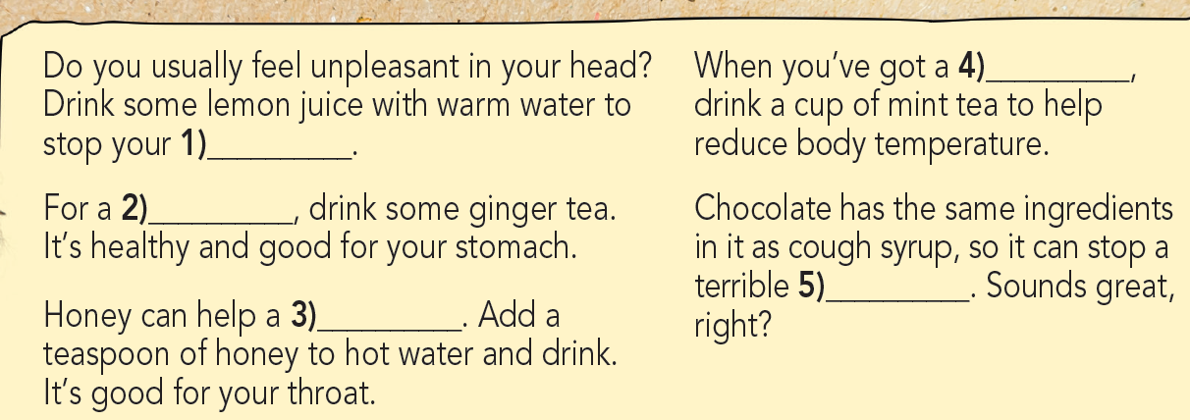
While-reading
2 Read the title of the article and look at the pictures. What medicine can someone find in the kitchen?
We all feel sick sometimes. Luckily, lots of things in your kitchen can make you feel better.
Answer:
lemon, ginger, honey, mint, chocolate

Slide 13
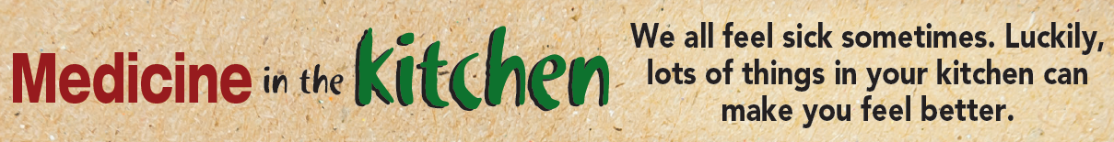
3. Read the article again and complete it with the words in Exercise 1.
Listen and check.
Do you usually feel unpleasant in your head? Drink some lemon juice with warm water to stop your 1) __________.
For a 2) _____________, drink some ginger tea. It’s healthy and good for your stomach.
Honey can help a 3) __________. Add a teaspoon of honey to hot water and drink. It’s good for your throat.
When you’ve got a 4) ____________, drink a cup of mint tea to help reduce body temperature.
Chocolate has the same ingredients in it as cough syrup, so it can stop a terrible 5) __________. Sounds great, right?
headache
stomach ache
sore throat
temperature
cough

Slide 14

Post-reading
Suggested Answer
The purpose of the text is to inform. It tells people how to use some medicine in the kitchen for some common health problems. It is very useful to me because I know how to feel better if I have got these health problems.

Slide 15

Which medicine in the article did you know about? Do you know any other medicine in the kitchen? Tell your partner.

Slide 16

CONSOLIDATION

Slide 17
Write a paragraph (60-80) about the medicine you can find in your kitchen.

Slide 18

WRAP-UP

Slide 19
Today’s lesson
Vocabularies
diseases
Skills:
Reading: medicine in the kitchen

Slide 20
Homework
Practise the vocabularies and structure and make sentences using them.
Do exercises in workbook on pages 22 & 23.
Prepare the next lesson (page 41 SB).

Slide 21

Lesson 3
Stay positive and have a nice day!

