Slide 1

Unit 1: My World
Lesson 1c: Vocabulary
Page 18

Slide 2
Lesson Outline
Warm-up
Vocabulary
Listening
Consolidation
Wrap-up

Slide 3
Objectives
By the end of this lesson, students will be able to…
- enrich vocabulary and to talk about Characters.
- practise listening for key information.

Slide 4

WARM-UP

Slide 5
Answer the questions
Who is your best friend?
Which characters do you like about him/her?

Slide 6

It’s time to learn …

Slide 7

Presentation

Slide 8



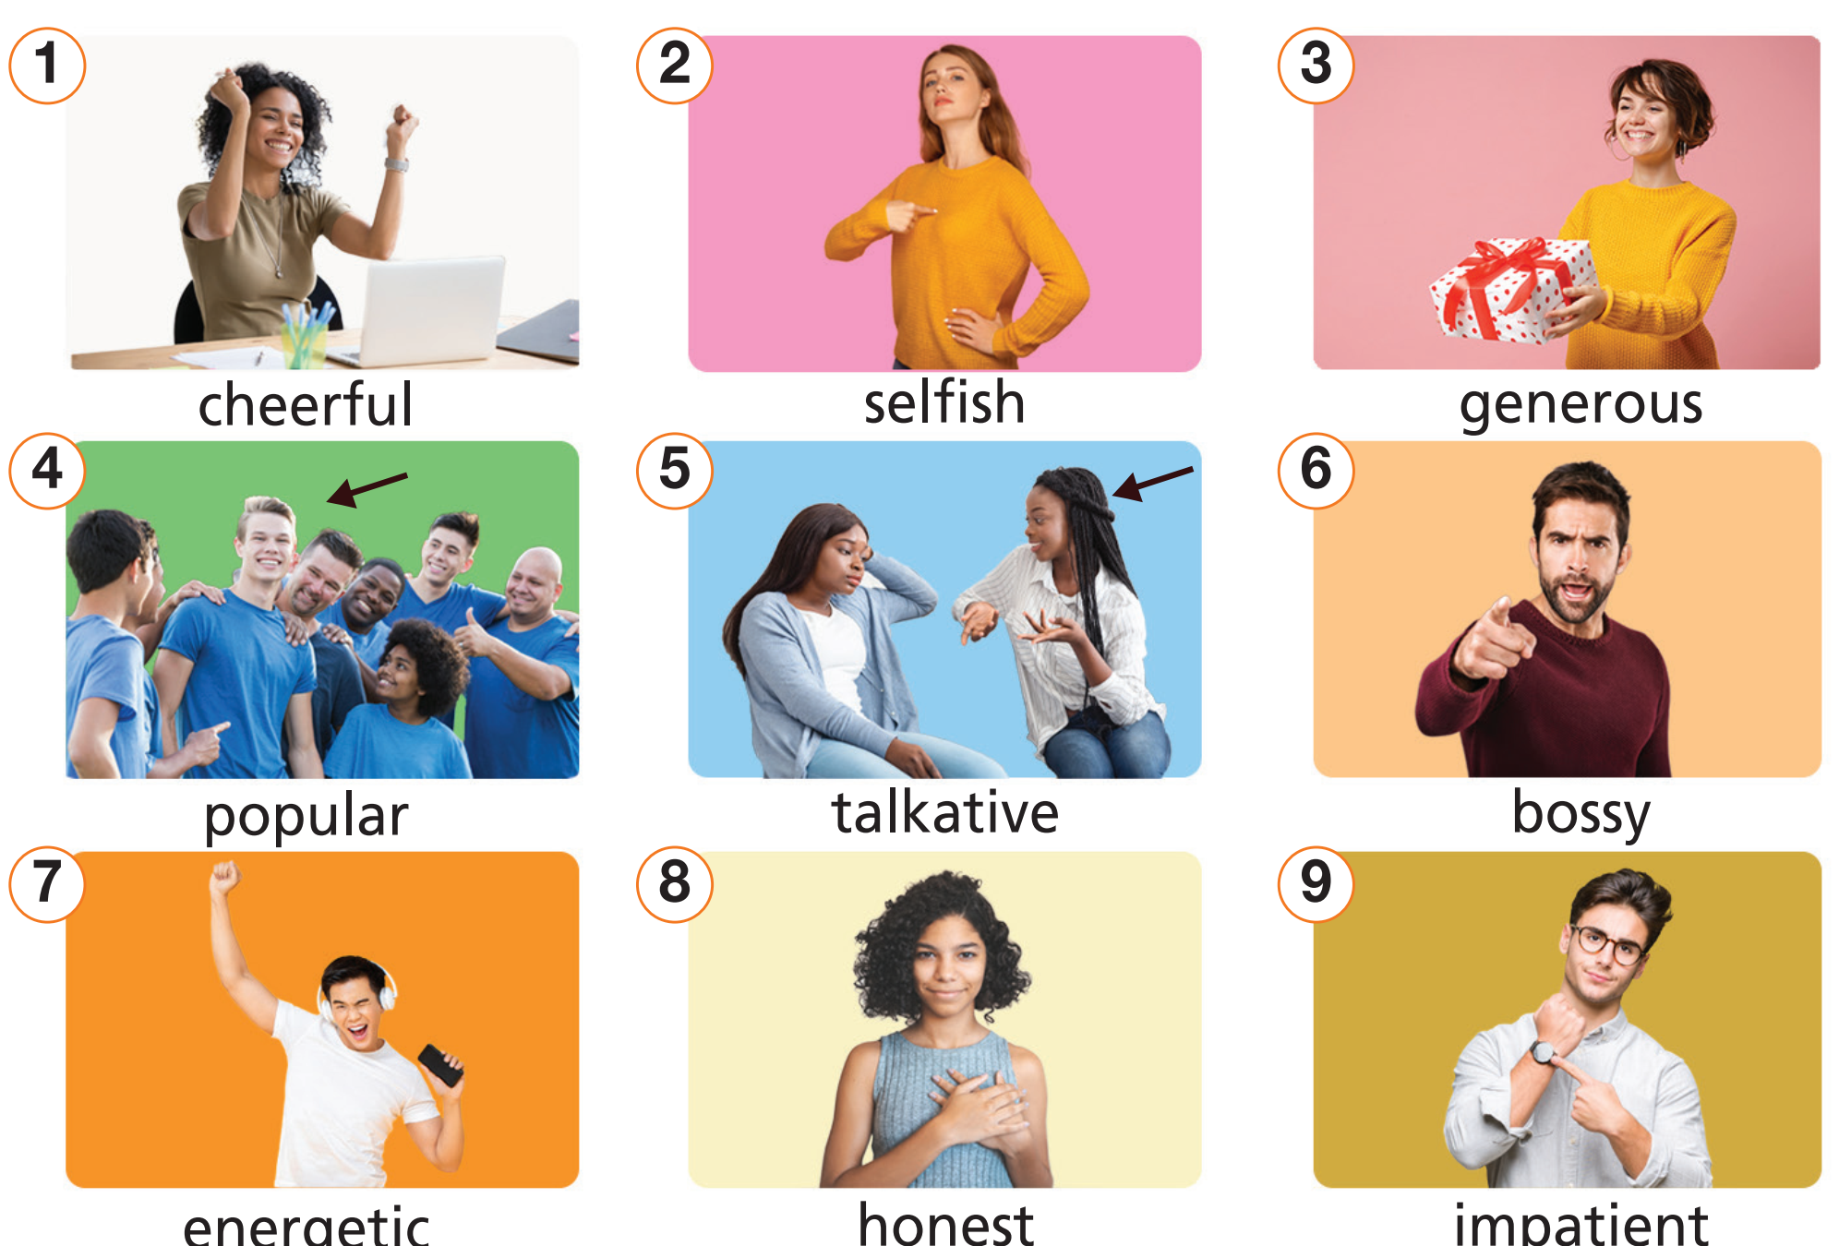
Listen and repeat.

Slide 9
Listen and repeat
Click on each word to hear the sound
bossy /ˈbɒsi/ (adj): hống hách, hay ra lệnh
cheerful /ˈtʃɪəfəl/ (adj): vui vẻ
energetic /ˌenəˈdʒetɪk/ (adj): hoạt bát, đầy năng lượng
generous /ˈdʒenərəs/ (adj): rộng rãi, hào phóng
honest /ˈɒnɪst/ (adj): chân thật, thành thật
impatient /ɪmˈpeɪʃənt/ (adj): thiếu kiên nhẫn, nóng vội
popular /ˈpɒpjələr/ (adj): nổi tiếng, được yêu thích
selfish /ˈselfɪʃ/ (adj): ích kỷ
talkative /ˈtɔːkətɪv/ (adj): hoạt ngôn, nói nhiều

Slide 10


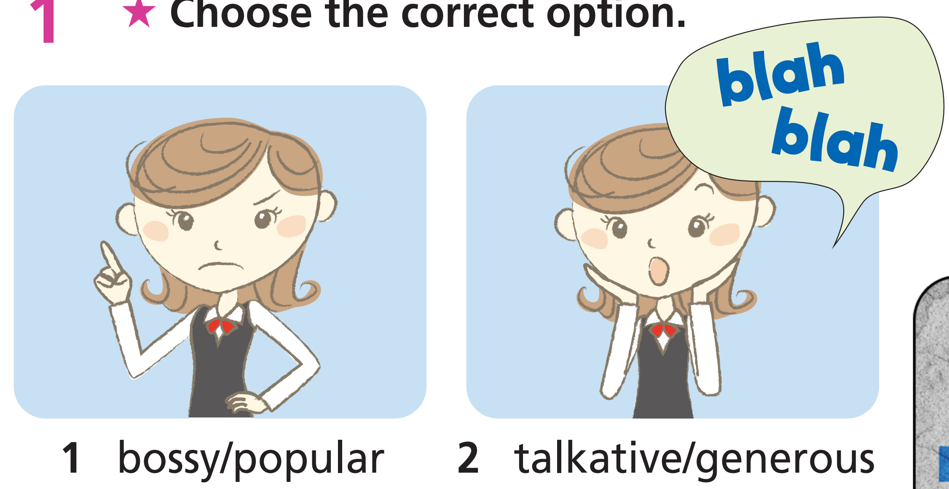
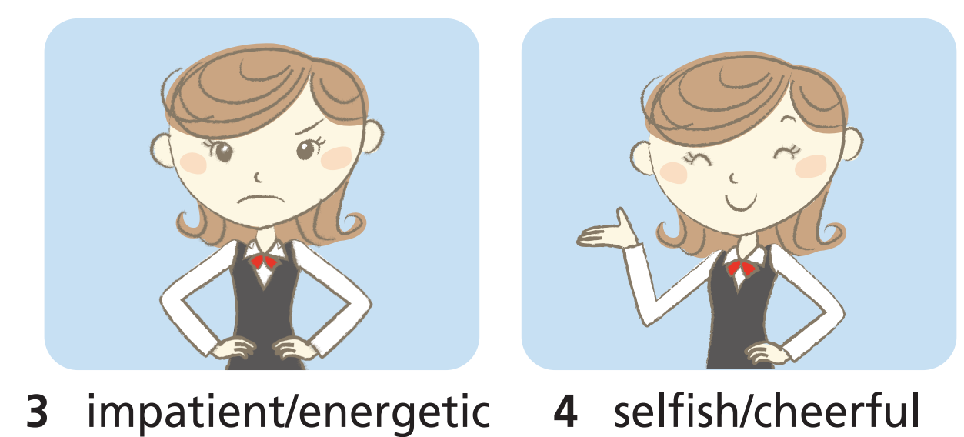
Check vocabulary

Slide 11

Practice

Slide 12
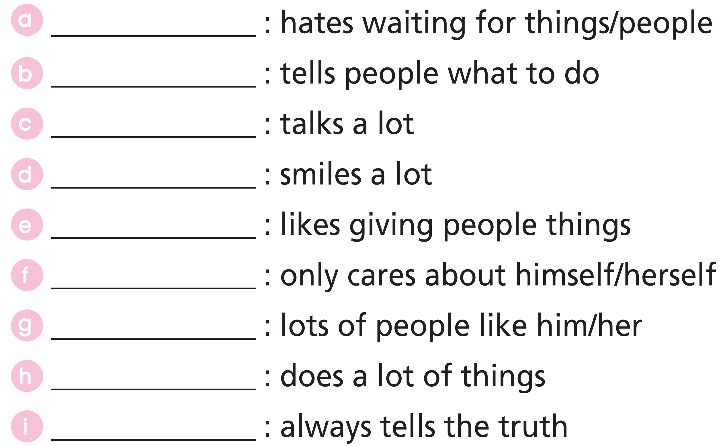
1
cheerful
2
selfish
3
generous
4
popular
5
talkative
6
bossy
7
energetic
8
honest
9
impatient

Slide 13
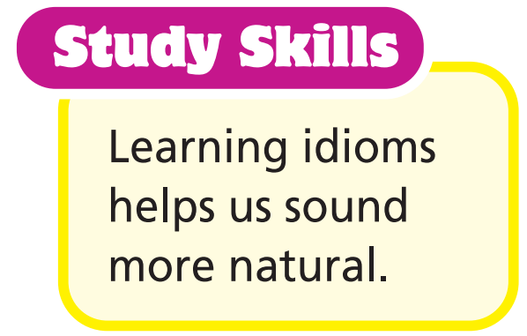

Character idioms
as cold as ice ➝ not showing any emotion
two-faced ➝ dishonest
smart cookie ➝ clever
Make sentences using the idioms above. Are there similar idioms in your language?

Slide 14
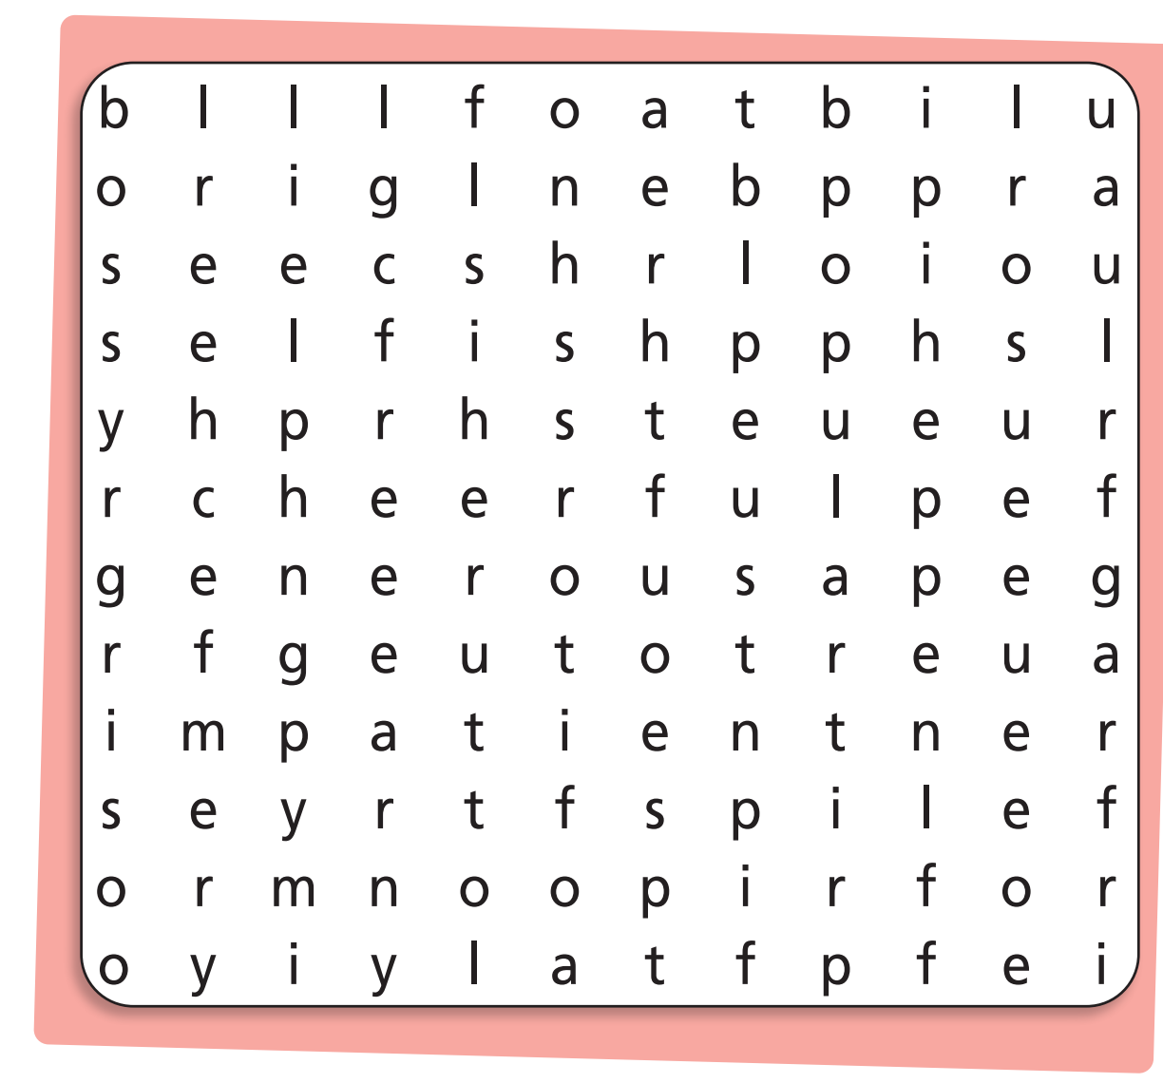
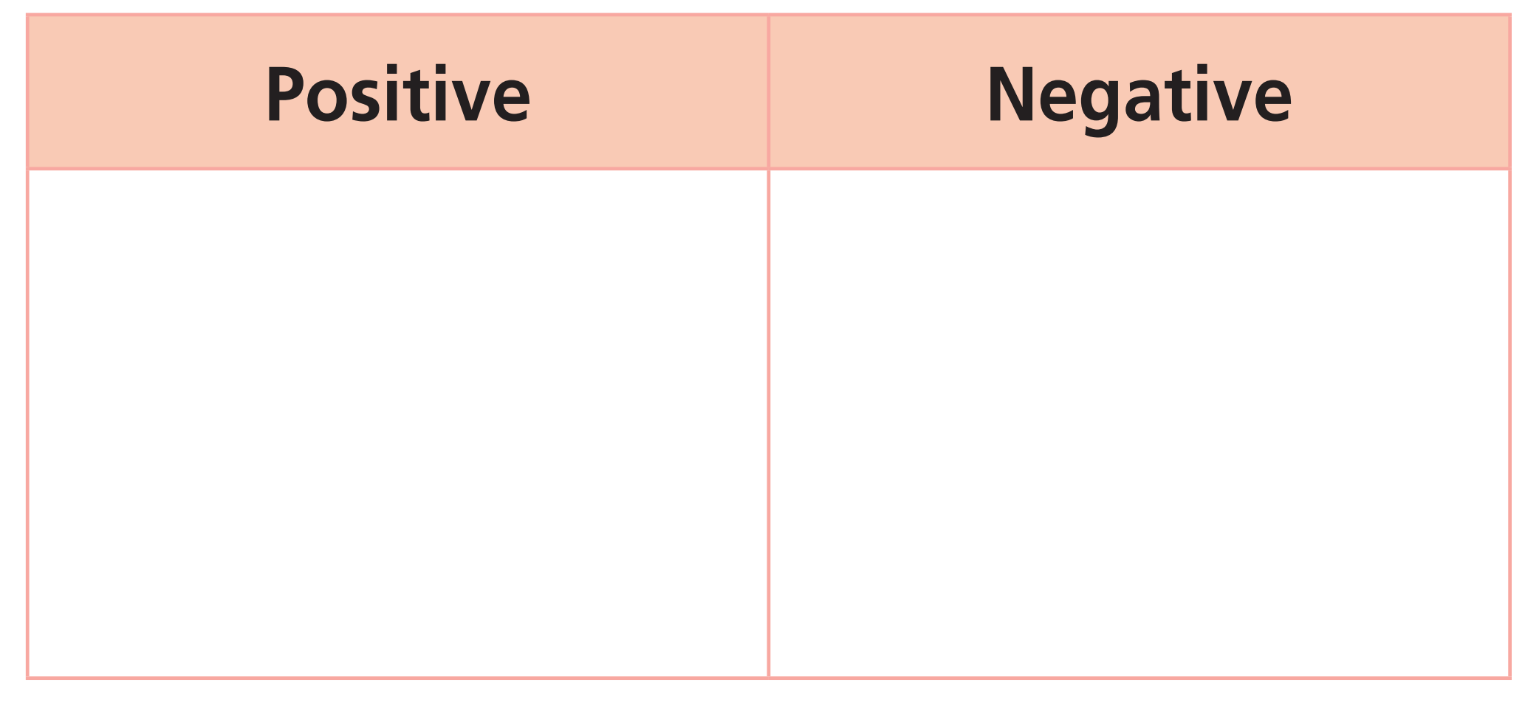
Extra Practice
WB, page 12
Find 6 character adjectives in the word search. Then list them under the correct heading.
cheerful
generous
popular
bossy
selfish
impatient

Slide 15

Production

Slide 16
Work in pairs. Use the characters above to make sentences about your classmates. Your partner will guess who he/she is.
Example
A: He is cheerful. He always makes people smile.
B: I guess he is C.
A: Yes, that’s right.

Slide 17

Listening

Slide 18


Pre-listening
Read the instruction, underline key words
Listen and match the people to the character adjectives.

Slide 19
While-listening
Listen and match the people to the character adjectives.
What are your answers?

Slide 20

Now, listen again to check answer.
Audio script
Helen is a really good friend who always tells you the truth about anything. She also likes to help out when somebody is in need, not like Greg who only cares about himself. Andy, on the other hand, likes to smile a lot and talk a lot.

Slide 21
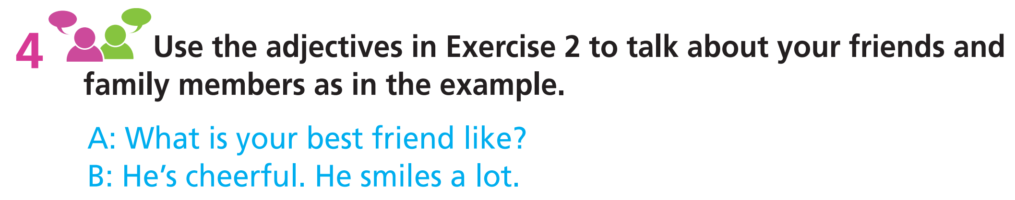
Post-listening

Slide 22

CONSOLIDATION

Slide 23
Write a paragraph (60-80 words) to describe the characters of the people around you (your parents, brothers, sisters, friends,..).

Slide 24

WRAP-UP

Slide 25
Today’s lesson
Vocabularies
Characters
Structures/ Sentence patterns
Sentences to describe someone’s characters

Slide 26
Homework
Practise the vocabularies and structure and make sentences using them.
Do the exercises in TA 7 Right on WB (page 12)
Prepare the next lesson (page 19 SB)
Do the exercise in TA 7 Right on Notebook (page 7)

Slide 27

Lesson 3
Stay positive and have a nice day!

