Slide 1

UNIT 1: MY FRIENDS
Review & Practice 2

Slide 2
Lesson Outline
Warm-up
Practice
Consolidation
Wrap-up

Slide 3
Objectives
By the end of this lesson, ﻿students will be able to review and talk about ……
spelling names
review where people are from
review what their friends like doing.

Slide 4

WARM UP

Slide 5
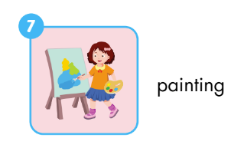



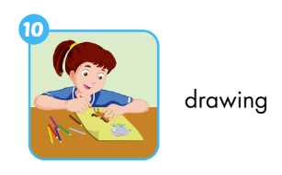
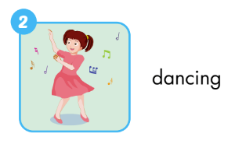
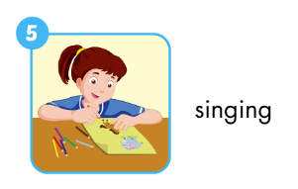

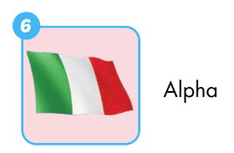

Activity 1
Look and read. Then write a tick (✓) or a cross (✘)?
✘
✓
✘
✓
✓
✓
✘
✓
✘
✓
Notes:
Divide ss into groups.
T shows picture. Ss in groups write tick or cross as fast as possible on their small board or A4 paper

Slide 6

Activity 2
LET’S THINK AND WRITE
Notes:
https://image.shutterstock.com/z/stock-photo-the-earth-or-globe-heart-shaped-surrounded-by-flags-concept-for-world-peace-charity-or-love-of-1481247392.jpg
- T prepare glue
Ask ss to prepare a small paper.
Set context: If you can choose where you from, which country do you choose?
Ask ss to write the name of the country down on the paper. Then, ask them to stick the paper on their shirts like a name tag.

Slide 7
Handout for “Passing the ball” game
What’s your name? | How do you spell your name?
How old are you? | Do you like singing?
Do you like dancing? | Do you like painting?
Do you like reading? | Do you like drawing?
Where’s he from? | Where’s she from?
Notes:
Teachers print this handout. Cut out each question. Pull all of them inside a bag.

Slide 8

Activity 3
LET’S PASS THE BALL!
Notes:
https://www.shutterstock.com/vi/image-vector/illustration-stickman-kids-sitting-circle-girl-1673160247
Prepare 2 balls
Turn the music on, let ss pass 2 balls at the same time.
When music stops, who are holding the balls will tic tac toe. Winner pick a question from the bag and ask, loser answer.
For question “where’s he/she from”, ss can point to anyone in the class and ask. The loser has to look at the ”country tag” and answer the questions

Slide 9
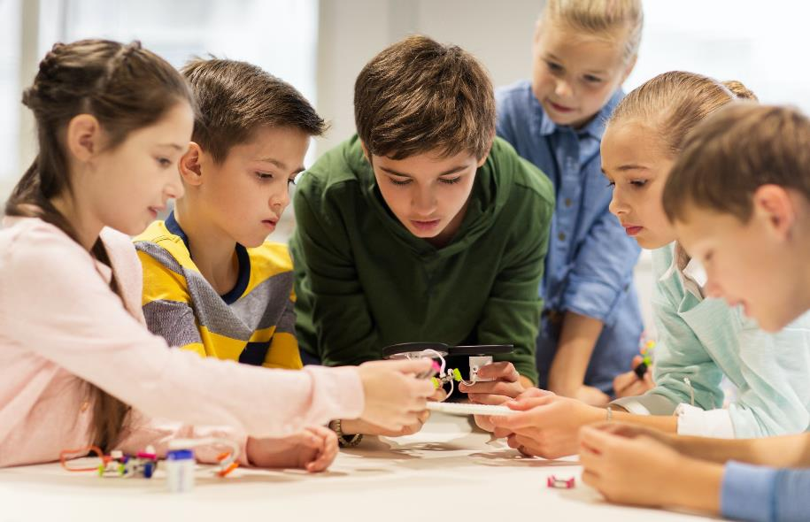
It’s
time
to
practice …

Slide 10

Practice

Slide 11

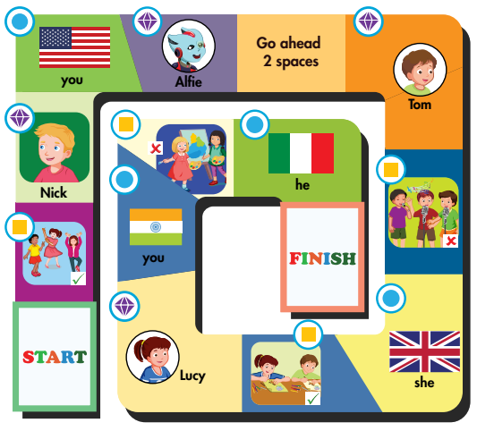
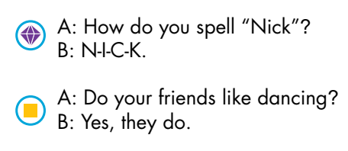

Activity 1
Notes:
﻿1. Divide the class into groups of four with two pairs in each group.
2. Have pairs play rock, paper, scissors for each turn.
3. The winning pair moves forward two spaces. The losing pair moves forward one.
4. Each pair must match the symbol to the useful language and then ask and answer. If they answer incorrectly, they must move back one space.
5. The pair that gets to the Finish first wins the game.

Slide 12
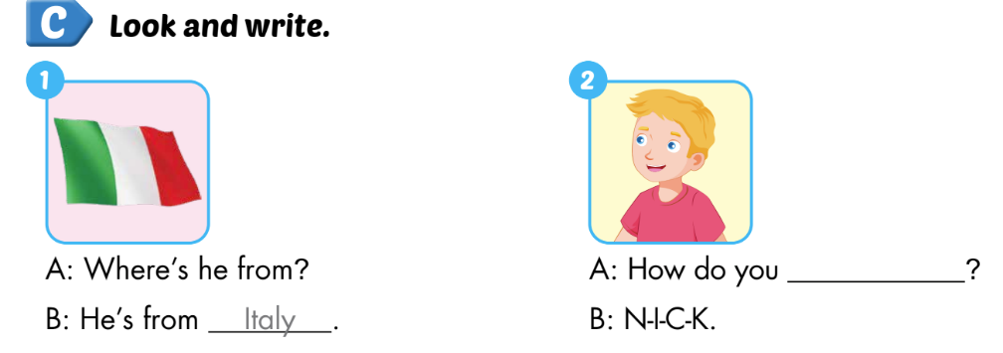
Extra Activity 1 WB p. 17
spell “Nick”

Slide 13

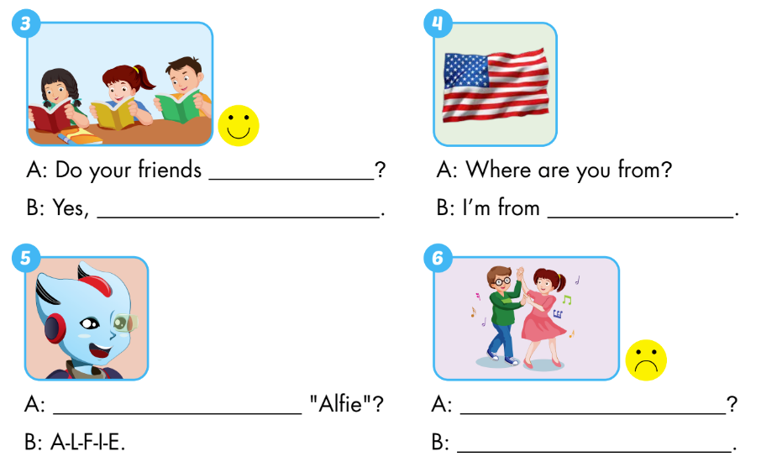
Extra Activity 1 WB p. 17
like reading?
they do
the USA
How do you spell
Do your friends like dancing
No, they don’t

Slide 14

CONSOLIDATION

Slide 15
Activity 1
Let’s copy and do a survey!
No. | What’s your name? | How do you spell “…”? | How old are you? | Where are you from?
Notes:
T invite a st to do the example 1st.
Let ss go around the class. Tic tac toe with their friends. The winner will ask, the loser will answer. They need to take note their friends’ answer.
Set the time. When time’s up, the one has most friends/ answers will be the winner

Slide 16
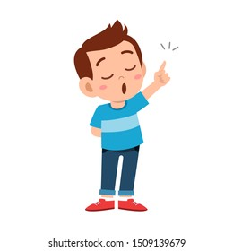
Activity 2
Let’s talk about your friends.
Hello, my name’s Cody. It’s “C-O-D-Y”. I’m 8. I’m from Italy.
This is my friend. She is Mai. It’s “M-A-I”. She’s 8. She’s from Japan.
This is my friend. He is Nick. It’s “N-I-C-K”. He’s 8. He’s from the UK.
…
That’s all for now.
It’s nice to meet you.
Goodbye.
Notes:
https://image.shutterstock.com/image-vector/cute-kid-teen-boy-show-260nw-1509139679.jpg
Let ss practice, follow the structure.
Call ss to have the speaking

Slide 17
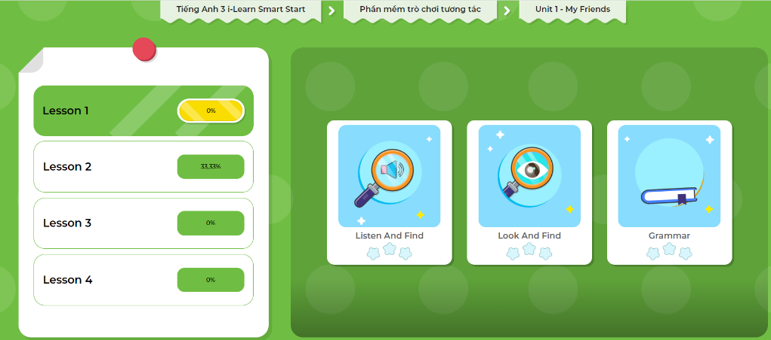
Extra-Act2. DHA app.
Click here to play the games

Slide 18

WRAP-UP

Slide 19
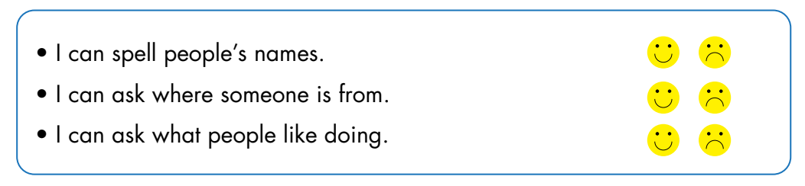
Today’s lesson

Slide 20
Homework
Practice vocabularies and structure. Make sentences using them.
Do the exercises in Tiếng Anh 3 i-Learn Smart Start Workbook (page 17)
Do the exercises in Tiếng Anh 3 i-Learn Smart Start Notebook (page 15)
Play the consolidation games in Tiếng Anh 3 i-Learn Smart Start DHA App on www.eduhome.com.vn
Prepare the next lesson (page 24)

Slide 21
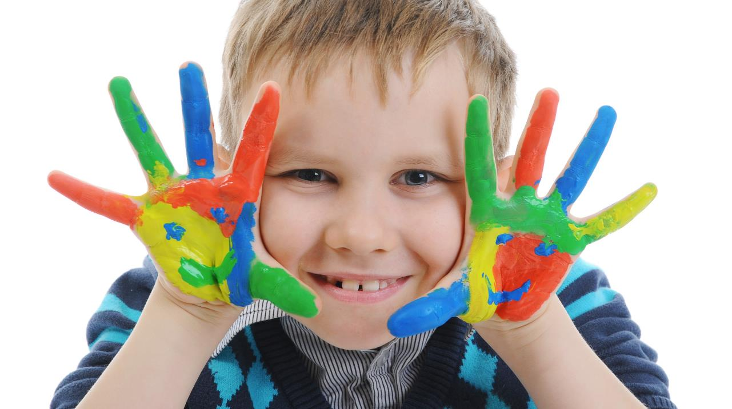
Enjoy your day!

