Slide 1


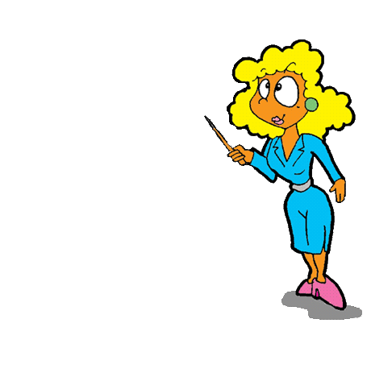

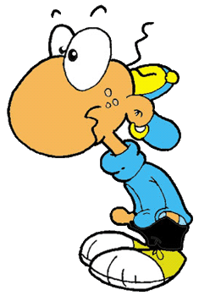


Slide 2





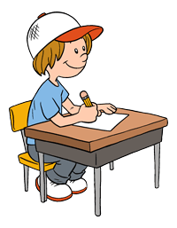

Be quiet!
Read the text.
Sit down!
Copy the summary.
Copy
the summary.

Slide 3
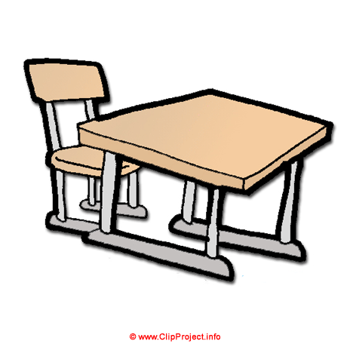


Go back to your place!
Come to the front!
Stand up!
Do you understand?
Go back to
your place!

Slide 4


Open your books!
Go to the board!
Listen carefully!
Close your books!
Open your
books!

Slide 5
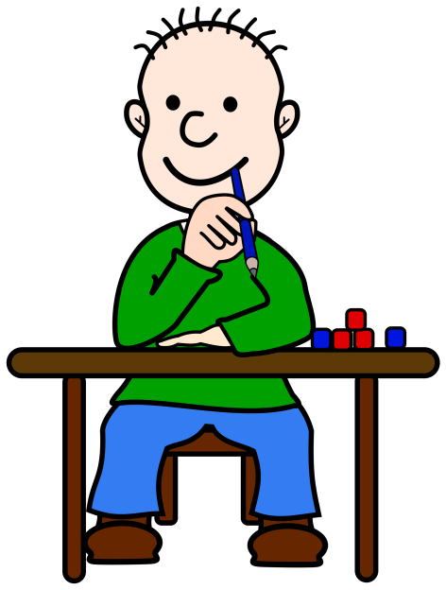
Work in pairs!
Copy from the board!
Do exercise 6!
Raise your hand!
Do
exercise 6!

Slide 6



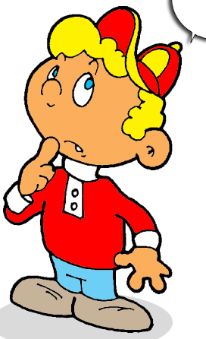
Show me your homework!
Close the window!
Do you have any questions?
Clean the board!
Do you have
any questions?

Slide 7

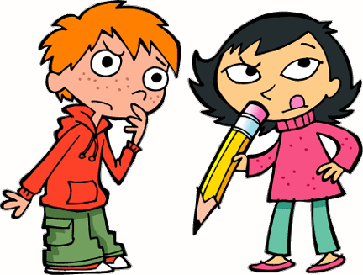
Did you do your homework?
How do you spell …?
Repeat, please!
Pay attention!
How do
you spell…?
T-E-A…???

Slide 8

Listen to the song!
Look at the board!
Come here, please!
Raise your hand if you want to answer!
Raise your hand if you want to answer!

Slide 9


Try again!
Come in!
Put your things away!
Did you bring your books?
Put your
things away!

Slide 10
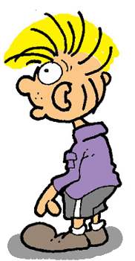

Switch off your phone!
Stand up, please!
Why are you late?
Repeat after me!
Switch off
your phone!

Slide 11

SƯU TẦM: ĐOÀN VĂN DOANH, NAM TRỰC, NAM ĐỊNH
LINK NHÓM DÀNH CHO GV BỘ MÔN VẬT LÝ TRAO ĐỔI TÀI LIỆU VÀ CHUYÊN MÔN CT 2018
https://www.facebook.com/groups/299257004355186

