Slide 1

Unit 4: HOME
Lesson 4.2 Review and practice
Page 65

Slide 2
Lesson Outline
Warm-up
Speaking
Consolidation
Wrap-up

Slide 3
Objectives
By the end of this lesson, students will be able to review asking where people are, asking what people are doing, asking where things are and talking about their homes.

Slide 4

WARM UP

Slide 5
WHAT’S NEXT?
Bo__
Box
Ta__ __ __
Table
Be__
Bed
De__ __
Desk
Mi__ __ __ __
Mirror
Cl__ __ __ __ __
Closet

Slide 6
WHAT’S NEXT?
Pi__ __ __
Picture
Ba__ __ __ __ __ __
Bathroom
Ki__ __ __ __ __
Kitchen
Be__ __ __ __ __
Bedroom
Ya__ __
Yard
Cha__ __
Chair

Slide 7

It’s time to learn …

Slide 8

speaking

Slide 9

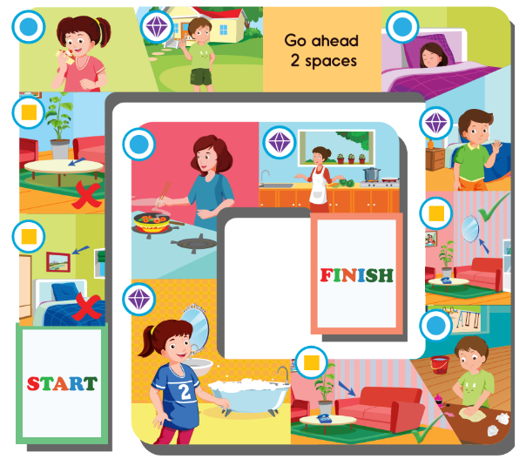



A: Where’s Mom?
B: She’s in the kitchen.
A: What’s she doing? B: She’s sleeping.
A: Is the mirror in the living room?
B: Yes, it is.

Slide 10
A: Where’s he?
B: He’s in the yard.
A: What’s she doing?
B: She’s cooking.
A: Is the sofa in the living room?
B: Yes, it is.

Slide 11
A: Where’s he?
B: He’s in the bedroom.
A: What’s she doing?
B: She’s eating.
A: Is the picture in the bedroom?
B: No, it isn’t.

Slide 12
A: Where’s she?
B: She’s in the bathroom.
A: What’s he doing?
B: He’s cleaning.
A: Is the table in the living room?
B: No, it isn’t.

Slide 13


I can say rooms in the house.
I can ask where people and things are.
I can say what people are doing.

Slide 14

Workbook
p. 44

Slide 15

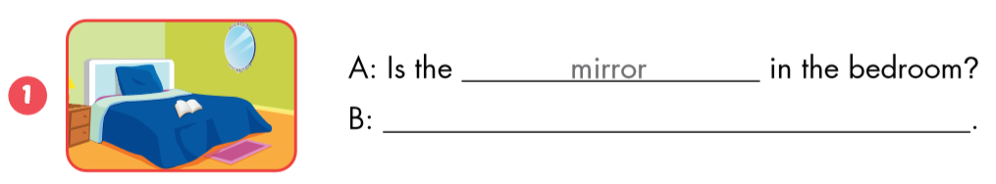
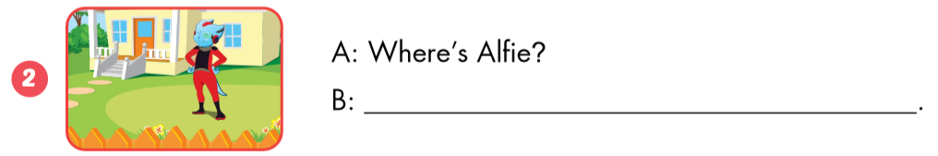
mirror
Yes, it is.
He’s in the yard.

Slide 16
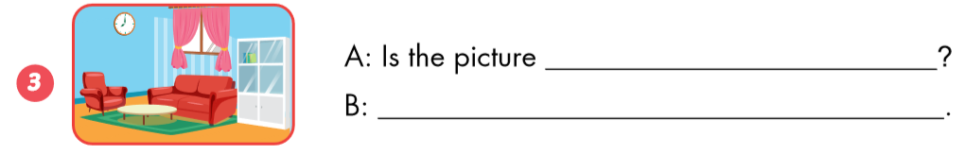
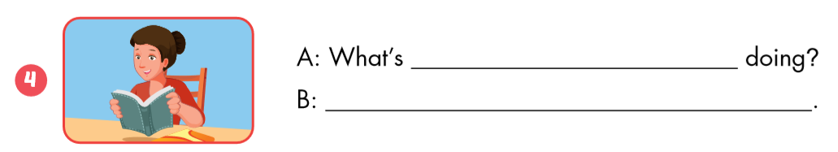
in the living room
No, it isn’t.
she
She’s reading.

Slide 17

CONSOLIDATION

Slide 18
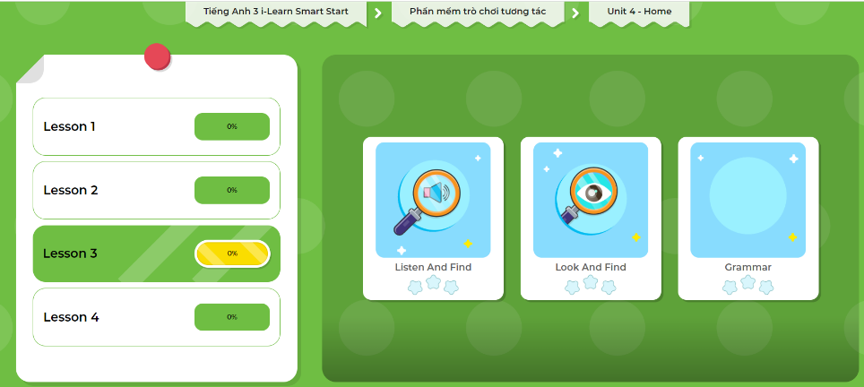
LET’S PLAY!
Click here to play the games!

Slide 19

WRAP-UP

Slide 20
Homework
Review the vocabularies and sentence patterns. Make sentences using them.
Do the exercises on page 47 (WB)
Prepare the next lesson (page 67 SB)
Play the consolidation games in Tiếng Anh 3 i-Learn Smart Start DHA App on www.eduhome.com.vn
Do the exercises in Tiếng Anh 3 i-Learn Smart Start Notebook on page 33.

Slide 21

Enjoy your day!

Slide 22

Have a nice day!

