Slide 1
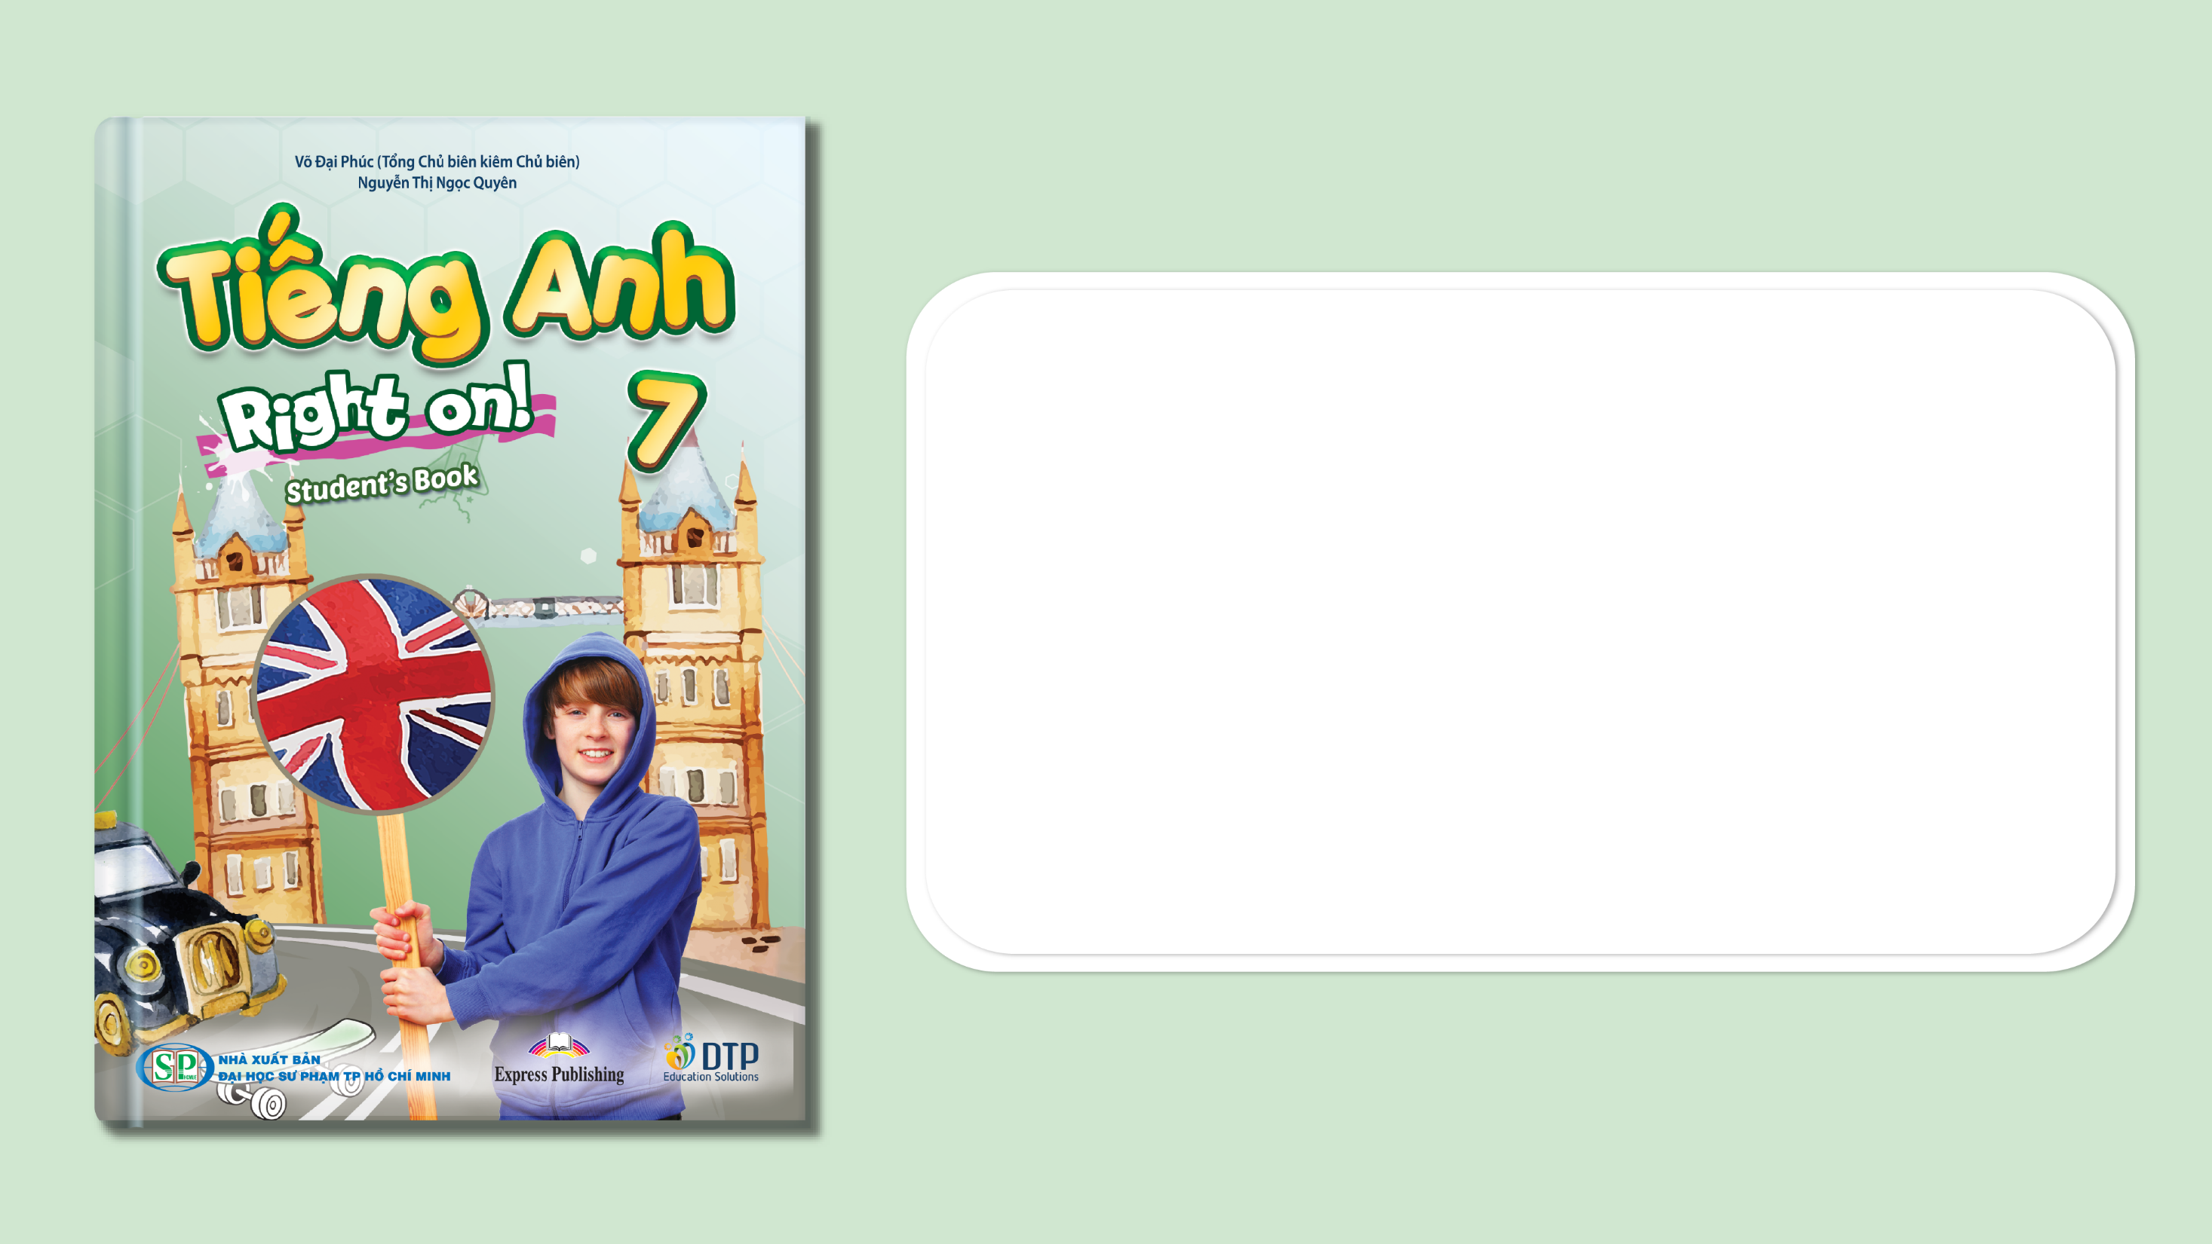
Unit 5: Travel & Transportation
Lesson 5e: Grammar (Cont.)
Page 87

Slide 2
Lesson Outline
Warm-up
Grammar
Consolidation
Wrap-up

Slide 3
Objectives
By the end of this lesson, students will be able to…
use structures: like/different from/the same as.

Slide 4

WARM-UP

Slide 5
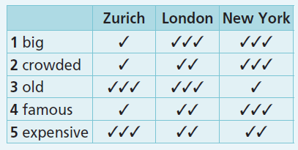
61 ★ Look at the table and write sentences about the cities as in the example.
1 Zurich is big, but London and New York are bigger. London is as big as New York.
2 Zurich is crowded, but London is more crowded. New York is the most crowded of all.
3 New York is old, but Zurich and London are older. Zurich is as old as London.
4 Zurich is famous, but London is more famous. New York is the most famous of all.
5 London and New York are expensive. London is as expensive as New York, but Zurich is the most expensive of all.
Grammar Bank, WB P. 75

Slide 6

Teacher prepares 10 questions about students (e.g. What’s your favorite fruit? When was your last holiday? etc.). T invites 2 or 3 pairs of students to the front of the class. In each pair, 1 student writes the answer on the board before the other student who has to turn his/her back to the board says the answer. If their answers are similar, they’ll get the point. Teacher asks the rest of the class ‘How are their answers?’, and all students should answer using structures ‘A’s answer is the same as / different from B’s answer.’
The pair with the highest score is the winner.

Slide 7

It’s time to learn …

Slide 8

PRESENTATION
like/the same as/
different from

Slide 9
Choose suitable uses for the following structures:
• like means _______________________________________________.
e.g. This shirt feels like cotton. It’s very soft.
• different from means ______________________________________.
e.g. My shoes are different from yours. Mine are blue. Yours are red.
• the same as means ________________________________________.
e.g. Your dress is the same as mine. We bought them at the same shop.
that someone or something is exactly like someone else or something else
‘similar to’
‘not the same’
‘similar to’
‘not the same’
that someone or something is exactly like someone else or something else

Slide 10
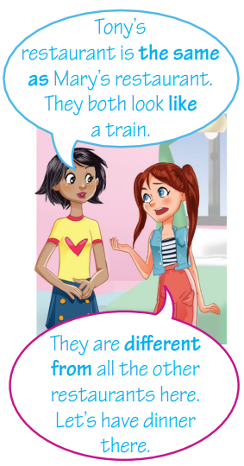
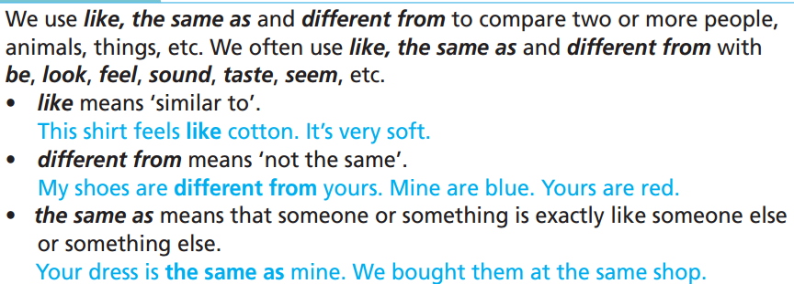
Remember:

Slide 11

PRACTICE

Slide 12
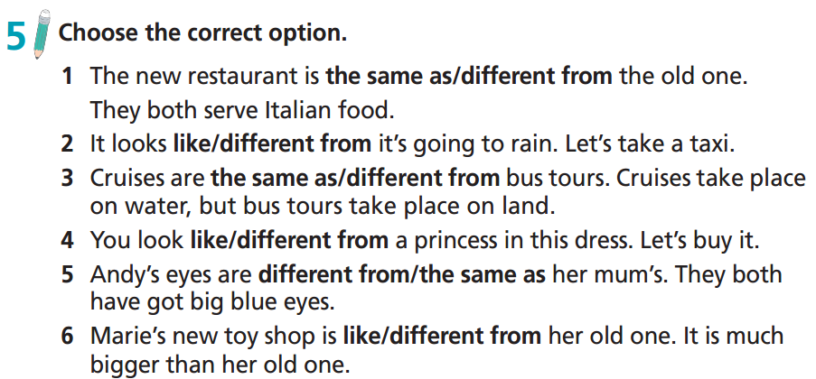

Slide 13
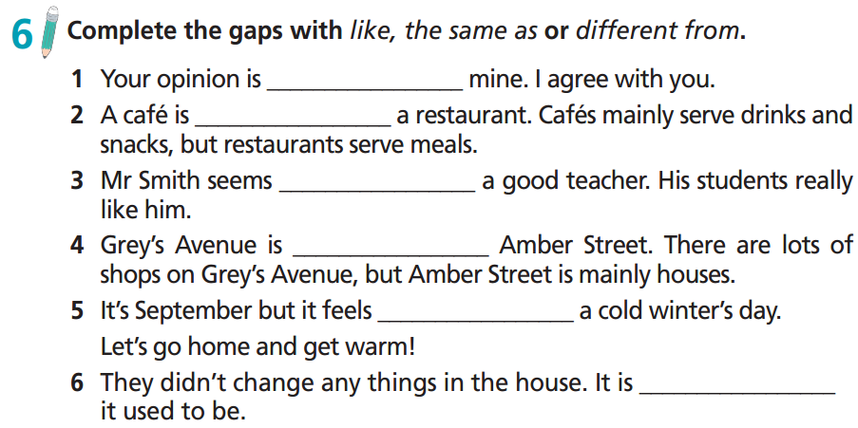
the same as
different from
like
different from
like
the same as

Slide 14
63 ★ Fill in each gap with like, the same as or different from.
1 My eyes are _______________ my parents’. We all have blue eyes.
2 He looks _______________ you, only a bit taller.
3 Michael is _______________ Danny. Michael is tall, but Danny is short.
4 This shirt feels _______________ silk.
5 Ann is _______________ other children at her age. She is calm, polite and patient.
6 I lost my hat. Can you buy me a new hat _______________ the lost one? I like that style.
7 My aunt is _______________ a mother to me. She takes care of me very well.
8 I love your shirt. I want one _______________ yours.
9 This cake tastes _______________ apple pie.
10 Your coat is _______________ mine. Mine is blue, but yours is yellow.
Extra Practice
Grammar Bank, WB p. 75
the same as
like
different from
like
different from
the same as
like
the same as
like
different from

Slide 15
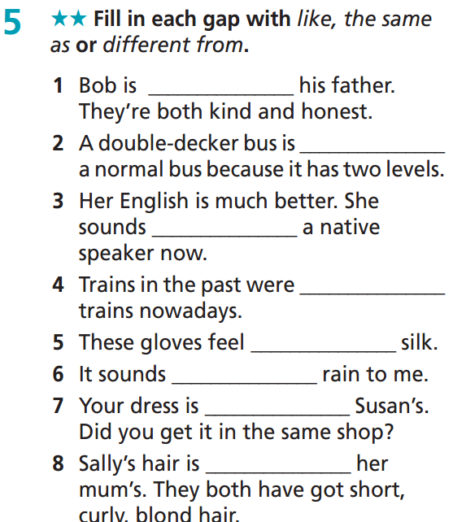
Extra Practice
WB p. 46
the same as
different from
like
different from
like
like
the same as
the same as

Slide 16
PRODUCTION

Slide 17
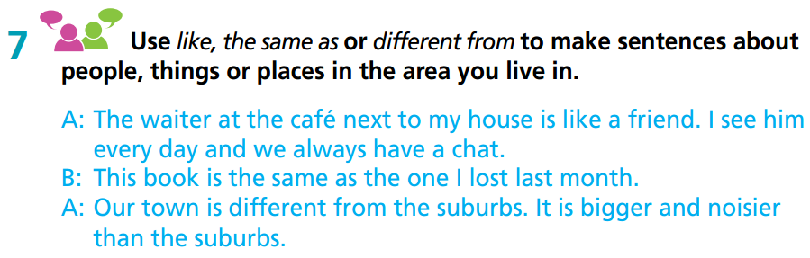
Work in pairs
I am different from my sister. I love outdoor sports, but she prefers surfing the Net and playing computer games.
My hobbies are the same as my brother’s.
We both love watching TV series and reading books.
My mother is like a close friend to me. She always listens to me and gives me good advice.

Slide 18
Report about people, things or places in the area you live in. Remember to use structures: like, the same as, and different from
Hi, my name is ……. I live in ……. There are some similarities in places / things / people here. …… like ……… the same as ……. There are also some differences here/between them ……….. different from ……………

Slide 19

CONSOLIDATION

Slide 20
Write a paragraph (60-80 words) about the similarities and differences of things / people / places around you. Remember to use structures: like, the same as and different from
E.g.
My room is the same size as other rooms in my house, but it was painted with pictures of trees and flowers on the wall. It looks like a green garden, so I feel very comfortable inside it. The lights in my room are also different from other rooms. I put many small lights on the four corners of the room instead of one big light in the middle.

Slide 21

WRAP-UP

Slide 22
Today’s lesson
Grammar
Learn and practise structures: like/different from/the same as.

Slide 23
Homework
Practise the grammar point and make sentences using them.
Do the exercises in TA 7 Right on WB (page 46)
Prepare the next lesson (page 88 SB)
Complete the grammar notes in TA 7 Right on Notebook (page 40)

Slide 24

Enjoy your day!

