Slide 1
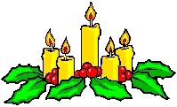
WELCOME TO MY CLASS
Good afternoon Everybody

Slide 2

Date
UNIT FIVE
FESTIVALS IN VIET NAM
Period 43
LOOKING BACK AND PROJECT

Slide 3
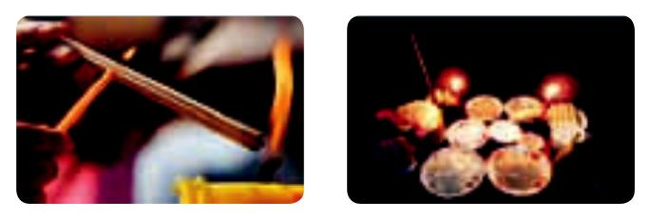
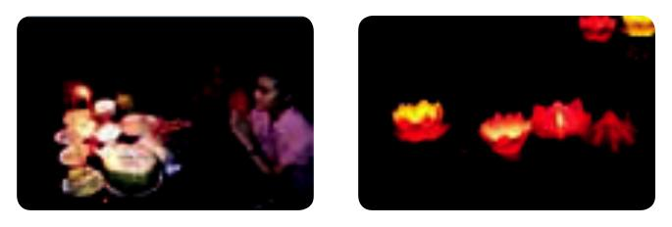
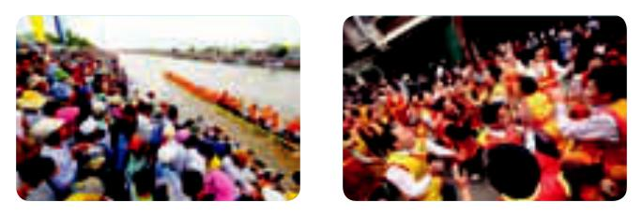
i. vocabulary: jumble words
(1. Ex. 1 / p. 56)
INCENSE
OFFERSING
1. icnesen 2. ofernfigs
3. pary 4. lnerants
PRAY
LANTERNS
5. csrwod 6. cehergin
CROWDS
CHEERING

Slide 4
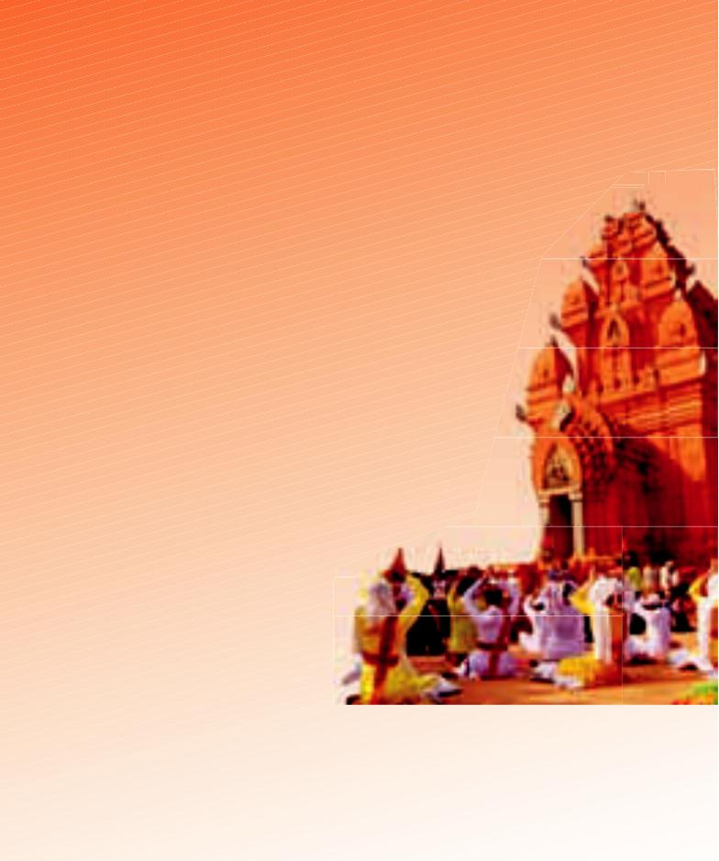
2. Complete the text about the Kate Festival with the words in the box. (Ex. 2 / p. 56)
commemorates performances ancient procession ethnic ritual respect perform
The Kate Festival is held by the Cham (1) _________ group in Ninh Thuan in the central part of Viet Nam. This festival (2) _________________ their heroes - the Gods Po Klong Garai and Po Rome and shows their (3) ____________ to these Gods.
At the festival, the Cham people have to do a (4) ___________
to welcome the costumes from the Raglai – the (5) ___________
Cham. People take part in a (6) ___________ to the
nearby temple. When the procession arrives at the Cham
tower, a group of dancers (7) ___________ a welcome
Dance in front of the tower. Besides, there is
the Poh Bang (door opening)
performance By a magician in the
temple and the chanting of a hymn. This is a really joyful festival which
features many theractivities like (8) ________________of the Ginang
drum and the Saranai fl ute and the Apsara dance.
ethnic
commemorates
respect
ritual
ancient
procession
perform
performances

Slide 5
II. GRAMMAR
1. Choose the correct answer. (Ex. 3 / p. 56)
1. When/ If you are Vietnamese, you should know the story of chung cakes and day cakes.
2. Even though/ When the New Year’s Eve is late at night, children stay awake to welcome the New Year and to watch the firework display.
3. Children like the Mid-Autumn Festival because/ although they are given many sweets and toys.
4. While/ If children are waiting for the moon to rise, they sing, dance and listen to the story of
Hang Nga and Cuoi.
5. Because/ When you come to the Lim Festival, you can enjoy the singing of the most skilled lien anh and lien chi.

Slide 6
2. Use your own words/ ideas to complete the sentences below. Complete your sentences with a partner.
(Ex. 4 / p. 56)
1. When the Lim Festival begins, ________________
2. Because we have many festivals in January, ____
___________________________________________
3. If you go to the Hue Festival, _________________
4. Although sticky rice is very tasty, _____________
5. While we are boiling chung cakes, ____________
LUCKY APPLES

Slide 7

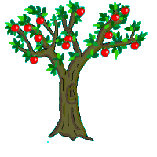
LUCKY APPLES
7
2
4
1
6
3
5

Slide 8
1. When the Lim Festival begins, __________.
people come to see the quan ho singing performance.

Slide 9
2. Because we have many festivals in January, _____.
we call it the month of fun and joy.

Slide 10
3. If you go to the Hue Festival, _________________.
you can enjoy an ao dai fashion show.

Slide 11
4. Although sticky rice is very tasty, _____________.
it’s hard to eat it every day.

Slide 12
5. While we are boiling chung cakes, ____________.
we often listen to our grandparents’ stories.

Slide 13
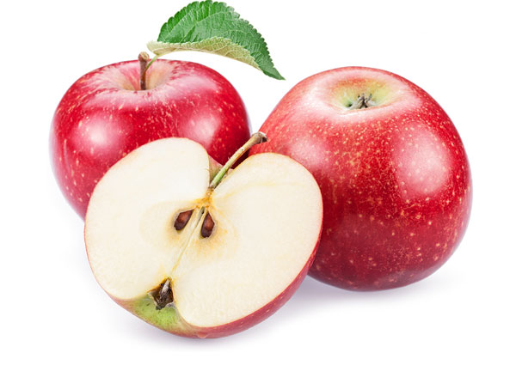
  LUCKY APPLES

Slide 14
  LUCKY APPLES

Slide 15
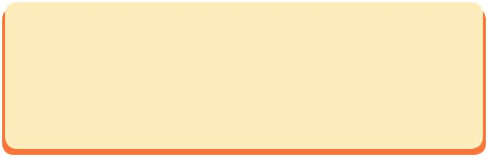

III. COMMUNICATION
1. Put the following things and activities in the correct columns.
(Ex. 5 / p. 56)
mooncakes lion dance floating lanterns family reunion visiting relatives kumquat welcome-the-moon party firework displays the first-footer Hang Nga and Cuoi stories
NEW YEAR FESTIVAL
MID – AUTUMN FESTIVAL
family reunion
visiting relatives
firework displays
kumquat
the first-footer
mooncakes
lion dance
floating lanterns
welcome-the-moon party
Hang Nga and Cuoi stories

Slide 16
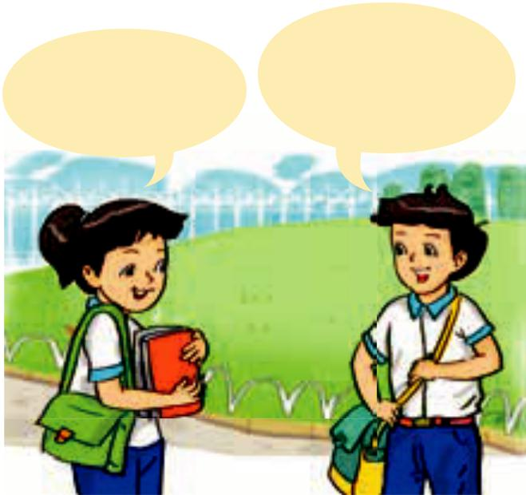
2. Work in pairs, find out which festival your partner prefers. Which three things or activities does your partner like best in the festival he/ she chooses? Why? (Ex. 6 / p. 56)
I enjoy being the
first-footer on New Year’s Day,
because I can get lucky money.
I like the firework
displays best because they
look beautiful.

Slide 17
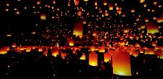
Finished! Now I can … .
● talk about festivals in Viet Nam and the reasons they are held
● use compound and complex sentences to talk about festivals
● stress and pronounce correctly multi-syllable words ending in -ion and -ian
● write about a festival I like

Slide 18
iV. AT HOME
Review the vocabulary of Unit 5.
Rewrite Ex. 4, 5 & 6 onto your exercise book.
Prepare GETTING STARTED - UNIT 6.

Slide 19




The bye bye song
Bye, bye.
See you tomorrow.
Bye, bye.
See you tomorrow.
Bye, bye.
See you tomorrow.
Bye, bye. Bye, bye.
The bye bye
song
Notes:
19

