Slide 1

Unit 3: All about food
Lesson 3b: Grammar
Page 56

Slide 2
Lesson Outline
Warm-up
Presentation
Practise
Production
Consolidation
Wrap-up

Slide 3
Objectives
By the end of this lesson, students will be able to…
know countable and uncountable nouns.
use a/an/some/any correctly.
learn some partitives.

Slide 4

WARM-UP

Slide 5
Choose the word whose underlined part is pronounced differently form that of the others.
1. A. fish B. rice C. crisp D. drink
/fɪʃ/ /raɪs/ /krɪsp/ /drɪŋk/
2. A. soda B. pasta C. biscuit D. sugar
/ˈsəʊdə/ /ˈpæstə/ /ˈbɪskɪt/ /ˈʃʊɡə/
3. A. coffee B. yoghurt C. orange D. carrot
/ˈkɒfi/ /ˈjɒɡət/ /ˈɒrɪndʒ/ /ˈkærət/

Slide 6

It’s time to learn …

Slide 7

Presentation

Slide 8
Put these words into two groups - countable and uncountable:
sugar, banana, cucumber, bread, milk, potato, pepper, fruit juice, orange, egg
Countable | Uncountable
banana
cucumber
potato
orange
egg
sugar
bread
milk
fruit juice
pepper

Slide 9
Complete the rules
• ……………………………… are nouns we can count.
They have singular and plural forms.
e.g. an apple – two/some apples.
• ………………………………… are nouns we cannot count.
They usually have singular forms.
e.g. some milk – NOT: milks.
These nouns include:
food (cheese, meat, flour, sugar, salt, etc.)
liquid (coffee, tea, water, etc.)
Countable nouns
Uncountable nouns

Slide 10
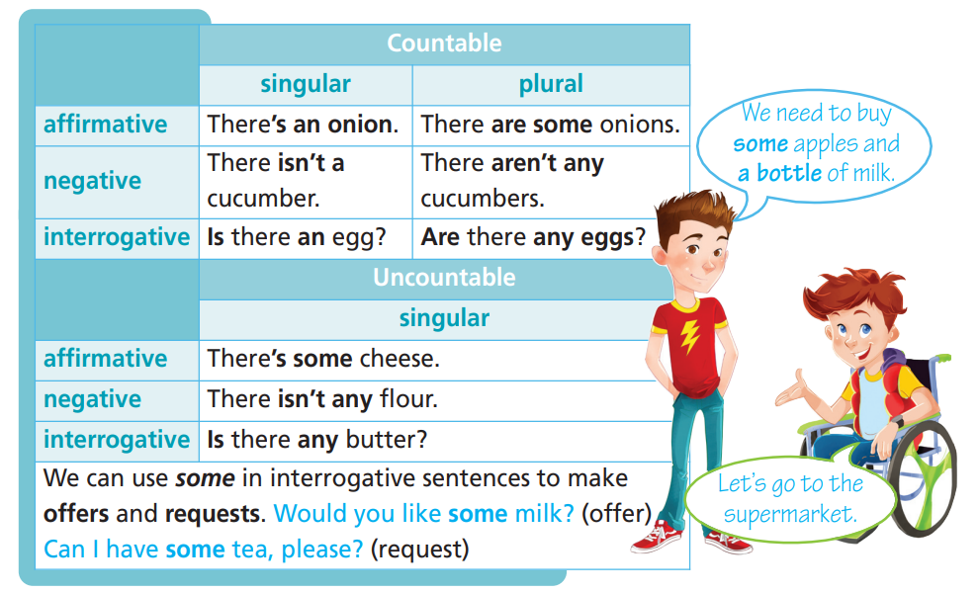
Read

Slide 11
Tick the correct column.
 | Countable |  | Uncountable | (+) | (-) | (?)
 | singular | plural
A
An
Some
Any
✓
✓
✓
✓
✓
✓
✓
✓
✓
✓
✓
offer
✓
✓
✓
✓

Slide 12

Practice

Slide 13
2 Decide if the nouns below are C (Countable) or U (Uncountable). Write the plural form of the countable nouns.
1 apple ➝ ____ _________
2 coffee ➝ ____ _________
3 water ➝ ____ _________
4 rice ➝ ____ _________
5 burger ➝ ____ _________
6 meat ➝ ____ _________
7 carrot ➝ ____ _________
8 lemon ➝ ____ _________
9 strawberry ➝ ____ _________
10 salt ➝ ____ _________
C
apples
U
U
C
carrots
U
C
lemons
U
C
strawberries
C
burgers
U

Slide 14
3 Choose the correct word.
1 Is there some/any sugar?
2 There isn’t some/any flour left.
3 Would you like a/an biscuit?
4 I need some/any milk for my cereal.
5 There’s a/an apple on the table.
6 Can I have some/any chips, please?

Slide 15
Extra practice
Underline the correct word.
1 Is there some/any sugar in the cupboard?
2 There isn’t some/any flour left.
3 Would you like some/any chocolate?
4 Can you give me a/some eggs?
5 This soup doesn’t have some/any salt in it.

Slide 16
6 I need some/any milk for my cereal.
7 There’s a/an apple on the table.
8 Can I have some/any water, please?
9 There is any/some milk in the fridge.
10 Are there some/any potatoes?

Slide 17












Complete the phrases with the following partitives: bag, cup, can, jar, bar, glass, bowl, loaf, packet, bottle, carton, piece.
a ………….. of cherries
a …………. of chocolate
a ……………….. of mustard
a ……………… of cereal
a …………….. of cola
a ………………… of milk
a ………… of tea
a …………. of water
a ………. of jelly beans
a ………… of bread
a ……………… of biscuits
a ……………. of pizza
bag
cup
bar
glass
bottle
jar
bowl
loaf
can
packet
carton
piece

Slide 18

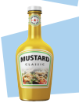



b) ★ Underline the correct word.
1 a bar/bag of chocolate
2 a loaf/bottle of mustard
3 a packet/can of biscuits
4 a carton/jar of juice
5 a bowl/can of cola

Slide 19
Production

Slide 20
PAIRWORK
Make a shopping list and tell your friend what you need to buy, using a/an/some and phrases of partitives.
SHOPPING LIST
milk……………..8 cartons
bread…………..2 loaves
cheese…………1 box
oranges………..1 kilo
chocolate……..3 bars
I need to buy 8 cartons of milk, 2 loaves of bread, 1 box of cheese, a kilo of oranges and 3 bars of chocolate.

Slide 21

CONSOLIDATION

Slide 22
Write five sentences (about 50 words) about the food you have or don’t have in your fridge, using the vocabulary and a/an/some/any or phrases of partitives you have studied today.

Slide 23

WRAP-UP

Slide 24
Today’s lesson
Grammar
Countable and uncountable nouns
a/an/some/any
Phrases of partitives

Slide 25
Homework
Practise speaking and writing sentences, using a/an/some/any and phrases of partitives.
Complete the grammar notes in TA 6 Right on Notebook (p. 30)
Prepare the next lesson (p. 57 SB)
Do the exercise in TA 6 Right on Workbook (p. 29)

Slide 26
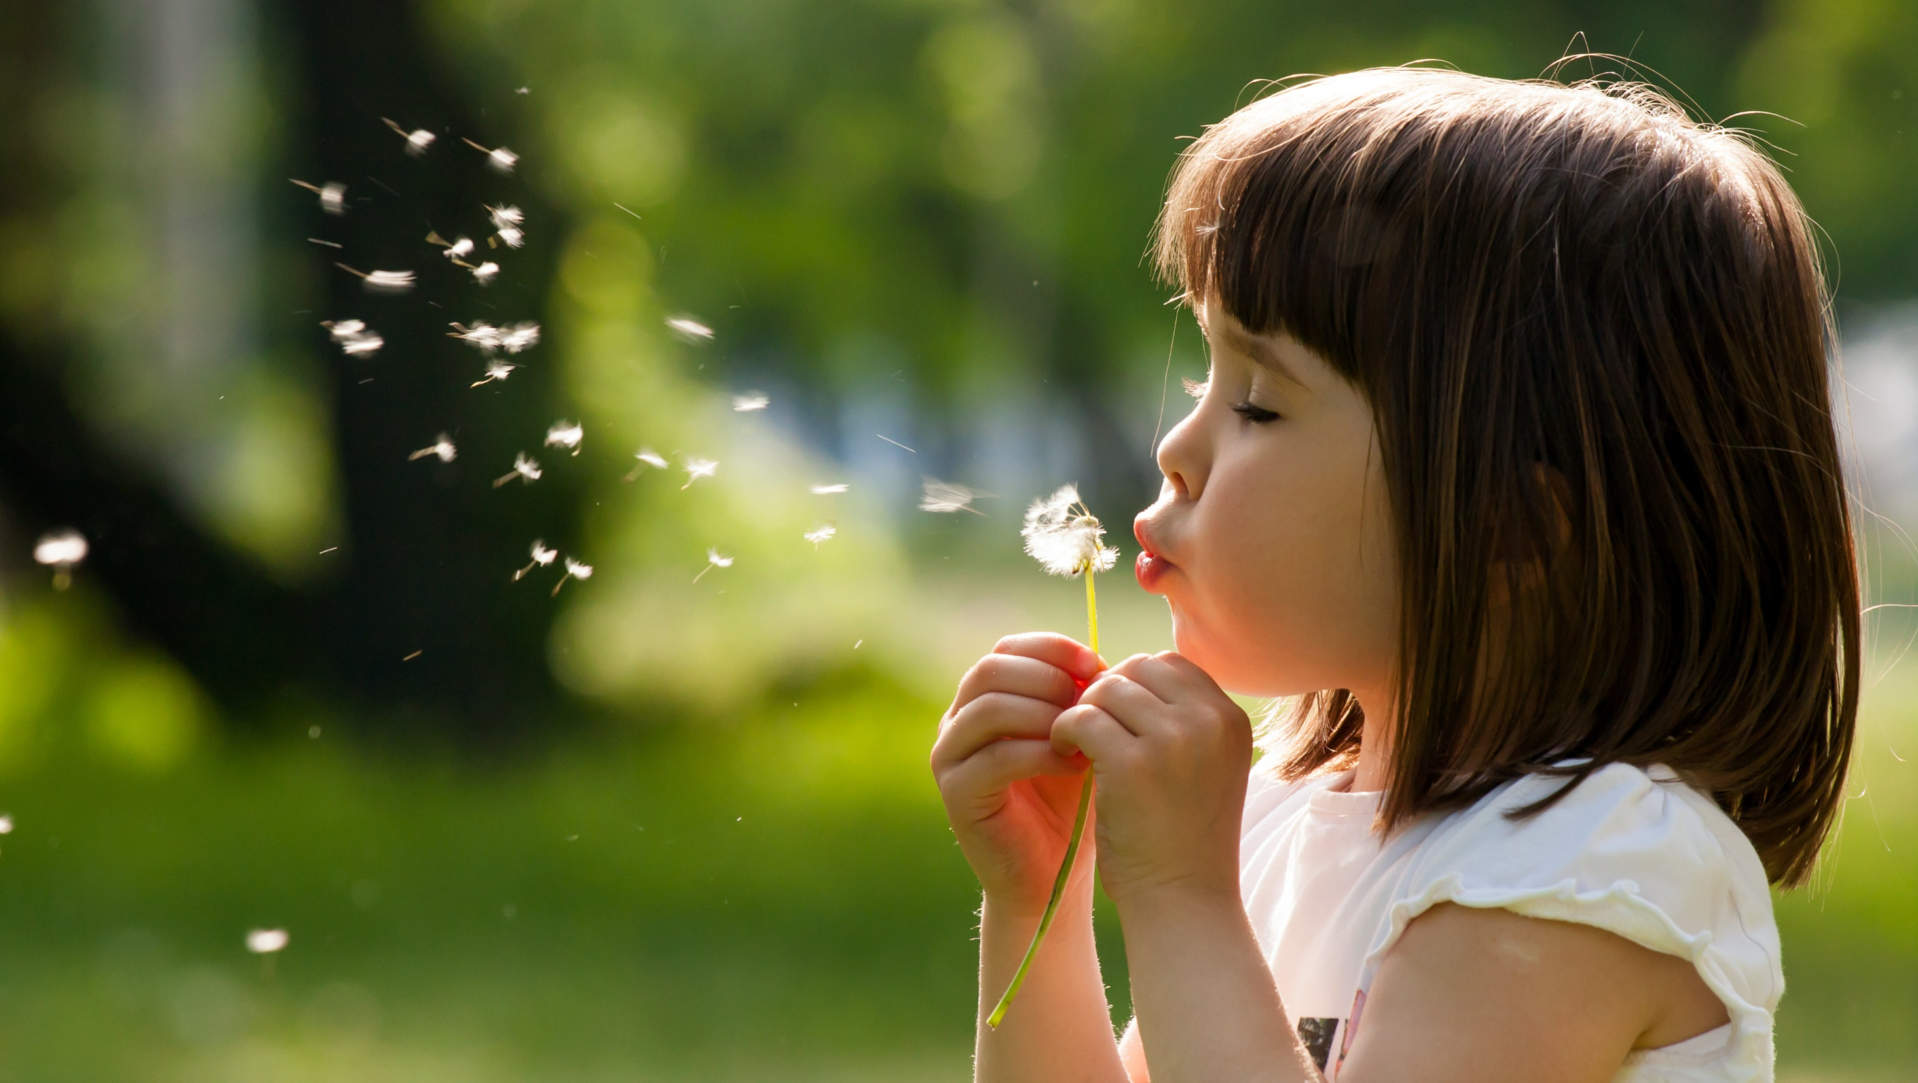
Enjoy your day!

