Slide 2
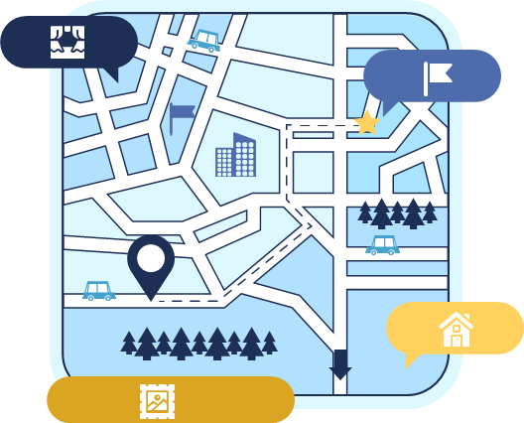
Unit 4
urbanization
SPEAKING
Changes in a living area

Slide 3
LESSON 4
SPEAKING
WARM-UP
Warm-up: URBANISATION Quiz
CONTROLLED PRACTICE
Vocabulary
Task 1: Read the words and phrases and decide which describes the topic.
LESS-CONTROLLED PRACTICE
Task 2: Work in pairs. Talk about the changes in River City.
FREE PRACTICE
Task 3: Discussion and report your answers to the whole class.
CONSOLIDATION
Wrap-up
Homework

Slide 4
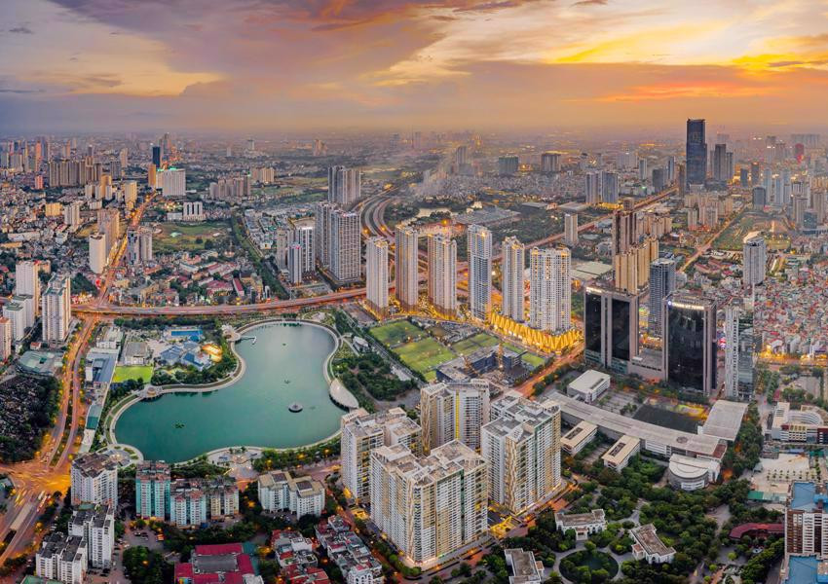
WARM-UP
CHOOSE
THE
CORRECT
INFORMATION
ABOUT
URBANISATION

Slide 5

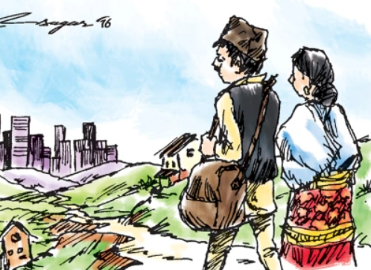
What is the process of urbanization?
1
Expanding farmland
Moving from rural to urban areas
Establishing national parks
Preserving natural habitats

Slide 6
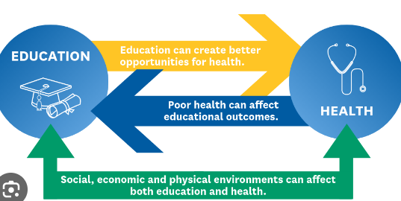
Which of the following is a pull factor for urbanization?
2
Tight-knit community relationships
Limited job opportunities
Access to better education and healthcare
Abundant agricultural opportunities

Slide 7

Which of the following is a push factor that might contribute to rural-to-urban migration?
3
To engage in farming activities
To experience a close-knit community
To enjoy a quieter lifestyle
To access more job opportunities

Slide 8
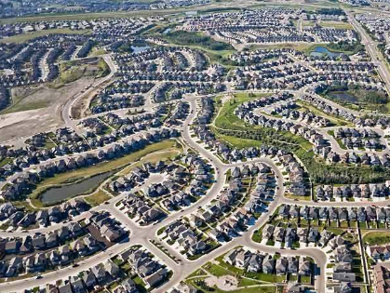
What term is used to describe the rapid growth of cities outward into surrounding areas?
4
Gentrification
Urbanization
Urban sprawl
Suburbanization

Slide 9
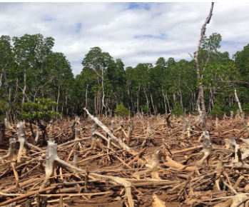
What environmental challenge may arise due to rapid urbanization?
5
Deforestation
Increased green spaces
Reduced air pollution
Preservation of biodiversity

Slide 10
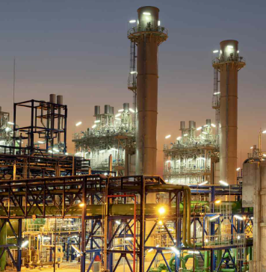
What is the primary driving force behind urbanization?
6
Industrialization
Agricultural expansion
Traditional practices
Nomadic lifestyles

Slide 11



Slide 12
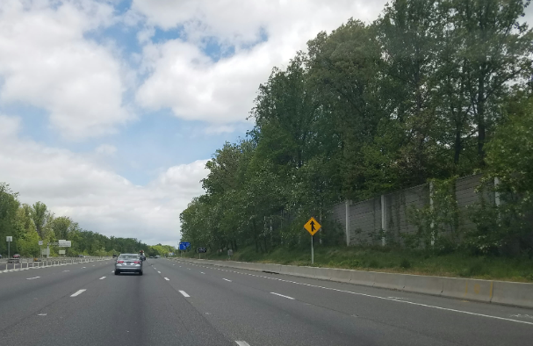

CONTROLLED PRACTICE
empty roads
/ˈˈem(p)tē rōd/
typically refers to roads or streets that have very few or no vehicles or pedestrians on them.

Slide 13
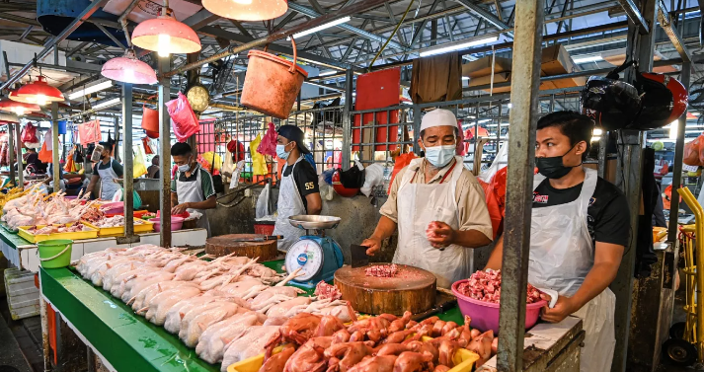
CONTROLLED PRACTICE
wet markets (n)
/wet ˈmɑːkɪt/
a market selling fresh meat, fish and vegetables.

Slide 14
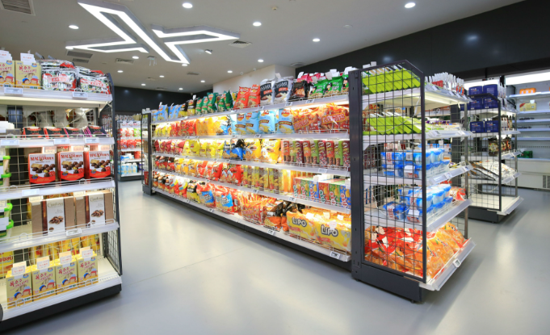
CONTROLLED PRACTICE
convenience stores (n)
/kənˈviːniəns stɔː(r)/
a small local shop that sells food, newspapers, etc. and has long opening hours

Slide 15
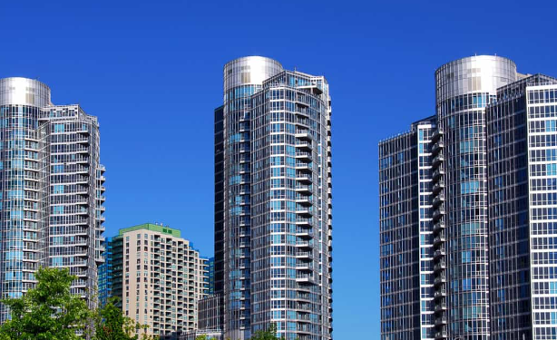
CONTROLLED PRACTICE
high-rise buildings
/haɪ raɪz ˈbɪldɪŋz/
tall structures characterized by their significant height and multiple floors or levels

Slide 16
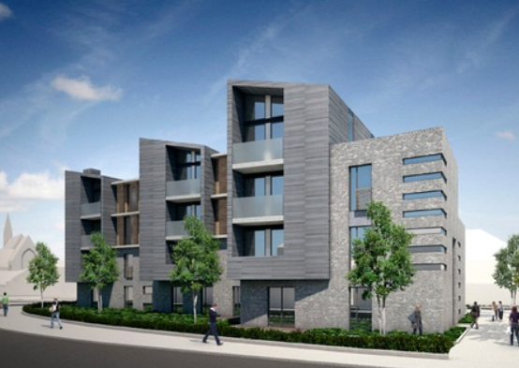
CONTROLLED PRACTICE
low-rise buildings
/ləʊ raɪz ˈbɪldɪŋz/
structures characterized by their relatively modest height, typically fewer than five or six stories, although the specific definition may vary by region and local building codes.

Slide 17
CONTROLLED PRACTICE
Form | Pronunciation | Meaning
1. empty roads | /ˈˈem(p)tē rōd/ | typically refers to roads or streets that have very few or no vehicles or pedestrians on them.
2. wet markets (n) | /wet ˈmɑːkɪt/ | a market selling fresh meat, fish, and vegetables.
3. convenience stores (n) | /kənˈviːniəns stɔː(r)/ | a small local shop that sells food, newspapers, etc. and has long opening hours

Slide 18
CONTROLLED PRACTICE
Form | Pronunciation | Meaning
4. high-rise buildings | /haɪ raɪz ˈbɪldɪŋz/ | typically refers to roads or streets that have very few or no vehicles or pedestrians on them.
5. low-rise buildings | /ləʊ raɪz ˈbɪldɪŋz/ | structures characterized by their relatively modest height, typically fewer than five or six stories, although the specific definition may vary by region and local building codes.

Slide 19
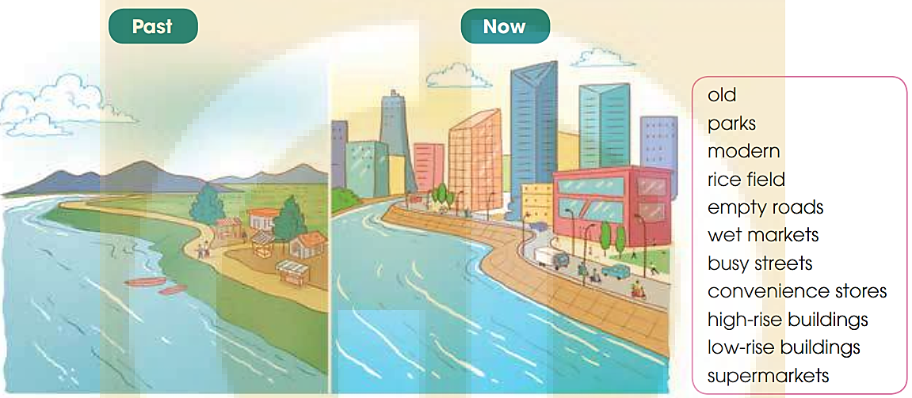
LESS-CONTROLLED PRACTICE
1
The pictures show how River City has changed over time.
Work in pairs. Read the words and phrases and decide which describe the city in the past (P) and which now (n)

Slide 20


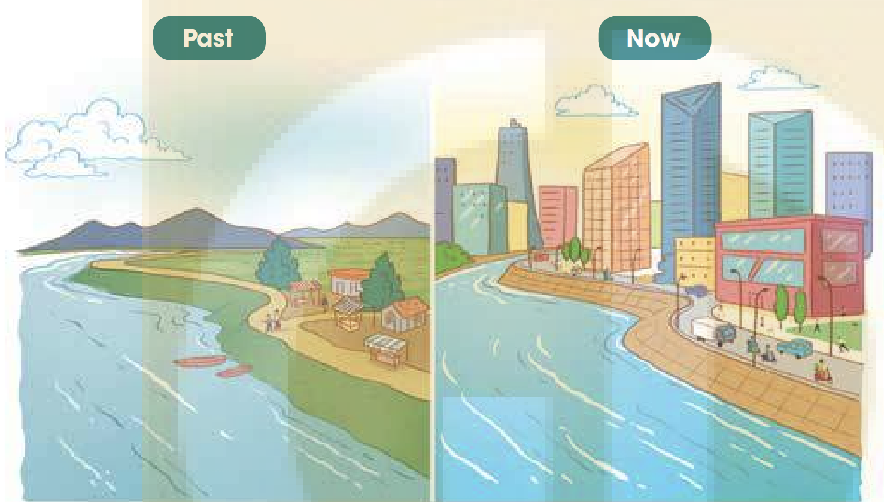


LESS-CONTROLLED PRACTICE
Past/Then:
low-rise buildings
old
rice field
wet markets
empty roads
Today/Now:
high-rise buildings
modern
park
convenience stores
supermarkets
busy streets

Slide 21
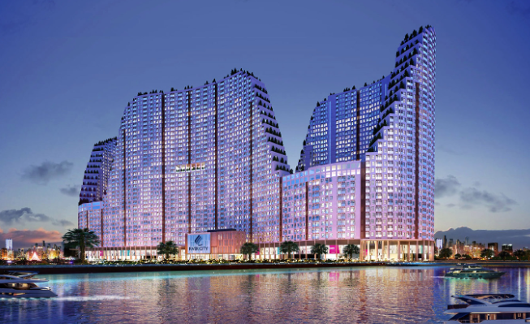
FREE PRACTICE
2
Work in pairs. Talk about the changes in River City.
Use the words and phrases in 1.

Slide 22
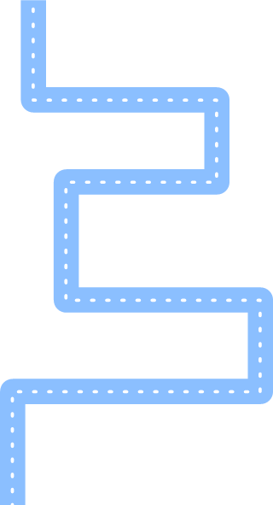


FREE PRACTICE
2
Work in pairs. Talk about the changes in River City.
Use the words and phrases in 1.
In the past, this place only had low-rise buildings. However, a lot of high-rise buildings have been built here.
They have opened a lot of convenience stores and supermarkets to replace the old wet markets.
There used to be a rice field outside the city, but it has been replaced by a city park.
In the past, the roads were almost empty. There was hardly any traffic. Now, the streets are busy and there are too many cars on the roads.

Slide 23
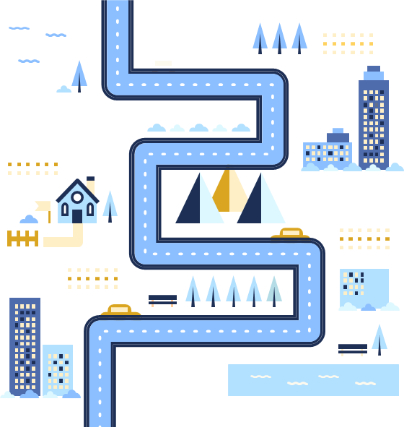
FREE PRACTICE
3
Report your answers to the whole class. Vote for the best description.
When we look at the picture of the River City in the past and at present, we have noticed a lot of changes in this city over the years. The old town/village now has become a more and more modern city. A lot of high-rise buildings have been built to replace all the low-rise buildings. There used to be a rice field outside the city, but it has been replaced by a city park. They have opened a lot of convenience stores and supermarkets to replace the old wet markets. In the past, the roads were almost empty, but now they have become very busy streets.

Slide 24

CONSOLIDATION
1
Wrap-up
What have you learnt today?
Discuss the skills and experience needed for the Changes in a living area
New Vocabulary

Slide 25

CONSOLIDATION
2
Homework
Learn new words by heart
Do exercises in the workbook.
Prepare for Lesson 5 - Unit 4.

Slide 26
Website: hoclieu.vn
Fanpage: facebook.com/www.tienganhglobalsuccess.vn

