Slide 1

Unit 4: Holidays!
Lesson 4f: Skills
Page 81

Slide 2
Lesson Outline
Warm-up
Vocabulary
Speaking
Listening
Writing
Consolidation
Wrap-up

Slide 3
Objectives
By the end of this lesson, students will be able to…
use words related to holiday: rainforest, lake, river, waterfall, island.
talk about a fixed future arrangement, future plan/ intention.
listen for important details.
write a letter about their holiday.

Slide 4

WARM-UP

Slide 5

Work in pairs.
Choose the word whose main stress is placed
differently from the others.
1. A. arrangement B. intention C. countryside D. computer
2. A. tropical B. amazing C. popular D. dangerous
3. A. wildlife B. province C. firework D. resort
/əˈreɪndʒmənt/
/ɪnˈtenʃn/
/ˈkʌntrisaɪd/
/kəmˈpjuːtə(r)/
/ˈtrɒpɪkl/
/əˈmeɪzɪŋ/
/ˈpɒpjələ(r)/
/ˈdeɪndʒərəs/
/ˈwaɪldlaɪf/
/ˈprɒvɪns/
/ˈfaɪəwɜːk/
/rɪˈzɔːt/

Slide 6
Work in pairs.
Discuss the following questions about your last holiday:
What kind of transport (e.g. by airplane/ bus/ car/ boat, etc.) did you use on your last holiday?
Did you eat some delicious things? What’re their names?
Did you have nice weather?
How did you feel about that holiday?
I went on holiday by car.
Yes. I ate very delicious seafood and hot pot.
Yes, the weather was very nice.
The holiday was wonderful.

Slide 7

It’s time to learn …

Slide 8
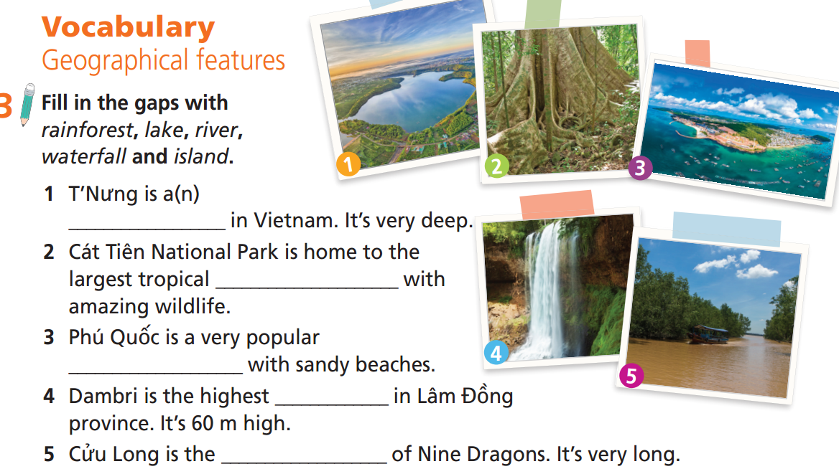
lake
rainforest
island
waterfall
river

Slide 9

Vocabulary
Listen and repeat.
rainforest /ˈreɪnfɒrɪst/ (n): rừng nhiệt đới
lake /leɪk/ (n): hồ
river /ˈrɪvə(r)/ (n): con sông
waterfall /ˈwɔːtəfɔːl/ (n): thác nước
island /ˈaɪlənd/ (n): hòn đảo

Slide 10
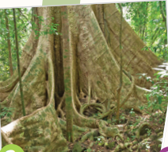
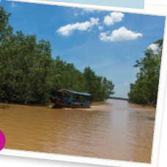
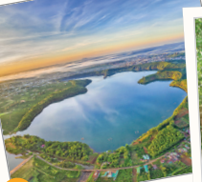
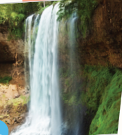
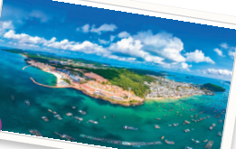
Unscramble the words:
INSTRFOREA
IERVR
KELA
FWERAALTL
IASLDN
Extra Practice
RAINFOREST
RIVER
LAKE
WATERFALL
ISLAND

Slide 11

Speaking

Slide 12
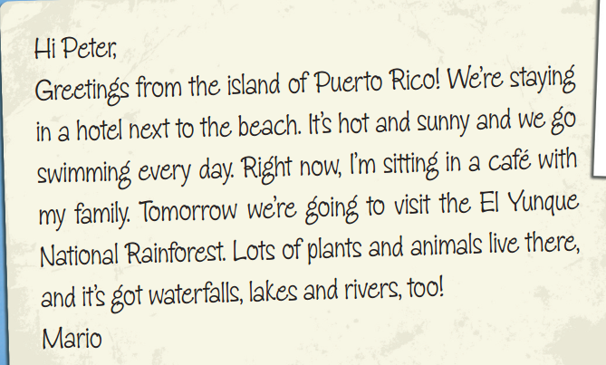
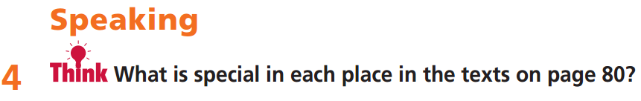
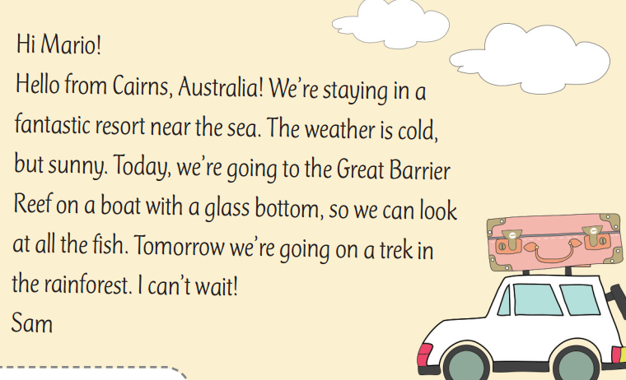
Puerto Rico is special because it’s a tropical paradise.
Cairns is special because there’s so much to do.

Slide 13
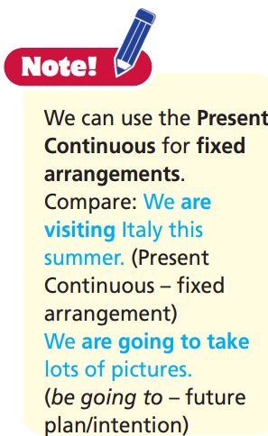

Slide 14
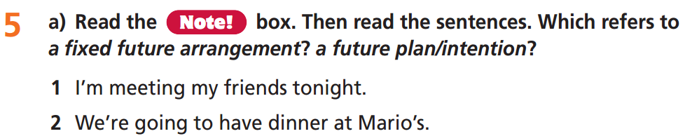
fixed future arrangement
a future plan/intention

Slide 15
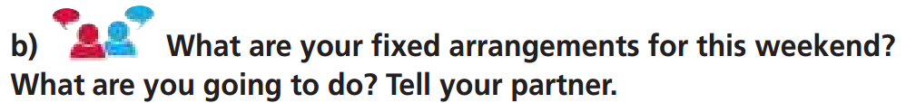
Fixed arrangement: This weekend I’m going fishing with my dad and brother.
What you are going to do: We’re going to catch lots of fish!

Slide 16
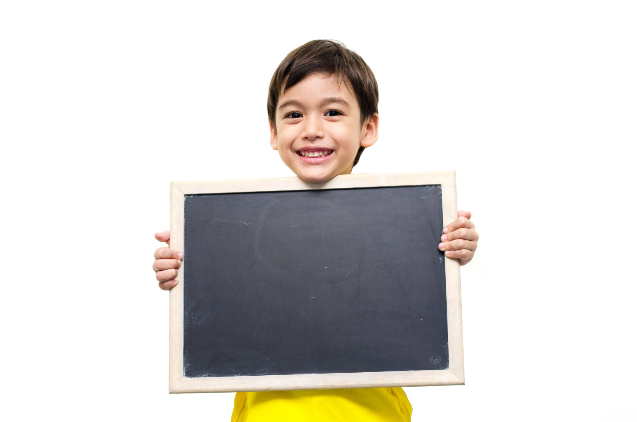
Listening

Slide 17
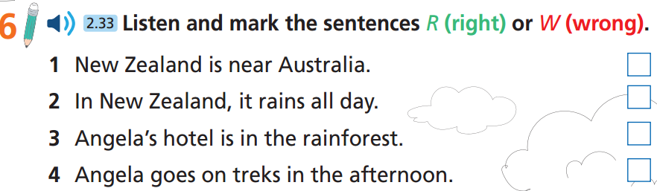
Pre-listening
Underline the key words.

Slide 18
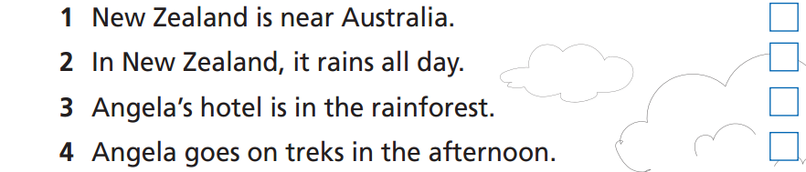
While-listening
Now listen and decide if the statements (1-4) are R (right), W (wrong) or DS (Doesn’t Say).  FIRST TIME

Slide 19
While-Listening
Now listen again and check.  SECOND TIME
R
Angela: Hi, Lisa. I'm fine! I'm on holiday with my family in New Zealand. It's near Australia.
☞ WHY IS THIS ANSWER?

Slide 20
While-Listening
Now listen again and check.  SECOND TIME
W
Angela: Not really. It's sunny in the mornings, but it
rains every day in the afternoon.
☞ WHY IS THIS ANSWER?

Slide 21

While-Listening
Now listen again and check.  SECOND TIME
R
Angela: In Tongariro National Park. Our hotel is in the
rainforest. It's amazing!
☞ WHY IS THIS ANSWER?

Slide 22
While-Listening
Now listen again and check.  SECOND TIME
W
Angela: In the mornings, we go on treks to see lakes
and waterfalls.
☞ WHY IS THIS ANSWER?

Slide 23
Extra listening
Listen again and choose the best answer.
1. Where is Angela going on holiday?
A. In New Zealand B. In Australia C. In America
2. What’s the weather like in the mornings?
A. cloudy B. rainy C. sunny
3. What can Angela see on her holiday?
The sea B. The lakes C. The mountain
4. When will Angela meet her friend again?
This weekend
When she gets back to school
After her holiday

Slide 24
1. Where is Angela going on holiday?
A. In New Zealand B. In Australia C. In America
Angela: Hi, Lisa. I'm fine! I'm on holiday with my family in New Zealand. It's near Australia.

Slide 25
2. What’s the weather like in the mornings?
A. cloudy B. rainy C. sunny
Angela: Not really. It's sunny in the mornings, but it
rains every day in the afternoon.

Slide 26
3. What can Angela see on her holiday?
The sea B. The lakes C. The mountain
Angela: In the mornings, we go on treks to see lakes and waterfalls.

Slide 27
4. When will Angela meet her friend again?
This weekend
When she gets back to school
After her holiday
Angela: ….. Maybe we can meet when I get back.

Slide 28
Audio - Scripts
Practice the conversation again.
Lisa: Hi, Angela! How are you?
Angela: Hi, Lisa. I'm fine! I'm on holiday with my family in New Zealand. It's near Australia.
Lisa: Is it hot there?
Angela: Not really. It's sunny in the mornings, but it rains every day in the afternoon.
Lisa: Where are you staying?
Angela: In Tongariro National Park. Our hotel is in the rainforest. It's amazing!
Lisa: What do you do there?
Angela: In the mornings, we go on treks to see lakes and waterfalls. We see lots of different animals, trees and plants, too. Maybe we can meet when I get back. We can look at my photos.
Lisa: That sounds great! See you then.

Slide 29

Post-Listening
Work in pairs
Discuss the following questions:
Where do you want to go on holiday? Why?
What kind of weather do you want to have on holiday? Why?
What activities do you want to do there?
I want to go to Sapa on holiday because it is very beautiful and it has fresh air.
I want to have very cold weather on holiday because I hope to see the snow in Sapa.
I want to go on treks in the mountain, visit local villages, and eat local food.

Slide 30

Writing

Slide 31
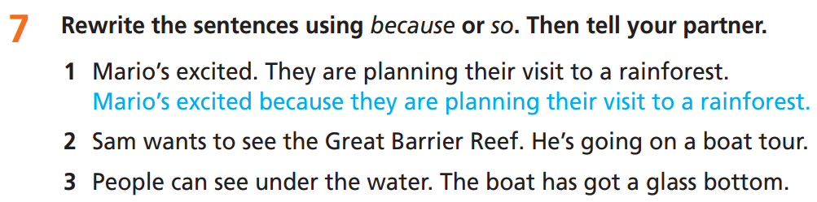
Pre-writing
2. Sam wants to see the Great Barrier Reef, so he’s going on a boat tour.
3. People can see under the water because the boat has got a glass bottom.

Slide 32
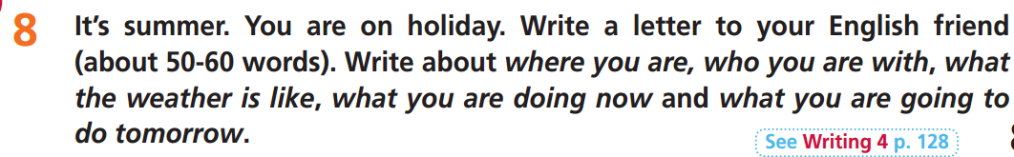
Underline the key words and answer the questions.

Slide 33
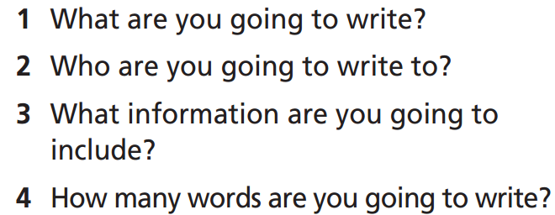
Write a letter.
Your English friend.
The information about your holiday: where you are, who you are with, what the weather is like, what you are doing now and what you are going to do tomorrow.
About 50-60 words.

Slide 34
Write your letter. Use the Present Continuous to talk about what you are doing now and be going to to talk about what you are going to do tomorrow.
Hi …………,
I'm having a great time here in ................................................................
……………………………………………………………………………………………………………..
…………………………………… I'm so happy to be here!
See you!
…………

Slide 35
Write your letter. Use the Present Continuous to talk about what you are doing now and be going to to talk about what you are going to do tomorrow.
Hi Michelle,
I'm having a great time here in Madeira! It’s a beautiful island in Portugal. I'm staying with my uncle and his family. It's sunny and hot here! Right now, I'm sitting in a café in Funchal. Tomorrow, I’m going to go sightseeing. I'm so happy to be here!
See you!
An

Slide 36

CONSOLIDATION

Slide 37
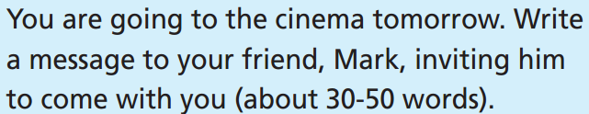
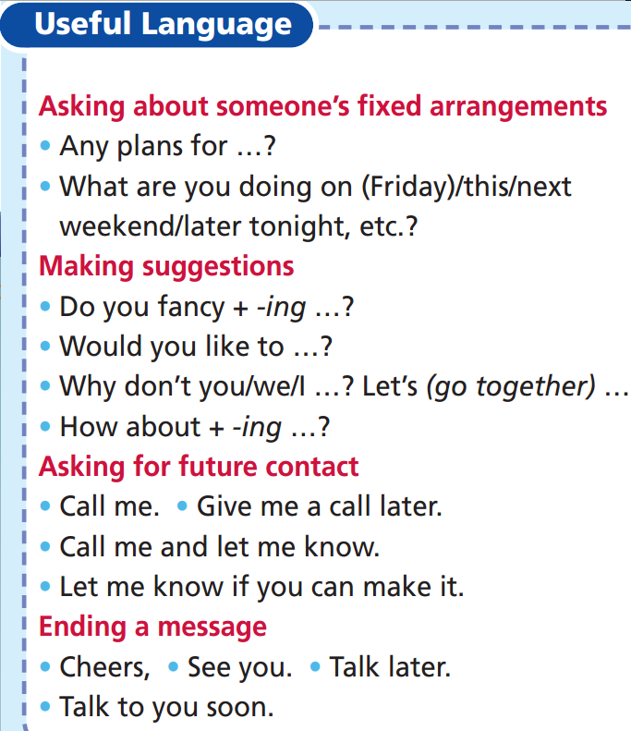
You can use phrases from the Useful Language box.
Mark,
How are things? What are you doing tomorrow? I’m going to the cinema. Why don’t you come with me? We can meet up at about 11:00. Let me know if you can make it.
Talk later.
Joe

Slide 38

WRAP-UP

Slide 39
Today’s lesson
Speaking:
talk about a fixed future arrangement, future plan/intention
Listening:
listen for important details
Writing:
write a letter about their holiday
Vocabulary
rainforest
lake
river
waterfall
island

Slide 40
Homework
Practise the vocabulary and make sentences using them.
Do the exercises in TA 6 Right on WB (p. 43).
Do the exercises in TA 6 Right on Notebook (p. 43).
Prepare for the next lesson (p. 82 SB).
Do Unit 4 Test 1 in Bài Tập Bổ Trợ TA 6 Right on (pp. 36-37).

Slide 41
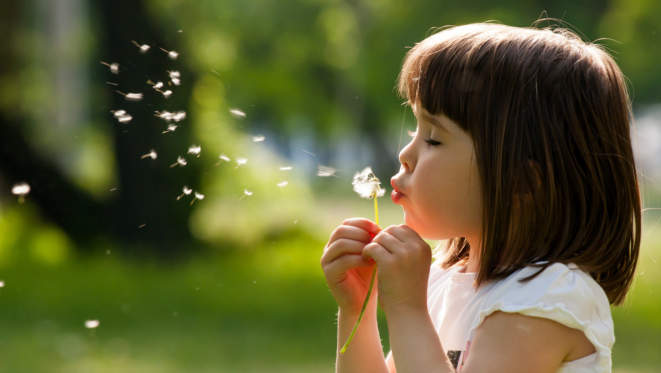
Enjoy your day!

