Slide 2

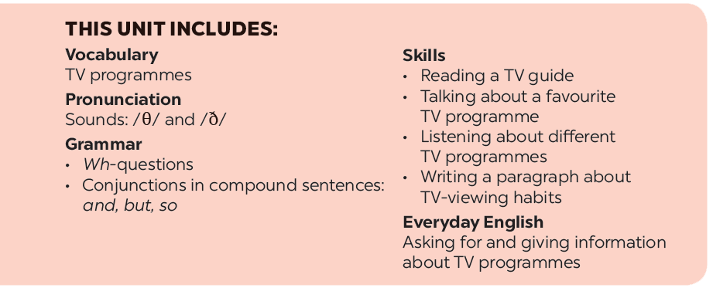

Slide 3







Vocabulary
Grammar
Put the words in the box in the correct column. Add more words if you can.
Complete each question with a suitable question word.
Use the words in the box to complete the text.
Use the conjunctions provided to connect the sentences.

Slide 4
Vocabulary

Slide 5


Put the words in the box in the correct column. Add more words if you can.
educational
educational
English in a Minute
English in a Minute
interesting
interesting
animated films
animated films
sports
sports
popular
popular
wildlife
wildlife
funny
funny
Programme | Adjectives describing programmes
sports
educational
wildlife
interesting
English in a Minute
popular
animated films
funny

Slide 6

Complete the sentences with the words / phrases in the box.
viewers
funny
educational
sports
animal
VTV1 is a popular TV channel in Viet Nam. It attracts many
(1) because it has interesting programmes.
The (2) programmes show tigers and giraffes in nature. People watch races or football matches on (3) programmes. Comedies make people laugh because they are (4) . Game shows are both fun and (5)
viewers
animal
sports
funny
educational.
.

Slide 7
Grammar

Slide 8

Complete each question with a suitable question word.
______ days a week do you go to class?
How many days a week do you go to class?
1.
I go to class five days a week.
I watched The Fox Teacher.
2.
What did you watch on TV last night?
did you watch on TV last night?
Why do you like the Wildlife programme?
______ do you like the Wildlife programme?
3.
Because I love animals.
_______ is your favourite person on TV?
Who is your favourite person on TV?
4.
I like Minh Phong in The Gift of Music.
How many hours a day do you watch TV?
_______ hours a day do you watch TV?
5.
About half an hour a day. I watch more at the weekend.

Slide 9

Use the conjunctions provided to connect the sentences.

Slide 10
1.
Ocean Life is on at 7.30. Laughing out Loud comes next at 8.00. (and)
Ocean Life is on at 7.30, and Laughing out Loud comes next at 8.00.
2.
I like The Seven Kitties very much. I watch it every day. (so)
I like The Seven Kitties very much, so I watch it every day.
3.
BBC One is a British channel. VTV6 is a Vietnamese channel. (but)
BBC One is a British channel, but VTV6 is a Vietnamese channel.
4.
Along the Coast is a famous TV series. I don’t like it. (but)
Along the Coast is a famous TV series, but I don't like it.
5.
I have a lot of homework tonight. I can’t watch Eight Feet Below. (so)
I have a lot of homework tonight, so I can't watch Eight Feet Below.

Slide 11



I want to have a brother.
I want to visit Singapore
I want to live in a tree house.

Slide 12

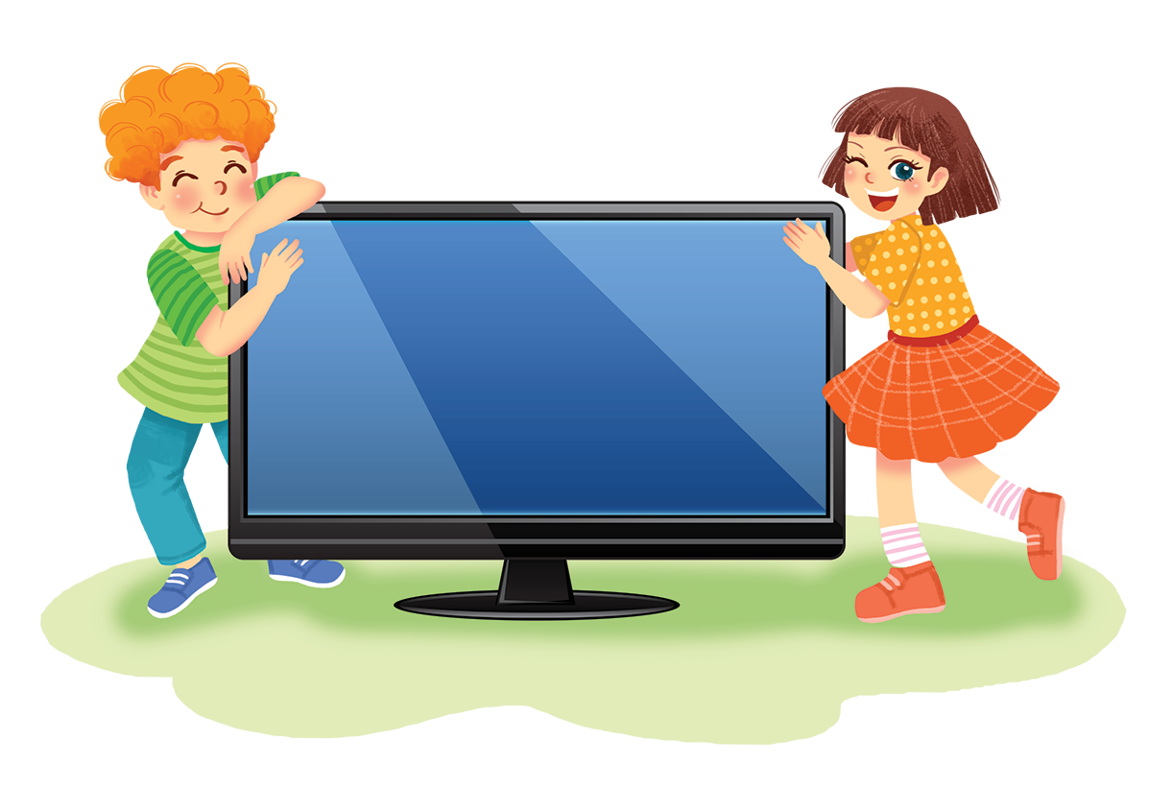
Work in groups. Interview your friends, using the questions below. Take notes of their answers and then report the results to the class.

Slide 13
1.
How much do you like watching TV?
A.
Going out.
B.
Reading books.
C.
Watching TV.
D.
Other: ______
2.
Where do you prefer to get information from?
A.
Books.
B.
Friends.
C.
Televion.
D.
Other: ______
3.
How many hours a day do you watch TV?
A.
One hour.
B.
Two hours.
C.
More than two hours.
D.
Other: ______

Slide 14
4.
Why do you watch TV?
A.
Because I have nothing else to do.
B.
Because my parents want me to.
C.
Because I like it.
D.
Other: ______
5.
How long do you think you can live without TV?
A.
Just one day.
B.
Up to a week.
C.
Up to a month.
D.
Other: ______

Slide 15
Now I can … |  |  | 
use the words related to TV programmes and people.
pronounce the sounds /θ/ and /ð/ correctly.
use wh-question words to make questions.
use conjunctions to connect clauses in compound sentences.
ask for and give information about TV programmes.
read a TV guide.
talk about a favourite TV programme.
listen about different TV programmes.
write a paragraph about TV-viewing habits.
✓
✓
✓
✓
✓
✓
✓
✓
✓
✓
✓
✓
✓
✓
✓
✓
✓
✓
✓
✓
✓
✓
✓
✓
✓
✓
✓

Slide 16







