Slide 1


Slide 2


Unit
11
SCIENCE AND TECHNOLOGY
LESSON 4: COMMUNICATION
1

Slide 3
LESSON 4: COMMUNICATION
WARM-UP
Video watching
Task 1: Listen and read the conversation. Pay attention to the highlighted sentences.
Task 2: Give news and respond to the news in the situations.
EVERYDAY ENGLISH
Task 3: Read the posts from some students about online learning and complete the table.
Task 4: Talk about a platform you use for your online classes or one you know about.
Task 5: Report the answers to the class.
ONLINE LEARNING
CONSOLIDATION
Wrap-up
Homework

Slide 4
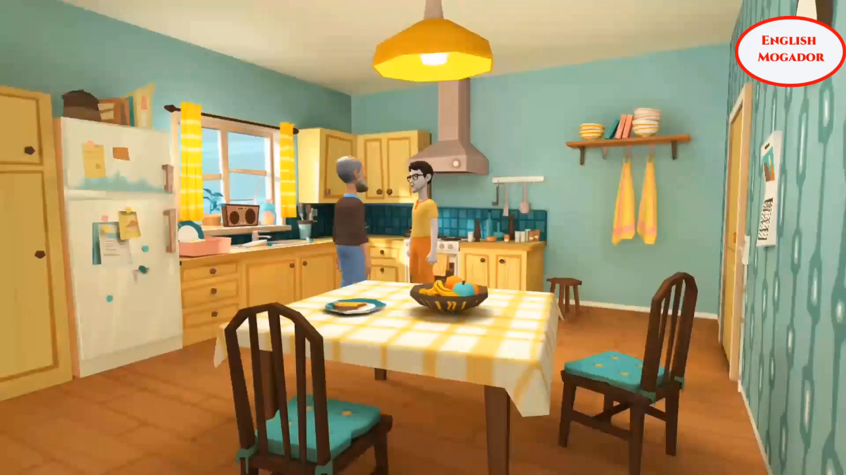
VIDEO WATCHING
WARM-UP
What is the video about?
Giving and responding to good news
Notes:
Video link: https://www.youtube.com/watch?v=ZnkREbyBs7I

Slide 5

EVERYDAY ENGLISH
1
Listen and read the conversation. Pay attention to the highlighted sentences.
Nick: Great news for us. We’ll have school clouds so we won’t have to carry lots of books to school.
Mi: Great!
Nick: And my dad promised to give me a new iPad to read books from the school clouds.
Mi: Congratulations!
Giving good news | Responding to good news
- Great news for us. - (Tell the news) | Great!: if good news is general and good for every one. Congratulations!: if the news is good for the speaker only

Slide 6


EVERYDAY ENGLISH
2
Work in pairs. Give news and respond to the news in the following situations.
1. You tell your classmate about the new vending machine at your school.
2. You tell your classmate about a new laptop that your dad gave you on your birthday.

Slide 7
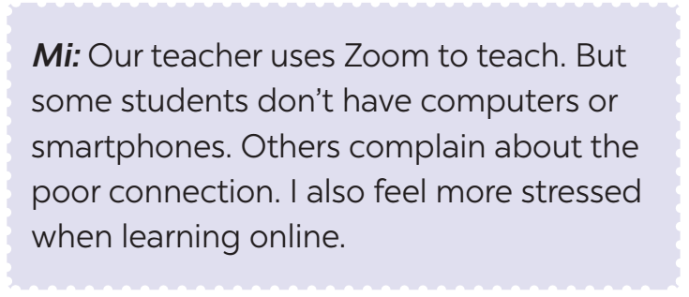
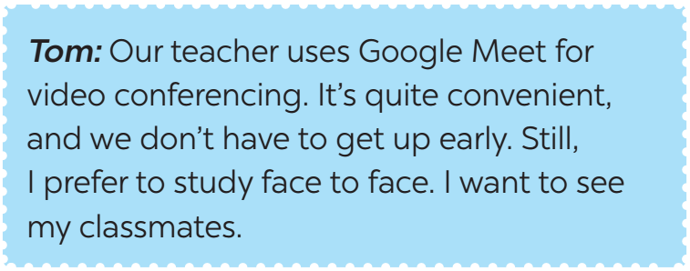
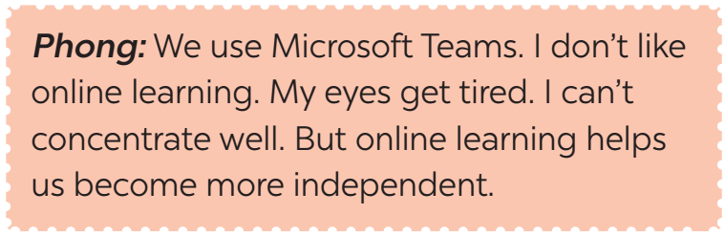
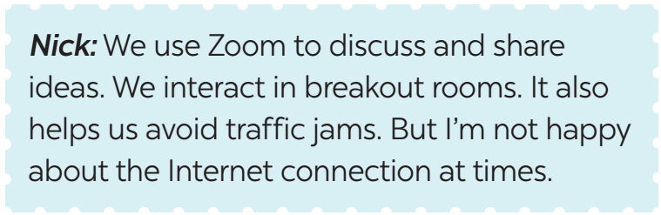
ONLINE LEARNING
3
Work in pairs. Read the posts from some students about online learning and complete the table.

Slide 8
ONLINE LEARNING
3
Work in pairs. Read the posts from some students about online learning and complete the table.
Benefits | Problems
1. It’s convenient. 2. 3. 4. | 1. Some students don’t have computers or smart phones. 2. 3. 4. 5.
Students don’t have to get up early.
The Internet connection is poor.
It helps students become more independent.
It makes some students feel more stressed when learning online.
It helps students avoid traffic jams.
Students can’t meet their classmates.
Some students get tired eyes and can’t concentrate well

Slide 9





ONLINE LEARNING
4
Work in groups. Talk about a platform you use for your online classes or one you know about. What are the benefits and problems of using it?

Slide 10
ONLINE LEARNING
5
Report the answers of one of your group members to the class.
You can conclude:
The name of the platform you use for your online classes or one you know about.
Its benefits
Its problems
Example:
Lan said that her extra class used Microsoft Teams. She said that she and her classmates found it difficult to use. However, it is convenient to have online classes on Microsoft Teams when the weather is bad.

Slide 11

CONSOLIDATION
1
Wrap-up
What have we learnt in this lesson?
Giving and responding to good news
Some benefits and problems of online learning

Slide 12

CONSOLIDATION
2
Homework
Learn the ways of giving and responding to good news
Do the exercises in the workbook

Slide 13

Website: hoclieu.vn
Fanpage: facebook.com/tienganhglobalsuccess.vn/

