Slide 1


Slide 2

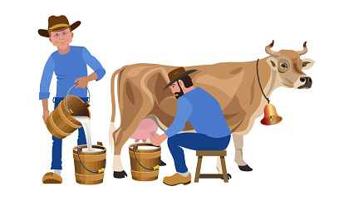
Unit
2
LIFE IN THE COUNTRYSIDE
LESSON 7: LOOKING BACK & PROJECT

Slide 3
LESSON 7: LOOKING BACK & PROJECT
WARM-UP
Revision
Task 1: Write a phrase from the box under the correct picture.
Task 2: Choose the correct answer A, B, or C.
VOCABULARY
Task 3. Complete the sentences with suitable comparative forms of the adverbs from the box.
Task 4: Underline the mistakes in the sentences and correct them
GRAMMAR
PROJECT
My favourite village
CONSOLIDATION
Wrap-up
Homework

Slide 4
WARM-UP
What have we learnt in Unit 2?
- words about life in the countryside
- the sounds /ə/ and /ɪ/ in words and sentences
- comparative forms of adverbs
- giving and responding to compliments
REVISION
- reading about different aspects of a Vietnamese village
- talking about the village or town where someone lives
- listening to someone’s opinion about life in the countryside
- writing a paragraph about what someone likes or dislikes
about life in the countryside

Slide 5
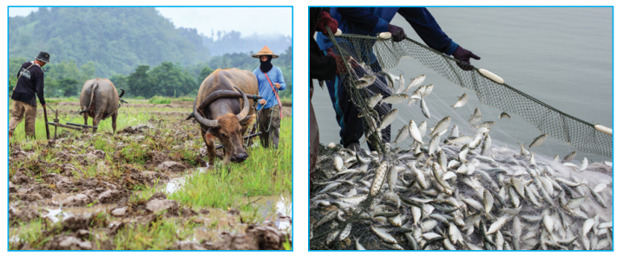
VOCABULARY
1
Write a phrase from the box under the correct picture.
unloading rice milking cows catching fish
ploughing fields feeding pigs drying rice
ploughing fields
catching fish
1. __________________
2. __________________

Slide 6
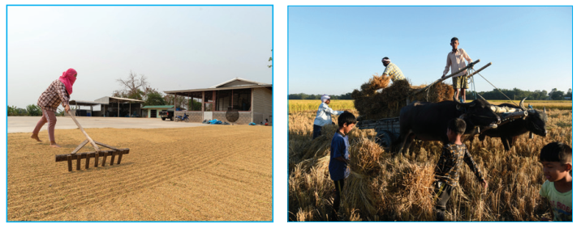
VOCABULARY
1
Write a phrase from the box under the correct picture.
unloading rice milking cows catching fish
ploughing fields feeding pigs drying rice
drying rice
unloading rice
3. __________________
4. __________________

Slide 7
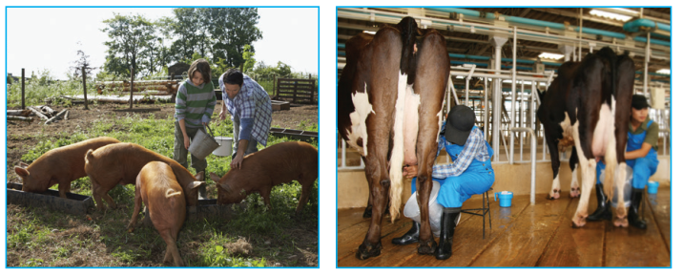
VOCABULARY
1
Write a phrase from the box under the correct picture.
unloading rice milking cows catching fish
ploughing fields feeding pigs drying rice
feeding pigs
milking cows
5. __________________
6. __________________

Slide 8
VOCABULARY
2
Choose the correct answer A, B, or C.
1. There is a huge cloud ______ as far as the eye can see.
A. surrounded B. stretching C. vast
2. People in my village are really ______; they are always generous and friendly to visitors.
A. well-trained B. funny C. hospitable

Slide 9
VOCABULARY
2
Choose the correct answer A, B, or C.
3. The development of cities destroys ______ areas of countryside.
A. vast B. much C. stretching
4. The workers in our factory are very ______ because they took a lot of good training courses.
A. hospitable B. kind C. well-trained
5. The area around the village is famous for its ______ landscape.
A. picturesque B. boring C. dull

Slide 10
GRAMMAR
3
Complete the sentences with suitable comparative forms of the adverbs from the box.
1. Every morning nick gets up ten minutes (early) ______ than his sister.
2. I speak French (fluently) ____________ now than I did last year.
3. You’ll find your way around the village (easily) __________ if you have a good map.
4. It rained (heavily) ____________ today than it did yesterday.
5. If you work (hard) _________, you will do (well) ________ in your exam.
earlier
more fluently
more easily
more heavily
harder
better

Slide 11
GRAMMAR
4
Underline the mistakes in the sentences and correct them.
1. I run faster as my brother does.
2. People in the city seem to react quicklier to changes than those in the country.
→ than
→ more quickly

Slide 12
GRAMMAR
4
Underline the mistakes in the sentences and correct them.
3. We need to work more hardly, especially at exam time.
4. You must finish harvesting the rice the earlier this year than you did last year.
5. As they climbed more highly up the mountain, the air became cooler.
→ harder
→ earlier
→ higher

Slide 13
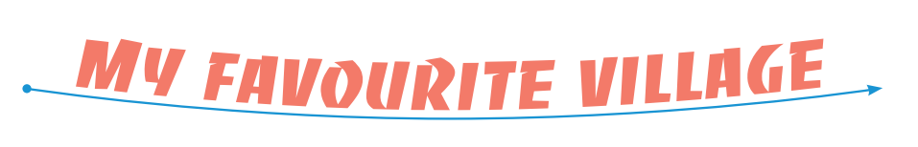
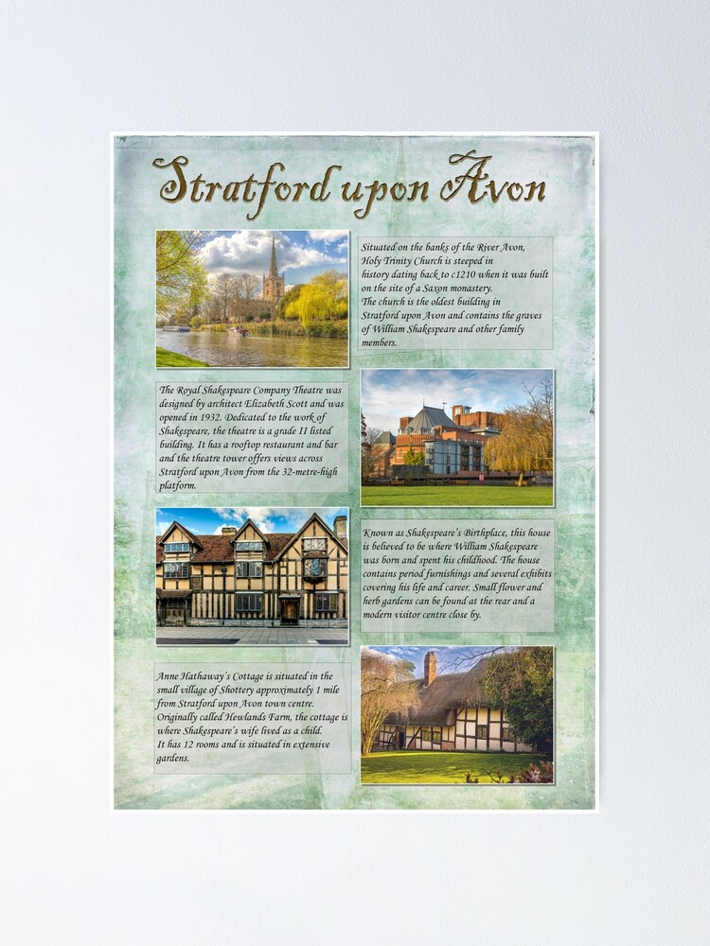
PROJECT
- Show your group’s poster about a village that you would like to visit.
- Present your poster to the class.

Slide 14
CONSOLIDATION
1
Wrap-up
Vocabulary review
Grammar review
Project: My favourite village

Slide 15

CONSOLIDATION
2
Homework
Do exercises in the workbook.

Slide 16

Website: hoclieu.vn
Fanpage: facebook.com/www.tienganhglobalsuccess.vn/

